Slide 1
Māori Language Research Symposium 2023
Drawing on linguistic concepts to teach te reo Māori; drawing on te reo Māori to teach linguistic concepts
Kanauhea Wessels
Te Herenga Waka
Victoria University of Wellington
Julie Barbour
Te Whare Wānanga o Waikato
University of Waikato
Notes:
Kan: short mihi
--------------------------------------------
In today’s presentation we are looking at the potential for interaction between linguistics and Māori language learning
This work for me was motivated by a desire to strengthen the Māori language content in my linguistics classes, with the hopes of engaging more Māori students.
--------------------------------------------
For me, it’s inspired by the richness of kōrero and discussions that can happen in a class when te reo Māori and te ao Māori intersects with linguistic concepts. Before really delving into the world of linguistics I couldn’t always explain how and why certain patterns and structures occurred in te reo Māori, but now, I think this technical knowledge adds another layer to the way things can be taught and learned in the class.

Slide 2
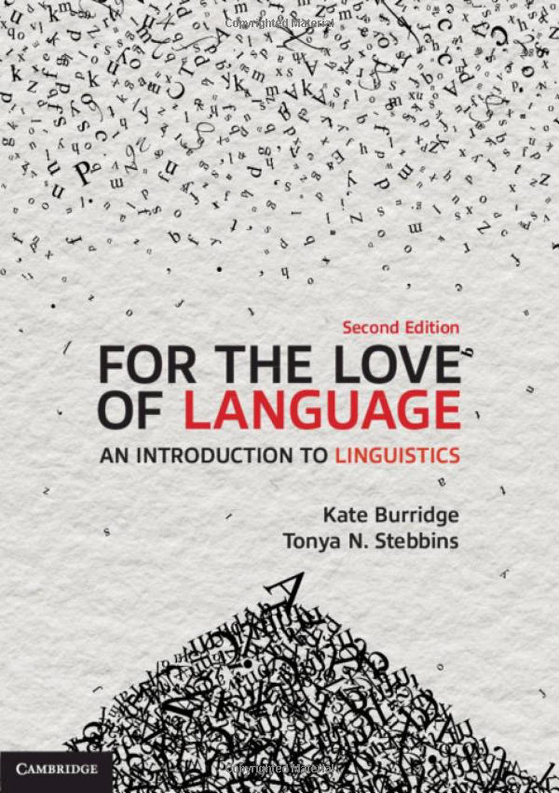
For the love of language
(Burridge & Stebbins 2020)
Notes:
For some time now, we have been looking for introductory linguisitics textbooks that contain material that we might be able to use in teaching. We are particularly interested in textbooks that are still in print, and that have new editions being released fairly regularly.
To date, most textbooks we have looked at have only a handful of vocabulary items, or small amounts of sociolinguistic information.
One textbook that we thought looked promising is Burridge & Stebbins, For the love of language. The authors, Kate Burridge and Tonya Stebbins are Australian linguists. Te reo Māori is one of 9 case study languages included in the textbook
The language is introduced with some sociolinguistic content in a one-page introduction. And in the index, there are references to topics about sociolinguistics, the lexicon, phonology, morphology and syntax. On the surface, it looks like a good source of teaching material.

Slide 3
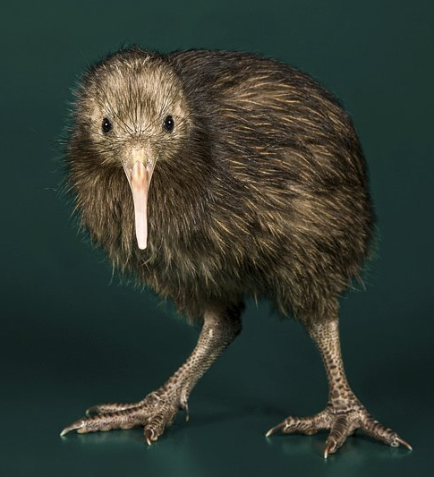
What do we learn about te reo Māori from Burridge & Stebbins?
New Zealand English uses words from Māori for names of places, people, organisations, words relating to sociocultural concepts and objects, names of flora and fauna [Yes]
BUT... kiwi is not a loan word from Māori used in New Zealand English [???] (p. 29)
kai- is a prefix that expresses a person who performs an action [Yes]
  ako ‘teach’ and kaiako ‘teacher’ [Yes]
  mahi ‘work’ and kaimahi ‘worker’ [Yes]
  kārero ‘speak’ and kaikārero ‘speaker’ [???] (p. 121)
Notes:
Once we started looking into Burridge & Stebbins work, we encountered some problems.
In their introduction to te reo Māori, the authors explain how NZE uses quite a lot of Māori vocabulary, mentioning for names of places, people, organisations, words relating to sociocultural concepts and objects, names of flora and fauna
But then they say that kiwi is not one of these. Except it is! We don’t have a word of English origin for the bird...
Later, they talk about word formation processes, and explain that in te reo Māori, there is an agentive prefix kai-
They give examples of ako, kaiako; mahi, kaimahi, and then this word kārero, and its kai- form, kaikārero.

Slide 4
A phonological process in Burridge & Stebbins [Final Consonant Deletion]
French
      petite ‘small, feminine’ [pətit] – pronounce final consonant
      petit ‘small, masculine’ [pəti] – delete final consonant
Like French: “Māori also shows regular consonant deletion in verb roots” (p. 222)
inu ‘to drink’
inumia ‘to be drunk (of liquid)’
“originally, the active verb forms were maur, awhit, hopuk, and so on, but when speakers stopped pronouncing the final conosonants, things got complicated”
Proto-Polynesian (3,500 years ago) *inu ‘to drink’, *inu-mia (Pawley 2001)
Proto-Oceanic (4,000 years ago) *inum ‘to drink’ (Ross, Pawley & Osmond 2016)
???
Notes:
In a section that talks about phonological processes, Māori is likened to French. The authors write: Māori also shows regular consonant deletion in verb roots.
So examples are given of verbs including inu and inumia. The authors say: “Originally, the active verb forms were maur, awhit, hopuk, and so on, but when speakers stopped pronouncing the final consonants, things got complicated”
As far as Polynesian linguists are aware, speakers “stopped pronouncing the final consonants” over 3500 years ago, so this is hardly a situation comparable to French where pairs of words like petit [peti] and petite [petit] are still in current usage.
Not only that, it isn’t a matter of just “dropping final consonants”; it is a larger change to the phonotactic structure of the ancestral language to open syllables.
So the information provided here is quite misleading, and the diachronic dimension is hidden in the word ‘originally’.

Slide 5

New materials for teaching:
A work in progress
Notes:
There is a need for us to create our own materials to illustrate linguistic concepts with Māori language data.
Equally, there is potential for language teachers to bring linguistic concepts into Māori language classrooms.
We are going to talk you through a couple of examples of materials and teaching strategies that we have made use of. We’ve drawn on analysis and examples from grammars of Māori written by Winifred Bauer and Ray Harlow, grammatical studies by Māori scholars like Peter Keegan, and there is a body of work that I’ve come across while working on the Special Issue that will inform further work. Kan’s own knowledge of te reo Māori as a native speaker and as a doctoral student of linguistics of course heavily influences her.

Slide 6
Teaching the category of number singular & plural (after Harlow 2015)
t- for possession of singular entities
10 | tōku pōtae | ‘my hat’
11 | ōku pōtae | ‘my hats’
12 | tōku hū | ‘my shoe’
13 | ōku hū | ‘my shoes’
Prefixes & Suffixes
t-ēnei, ēnei | hat, hat-s
Number as a function of nominal modifiers
‘nothing’ as meaningful
 | Māori | English
Singular | t- | -Ø
Plural | Ø- | -s
t- for singular demonstrative determiners
7 | tēnei tūru | ‘this chair’
8 | ēnei tūru | ‘these chairs’
18 | tēnei waea pūkoro | ‘this phone’
19 | ēnei waea pūkoro | ‘these phones’
Notes:
On this slide, we are illustrating the grammatical category of number, and within this, the contrast between singular and plural.
In Māori: we can see t- affixed to possessives (10, 12) and demonstratives (7 and 18) for singular entities, compared with the absence of t- for plural entities
In the English translations: singular nouns have no extra morphology – a noun by itself can be singular, but plural nouns have an –s suffix. (and there is a singular-nonsingular distinction in the English demonstratives also)
What this data shows clearly is that Māori codes explicitly for singular (which is typologically less common), while English codes explicitly for plural (which is typologically more common).
The understanding that languages can express the same category (number), coding the same types of information about the world (singular vs. plural), using different strategies (coding nominal heads, or nominal modifiers, with prefixes or suffixes, or other strategies), is a fundamental understanding in linguistics.
Not only that, understanding that ‘nothing’ can be a meaningful part of a system of contrasts in language is important.
--------------------------------------------
The way I teach this concept of number with my classes is that ‘T is for tahi’. Just explaining that when it comes to demonstrative determiners, possessive forms, or even articles like ‘te’ and ‘ngā’, that a ‘t’ marks the singular forms. It’s also an opportunity to explain how this differs to English where plurality is marked on the noun, usually with an ‘-s’ suffix.
The demonstrative determiners taua and aua are usually introduced in class around the same time too, which in addition to teaching number, also allows the concept of anaphora to be presented, showing that there is a small set of vocabullary in te reo Māori that reference content previously mentioned.

Slide 7
Reduplication (Keegan 1996)
Simplex | Gloss | Reduplicated | Gloss
hopu | ‘catch’ | hopuhopu | ‘catch one after another’
pātai | ‘question’ | pātaitai | ‘question frequently’
pātuki | ‘strike, knock’ | pātukituki | ‘strike or knock repeatedly’
takahuri | ‘roll, turn’ | takahurihuri | ‘keep on turning round, roll over and over’
epa | ‘pelt’ | epaepa | ‘pelt continuously’
patō | ‘knock’ | patōtō | ‘knock repeatedly’
Function
  repetition of an action
Forms
complete: hopu → hopu~hopu
partial: pātai → pātai~tai
Notes:
Another teaching example we use relates to reduplication.
Peter’s thesis Reduplication in Māori contains a lot of data that can be used to illustrate different forms and functions of reduplication.
These items show the use of reduplication for repetition. This is an iconic use of reduplication, where in the words of Lakoff and Johnson, ‘MORE OF FORM stands for MORE OF CONTENT’ (1980:128)
Treating the roots as morphologically simple, These data illustrate both complete, and partial reduplication of a word – these are the two major forms of reduplication that we find in the world’s languages.

Slide 8
Reduplication (Keegan 1996)
Simplex | Gloss | Reduplicated | Gloss
hopu | ‘catch’ | hopuhopu | ‘catch one after another’
pātai | ‘question’ | pātaitai | ‘question frequently’
pātuki | ‘strike, knock’ | pātukituki | ‘strike or knock repeatedly’
takahuri | ‘roll, turn’ | takahurihuri | ‘keep on turning round, roll over and over’
epa | ‘pelt’ | epaepa | ‘pelt continuously’
patō | ‘knock’ | patōtō | ‘knock repeatedly’
Forms
  CVCV (~hopu)
  CVV (~tai)
  VCV (~epa)
  ? (~tō)
Abstracting to a single CV template
  ~(C)V(C)V
  long vowels occupy two V slots
Notes:
From that observation, we can form CV templates of the reduplicative element of each word.
Students find it relatively easy to create CV templates for individual words, although they can get a bit confused by long vowels. Of course, this would be easier if I converted the orthography from ō to oo, but the idea is to get the students to understand for themselves how long vowels fit into the system of reduplication as a whole.
They then need to figure how how to represent the different looking CV templates as a general CV structure to express repetition of a verb. This involves more abstract thinking, and the ability find a pattern from seemingly different forms of reduplication.

Slide 9
Kei te whakapai a Tana i te whare.
E whakapaipai ana rāua i te rākau.
Kua peke te kau i te taiapa.
I te pekepeke ngā tamariki.
Huri atu ki tō hoa.
Ka hurihuri haere te whānau i te kura.
Notes:
Reduplication isn’t something I teach explicitly in reo Māori classes, but sometimes I’ll put up sentences for students to look at and work through.
And when possible if there’s a chance to use words that can be partially or completely reduplicated, then I will.
These are some pairs of structures that have kupu with partial or complete reduplication. I usually don’t point out these aspects of the language to students, but instead I wait for students to question any relationship between the words to have some extra discussions about the reo, then we might work through other words that could be familiar to them, and go from there. Sometimes we just explore possibilities around those words and consider any semantic relationship between words.
For instance: peke, pekepeke, and *pepeke* - where ‘pepeke’ is also the name for an endemic brown frog.

Slide 10
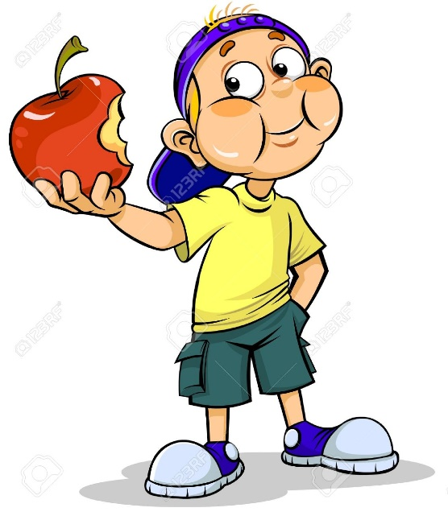

He aha te ‘rerehāngū’?
Reremahi – Active sentence
Rerehāngū – Passive sentence
Kei te kai a Tama i te āporo
Tama is eating the apple
Kei te kainga te āporo (e Tama)
The apple is being eaten (by Tama)
Notes:
Passive sentences are common structures used and heard in te reo Māori and they can sometimes be a difficult concept to teach, learn and understand.
These are structures that are often taught in first year courses, and at the moment, I usually teach them after students have an understanding of active sentences in the language. A lot of the time students will ask why they need to know these structures and it’s helpful for me to rely my linguistic training and being able to explain the difference between the two structures and how each of them have a different focus.
Active sentences, the focus is on the agent/doer of the action (whoever or whatever is actioning the verb)
Passive sentences, the focus on the patient of the verb (the receiver of the action).
So, passive sentences change the focus to whoever or whatever is affected by the verb (the patient).
One thing I am quite mindful of though is avoiding words like agent and patient, however, it’s often the case that there are linguistic students in the class, or students who have learned a number of languages before and really appreciate understanding the technical aspects of the reo.

Slide 11
Continuous & Discontinuous Quantification (Wessels, Stowers & Barbour in press.)
Kua | kai | mātou | i | ngā | āporo | katoa.
prf | eat | 1pl.excl | obj | the.pl | apple | all
‘We’ve eaten all the apples.’
Continuous modification of O-function nominal
Kua | kai-nga | ngā | āporo | katoa.
prf | eat-pass | the.pl | apple | all
‘All the apples have been eaten.’
Continuous modification of S-function nominal in passive intransitive clause
Kua | kai-nga | katoa-tia | ngā | āporo.
prf | eat-pass | all-pass | the.pl | apple
‘The apples have all been eaten.’ (Moorfield 2001: 92)
Discontinuous modification of S-Function nominal in passive intrasitive clause
Notes:
The final set of examples comes from a paper the Kan and I put together with our colleague Beau Stowers for the special issue, and I will be incorporating it into my comparative linguistics paper from next year to demonstrate the distinction between continuous and discontinuous modification in language.
The focus of this data is the position and behaviour of katoa, the universal quantifier.
In the first clause, the quantifier is positioned in the object noun phrase i ngā āporo katoa. The second example shows the same situation expressed in a passive clasue, with katoa now modifying the apples as the subject noun phrase. Note the passive suffix on the verb kai.
In the third clause the quantifier katoa is positioned in the verb complex, and from there, it discontinuously modifies the apples. Note the passive agreement morphology in this clause – kai-nga katoa-tia. Discontinuous quantification can only apply to S-function nominals (subject of active and passive transitive clauses) and A-function nominals (subject of active transitive clauses), but not O-function nominals. This is an example of a nominative pattern which can be compared with other pattens of discontinuous modification.

Slide 12

Some interim reflections
There is a lack of accurate published teaching material presenting language data from te reo Māori analysed using a linguistic lens
Māori language data can demonstrate fundamental categories, concepts and processes in linguistics
The technical understanding of a language can add another layer to the teaching and learning of te reo Māori to complement te ao Māori perspectives already embedded in the classroom
BUT any newly developed materials need to be carefully checked, ideally by speakers and language specialists who can identify and eliminate errors
Notes:
Where does this leave us?
firstly: there is certainly a lack of current teaching materials that presenting language data from te reo Māori with linguistic analysis. Where data is included, it is not always accurate.
secondly: language data, Māori language data can be used effectively to demonstrate important catgories, processes and concepts in linguistics
(Sometimes) the technical understanding of a language can add another layer to the teaching and learning of te reo Māori to complement te ao Māori perspectives already embedded in the classroom
finally: any newly developed teaching materials need to be carefully checked, ideally by speakers and language specialists who can identify and eliminate errors. Inaccurate data is problematic, particularly if the objective is to facilitate understandings of the language with linguistics and within Māori language teaching.
---

Slide 13
Some References
Bauer, Winifred A. & Parker, William & Evans, Te Kareongawai & Teepa, Te Aroha Noti. 2003 [1997]. The Reed reference grammar of Māori. Auckland: Reed.
Burridge, Kate & Stebbins, Tonya. 2020. For the love of language, 2nd edn. Cambridge: Cambridge University Press.
Harlow, Ray. 2007. Māori: A linguistic introduction. Cambridge: Cambridge University Press.
Harlow, Ray. 2015 [2001]. A Māori Reference Grammar. Wellington: Huia Publishers.
Ross, Malcolm, Andrew Pawley & Meredith Osmond (eds). 2016. The lexicon of Proto Oceanic. Vol. 5 People: body and mind. Asia-Pacific Linguistics, A-PL 28.
Wessels, Kanauhea, Beau Stowers & Julie Barbour (2023 in press). Katoa: a descriptive, comparative and historical analysis. Te Reo: Journal of the Linguistic Society of New Zealand.
Image of Kiwi from: https://www.rawpixel.com/search/kiwi%20bird?page=1&path=_topics&sort=curated

