Slide 1

Defining and deploying the concept of ‘precarious employment’: Valuable idea or empirical fallacy?
D. East, D. Howard, G. Piercy, and B. Cochrane

Slide 2
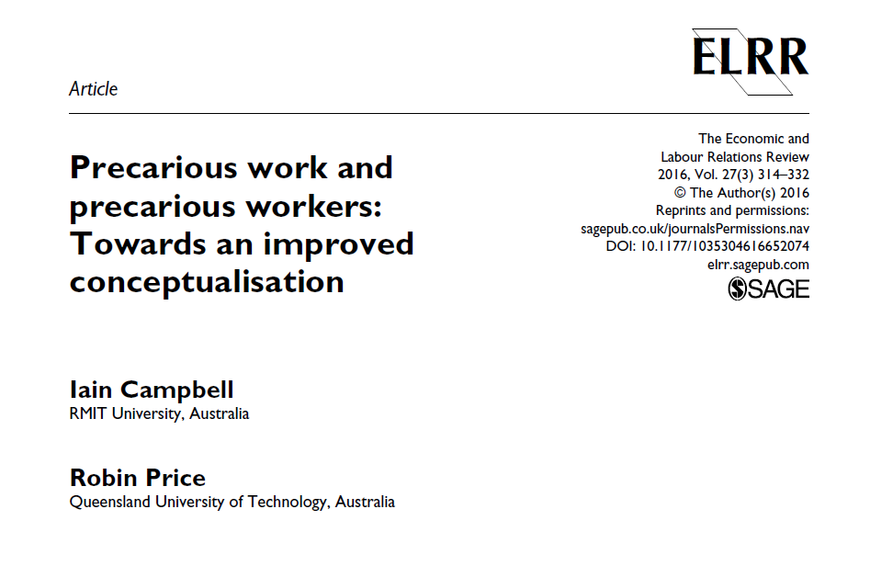
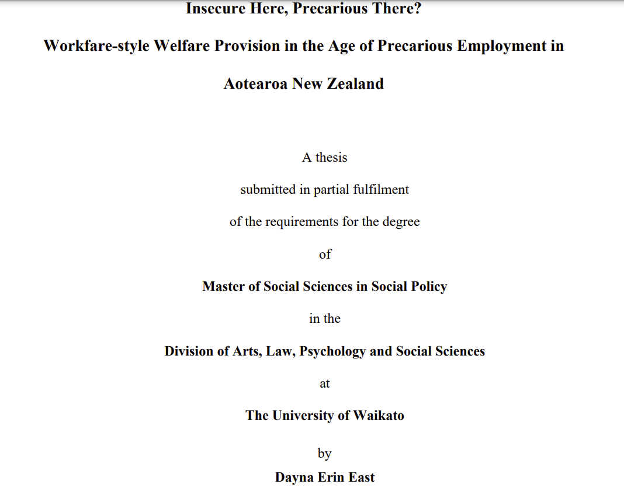

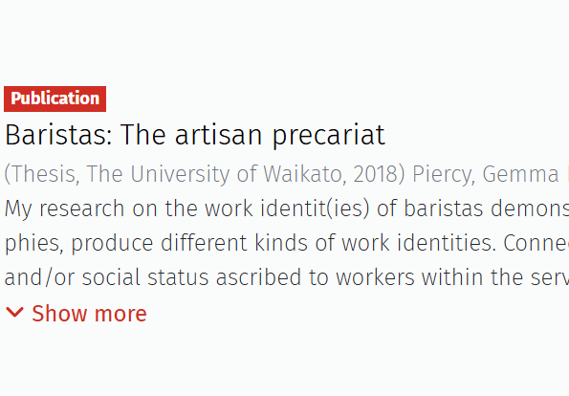
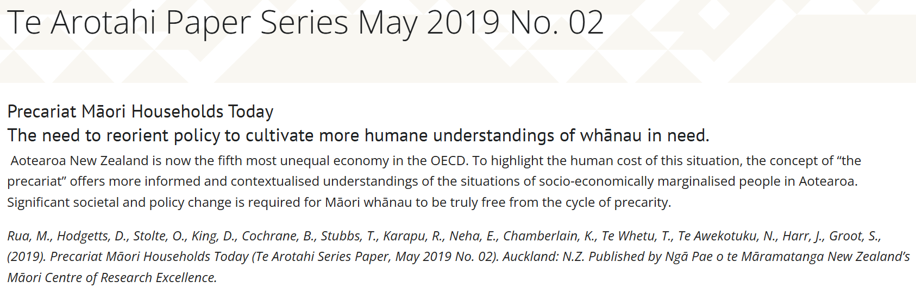
Project Origins
Different levels. Depends on the person?
Need to make it clear to students
Why is precarious employment so hard to define?

Slide 3
Context
Early 2000s:
  Standing’s repackaging of his work on flexible labour as precarious employment and the declaration of an emerging precariat class.
  Researchers are influenced by the ideas of precarious employment and associated terms, such as precarity, precariousness, and precariat.
  Into the contemporary:
  Extensive work defining and operationalising the interrelated concepts ‘precarity’, ‘the precariat’ and ‘precarious employment’.
  Terms remain elusive, causing theoretical and empirical dilemmas.
  Further work is needed to define and, in turn, operationalise these terms more precisely.
  For definitional clarity we locate our work within the Antipodean South, across the post-WWII Keynesian and neoliberal eras.

Slide 4
Precarity
We think it is important to delineate precarious employment from precarity
This is because precarity itself has become an amorphous term
Definitions range, for example:
Labour market phenomenon
Class identity
Generalized life condition
We seek to avoid the slippages between these classifications by speaking to precarious employment rather than the more elusive term ‘precarity’.

Slide 5
Challenges in the literature
Precarious employment is also not without definitional challenges
1. Inconsistent usage of terms
There is a wide variety of alternative titles (e.g., contingent, non-standard, casual, fixed-term, temporary, etc.) that are often used interchangeably with precarious employment.
2. Blurring of distinguishing characteristics
Although precarious employment might overlap with these labour market experiences, they are heterogeneous and often clearly distinguishable phenomena and processes.

Slide 6
Challenges in the literature
3. Binary positioning of precarious and standard employment
Amalgamates a wide range of employment arrangements at each pole.
Assumes that all non-standard employment arrangements share a common predisposition towards higher insecurity due to their deviation from ‘standard employment’.
4. The valorisation of standard employment relationships
Insecurity can be experienced in standard employment arrangements, and some non-standard employment can be relatively secure.
The standard employment relationship has never actually been ‘standard’ but can instead be understood as a selective, exclusive phenomenon unique to industrialised developed countries for a distinct period

Slide 7
Challenges in the literature
Precarious employment can be characterised by instability, insecurity and uncertainty in all aspects of the employment arrangement.
Beyond these characteristics, purchase on the concept is challenging - inhibiting comparison and empirical investigation.
5. Continuum approach to defining precarious employment:
Conceptualises precarious employment across a continuum of experiences, involves measuring the precariousness of an employment type based on a range of dimensions that signal insecurity in employment arrangements.
There is little consensus as to which indicators should be included.
But it does capture the complexity of precarious employment.

Slide 8
The definition
We define precarious employment as work for remuneration that is deemed more-or-less precarious based on three indicators explicitly related to the regularity of the employment contract:
the job can be terminated with little or no prior notice from the employer
working hours and/or earnings are uncertain/irregular
a contract for ongoing employment is non-existent.
Across different typologies and definitions, job insecurity is the core/essential element (or common denominator) of precarious employment.
Precarious employment, so defined, will be experienced differently by heterogeneous workers who possess different buffers against its insecurity.
Regardless of the subjective experience, workers can objectively be said to be (or not) in precarious employment.

Slide 9
Excluded dimensions
Low-wage work:
If low-wage work is coupled with guaranteed hours and a contract for ongoing employment that cannot be easily terminated without notice, the challenges for low-wage workers will be distinct from those engaged in precarious employment.
Labour market security:
Inadequate employment opportunities, albeit engendering insecurity, are better understood as a condition of the labour market, macroeconomic policy, and political positioning.

Slide 10
Excluded
Dimensions
Skill reproduction security:
Inadequate opportunities for training and upskilling, coupled with a secure employment contract wherein the worker can expect regular hours and continuity of employment, will present different challenges and difficulties for a worker in precarious employment.
Employment security:
The ability to find another job at any stage, rather than being an indicator of precarious employment, is best understood as a buffer against negatively experiencing precarious employment.
These experiences further degrade the employment experience but are not essential to the experience of precarious employment; we view them as distinct challenges.

Slide 11
Advantages of our definitions
Our definition helps us move away from the vague sense in which precarious employment has been used as a catch-all for ‘bad’ jobs.
Literature conflates distinct employment experiences.
Need to recognise the heterogeneity of human experience in the labour market.
Theoretical clarity is essential for operational clarity to measure and compare phenomena in labour markets.
Our definition can be empirically deployed more readily than:
Definitions that attempt to present an exhaustive list of indicators, and
A bare definition such as Kalleberg’s definition of precarious work as “employment that is uncertain, unpredictable, and risky from the point of view of the worker” (Munck, Pradella & Wilson, 2020, p. 1).

Slide 12
References
Arnold, D., & Bongiovi, J. R. (2013). Precarious, Informalizing, and Flexible Work: Transforming Concepts and Understandings. American Behavioral Scientist, 57(3), 289-308. doi:10.1177/0002764212466239
Bhattacharya, A., & Ray, T. (2021). Precarious work, job stress, and health‐related quality of life. American journal of industrial medicine, 64(4), 310-319.
Campbell, I., & Price, R. (2016). Precarious work and precarious workers: Towards an improved conceptualisation. The Economic and Labour Relations Review, 27(3), 314-332. doi:10.1177/1035304616652074.
Choonara, J. (2022). The problem with precarity: precarious employment and labour markets. In J. Choonara, A. Murgia, & R. M. Carmo (Eds.), Faces of precarity: Critical perspectives on work, subjectivities and struggles (pp. 94-113). Bristol University Press.
East, D. (2020). Insecure here, precarious there? : Workfare-style welfare provision in the age of precarious employment in Aotearoa New Zealand. Masters thesis. University of Waikato. https://hdl.handle.net/10289/14042
Jaydarifard, S., Smith, S. S., Mann, D., Rossa, K. R., Salehi, E. N., Srinivasan, A. G., & Soleimanloo, S. S. (2023). Precarious employment and associated health and social consequences; a systematic review. Australian and New Zealand Journal of Public Health, 47(4), 1-7.

Slide 13
References
Jesnes, K. (2018). Approaches to atypical and precarious work. Fafo: Oslo, Norway.
Kalleberg, A. L., & Hewison, K. (2013). Precarious work and the challenge for Asia. American Behavioral Scientist, 57(3), 271-288. doi:10.1177/0002764212466238
Kalleberg, A. L., & Vallas, S. P. (2018). Probing precarious work: Theory, research and politics. In S. P. Vallas & A. L. Kalleberg (Eds.), Precarious work (pp. 1-32). Emerald Publishing Limited.
Koranyi, I., Jonsson, J., Rönnblad, T., Stockfelt, L., & Bodin, T. (2018). Precarious employment and occupational accidents and injuries–a systematic review. Scandinavian journal of work, environment & health, 44(4), 341-350.
Kreshpaj, B., Orellana, C., Burström, B., Davis, L., Hemmingsson, T., Johansson, G., ... & Bodin, T. (2020). What is precarious employment? A systematic review of definitions and operationalizations from quantitative and qualitative studies. Scandinavian journal of work, environment & health, 46(3), 235-247.

Slide 14
References
Millar, K. M. (2017). Toward a critical politics of precarity. Sociology compass, 11(6), e12483.
Munck, R., Pradella, L., & Wilson, T. D. (2020). Introduction: Special issue on precarious and informal work. Review of Radical Political Economics, 52(3), 361-370. https://doi.org/10.1177/0486613420929205.
Shin, K. Y., Kalleberg, A. L., & Hewison, K. (2023). Precarious work: A global perspective. Sociology Compass, 17(12), e13136.
Standing, G. (2011). The precariat: The new dangerous class. Bloomsbury Publishing.
Vosko, L. (2010). Managing the margins: Gender, Citizenship, and the International Regulation of Precarious Employment. Oxford University Press.
Vosko, L., Zukewich, N., & Cranford, C. (2003). Precarious jobs: a new typology of employment. Perspectives on Labour and Income, 15(4).

