Slide 1
When your maunga is a mountain but your moana is not a sea;
Insights from the perception of synonymy of te reo Māori Loanwords in New Zealand English lexical equivalents
Niklas Alexander Pohl – University of Waikato
Andreea Calude – University of Waikato
Hēmi Whaanga – Massey University
Eline Zenner – KU Leuven
Laura Rosseel – Vrije Universiteit Brussels

Slide 2
Introduction: Language Contact and Loanwords
Ongoing contact between languages and their speakers inevitably leads to a flow of words being borrowed from one language (source language) into another (recipient language).
→ Loanwords
Loanwords often adapt to the phonological and morphosyntactic characteristics of the recipient language. (Haspelmath 2009; Winford 2010)
For example: The English word pullover /ˈpʊlˌəʊvə^{r}/
French: /pylɔˈvɛʁ/ or /pulɔˈvoeʁ/
Czech ‘/pulovr/ or /pulovr/’
German ‘ /pʊ(l)ˈloːvɐ/’ (Duběda 2020).

Slide 3
Loanwords and Meaning - 1
Semantic Reduction: a loanword retains only a single meaning.
e.g. English word chat in Italian
Taxonomic Specialisation: a loanword takes up a more specialised meaning.
e.g. Spanish word sombrero in English
(Winter-Froemel 2011)

Slide 4
Loanwords and Meaning - 2
The meaning(s) of loanwords cannot be assumed.
Recent studies on loanword meaning have seen a sociopragmatic shift.
By necessity → increased interest in onomasiology. (Anderson et al. 2017; Crombez 2022)
Notes:
Meaning of loanwords cannot be assumed on the meaning of a them within their respective source languages.
Then, I want to have a short explanation of onomasiology as in, peopeple ar emore interesting why people ue a loanword instead of an already existing alternative → Then onomasiology comes in, as we must know which words express the same concepts in order to investigate this type of variation.
Which also relates to the most fundamental tenant of sociolinguistics, namely that there are different ways a speaker may say the same thing based on their communicative needs.
Recent studies on meaning of loanwords has seen a sociopragmatic shift.
By necessity, researcher are increasingly becoming more interested in onomasiology.
Return to the most basic tenant of sociolinguistic variations as by Labov ‘(quote about saying different things in the same manner)

Slide 5
Introduction: Lexical Semantics, Semasiology and Onomasiology
Semasiology:
Study of lexical items and how many concepts they express.
Onomasiology:
Study of the different lexical items that express the same concept. (Geeraerts 2010)
Example: ‘run’ (Gries 2006)
running as type of movement Running someone over in a conversation
Notes:
If onomasiology is one side of the coin,
Then, the other side is semasiology, which is the field of linguistics interested in.
And semasiology is important because it is in a somewhat paradoxical relationship with onomasiology. That is, without knowing which concepts a word can express, we cannot know which meaning nuances are inherent to it, compared to another word.

Slide 6
This Project – Filling Two Gaps
Recent attempts at integrating onomasiology and semasiology (Zenner et al. 2023).
As research is often based on corpus linguistics data:
This project presents:
1. An experimental approach to the integration of semasiology and onomasiology.
- (near-)synonymy of loanwords and recipient language lexical equivalents.
2. Case study: New Zealand English (NZE)

Slide 7
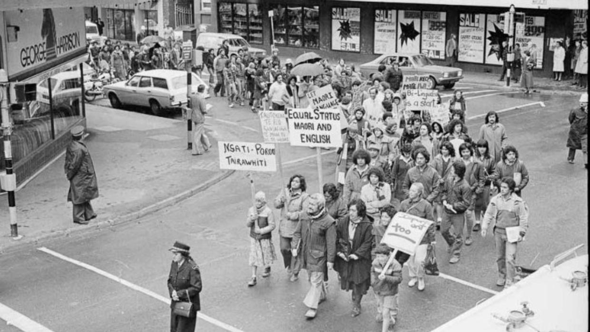
Language Contact between te reo Māori and NZE
First contact - James Cook in 1769
Te Tiriti o Waitangi 1840
- Territory and land wars 1845 to 1872
- Education Ordinance Act 1847
- Native Schools Act 1867
- Education Act 1877
Endangered State of te reo Māori confirmed in the mid 1970s
https://nzhistory.govt.nz/media/photo/maori-language-week-protest-march
Notes:
marks the beginning of profound changes for the indigenous language.

Slide 8
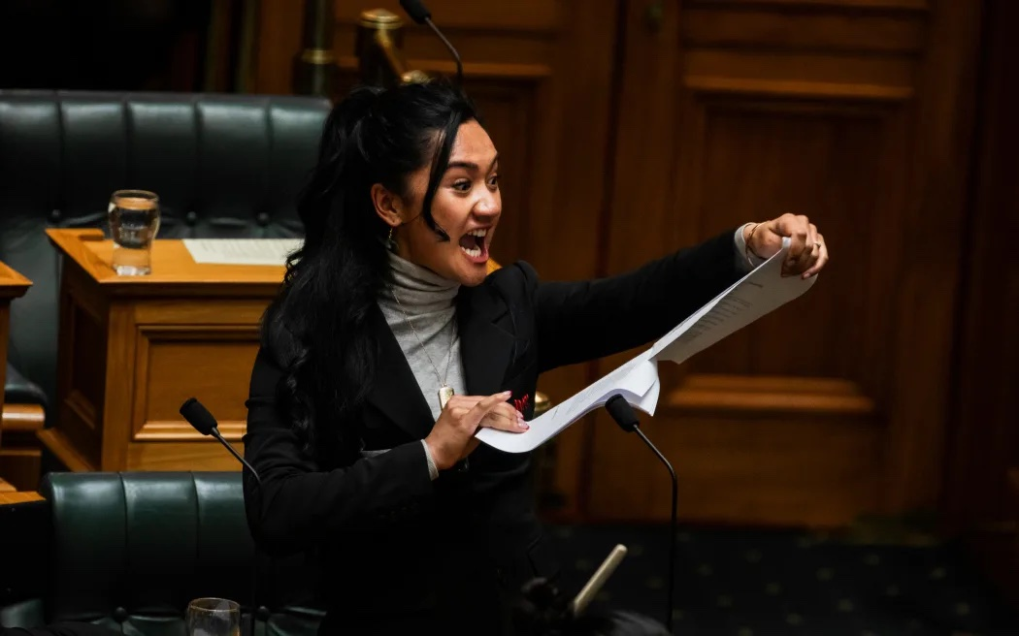
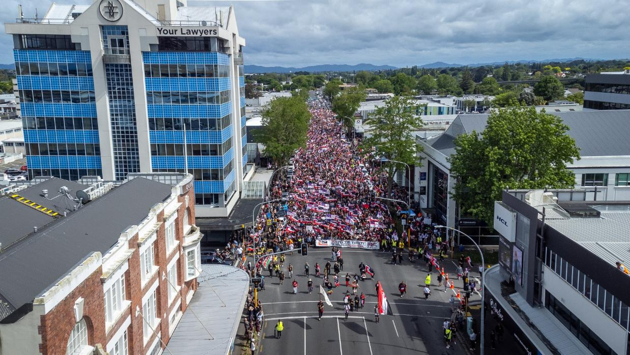
Language Contact between te reo Māori and NZE
Campaigns, and protests led by Māori 1970s-1980s
- Māori Language Day, Te Wiki o te reo Māori
- Māori language Act 1987
- First Bilingual School 1978, Kōhanga Reo 1982, Kura Kaupapa Māori 1985, Te Mātāwai and The Māori language Act 2016
(Greensill et al. 2017)
Currently: The Treaty Principles Bill
Hīkoi mō te tiriti – Toitū te tiriti
https://e-tangata.co.nz/comment-and-analysis/hanas-haka-shows-up-the-house/
https://www.thepost.co.nz/nz-news/360490389/hikoi-mo-te-tiriti-what-you-need-know
Notes:
marks the beginning of profound changes for the indigenous language.

Slide 9
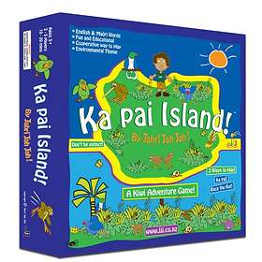
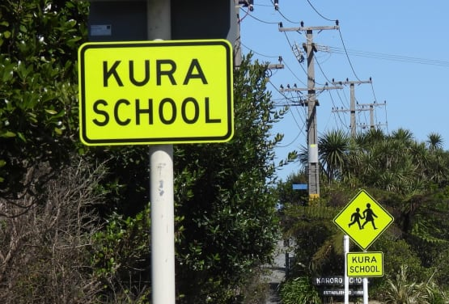
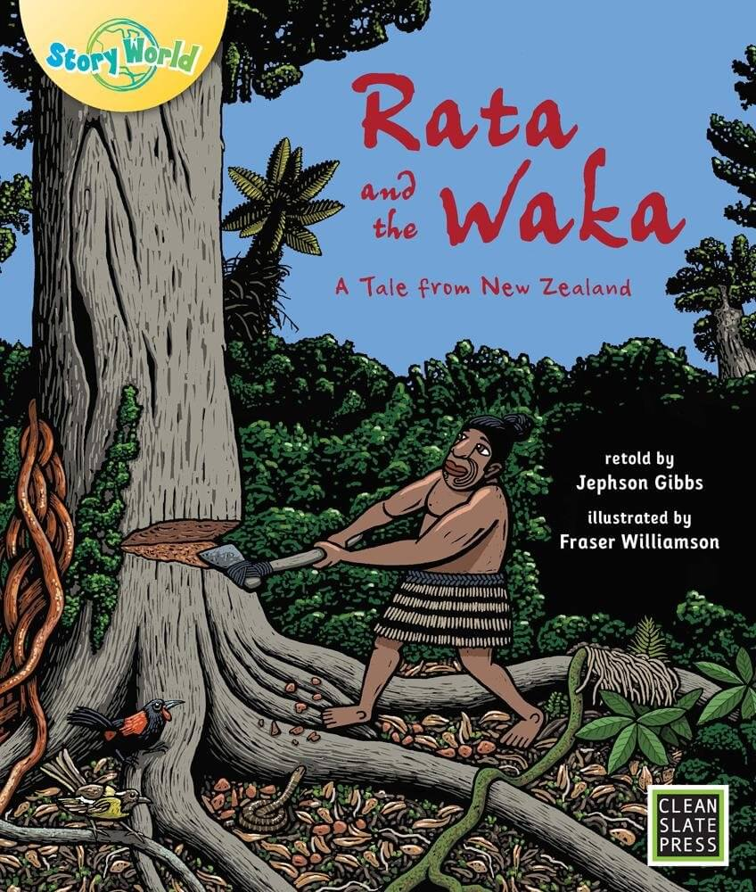
Māori loanwords in NZE
Māori loanwords are ubiquitous, salient, and probably still increasing (Trye et al. 2019).
Influx of words from 3 semantic domains (flora and fauna, material culture, and social culture) (Macalister 2006).
https://www.rnz.co.nz/news/ldr/475482/they-ll-have-no-bloody-idea-bilingual-signs-on-the-west-coast
https://flyingstartbooks.com/bookshop/rata-and-the-waka-big-book-edition/
https://pricespy.co.nz/product.php?p=765364
Notes:
With all these things known, what is left to investigate

Slide 10
Māori loanwords in NZE
Research of usage of te reo Māori loanwords:
- across media platforms (e.g. Daly 2007; Trye et al. 2019; )
- contextual restriction (De Bres 2006)
- reinforcement of monolingual status in Aotearoa (Degani 2010; Harlow 2005)
- sensitivity towards adaptation (Davies & Maclagen 2007)
- flagging (Levendis and Calude 2018)
Notes:
With all these things known, what is left to investigate

Slide 11
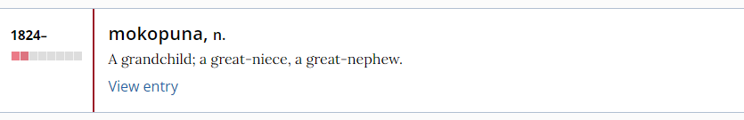
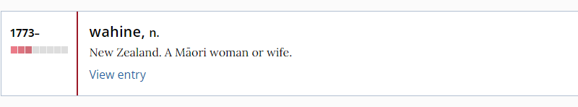
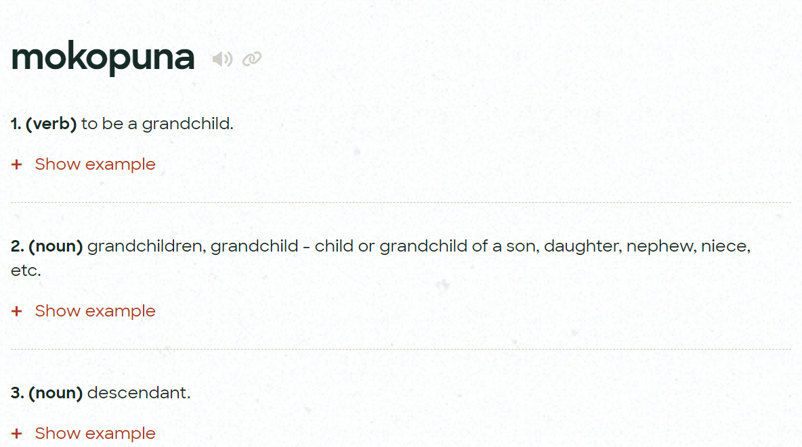
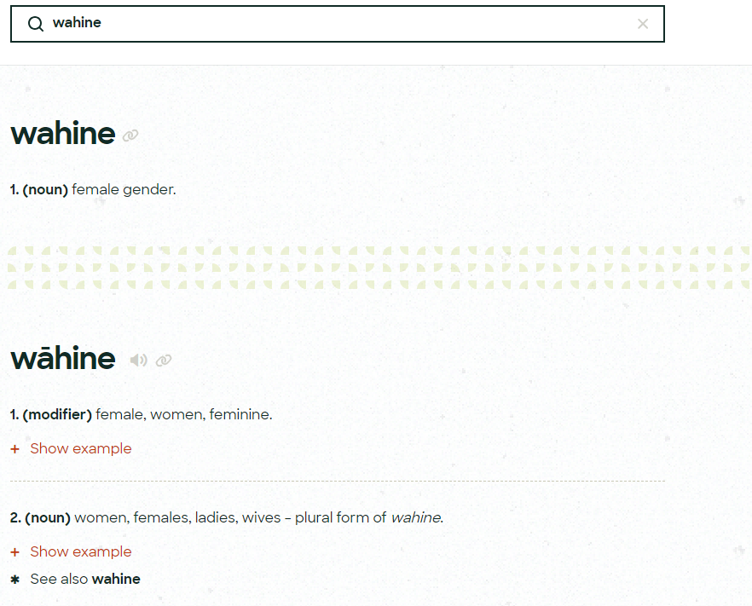
Why loanwords in NZE? – wahine and mokopuna
There is almost no systematic evidence of the meaning of te reo Māori loanwords!
https://maoridictionary.co.nz/search?&keywords=wahine (last access 16/10/2024
https://www.oed.com/search/dictionary/?scope=Entries&q=wahine (last access 16/10/2024)
https://maoridictionary.co.nz/search?idiom=&phrase=&proverb=&loan=&histLoanWords=&keywords=mokopuna/10/2024) (last access 16/10/2024
https://www.oed.com/search/dictionary/?scope=Entries&q=mokopuna (last access 16/10/2024)

Slide 12
(Some) Research Questions
1. How synonymous are te reo Māori loanwords and NZE lexical equivalents perceived to be by adult speakers of New Zealand English?
Dependent Variable:
Synonymy ratings
2. Which sociodemographic parameters can capture variation between participants in their perception of the synonymy status between pairs of te reo Māori words and NZE alternatives?
Independent Variable:
Semantic fields (RQ1) + Sociodemographic parameters (RQ2)

Slide 13
Methodology
3-tiered questionnaire:
1st tier: Assessing synonymy rating on analogue slider scales (2 x 30 target words + 10 Fillers)
2nd tier: Open-answer follow-up questions
3rd tier: Sociodemographic background questionnaire

Slide 14
1st Tier: Synonymy Assessment:
Stimuli and glosses
Flora and Fauna | Material Culture | Social Culture
paua (abalone), ika (fish), harakeke (flax), kumara ((sweet)potato) | motukā (car), ahi (fire), pukapuka (book), koha (gift), pā (village), kura (school), whare (house), waka(canoe), maunga (mountain), kai (food) | tauiwi (foreigner), kawa (protocol), tangi (funeral), utu (revenge), kōtiro (girl), kāwanatanga(government), hikoi (march), Rangatira (chief), kaumātua (elders), tama (boy), taniwha (monster), whakapapa (lineage), kōrero (talk), waiata (song), mana (power), wahine (woman)
Flora and Fauna | Material Culture | Social Culture
kurī (dog), manu (bird), mako (shark), pīwakawaka (fantail) | tarau (trousers), korowai (cloak), kete (basket), taonga (treasure), koru (spiral), pounamu (greenstone), puku (stomach), hāngī (oven), moko (tattoo), moana (sea) | rūnanga (council), wero (challenge), manuhiri (visitor), ākonga (stuent), rangatiratanga (sovereignty), atua (god), kaitiaki (guardian), tikanga, hui (meeting), mokopuna (grandchildren), tāne (man), Tamariki (children), karakia (prayer), iwi (tribe), aroha (love), whānau (family)

Slide 15
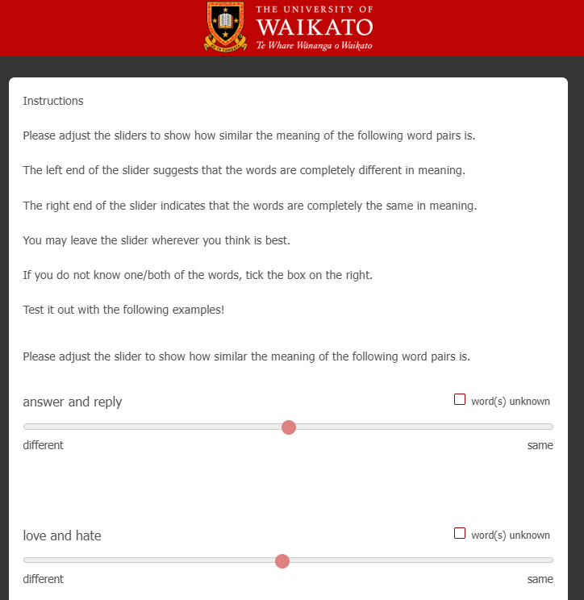
1st Tier: Synonymy
1st Tier: Synonymy Assessment

Slide 16
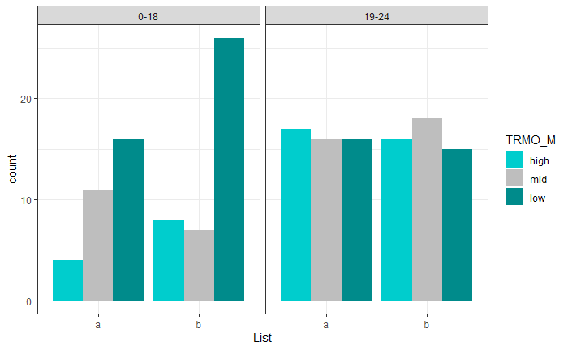
Participants
TRMO | Lived 0-18 | Lived 0-18 | Lived 19-24 | Lived 19-24 |  | Sum
 | A | B | A | B
High | 4 | 8 | 17 | 16 |  | 45
Mid | 11 | 7 | 16 | 18 |  | 52
Low | 16 | 26 | 16 | 15 |  | 73
Sum | 31 | 41 | 49 | 49 |  | 170
TRMO – exposure to and attitude towards te reo Māori (low 0-2; mid 3; high 4-6 )
Time lived in Aotearoa New Zealand (0-18 years; 19-24 years)

Slide 17
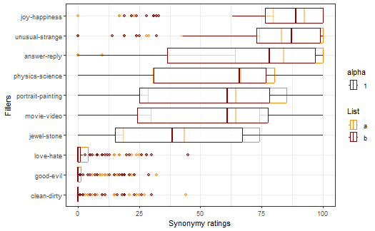
(Some) Results – The Synonymy Ratings
Filler | Mean | SD | P50
joy-happiness | 83.859 | 21.589 | 91
unusual-strange | 80.871 | 21.297 | 86
answer-reply | 69.429 | 33.132 | 80
physics-science | 55.724 | 29.966 | 66
portrait-painting | 54.894 | 31.693 | 64
movie-video | 53.947 | 29.299 | 63
jewel-stone | 44.182 | 30.412 | 41
love-hate | 3.324 | 7.415 | 0
good-evil | 2.847 | 6.468 | 0
clean-dirty | 2.612 | 6.983 | 0

Slide 18
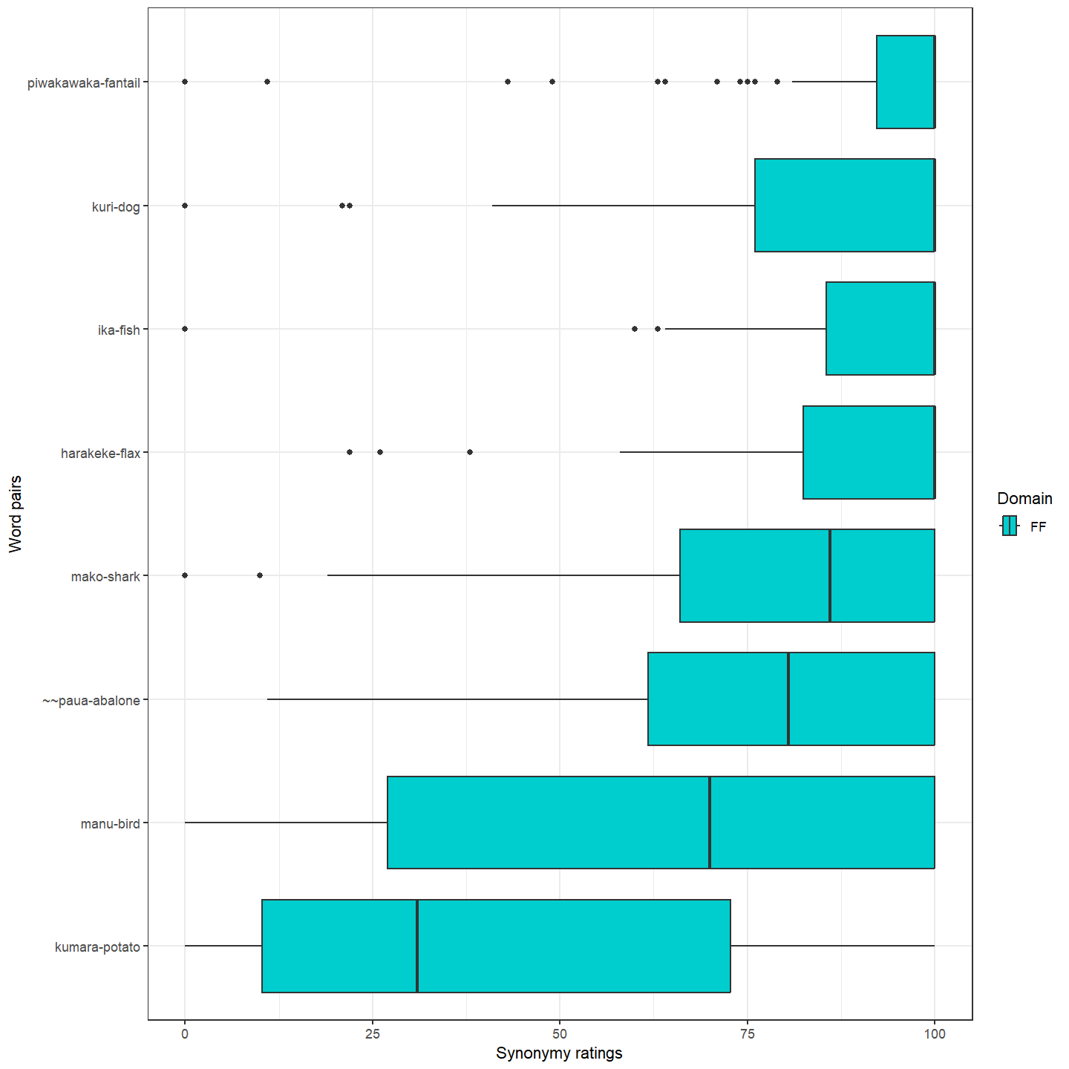
RQ 1? – Flora and Fauna
How synonymous are te reo Māori loanwords and NZE lexical equivalents perceived to be by adult speakers of New Zealand English?

Slide 19
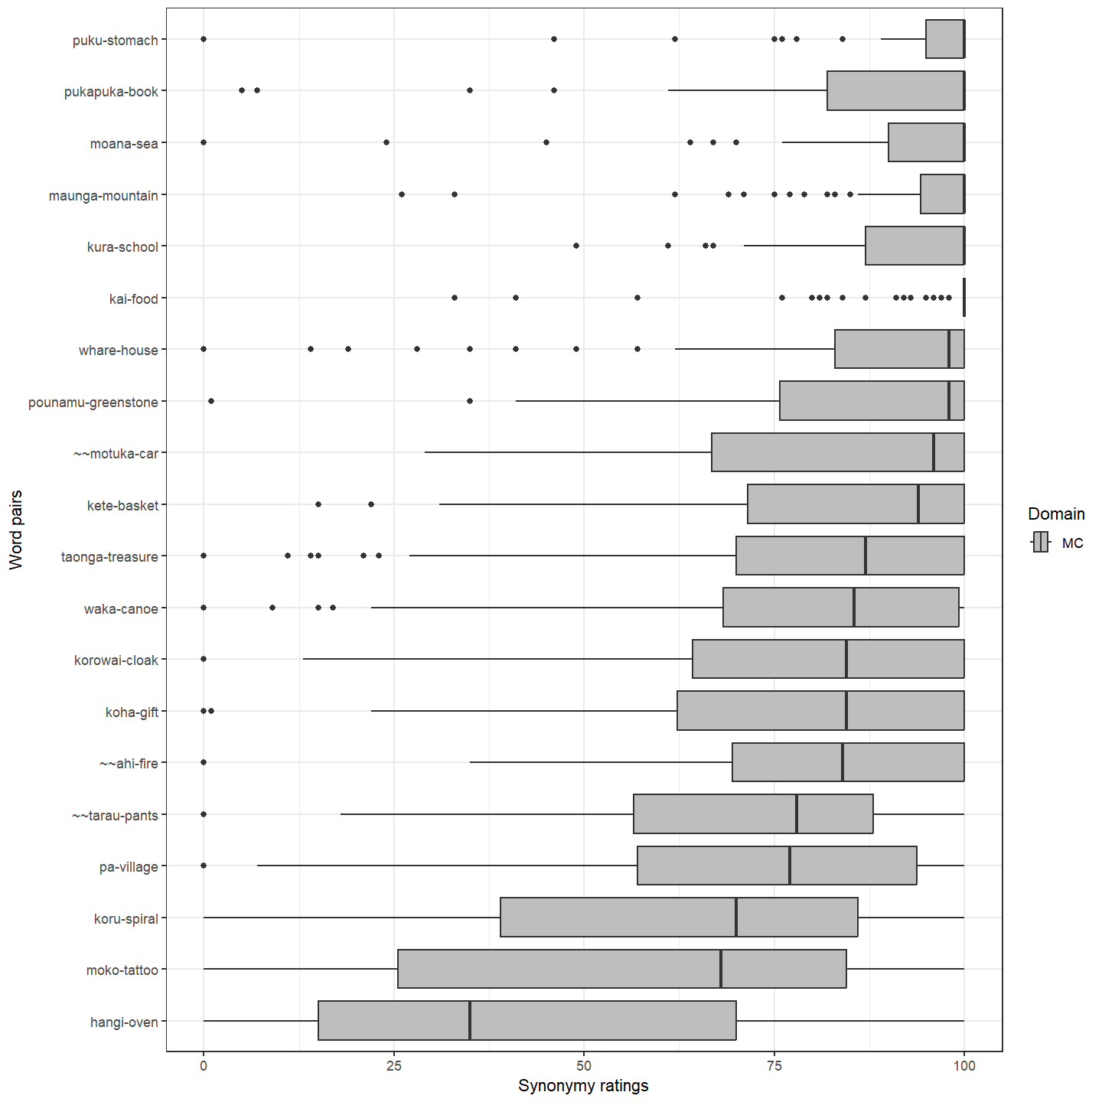
RQ 1? – Material Culture
How synonymous are te reo Māori loanwords and NZE lexical equivalents perceived to be by adult speakers of New Zealand English?

Slide 20
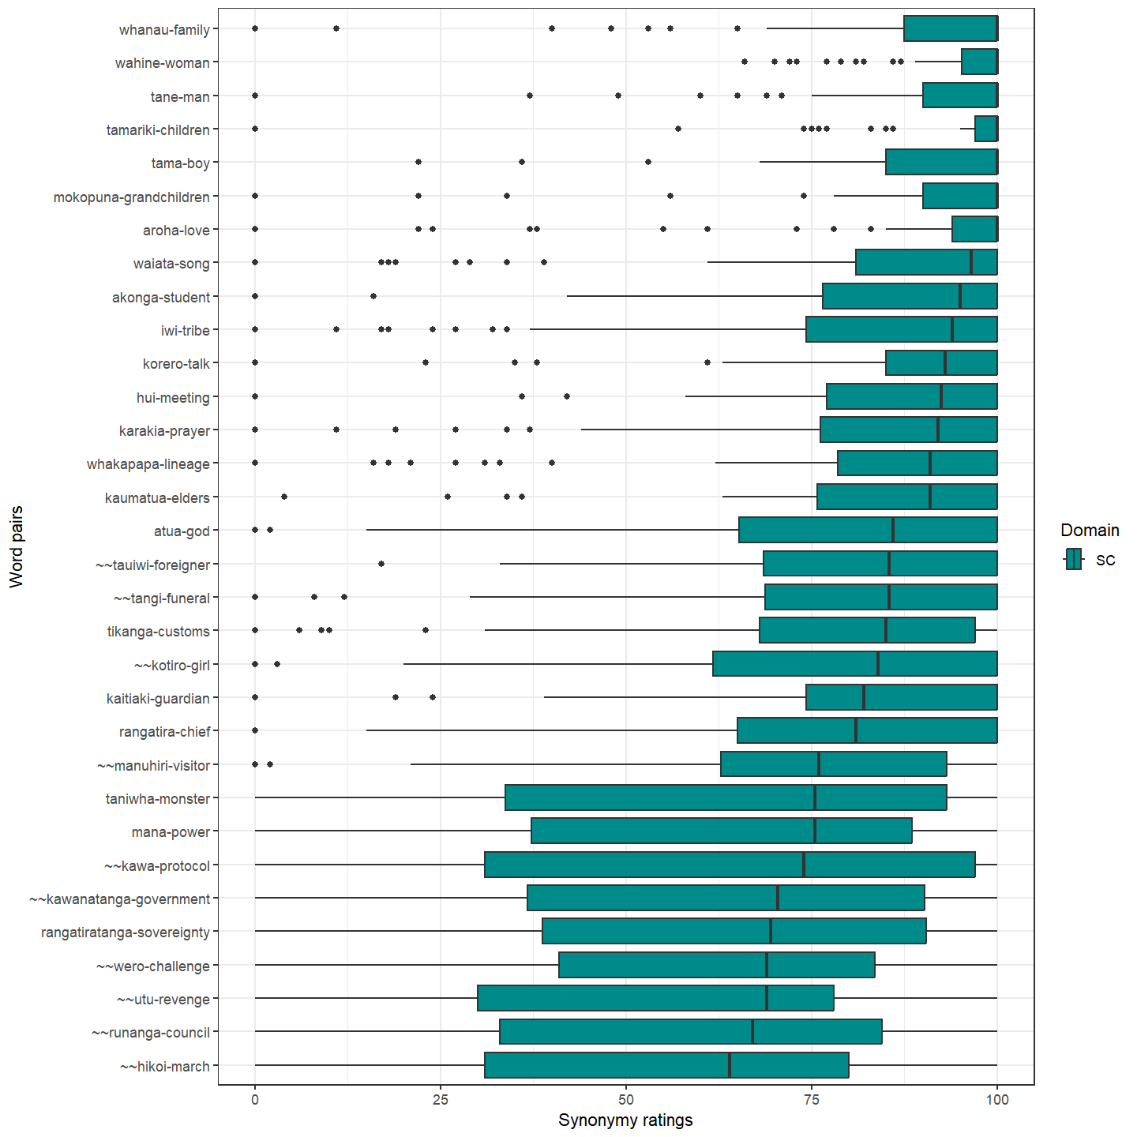
RQ 1? – Social Culture
How synonymous are te reo Māori loanwords and NZE lexical equivalents perceived to be by adult speakers of New Zealand English?

Slide 21
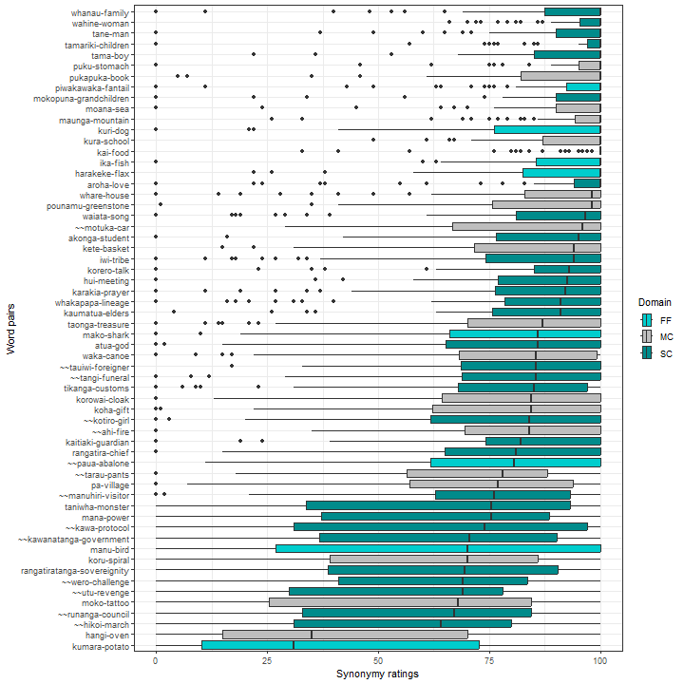
RQ 1?
How synonymous are te reo Māori loanwords and NZE lexical equivalents perceived to be by adult speakers of New Zealand English?

Slide 22
(Some) Results – Predicting synonymy ratings?
No statistically significant effects.
However
Random effects | Variance | Standard deviation
Participants | 167.4 | 12.94
Word Pairs | 151.4 | 12.30
Residual | 424.2 | 20.60

Slide 23
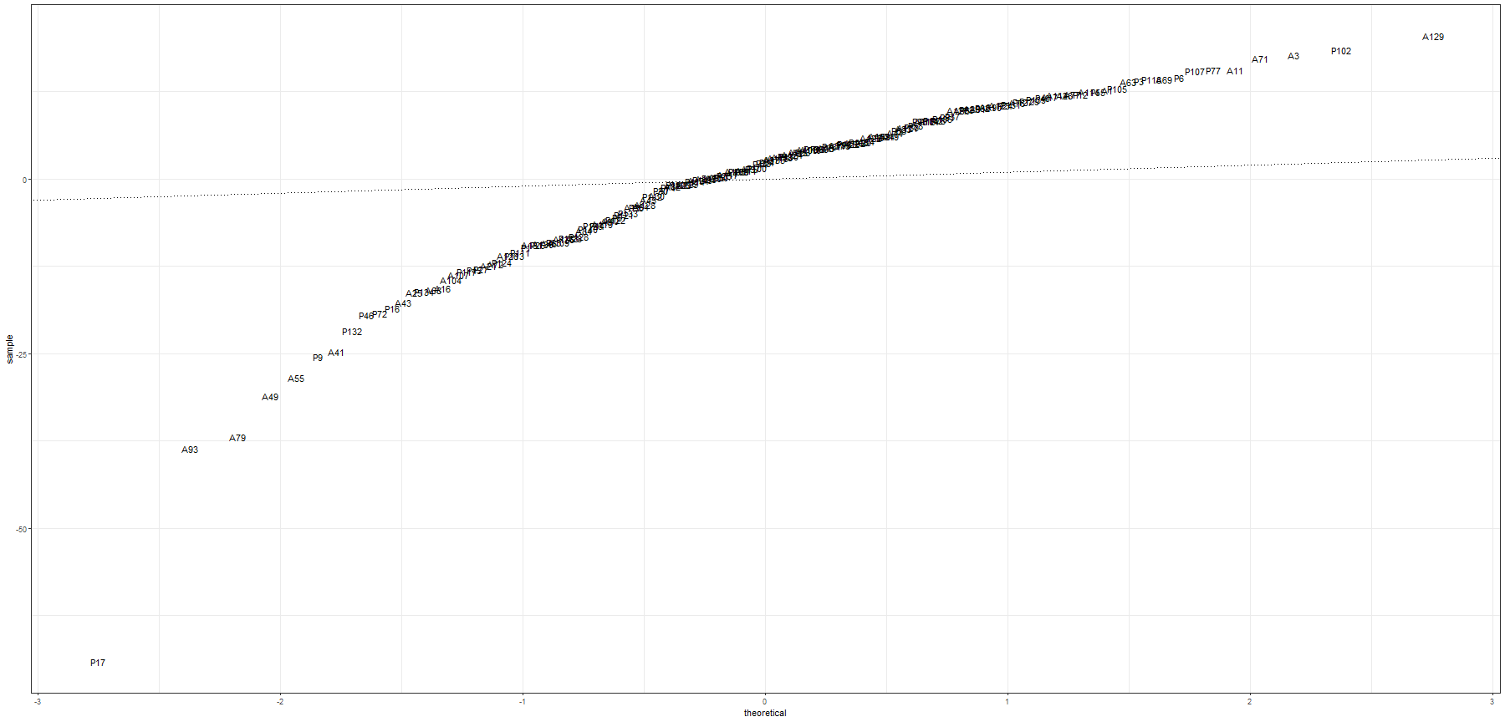
Random effects: Participants
Random effects

Slide 24
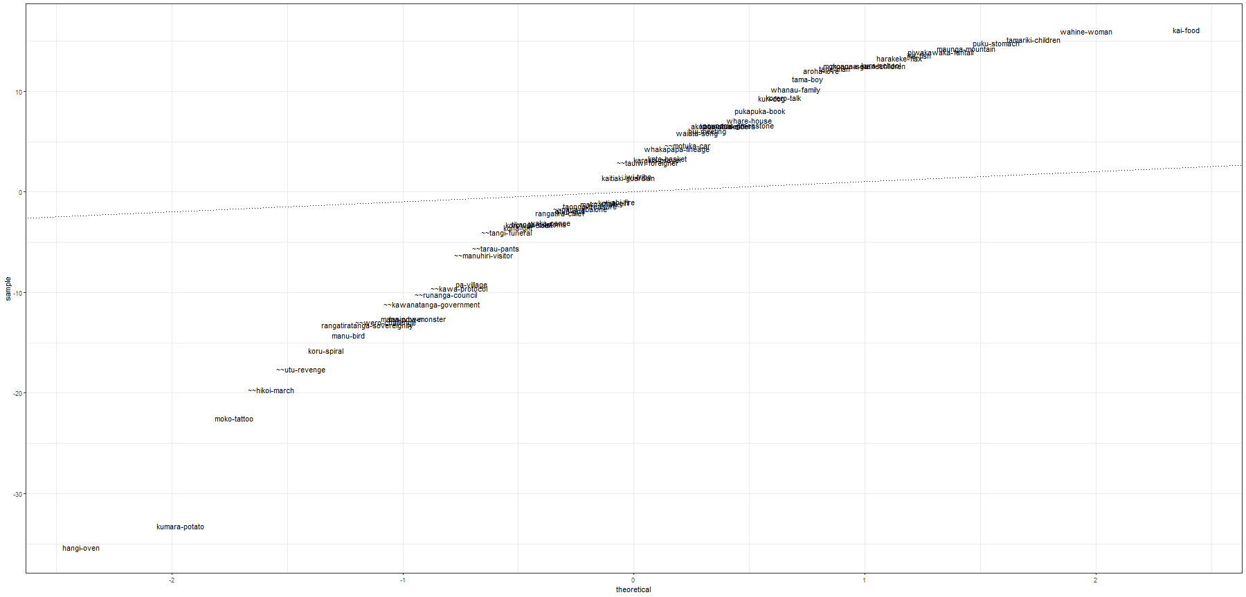
Random effects: Word Pairs

Slide 25
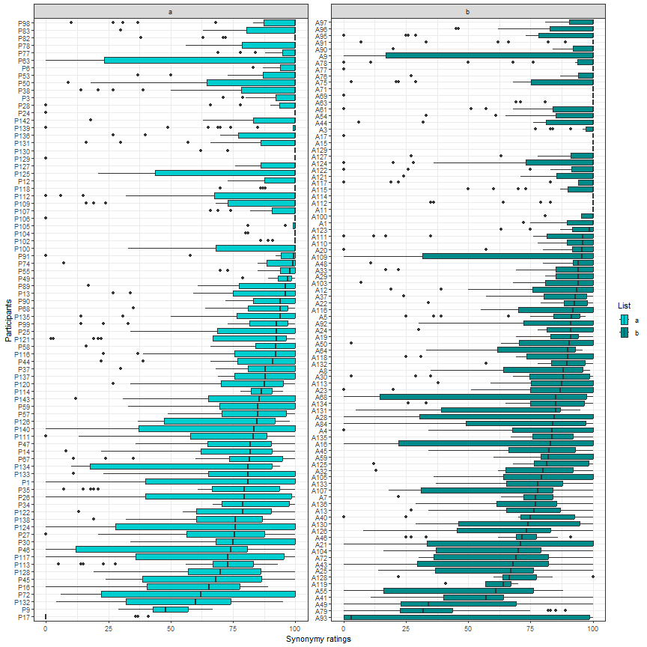
RQ2 ?
Which sociodemographic parameters can capture variation between participants in their perception of the synonymy status between pairs of te reo Māori words and NZE alternatives?
Notes:
Stress that neither TRMO nor time lived in Aotearoa NZ was able to

Slide 26
Summary - Results
1. te reo Māori loanwords are perceived to be highly synonymous with NZE lexical equivalents.
2. Random effects show extremely high variation between individual word pairs and participants.
3. Value of experimental methods for (loanword) meaning research and in particular the integration of onomasiological and semasiological approaches.

Slide 27
Where do we go from here?
Next Steps:
    Thematic Analysis
    Moving towards Developmental Sociolinguistics:
  Matched-Guise (Study 2)
  Implicit Association Test (Study 3)

Slide 28

Special Thanks
Special thanks are extended towards
Te Apārangi - Royal Society
for sponsoring this project and my research with their Marsden Fund.

Slide 29

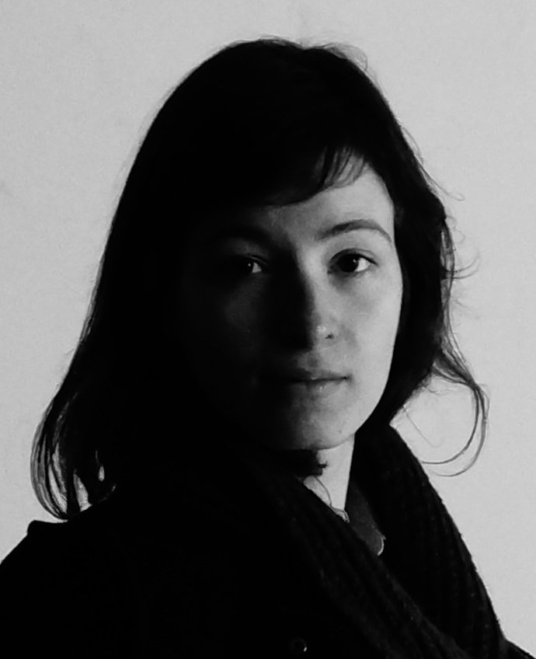


Special Thanks
Hēmi Whaanga Laura Rosseel Eline Zenner Andreea Calude

Slide 30
Special Thanks
Jessie Burnette – PhD-Buddy
For their continued support and friendship since the beginning of our PhD-journey.
(And for providing inter-rater reliability for my thematic analysis)
(See how you get a whole slide dedicated to you, Jessie? I am, hereby, proving to be the morally better PhD student (objectively))

Slide 31


Mihimihi
E mihi ana ki te iwi me te whenua o Waikato, te whenua manaaki i ahau
Ko Tainui te waka
Ko Pirongia te maunga
Ko Waikato te awa
Tēnā koutou, tēnā koutou, tēnā tātou katoa!

Slide 32
References
Anderson, G., Furiassi, C. & Mišić-Ilić, B. (2017). The pragmatic turn in studies of linguistic borrowing. Journal of Pragmatics, 113, 71-76.
Crombez, Y., Ghyselen, A., Winter-Froemel, E. & Zenner, E. (2022). The sociopragmatic parameters steering the reported selection of Anglicisms or their Dutch alternatives. Linguistics, 60(4), 973-1010.
Daly, N. (2007). Kūkupa, koro, and kai: The use of Māori vocabulary items in New Zealand English children’s picture books. New Zealand English Journal, 21, 20-33.
Davies, C. & Maclagan, M. (2006). Māori words – read all about it: Testing the presence of 13 Māori words in four New Zealand newspapers from 1997 to 2004. Te Reo, 49, 73-99.
De Bres, J. (2006). Māori lexical items in the mainstream television news in New Zealand. New Zealand English Journal, 20, 17-34.
Degani, M. (2010). The Pakeha myth of one New Zealand/Aotearoa. An exploration in the use of Maori in New Zealand English. In R. Facchinetti, D. Crystal, & B. Seidlhofer, (Eds.), From international to local English and back again (165-196). Peter Lang.
Deverson, T. (1991). New Zealand English lexis: the Maori dimension. English Today, 7(2), 18-25.
Geeraerts, D. (2010). Theories of lexical semantics. Oxford University Press.
Gries, S. T. (2006). Corpus-based methods and cognitive semantics: The many senses of to run*. In S. T. Gries & A. Stefanowitch (Eds.), Corpora in cognitive linguistics: Corpus-based approaches to syntax and lexis (pp. 57-100). De Gruyter.
Haspelmath, M. (2009). Lexical borrowing: concepts and issues. In M. Haspelmath, & U. Tadmor (Eds.), Loanwords in the world’s languages: A comparative handbook (pp. 35-54). De Gruyter Mouton.
Harlow, R. (2005). Covert attitudes to Māori. International Journal of Sociology of Language, 172, 133-147.
Levendis, K. & Calude, A. (2019). Perception and flagging of loanwords – A diachronic case study of Māori loanwords in New Zealand English. Ampersand, 6, 100056.
Macalister, J. (2006). The Maori presence in the New Zealand English lexicon, 1850-2000: Evidence from a corpus-based study. English world-wide, 27(1), 1-24.
Trye, D., Calude, A., Keegan, T. T. & Falconer, J. (2019). When loanwords are not loanwords: Using networks and hupergraphs to explore Māori loanwords in New Zealand English. International Journal of Corpus Linguistics, 28(4), 461-499
Greensill, H., Manuirirangi, H. & Whaanga, H. (2017). Theme 1. Māori language resources and Māori initiatives for teaching and learning te reo Māori. In H. Whaanga, T. T. Keegan & M. Apperley (Eds.), He whare hangarau Māori language, culture & technology. Te Pua Wānanga ki te Ao, Te Whare Wānanga o Waikato.
Winford, D. (2010). Contact and borrowing. In R. Hickey (Ed.), The handbook of language contact (pp. 170-187). Wiley-Blackwell.
Winter-Froemel, E. (2011). Entlehnung in der Kommunikation und im Sprachwandel: Theorie und Analysen zum Französichen. De Gruyter.
Zenner, E., Hilte, L., Backus, A. & Vandekerckhove, R. (2023). On sisters and zussen: integrating semasiological and onomasiological perspectives on the use of English person reference nouns in Belgian-Dutch teenage chat messages. Foloa Linguistica, 57(2), 449-480..

Slide 33
Thank you for listening!

Slide 34
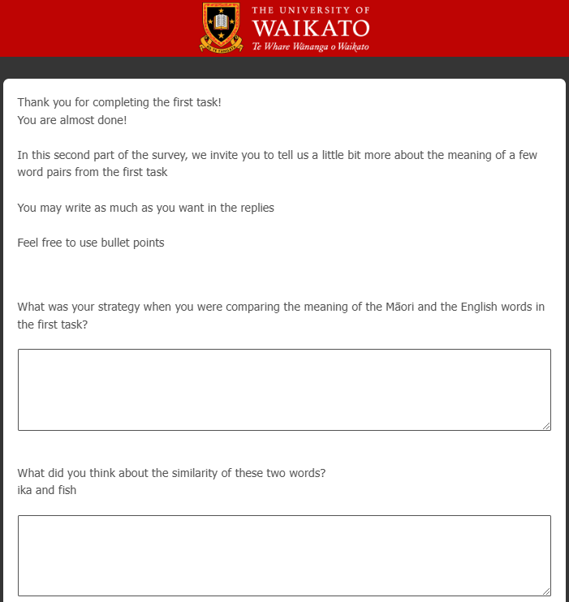
^{2nd} Tier: Follow-up Questions
2nd Tier: Follow-up questions

Slide 35
Method: Questionnaire Design
Word list A |  | Fauna & flora | Material culture | Social culture | Total
Concrete | Animate | 4 | 2 | 8 | 14
 | Inanimate | 0 | 8 | 3 | 11
Abstract | Animate | 0 | 0 | 0 | 0
 | inanimate | 0 | 0 | 5 | 5
Total |  | 4 | 10 | 16 | 30
Word list B |  | Fauna & flora | Material culture | Social culture | Total
Concrete | Animate | 4 | 1 | 9 | 14
 | Inanimate | 0 | 9 | 2 | 11
Abstract | Animate | 0 | 0 | 0 | 0
 | inanimate | 0 | 0 | 5 | 5
Total |  | 4 | 10 | 16 | 30

Slide 36
Target word pairs – completion rates
Completion rate | FF | MC | SC
0-25% | - | - | -
26-50% | paua | motuka, ahi | tauiwi, kawa, tangi, utu, kotiro, kawanatanga, hikoi
51-75% | ika, harakeke | pukapuka, koha, | rangatira, kaumatua, tama
76-100 % | kumara | pa, kura, whare, waka, maunga, kai | taniwha, whakapapa, korero, waiata, mana, wahine
Completion rate | FF | MC | SC
0-25% | - | - | -
26-50% | - | tarau | runanga, wero, manuhiri
51-75% | kuri, manu | korowai | akonga, rangatiratanga, atua, kaitiaki
76-100% | mako, piwakawaka | kete, taonga, koru, pounamu, puku, hangi, moko, moana | tikanga, hui, mokopuna, tane, tamariki, karakia, iwi, aroha, whanau

Slide 37
Participant Exclusion Criteria
We removed all participants who only partially completed the filler ratings, those who rated the antonym fillers to be more than 50% synonymous, and any who did not provide a judgement for any of our target word pairs (n =18).
We removed all participants who took less than 5 minutes to complete all three tiers of the questionnaire (n = 16).
We removed participants who did not provide their full sociodemographic background information or answered them in a suspicious manner (n = 7).

Slide 38
Te Reo Māori Orientation – An aggregate score
Per fulfilled criterion, 1 point was awarded to participants
If a participant was born in ANZ and used a Māori word for the country (Aotearoa) or their ethnicity (Māori / Pākehā).
If a participant indicted that they have (an) iwi affiliation(s).
If a participant indicated that they speak te reo Māori (regardless of proficiency).
If a participant indicated that they hear te reo Māori spoken around them.
If a participant indicated that they were very happy (5pt. Likert-scale) about te reo Māori being compulsory in school.
Based on their score, participants were then classified into one of three groups:
Participants with 0-2 points were grouped into a Low TRMO category,
participants with 3 points were grouped into a Mid TRMO category, and
participants with 4-6 points were grouped into a High TRMO category.

Slide 39
Knowledge of Māori words
Random effects |  | Variance | Standard deviation
Participants |  | 3.447 | 1.857
Word Pairs |  | 4.029 | 2.007
Fixed effects | Estimate | Std. Error | z-value | p-value
(Intercept) | 1.809 | 0.3612 | 5.009 | 5.48e-07
TRMO_1 | 0.9875 | 0.3629 | 2.721 | 0.00651
TRMO_2 | 2.2307 | 0.3633 | 6.140 | 8.26e-10
Lived_ANZ_2 | 0.8898 | 0.3199 | 2.782 | 0.00541

Slide 40
Target word pairs – Follow-Up Questions
Word list A | Word list B | Semantic field | Concreteness | Animacy
Kurī | Ika | Flora and fauna | Concrete | animate
Pounamu | Koha | Material Culture | Concrete | Inanimate
Moana | Maunga | Material Culture | Concrete | animate
Atua | Taniwha | Social Culture | Concrete | animate
Wero | Tangi | Social Culture | Concrete | inanimate
Aroha | Utu | Social Culture | Abstract | Inanimate

