Slide 1

Recent Changes to welfare policy & the Labour market
Symposium: The National-led Government’s First Year: Public Policy Changes And Their Employment Relations Issues, Trends & Implications, AIRAANZ Conference, February 3-5, 2025 Victoria University, Wellington, NZ
Bill Cochrane, University of Waikato bill.cochrane@waikato.ac.nz

Slide 2
introduction
This presentation:
  Outlines changes to the welfare system, (job seeker’s benefit)
  Discusses likely impacts on the New Zealand labour market
  Compares the approach taken by the previous Labour Government
  Makes concluding comments regarding the interaction of welfare and the labour market

Slide 3
Nationals changes: a Brief overview
Upston (August 2024) announced the main changes to be made to the welfare system;
  Extending the period over which an obligation failure counts against a beneficiary from 12 months to two years
  Requiring Job Seeker Support recipients to reapply every six months
  Making it mandatory for all beneficiaries with work obligations to have a jobseeker profile before their benefit is granted
  A new money management sanction that will see half a person’s benefit go onto a payment card that can only used for a limited range of essential products and services (this was part of the National/Act coalition agreement)
  A new community work experience sanction that will require beneficiaries to build their skills and confidence to help them get a job
  In addition
  National will reinstate indexing benefits to inflation, aiming to ensure that beneficiaries' support adapts to real changes in living expenses while maintaining a gap between benefits and potential earnings from fulltime employment. The aim being to increase incentive for jobseekers to actively pursue work.

Slide 4
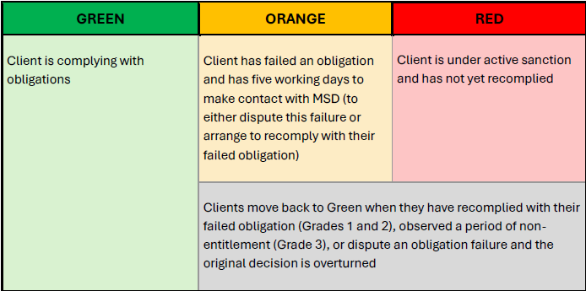
The much vaunted traffic light system
https://www.beehive.govt.nz/sites/default/files/2024-08/Traffic%2520Light%2520System%2520Stages.pdf

Slide 5
National’s Rationale for these changes
Rapid increase in so-called “welfare dependency” under last Labour Government.
Due to alleged removal of clear consequences for jobseekers who do not meet their obligations.
National aims to “refocus the welfare system so supporting people who can work into jobs is the number one priority, rather than entrenching benefit dependency at the expense of the taxpayer.”
“the welfare system should be there to support Kiwis who genuinely need help. But it must also be designed around the principle that those who can work, should. That means making it crystal clear for those receiving a jobseeker benefit exactly what their obligations are and exactly what consequences they will face if they refuse to do their bit.”
Changes to the fixing of benefit rates are designed to increase work incentives.
https://www.national.org.nz/policies/reducing-benefit-dependency

Slide 6
Likely impact of national’s changes (1)
I think that a serious case can be made that, other than making beneficiaries already wretched lot somewhat more wretched, these changes will have little or no effect on the labour market as a whole.
It should be noted that total benefit cancellations numbers are quite low – 2643 in the September quarter of 2024 (MSD, 2024)
Essentially, at the margins, some people will be deterred from signing on to a benefit, some will be sanctioned off benefits (probably temporarily), and the majority will doggedly endure as they have no practical option.
Most jobseeker beneficiaries are on the benefit because they cannot access suitable employment at their current location.
As soon as credible employment opportunities arise, most beneficiaries will take them – few choose to live in poverty if alternatives exist.

Slide 7
Likely impact of national’s changes (2)
Supposing that these changes have any appreciable impact, there are several potential effects:
  Productivity—Jobseeker benefit recipients are likely to have worse labour market attributes than those currently in the labour market, implying that they will have lower productivity. Hence, introducing any significant number of such persons to the labour market will lower aggregate productivity in the short to medium term. In the long run, ex-beneficiaries' productivity may rise as they acquire skills and experience.
  Productivity – Firms may choose to substitute labour for capital if the cost of labour is low enough – it could be expected that Jobseeker benefit recipients entering the job market would command lower wages than existing job holders; this could suppress the rate of technical innovation in labour-intensive industries and hence lower productivity growth.

Slide 8
Likely impact of national’s changes (3)
  Competition — If the number of ex-jobseekers entering the job market due to the new benefits regime is appreciable, this will depress wages through competition with existing employees. This is most likely to occur in the low-wage/low-skill sector, and as noted, it may also lower productivity growth and exacerbate in-work poverty. It should be noted that competition in the low-wage labour market will interact with the changes to minimum wage fixing.
  Stepping Stones – One recurring argument is that securing low-wage employment is a steppingstone to higher-paid and more secure employment. Evidence on this is mixed with the literature finding that for unemployed individuals, taking a low-paid job significantly enhances their chances of moving to higher-paid jobs. Against this, there is substantial evidence of persistence in unemployment and low pay, along with methodological limitations that result in some studies overestimating the future likelihood of transitioning to higher-paid jobs (See Plum, Pacheco & Dasgupta, 2021).

Slide 9
Likely impact of nationals changes (4)
Precarity —If the welfare changes achieve their goals, they will move beneficiaries into mostly low-wage employment. Considering the characteristics of beneficiaries, many of these jobs will be insecure, resulting in the proliferation of insecure employment (exacerbated by the 90-day provisions).
Morale Effects – The changes have a psychological purpose, aiming to terrify beneficiaries and making their lives so unpleasant that any option is better than remaining on the benefit

Slide 10
Would labour have been any different?
While it moved with glacial speed to implement some of the recommendations of the Welfare Expert Advisory Group (WEAG), Labour remains committed to neo-liberal management of the labour market.
In this sense, it is a kinder, gentler welfare regime than National, but in essence, they are both variants of the same model, a model that New Zealand has followed since the 1990s, which has consistently failed to deliver in key areas such as productivity, wage growth, poverty reduction and a less iniquitous income distribution.
The current round of welfare changes is just more of the same, increasing uncertainty and anxiety for beneficiaries, failing to address the issues that confront the labour market and pandering to the worst sentiments of the electorate.

