Slide 1
E-learning for
Continuing Professional Development
Howell Round
University of Waikato, New Zealand

Slide 2
Advantages of e-learning for CPD
Most material available anywhere, anytime if you
  have an internet connection
Often modularised, so can do bits when you have the time
Doesn’t cost a lot to produce & maintain if using volunteers
Easily updated

Slide 3
Advantages of e-learning for CPD
Can get the “top guns” in the field to front presentations
Can access the papers/speakers for the conferences
you couldn’t get to
Available even to financially-challenged physicists/
institutions/countries
Can record your progress if it is assessed for CPD

Slide 4
What resources are needed to produce
on-line material?
Enthusiasm
Time
People
Technical skills
Finance

Slide 5
Search the internet for very good sites
Emitel
Emerald
AAPM
BIIJ
ACPSEM
But after those there doesn’t seem to be a lot…..

Slide 6
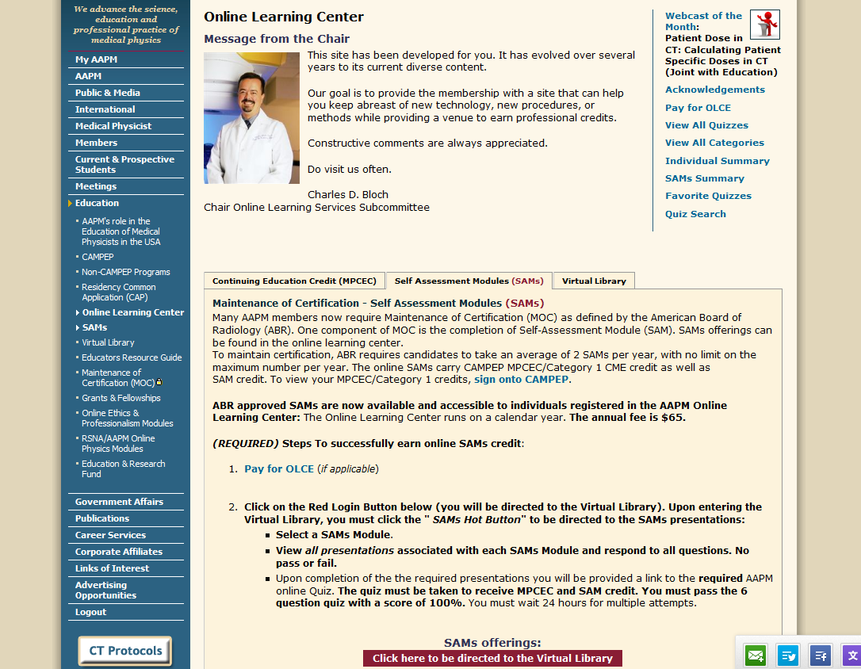

Slide 7
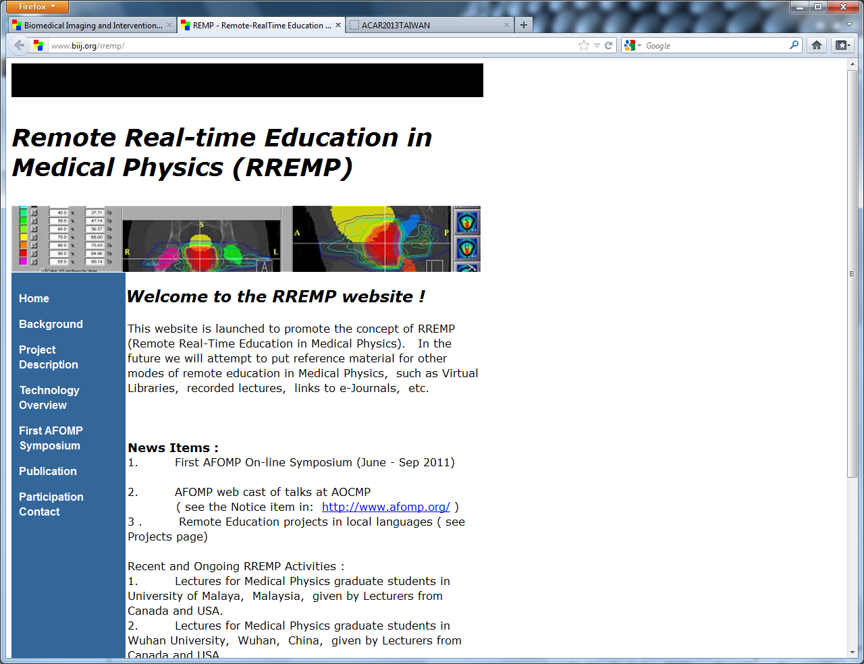

Slide 8
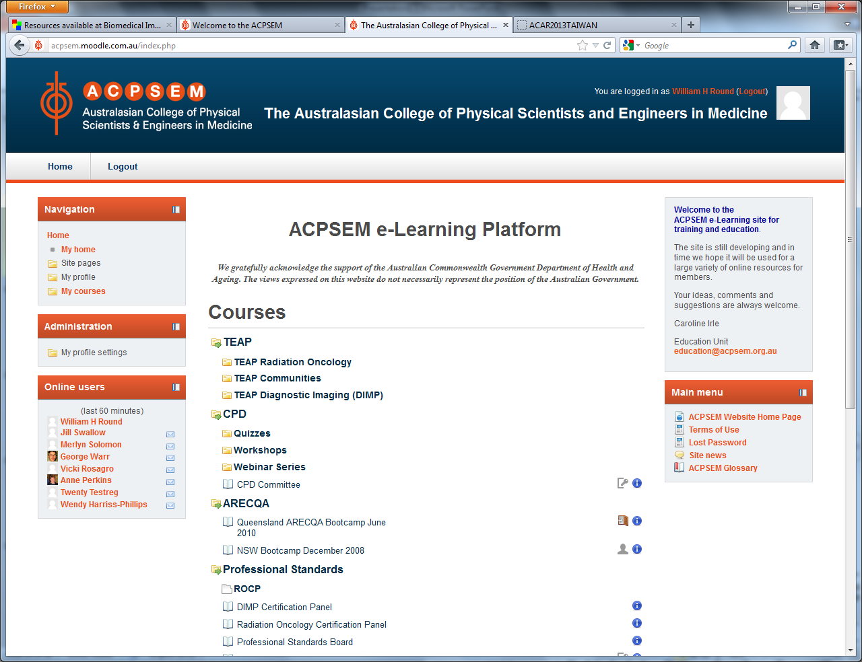

Slide 9
Types of on-line resources for CPD
Emitel
Emerald
Open access journals
Quizzes
On-line teaching modules
Conference and workshop recordings/proceedings
Webinars

Slide 10
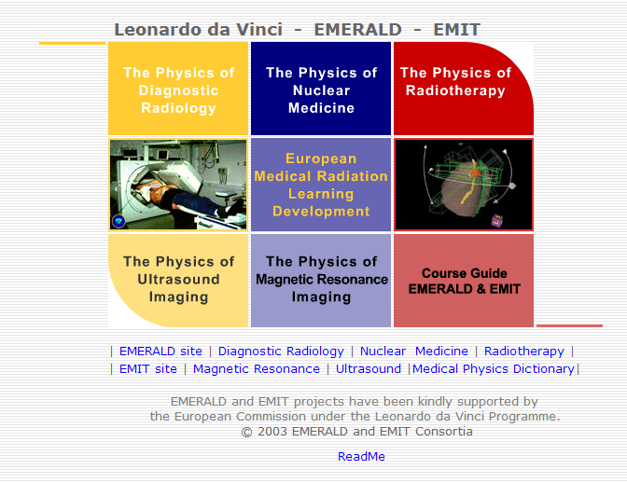

Slide 11
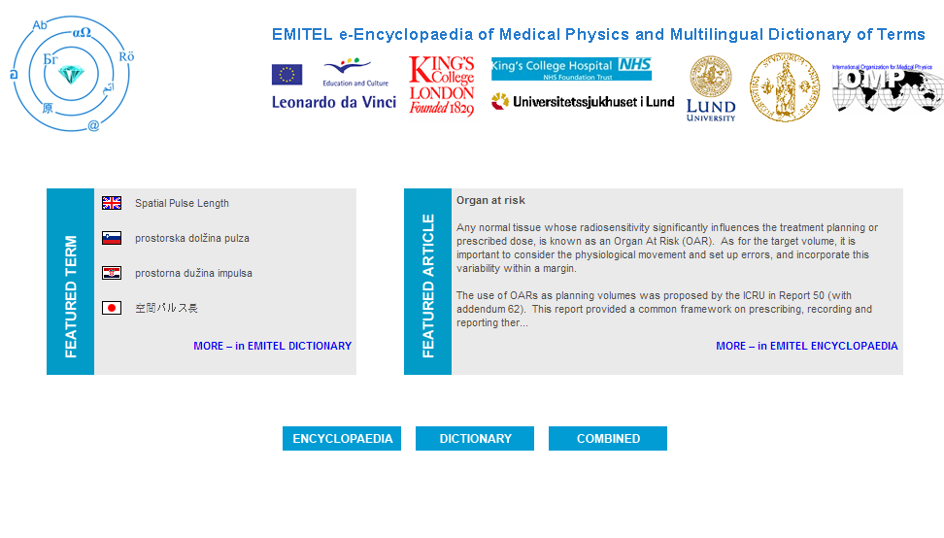

Slide 12
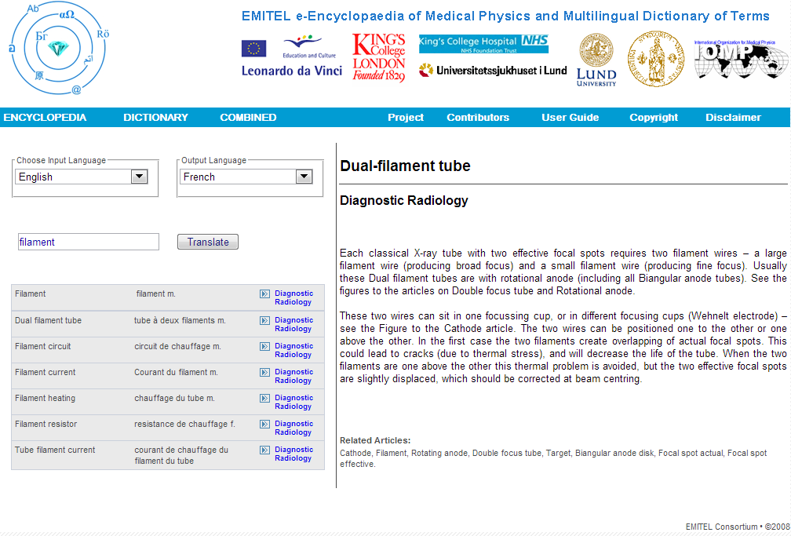

Slide 13
Open Access Journals
Journal of Applied Clinical Medical Physics (USA)
BioMed Central Medical Physics (USA)
Medical Physics (some open access) (USA)
International Journal of Medical Physics, Clinical
Engineering and Radiation Oncology (USA)
Health Physics (Europe)
Physics in Medicine and Biology (some open access) (UK)
Polish Journal of Medical Physics and Engineering (Poland)
Biomedical Imaging and Intervention Journal (Malaysia)
Iranian Journal of Medical Physics (Iran)
Journal of Biomedical Physics and Engineering (Iran)
Journal of Medical Physics (India)
African Journal of Medical Physics, Biomedical
Engineering and Sciences (Nigeria)
Bangladesh Journal of Medical Physics (Bangladesh)
Revista Mexicana de Medicina Fisicay Rehabilitacion (Mexico)
Revista de Fisica Medica (Spain)

Slide 14
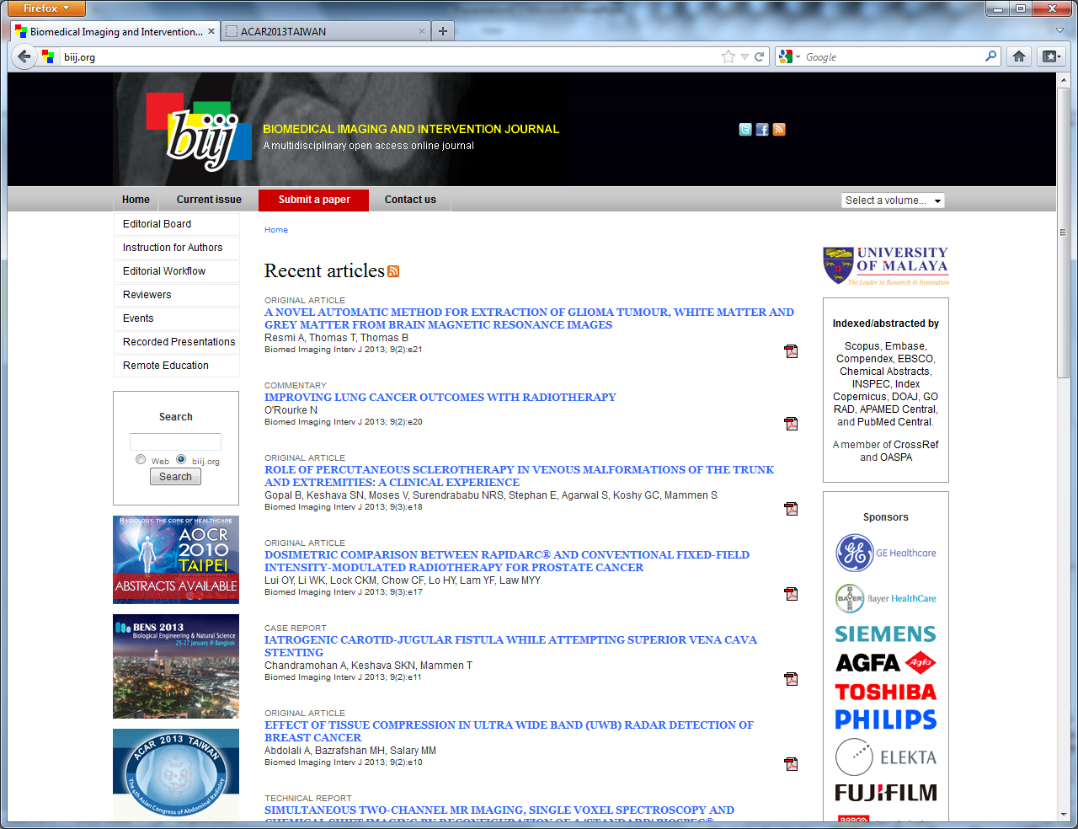

Slide 15
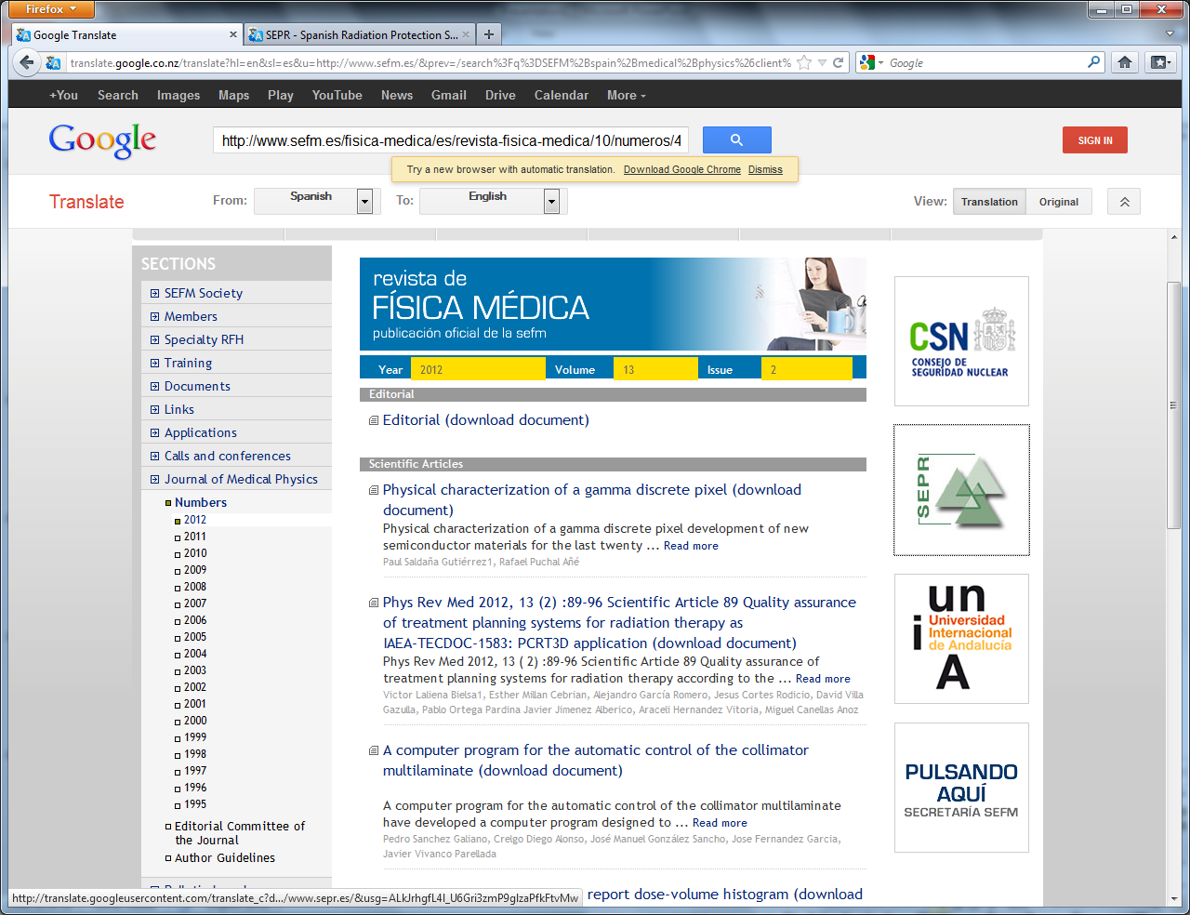

Slide 16
Quizzes

Slide 17
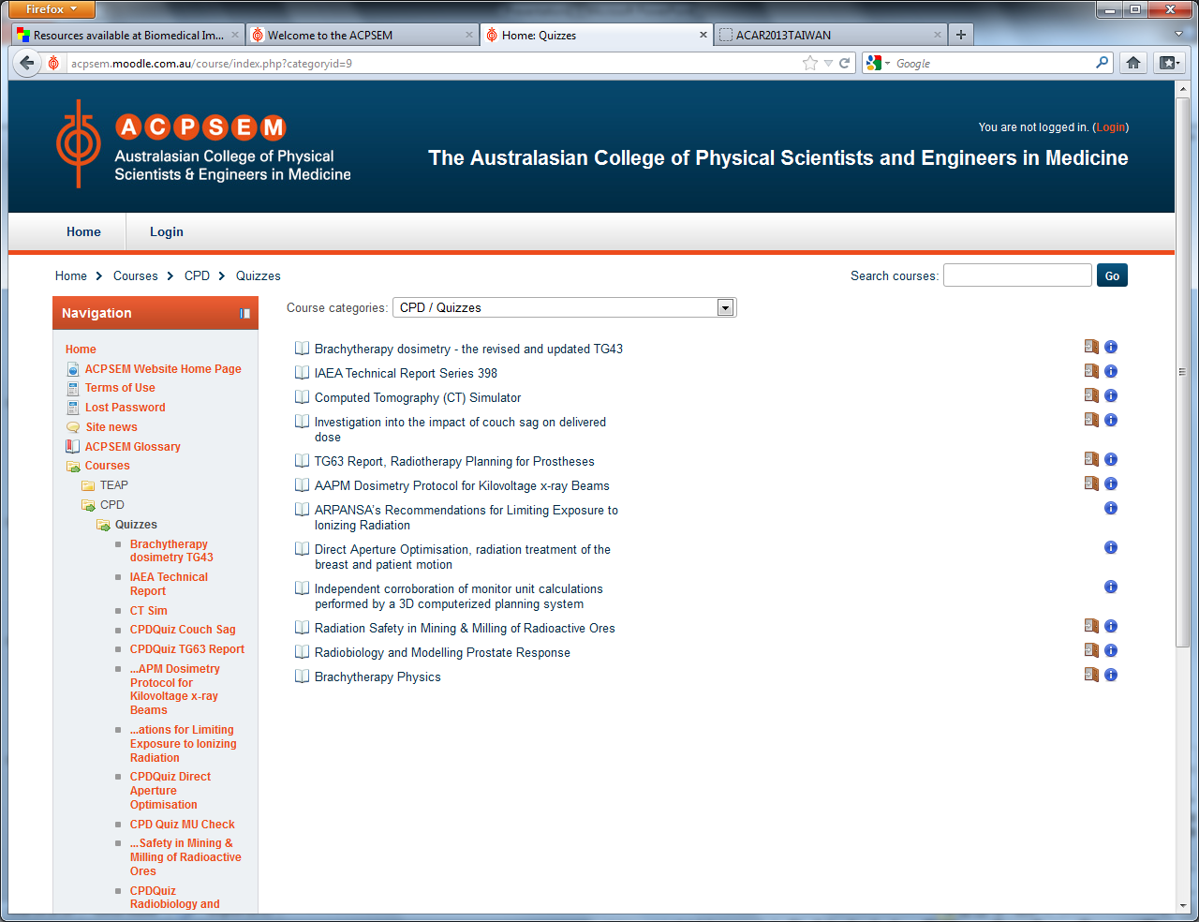

Slide 18
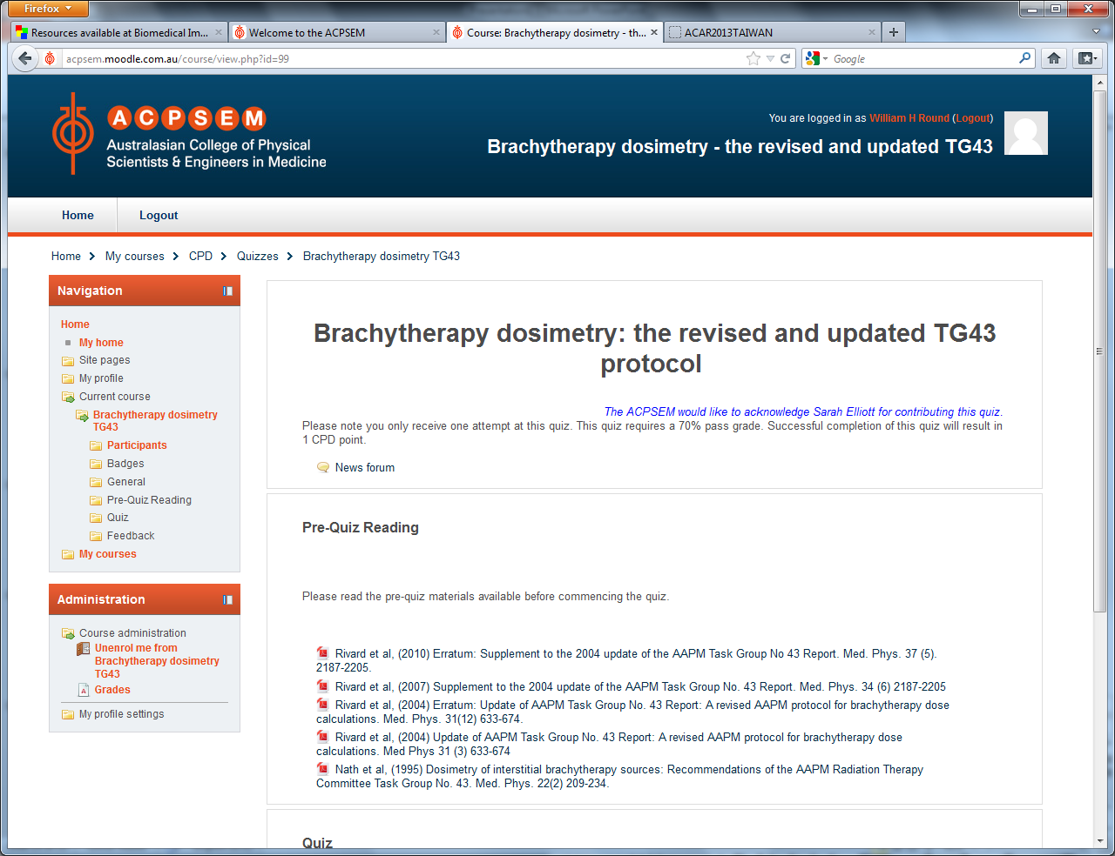

Slide 19
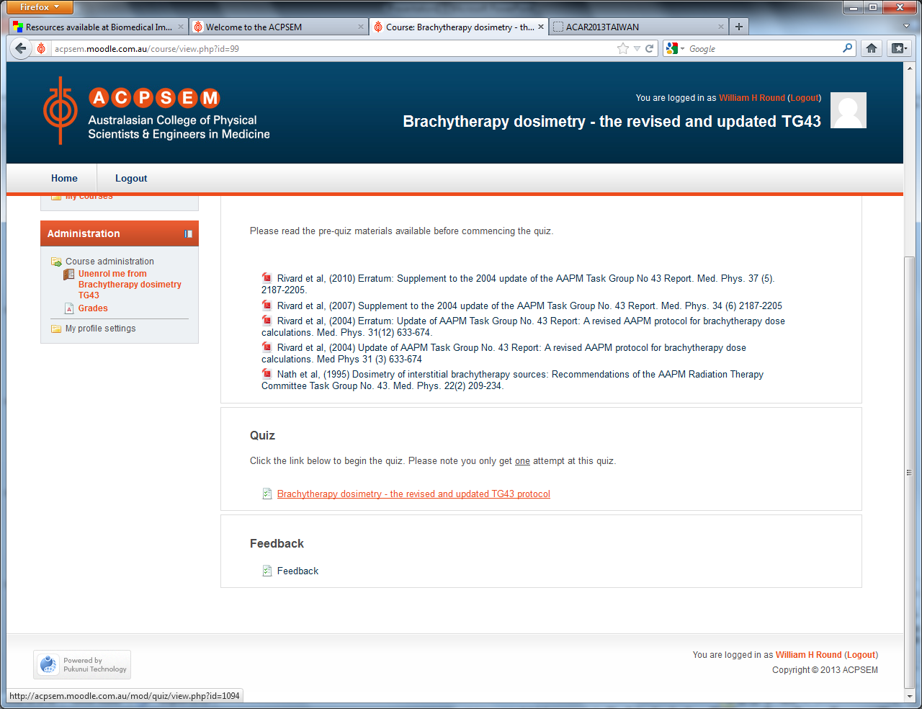

Slide 20
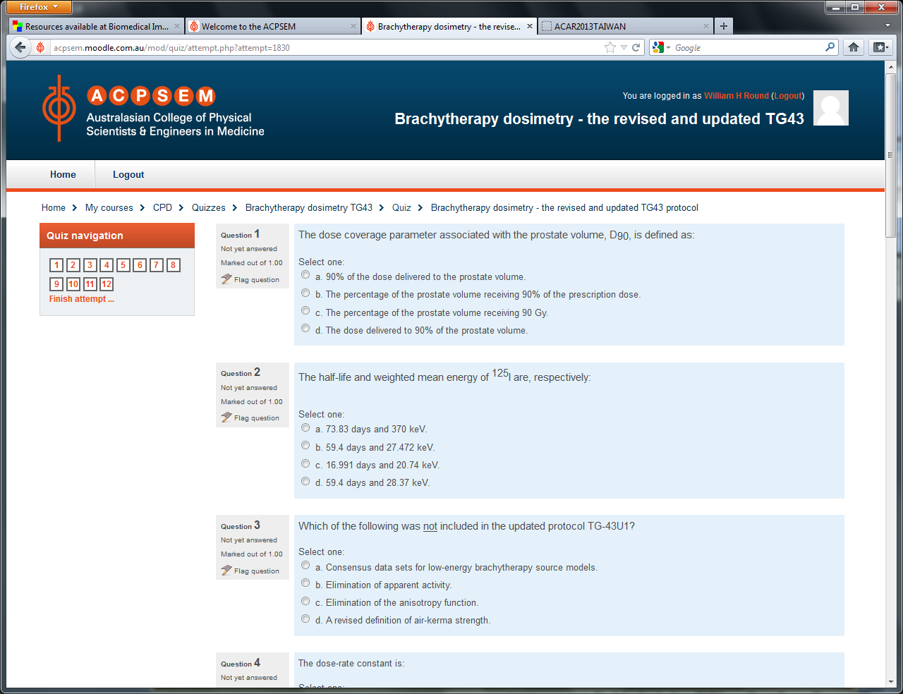

Slide 21
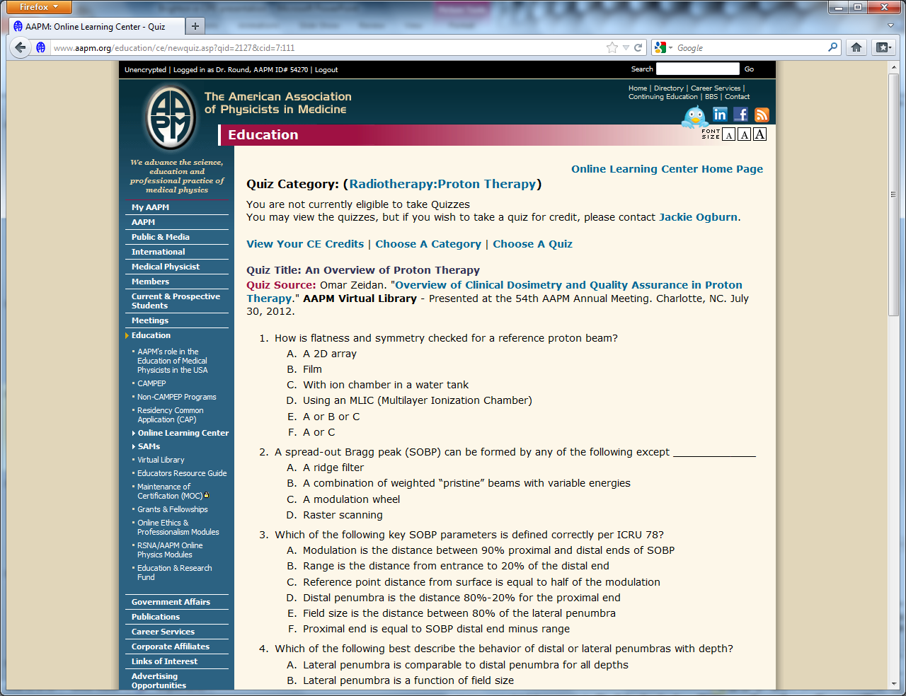

Slide 22
On-line Teaching Modules

Slide 23
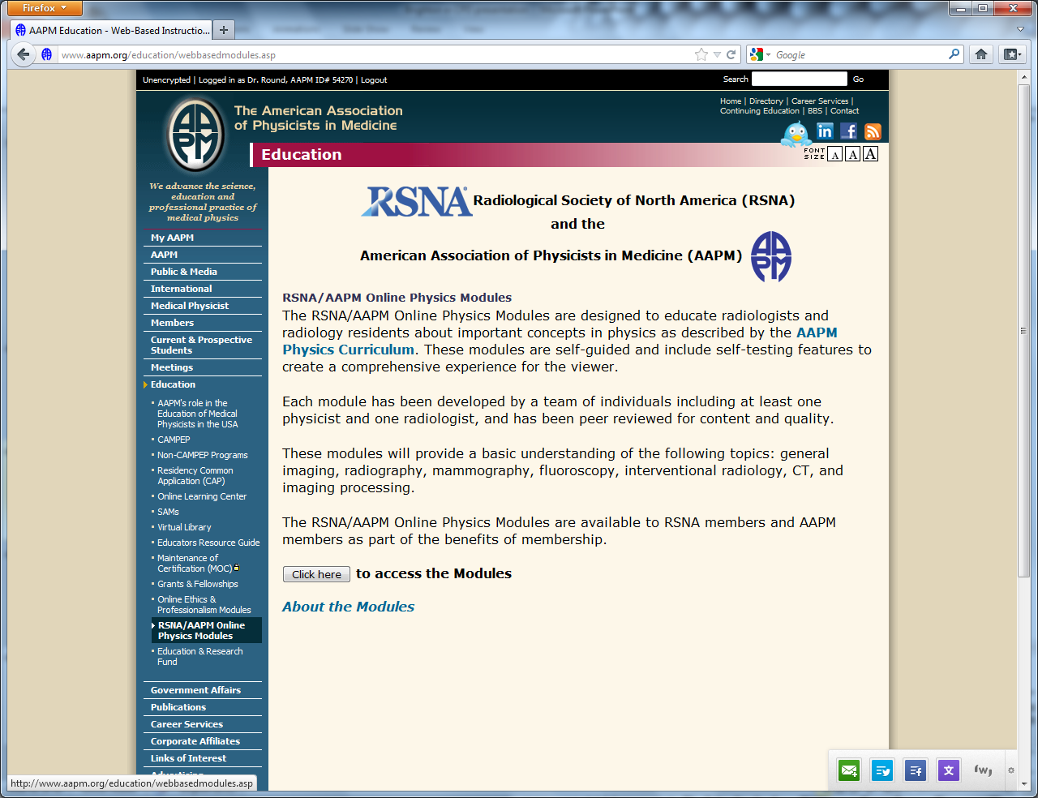

Slide 24
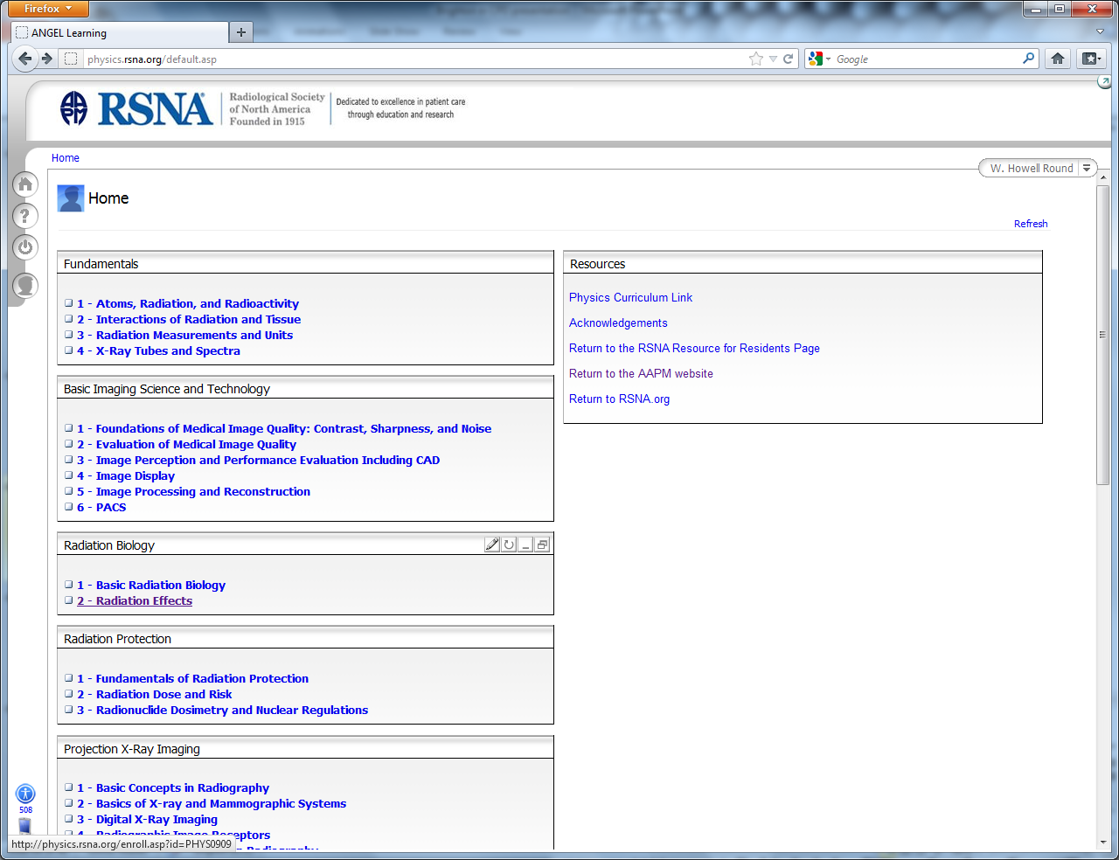

Slide 25
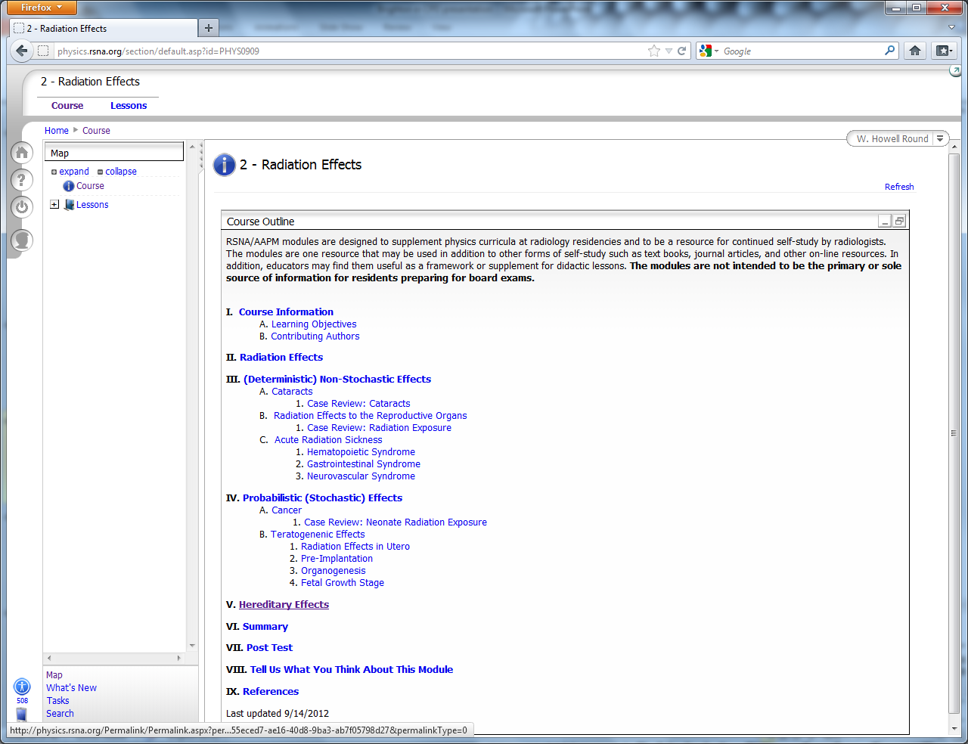

Slide 26
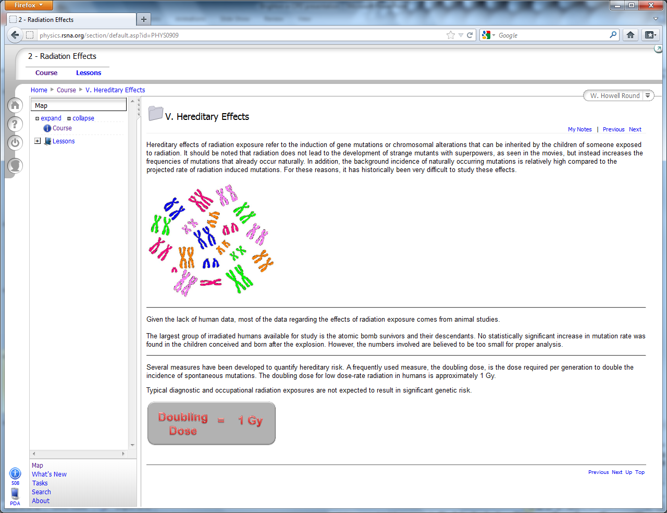

Slide 27
Conference & Workshop Recordings/Proceedings

Slide 28
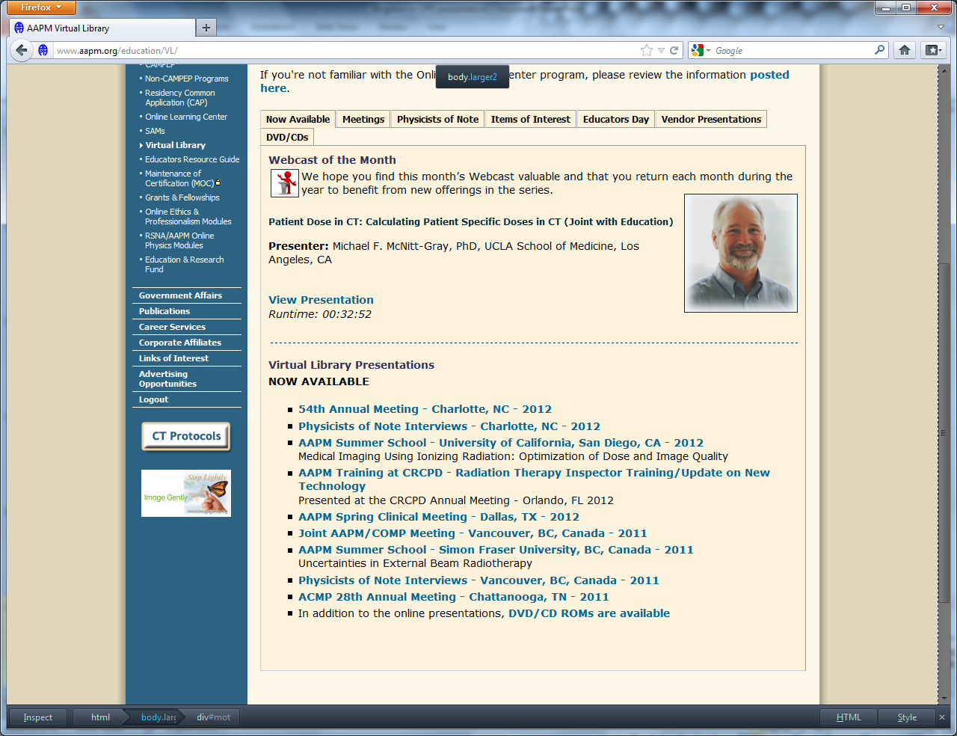

Slide 29
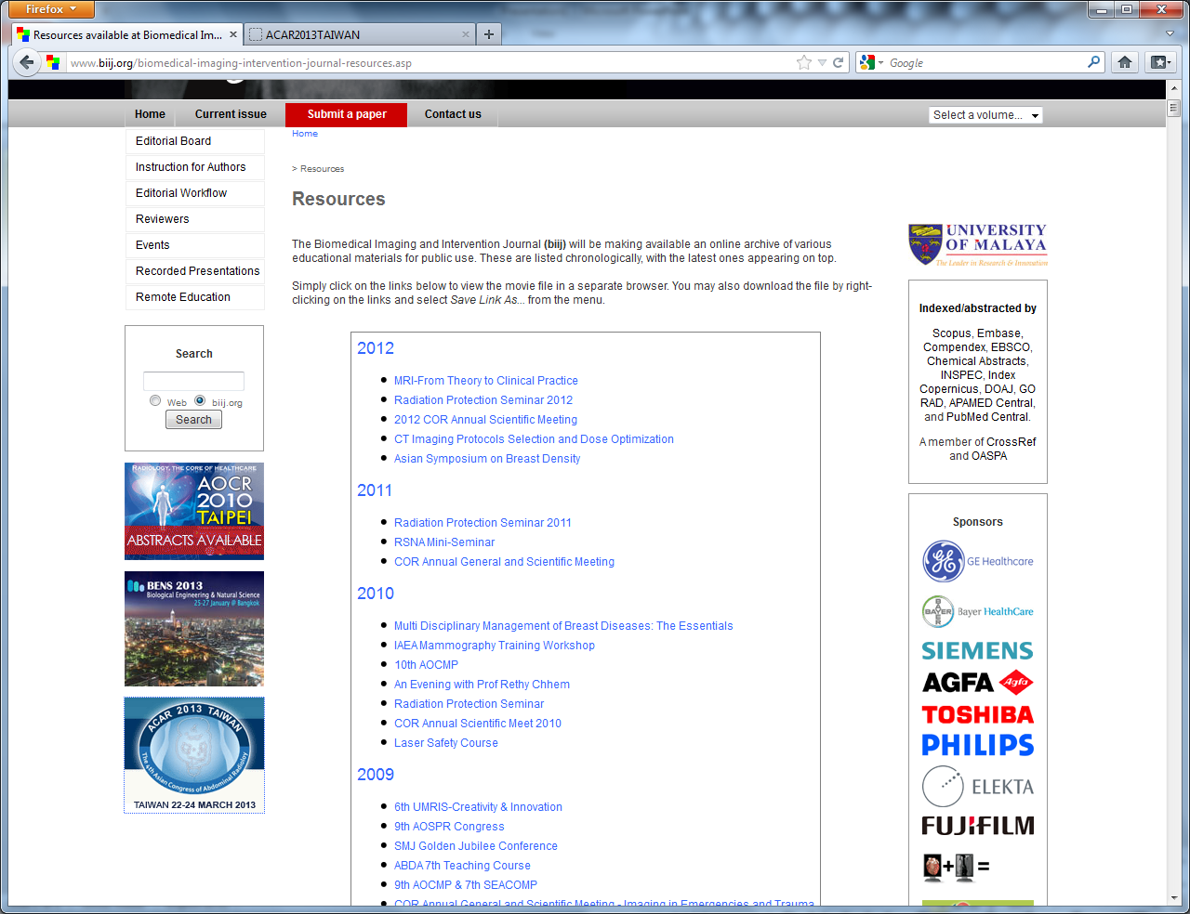

Slide 30
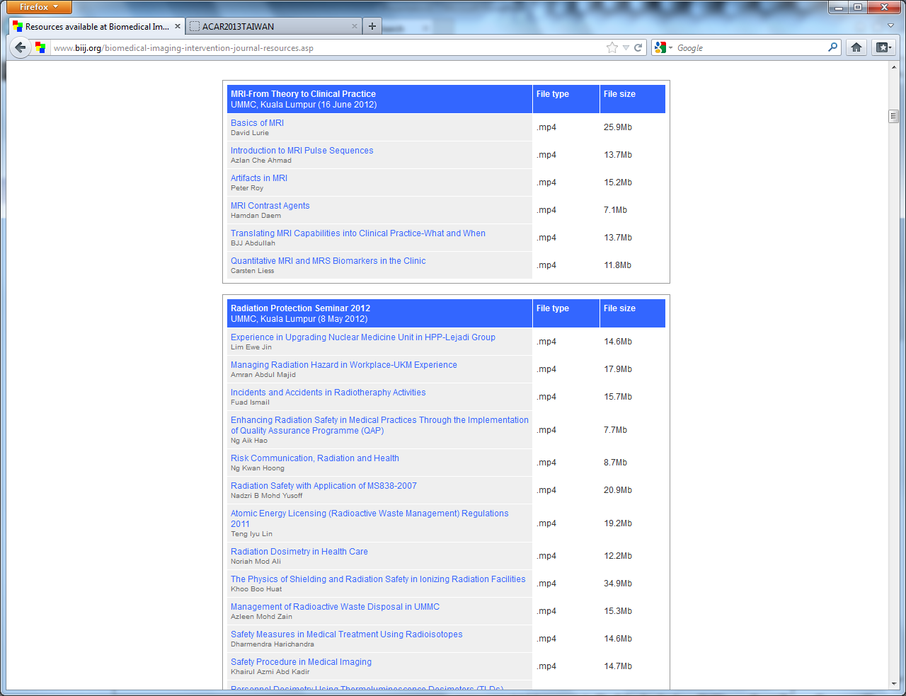

Slide 31
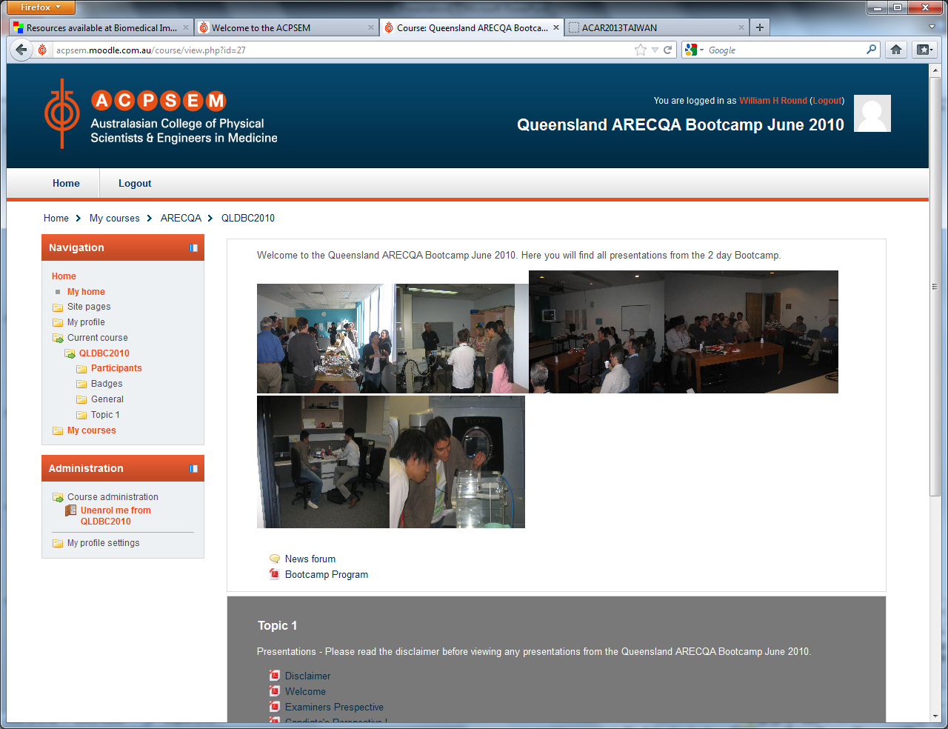

Slide 32
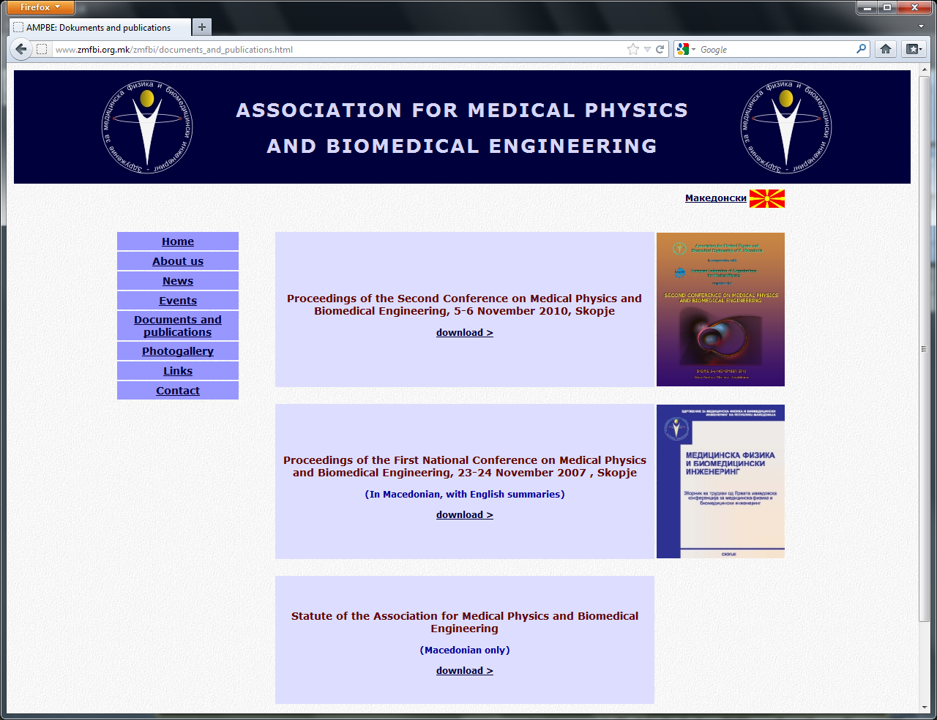

Slide 33
Webinars

Slide 34
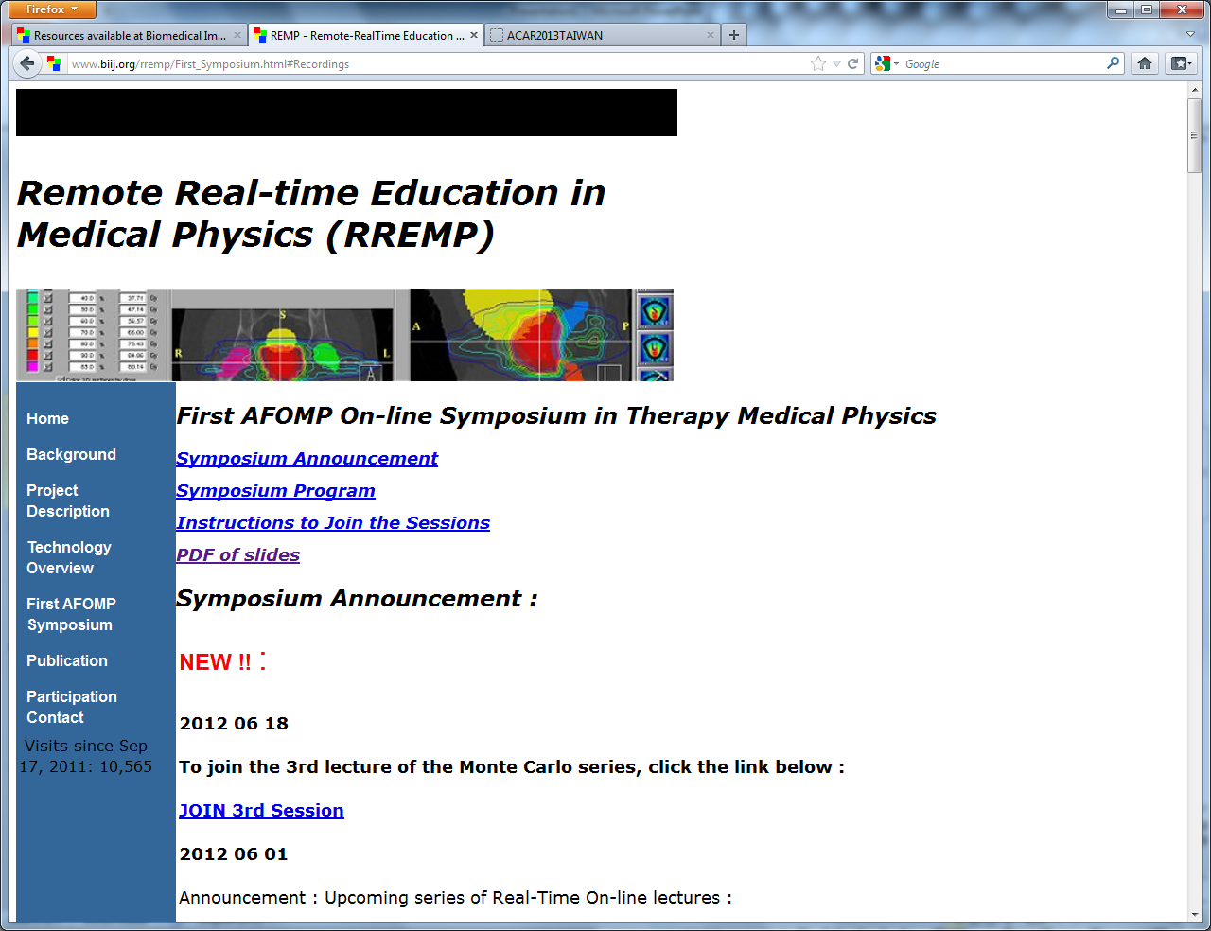

Slide 35
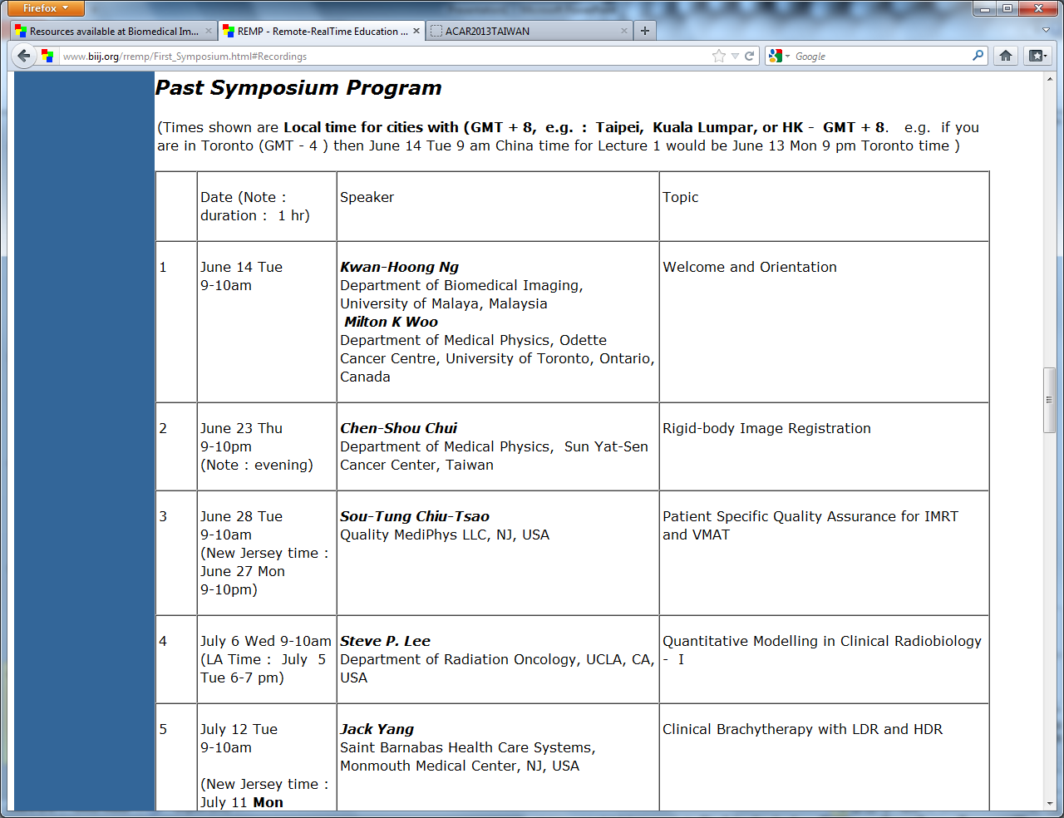

Slide 36
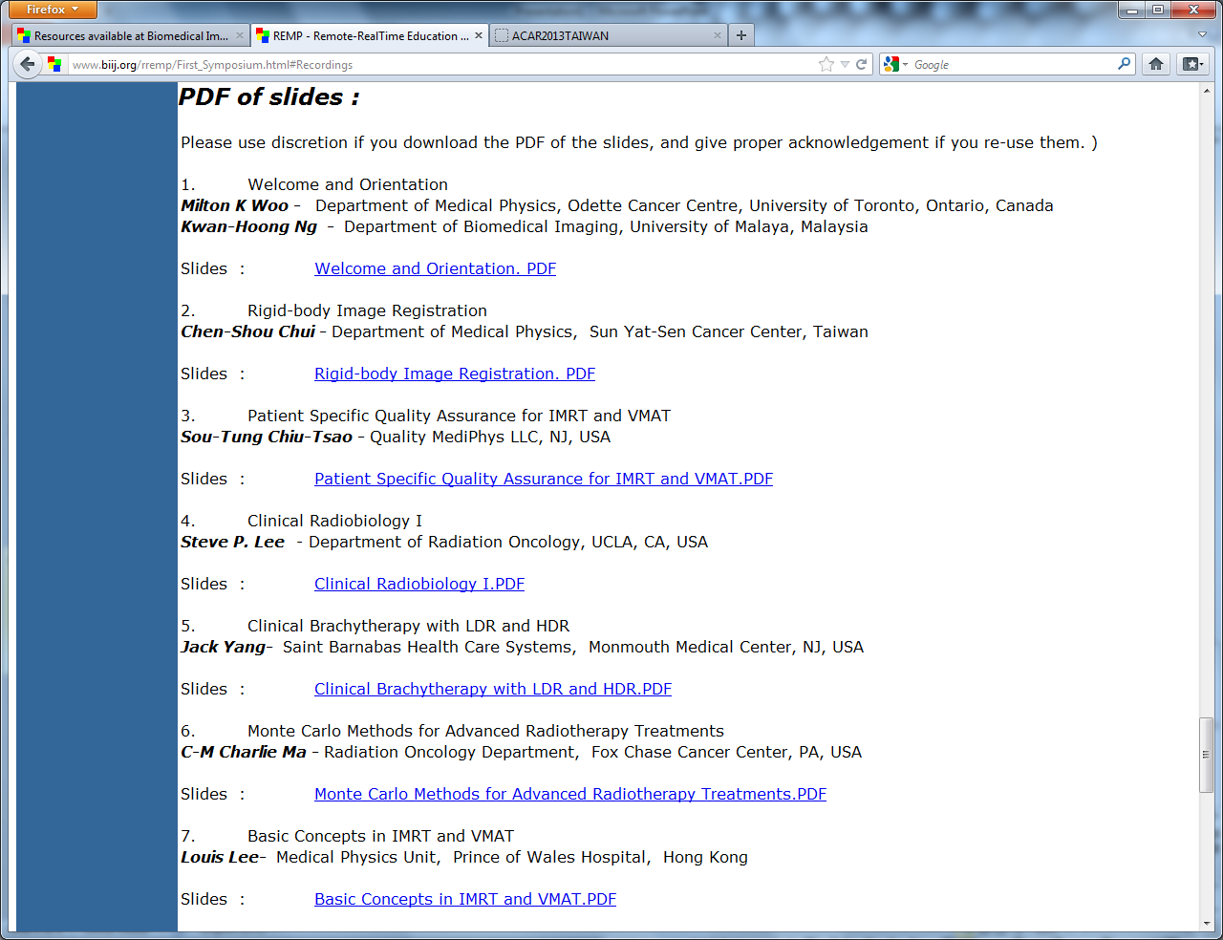

Slide 37
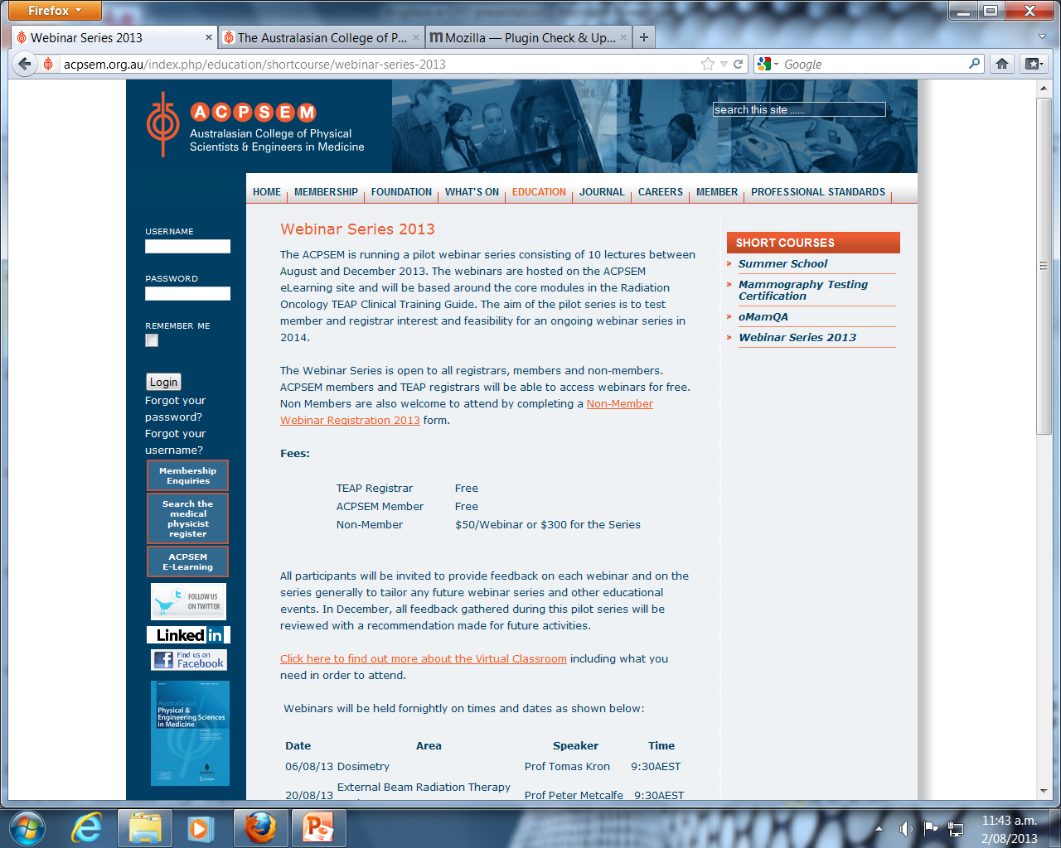

Slide 38
Access issues
Scattered around the web
  Mostly exists on just a few sites
No central directory
  How do you find out what is available?
Restrictions on who can access
  Often only to medical physics society members (even for newsletters!)
  Access for fee for non-members
  If you can’t check it out, how do you know if it’s what you want?

Slide 39
Access issues
Language
  Sometimes in local language
  On-line translators do not translate everything on a page
  On-line translations can be poor

Slide 40
Concluding remarks
Medical physicists have an ethical duty to keep their CPD
up-to-date to ensure that they are competent to practice
As it is a safety issue, we must aim to make material
  Available for zero cost
  Easy to find
  Easy to access
  User-friendly
  Comprehensive
  Record all conferences and workshops
  In all languages

Slide 41
Thank You

