Slide 1
Truth as a cultural value
Jeremy Wyatt

Slide 2
Plan for the talk
My main aims during the talk:
  To argue that truth is best described as a cultural, rather than a human, value
  To outline two ways in which truth’s status as a cultural value might shed light on the nature of truth

Slide 3
Sher’s value-first strategy
Sher offers an extended defence of the value theory of truth:
  (VT₁) Truth is an intrinsic human value
  (VT₂) Because truth is an intrinsic human value, humans have developed certain ‘truth norms’
  (VT₃) A truth-bearer is true iff it satisfies the truth norms
Underlying the value theory is a novel strategy for thinking about truth’s nature
According to this strategy: we should first observe that truth is an intrinsic human value and then develop an account of truth’s nature on the basis of this observation
  Call this the value-first strategy

Slide 4
Sher’s value-first strategy
My root concern with Sher’s implementation of the value-first strategy is that it fails to reflect cultural variation in attitudes towards truth
When we account for this variation, we come to see that:
  Truth is best described as a cultural, rather than a human, value;
  What Sher calls ‘truth norms’ likely vary across cultures; and thus
  The value-first strategy motivates some underexplored ideas about truth’s nature

Slide 5
Attitudes towards truth: cultural variation
Regarding (VT₁): we can set aside the issue of whether truth is an intrinsic or extrinsic value, focusing on whether truth is a human value
Sher’s proposal: truth is a human value in the sense that valuing truth has been “enshrined by our civilization as indicative of our humanity” (2024, p. 8)
  Sher’s construal of what valuing truth involves: “[w]hat is valuable is certain truth-attitudes/behavior by humans. It is valuable that we be truthful, that we pursue truth in inquiry, that we regard truth as a value that is constitutive of our humanity” (ibid.)
  ‘Our civilization’ is meant to include “all geographical regions where humans live and a very long swath of history, say, from ancient Mediterranean and Eastern cultures to the present day” (ibid.)

Slide 6
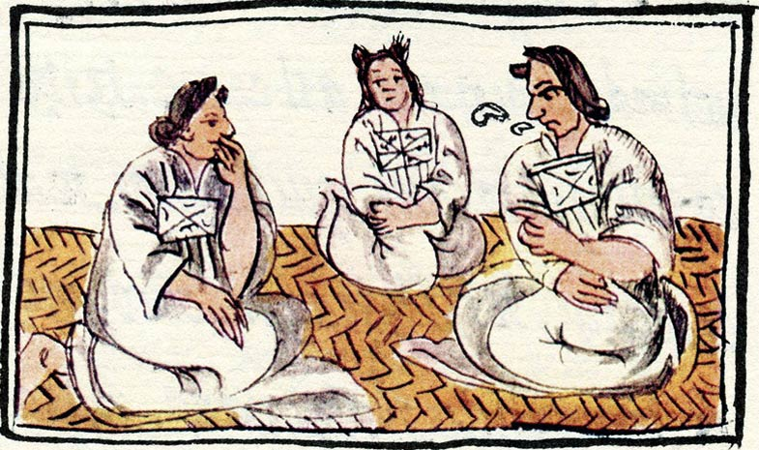
Attitudes towards truth: cultural variation
There are at least two case studies that raise concerns for the proposal that truth is a human value
Case study #1: the sixteenth-century Nahua people
  James Maffie has discussed the Nahuatl word neltiliztli, which is standardly translated as ‘truth’
  He offers several arguments against this standard translation, and proposes instead that neltiliztli should be translated as “well-rootedness-cum-alethia” (2002, p. 75)
‘Nahuatl women, composers of songs’; Florentine Codex Book X

Slide 7
Attitudes towards truth: cultural variation
Maffie’s proposed translation of neltiliztli incorporates the Nahua concept of teotl
  Teotl is meant to be a “single, vital, dynamic, vivifying, eternally self-generating and self-conceiving as well as self-regenerating and self-reconceiving sacred energy or force” (ibid.)
According to Maffie’s translation: for neltiliztli to apply to a cognition or utterance, the cognition/utterance must be “well rooted in teotl and…that through which teotl discloses itself” (2002, p. 80)

Slide 8
Attitudes towards truth: cultural variation
In short: Maffie argues that translating neltiliztli as ‘truth’ seriously misrepresents the meaning of neltiliztli
  He also holds that there is no other Nahuatl word which should be translated into English as ‘truth’
For these reasons: Maffie concludes that we should take the Nahua to have lacked a concept of truth
(For an alternative analysis of neltiliztli, see McLeod (2023, pp. 60-73))

Slide 9
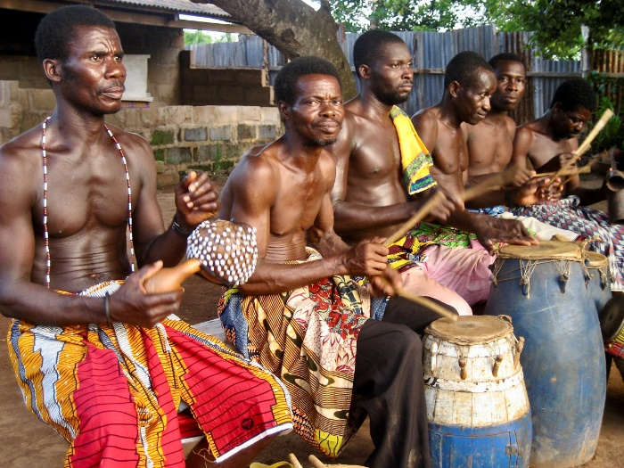
Attitudes towards truth: cultural variation
Case study #2: The Ewe people of West Africa
  N.K. Dzobo (1992) identifies four concepts that are in use by present-day Ewe and can be reasonably described as ‘truth concepts’
Dzodze Drummers, image by Brian Jeffery

Slide 10
Attitudes towards truth: cultural variation
The first is expressed by nyatefe, which Dzobo identifies as the most common translation of ‘truth’ into Ewe
“[T]ruth as nyatefe…consists in a high degree of correspondence between the truth-claim and the objective state of affairs so stated; its validity also lies in its high degree of accuracy and reliability” (1992, p. 80)
  In this way: the truth concept expressed by nyatefe is a correspondence concept

Slide 11
Attitudes towards truth: cultural variation
The second Ewe truth concept is expressed by the terms nyanono/nyano, nyagbagbe, and nyagba
  Broadly speaking: according to this concept, the truth of an idea consists in “its power to bring about a better human situation and continuously to improve the conditions of life” (1992, p. 81)
  This truth concept can be fairly described as pragmatist

Slide 12
Attitudes towards truth: cultural variation
The third Ewe truth concept is expressed by nyadzodzoe
  According to this concept: true statements are ‘straight,’ or correct, in the sense that they are supported by statements that have already been accepted as correct
  Dzobo points out that this concept is often used when two or more people are trying to settle a dispute (1992, p. 82)

Slide 13
Attitudes towards truth: cultural variation
The fourth Ewe truth concept is expressed by anukware (this word is borrowed from the Ghanaian language Akan, in which it is spelled nokware)
  According to this concept, the truth of a statement made by a particular person consists in the statement’s consistency with other statements that they have made
  In this way: this concept takes truth to consist in a kind of coherence (1992, pp. 82-3)

Slide 14
Attitudes towards truth: cultural variation
These case studies raise two concerns for the proposal that truth is a human value
Concern #1: If the Nahua lacked a concept of truth, then they didn’t take valuing truth to be constitutive of humans’ humanity
  Indeed: the Nahua would have lacked any attitudes whatsoever towards valuing truth
  From this, it follows that truth is not a human value
Concern #2: If the Ewe use more than one truth concept, then suggesting that they take ‘valuing truth’ to be constitutive of humans’ humanity obscures the complexity in their thought about truth
  Instead: an Ewe person’s attitudes towards ‘valuing truth’ will be about different practices in different contexts, depending upon which truth concept they use in a given context
In light of these considerations: it seems preferable to describe truth as a culturally-specific—or more briefly, a cultural—value

Slide 15
Culture and truth norms
Turning to (VT₂): Sher holds that because truth is an intrinsic human value, humans have developed certain truth norms
The truth norms are meant to guide and constrain our knowledge-gathering practices and to include (2024, p. 14):
  (N1) Our theories/sentences about the world should attribute to the world, or to objects in the world, properties it/they have, rather than properties it/they do not have
  (N2) Search for truth. Not just for truths whose knowledge provides material benefits, but for truths which provide knowledge for its own sake. In particular, search for significant truths. Be willing to expand your energy, effort, and resources on searching for such truths
  (N3) Search for effective routes of correspondence. Be willing to replace the standard routes of reference and correspondence by new, innovative routes, according to need

Slide 16
Culture and truth norms
My concern with (VT₂) is that since truth appears to be a cultural value, it is unlikely that there is a single set of ‘truth norms’ that applies across all cultures
If the Nahua lacked a concept of truth, then we can safely infer that they did not value truth
  Moreover: if they did not value truth, then the Nahua wouldn’t have developed any truth norms
If the Ewe use four truth concepts, then it is likely that they have developed distinct sets of truth norms that respectively incorporate these concepts
  For instance: if the Ewe have developed norms like (N1) and (N3), then these norms presumably incorporate the correspondence concept expressed by nyatefe
  By contrast: (N1) and (N3) won’t incorporate the non-correspondence concepts expressed by nyanono/nyano, nyagbagbe, and nyagba; nyadzodzoe; and anukware
  Instead: the latter concepts will presumably be incorporated into a set(s) of non-correspondence-theoretic truth norms

Slide 17
Culture and truth’s nature
Finally: let us consider (VT₃), relabeled as follows:
  (T) A truth-bearer is true iff it satisfies the truth norms
As she takes the truth norms to be (partly) correspondence-theoretic, Sher argues via (T) that truth consists in (direct or indirect) correspondence
However: given that truth is a cultural value, the value-first strategy actually motivates some underexplored ideas about truth’s nature
These can be developed in at least two ways: (i) as a novel form of alethic pluralism or (ii) as a view that is inspired by some remarks from Alfred Tarski

Slide 18
Cultural alethic pluralism
In essence: alethic pluralism is the view that there is more than one way for a truth-bearer to be true (Pedersen and Wright 2018)
Pluralists standardly hold that the various ways of being true fragment across domains
  For instance: perhaps a proposition about the boiling point of water is true iff it corresponds to physical reality
  By contrast: a proposition about the moral importance of human rights is true iff it coheres with a particular body of moral and non-moral propositions

Slide 19
Cultural alethic pluralism
The value-first strategy can be naturally paired with a novel variety of alethic pluralism
According to this view: the various ways of being true fragment both across cultures and across contexts that are occupied by members of a single culture
  This view might be called cultural alethic pluralism

Slide 20
Cultural alethic pluralism
We’ve seen that we have reason to believe:
  That humans in some cultures (e.g. the Nahua) have not developed truth norms of any sort and
  That humans in other cultures (e.g. the Ewe) have developed multiple sets of truth norms, each of which is applicable in certain contexts
In light of this, the cultural alethic pluralist proposes that we rephrase Sher’s (T):
  (T^{P}) A truth-bearer x is true in culture R and context C iff (i) there is a set of truth norms N that is used by members of R in C and (ii) x satisfies N

Slide 21
Cultural alethic pluralism
In cultures like that of the Nahua, condition (i) fails to hold
As a result: (T^{P}) generates a striking consequence—that in cultures of this sort, there are no true truth-bearers
In other words: (T^{P}) entails that the theory of truth that applies in such cultures is alethic nihilism (see Gamester (2023) and Liggins (2019, forthcoming))

Slide 22
Cultural alethic pluralism
(T^{P}) also entails that in cultures like that of the Ewe, there are multiple ways for a truth-bearer to be true
In such cultures: people use truth norms N₁ in context C₁, N₂ in context C₂, and so on for all of the sets of truth norms N_{i} used by members of the culture
  This means that in such cultures, a truth-bearer x can be true in virtue of satisfying N₁ in C₁, satisfying N₂ in C₂, …, or satisfying N_{i} in C_{i}

Slide 23
Cultural alethic pluralism
It is also possible that there is a third sort of culture whose members have developed exactly one set of truth norms N which are meant to apply in any context
(T^{P}) entails that in cultures of this sort, a truth-bearer x is true iff x satisfies N

Slide 24
Cultural alethic pluralism
Types of culture | Truth-conditions within cultures
Culture R₁ that has developed no truth norms | None; there are no true truth-bearers in R₁
Culture R₂ that has developed a single set N of truth norms | Truth-bearer x is true in R₂ iff x satisfies N
Culture R₃ that has developed distinct sets N₁, N₂, …, N_{i} of context-specific truth-norms | Truth-bearer x is true in R₃ iff x satisfies N₁ in C₁, satisfies N₂ in C₂, or …, or satisfies N_{i} in C_{i}
Table 1: Cultural alethic pluralism

Slide 25
A Tarskian option
However, some might urge on the following grounds that cultural alethic pluralism is simply a bridge too far:
  It is sensible enough to grant that members of different cultures have used different truth concepts and may have even lacked truth concepts altogether
  It is also sensible to grant that which truth norms people develop is partially determined by the truth concepts that are used within their cultures
  However: the idea that the conditions that must be satisfied for a truth-bearer to be true are indexed to culture is simply incomprehensible

Slide 26
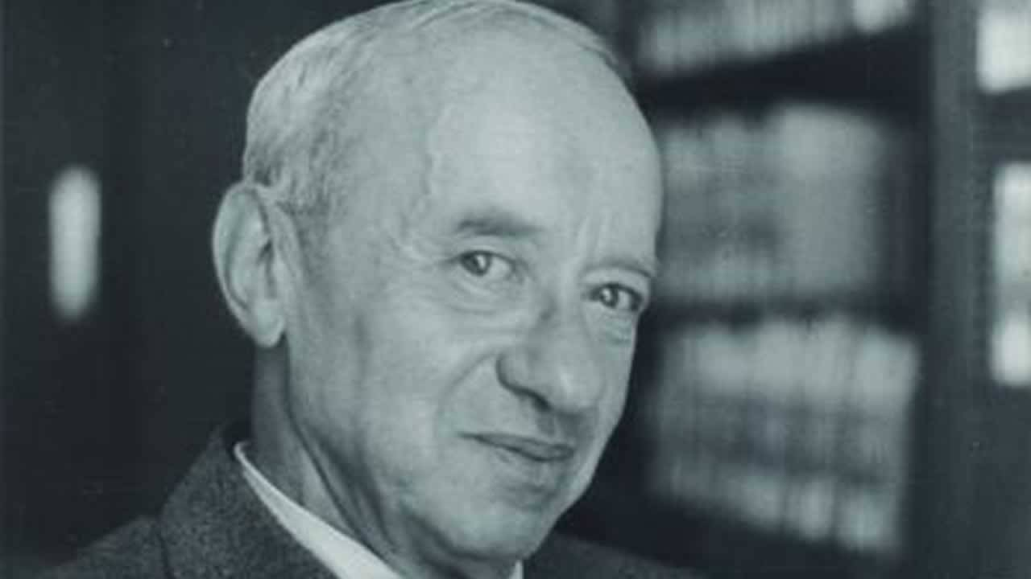
A Tarskian option
Given this concern, it is worth noting that an adherent of the value-first strategy has a second option regarding truth’s nature
This option is grounded in remarks that Tarski offers in a different setting:
“We should reconcile ourselves with the fact that we are confronted, not with one concept, but with several different concepts[.] [W]e should try to make these concepts as clear as possible (by means of definition, or of an axiomatic procedure, or in some other way); to avoid further confusions, we should agree to use different terms for different concepts; and then we may proceed to a quiet and systematic study of all concepts involved, which will exhibit their main properties and mutual relations.” (Tarski 1944, p. 355)

Slide 27
A Tarskian option
The Tarskian idea here is that instead of indexing truth to culture and context as in (T^{P}), we should simply “agree to use different terms for different concepts”
In doing so: we would adopt a theory of truth that incorporates multiple variants of Sher’s (T)
Let the truth norms be the truth-theoretic epistemic norms that guide and constrain the knowledge-gathering practices of those who use the word ‘truth’
  Define the nyatefe norms, the nyanono norms, etc. along similar lines
The resultant theory of truth would then contain biconditionals such as:
  (T₁) A truth-bearer is true iff it satisfies the truth norms
  (T₂) A nyatefe-bearer has nyatefe iff it satisfies the nyatefe norms
  (T₃) A nyanono-bearer has nyanono iff it satisfies the nyanono norms

Slide 28
A Tarskian option
Unlike cultural alethic pluralism, this Tarskian view doesn’t commit us to saying that the conditions for being true are indexed to culture
Whether this is ultimately an advantage or a cost is a question that I leave open

Slide 29
Conclusions
Main conclusions:
  Truth is best described as a cultural, rather than a human, value
  For this reason: it is likely that people in different cultures have developed different sets of ‘truth norms’
  In light of this: Sher’s value-first strategy compels us to seriously consider both cultural alethic pluralism and a Tarskian account of truth which uses “different terms for different concepts”

Slide 30
Kia ora!

