Slide 1
Commonsense, Coercions of Logic, and the Death Drive:
Responding to Reviews of In Search of Responsibility as Education
Marta Estellés, University of Waikato, New Zealand
AAACS Conference
Philadelphia, April 2024

Slide 2

Notes:
This documentary is a perfect example of what common sense is from an Bourdieaun perspective. Not because of the particular content (even though unfortunately many of us have grown in similar beliefs) but because it clearly shows how our sense of judgement cannot be dissociated from our socialisation experiences.

Slide 3

Common sense
“a stock of self-evidences shared by all, which…ensures a primordial consensus on the meaning of the world, a set of tacitly accepted commonplaces which make confrontation, dialogue…possible and among which a special place must be reserved for the principles of classification” (Bourdieu, 2000, p. 98).
All forms of power required consent/legitimacy and common sense is a battleground where this conformity is disputed.
Notes:
Bourdieu defines common sense as “a stock of self-evidences shared by all, which…ensures a primordial consensus on the meaning of the world, a set of tacitly accepted commonplaces which make confrontation, dialogue…possible and among which a special place must be reserved for the principles of classification” (Bourdieu, 2000, p. 98).
Principles of classification/division organize the image of the social world and where we sit in the world, what are the problems, etc. all these questions which are accepted as self-evident by a group (rich and poor)
So this understanding of common sense is radically different to Arendt’s one because of its social dimension and, therefore, its connection with power. Bourdieu saw power as culturally and symbolically created, and constantly re-legitimised through an interplay of agency and structure. Because of that interplay between agency and structure, all forms of power…
Unfortunately,

Slide 4
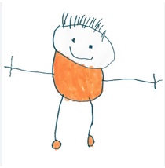
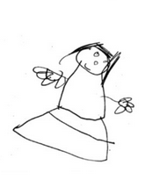
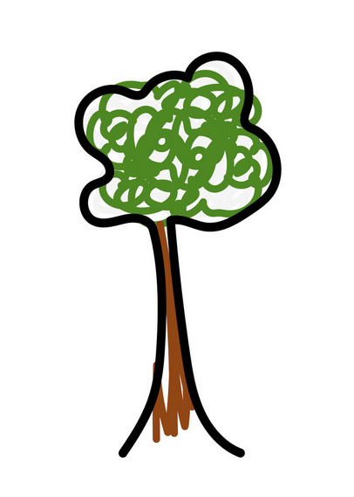
Notes:
Unfortunately, the documentary didn’t ask kids what they think about climate change. I couldn’t help myself and I ask my favourite neighbours Noah and Summer (5yo) on their solution to climate change: tree planting (similar results in Hayward’s book and other studies with children). This, however, is not a natural or intuitive response

Slide 5


Slide 6
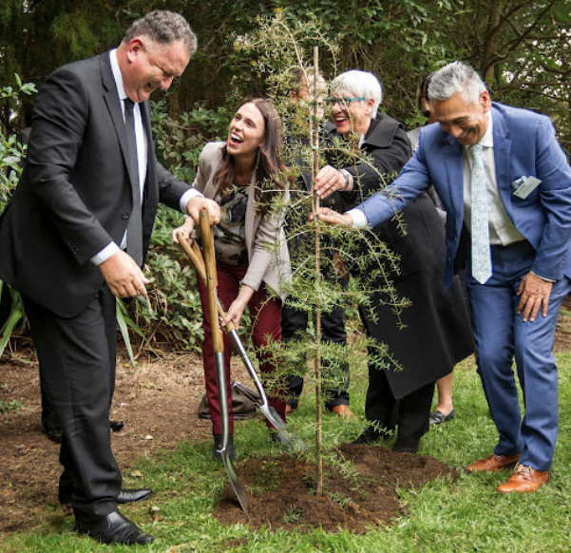
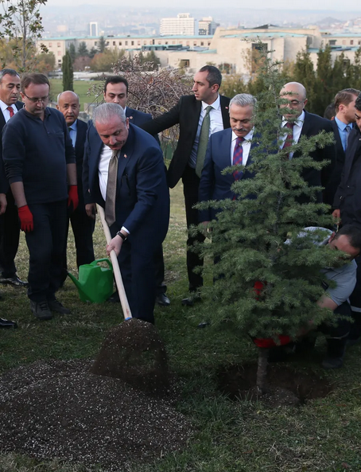
Notes:
Politicians all over the world (from very different ideological perspectives –e.g., Ardern and Erdogan) have introduced plans to plant trees (some more successful than others)

Slide 7
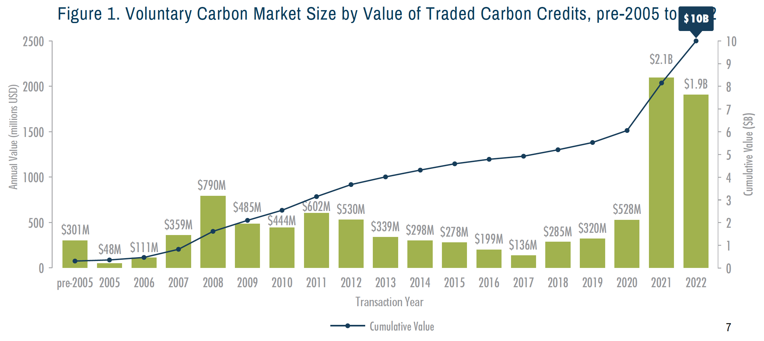
Notes:
Growing industry of carbon offsetting, which allows several industries keep business as usual

Slide 8
“Because of climate change, we all should eat less meat”
disagree
AGREE
Notes:
Another example from NZ. In my social studies classes at ITE, I use this sentence as a controversial issue to discuss. There was no controversy: all of the students disagree, except one that was in the middle. I forgot that NZ’s biggest industry was farming

Slide 9
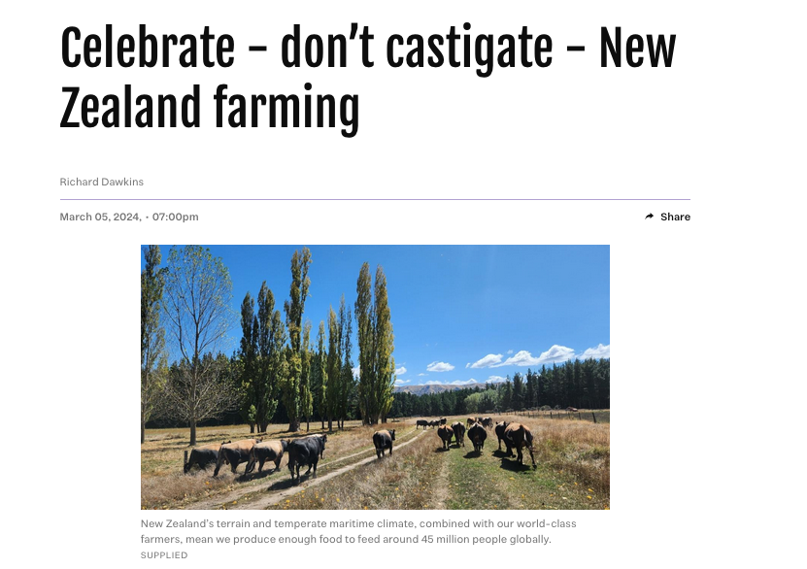
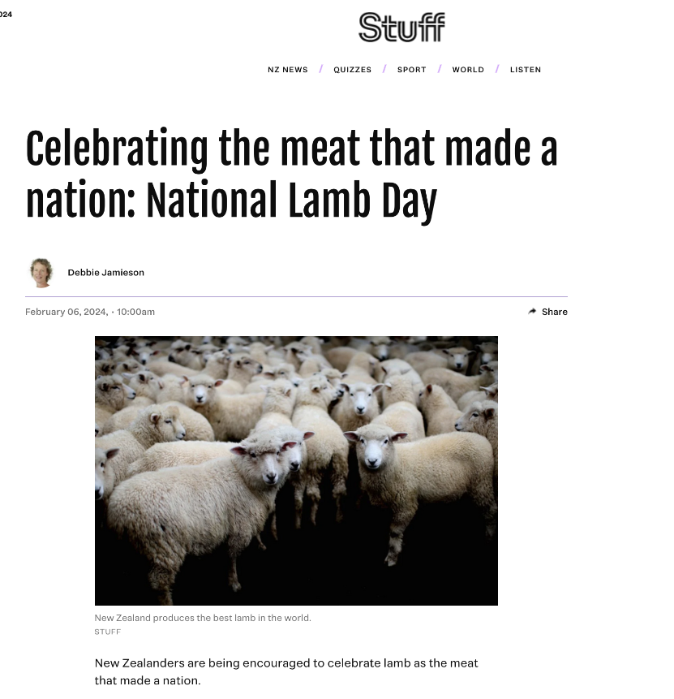

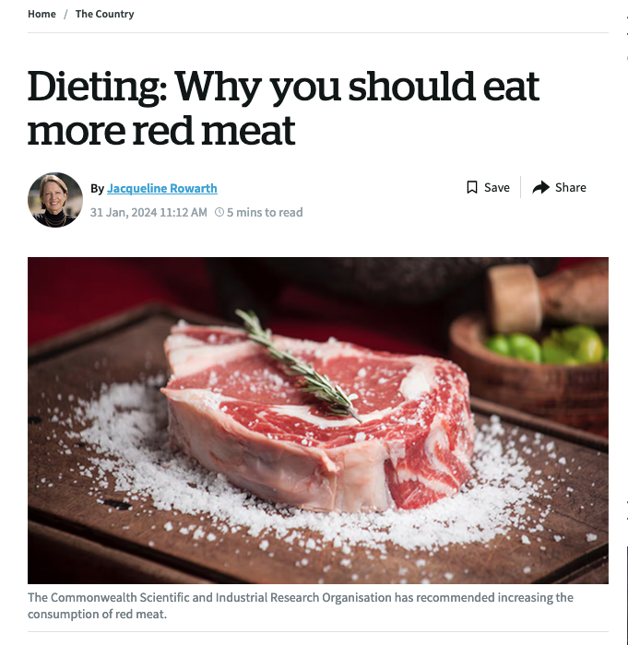
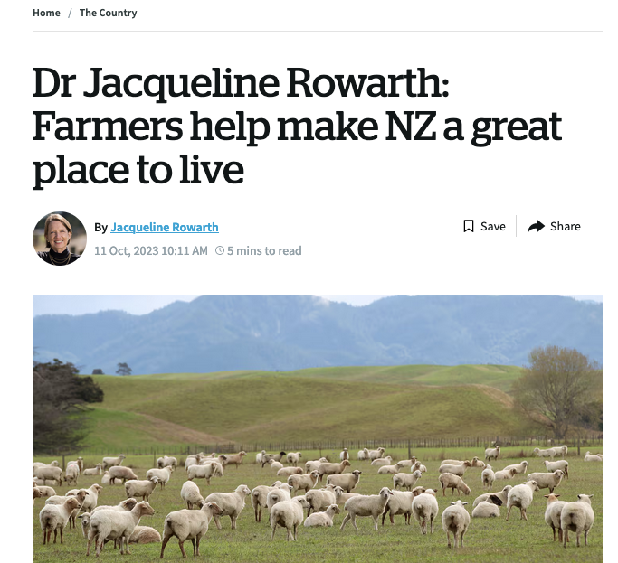
Notes:
Some NZ media portayals of farming/eating meat

Slide 10
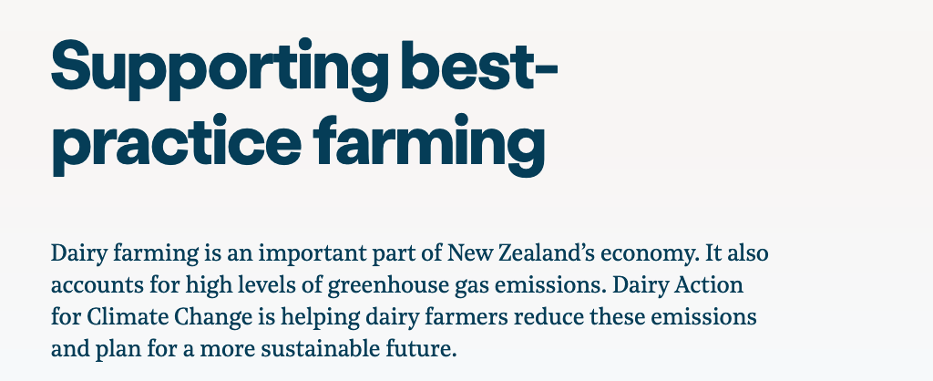
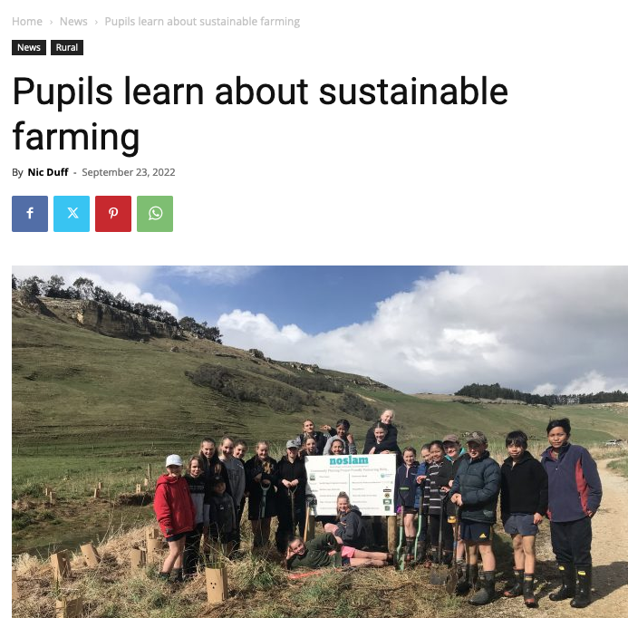


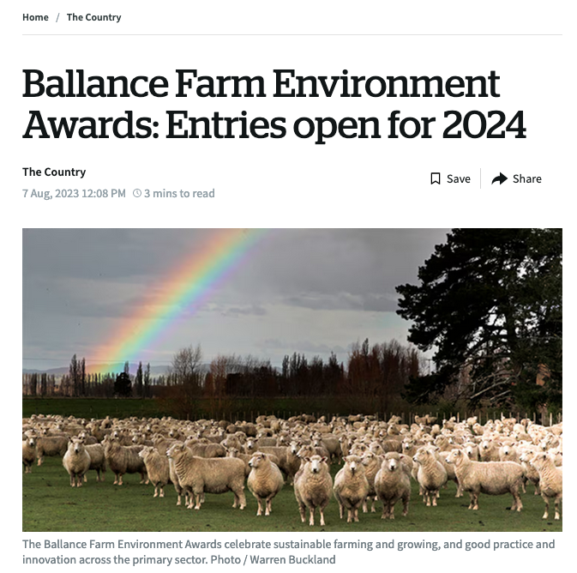
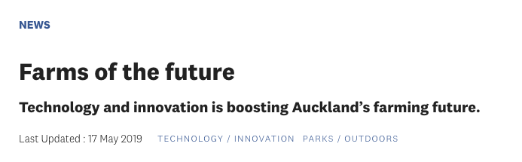
Notes:
The common sense from a policy perspective is ‘sustainable farming’. See these plans

Slide 11
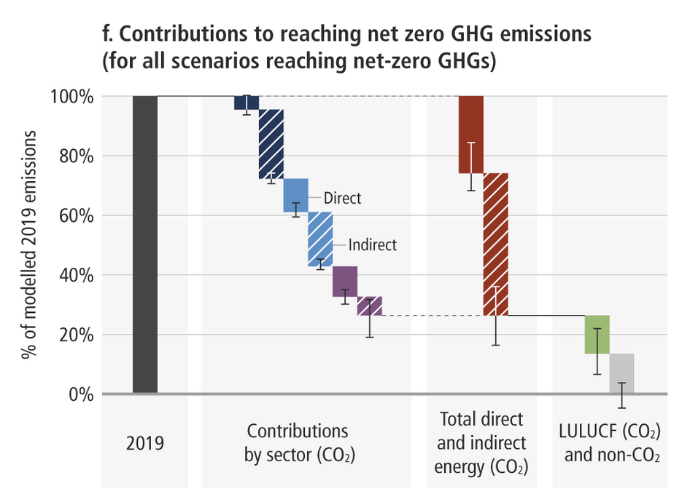
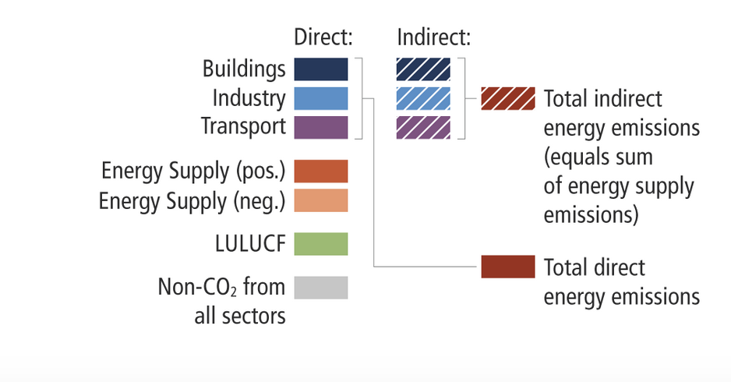
“Self-evident” responses to climate change
They embrace a ‘Third way approach’, which assumes the ‘inevitability’ of capitalism (Snyder, 2019) and dissuade individuals from engaging in radical projects of responsibility
They are shaped by power
IPPC (2022)
Notes:
These are only two examples of ”self-evident” solutions to climate change. There are many more: using natural fibers instead of plastic, investment in renewal energies, technologies for carbon secuestration,
According to the IPPC, these solutions would only constitute around 10-15% of the carbon emissions required
What these examples of common sense “solutions” to climate change have in common is that they assume the inevitability of capitalism, they embrace a ‘third way approach’ which dissuade individuals from engaging in radical projects of responsibility
These responses hide that they are shaped by power
When Trump attacked Greta Thunberg for “her Anger Management problem”, it wasn’t only a mockery of a poor girl, it was an ideological battle and Greta has proven to have less resources available to turn her proposals into common sense

Slide 12
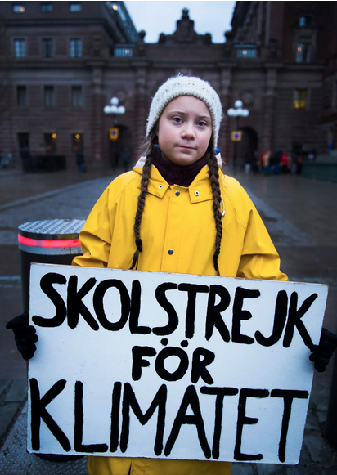
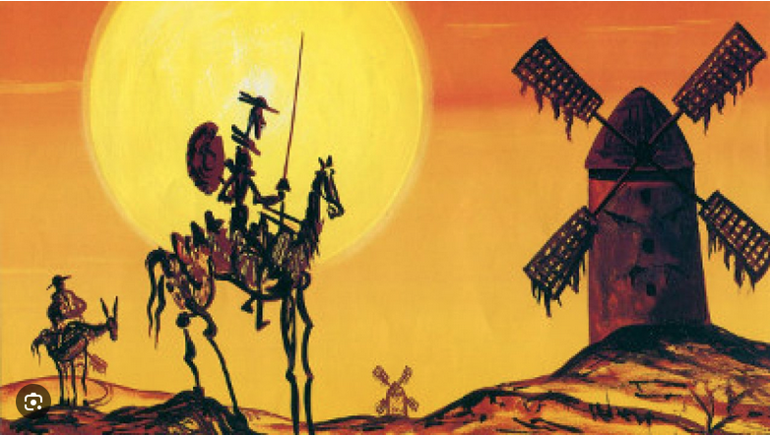
Curriculum against common sense
The potential of allegories (and their limitations)
Notes:
So I argue that we need a curriculum against common sense, a curriculum that allow us to question the effect of these responses and where these responses come from (ie., the powers driving them)
Hannah Spector in her book recommend the use of literature and particularly allegories as curriculum for crises that give us some common sense (which for Bourdieu would be the opposite),and while I see lots of potential on this and I have actually been tempted several times to use El Quixote as an allegory of Greta, a crazy person who at the end of the story is the only one who is sensible. The limit of allegories like this is that allegories might warn us about the effect of power, but not about its causes (where do these categories of being crazy come from, who has created and proliferated them)

Slide 13
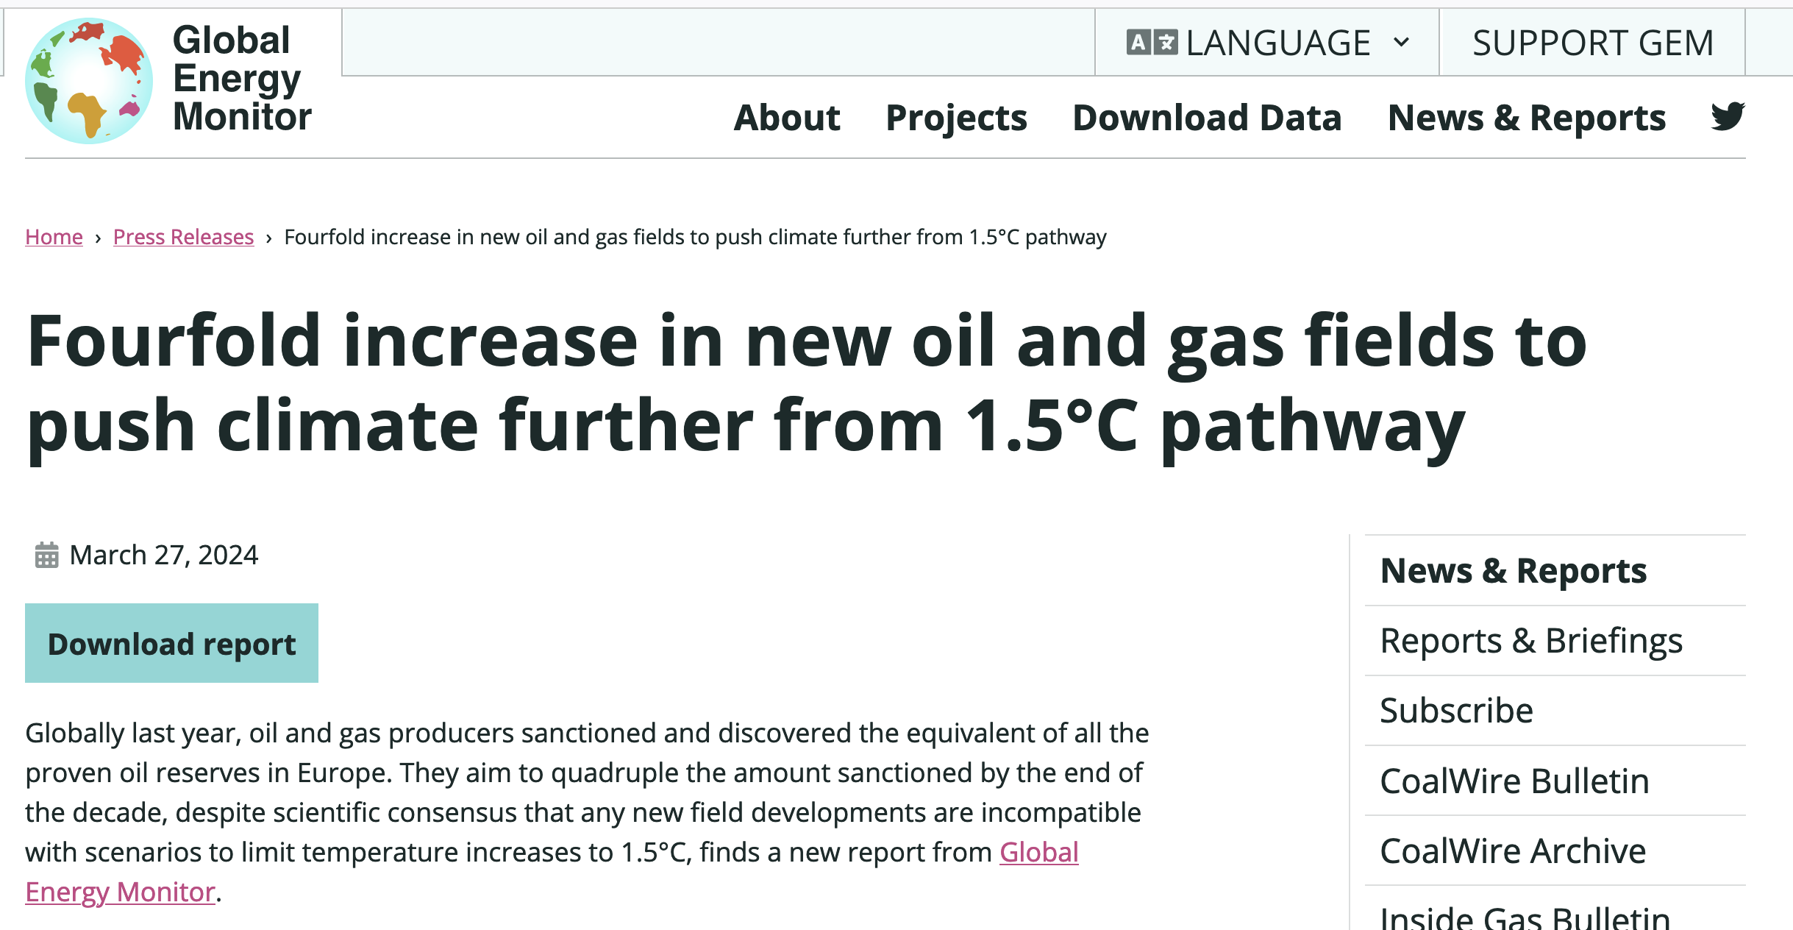
Notes:
Current current of climate change denials in the world is not independent from this increasing interest in oil and gas

Slide 14
A curriculum beyond common sense
Beyond raising consciousness:
“While making things explicit can help, only a thoroughgoing process of countertraining, involving repeated exercises, can, like an athlete’s training, durably transform habitus” (Bourdieu, 2000, p. 172)
Notes:
But as Bourdieu would say, it is not only about raising consciousness, we need a curriculum beyond common sense that countertrains our bodies to perhaps be more bored, less efficient, with less comfort, more wrinkles, but living more sustainable, respectful, fulfilling and responsible lives

Slide 15
references
Bourdieu, P. (2000). Pascalian meditations. Standford University.
Crary, J. (2022). Scorched earth. Verso.
IPCC, 2022: Climate Change 2022: Mitigation of Climate Change. Contribution of Working Group III to the Sixth Assessment Report of the Intergovernmental Panel on Climate Change [P.R. Shukla, J. Skea, R. Slade, A. Al Khourdajie, R. van Diemen, D. McCollum, M. Pathak, S. Some, P. Vyas, R. Fradera, M. Belkacemi, A. Hasija, G. Lisboa, S. Luz, J. Malley, (eds.)]. Cambridge University Press, Cambridge, UK and New York, NY, USA. doi: 10.1017/9781009157926
Snyder, T. (2019). The Road to Unfreedom. Penguin Books.
Spector, H. (2023). in search of responsibility as education traversing banal and radical terrains. Routledge.

