Slide 1
Violence Metaphors: A cognitive linguistic study of YouTube Breast Cancer Discourse in New Zealand and Pakistan
Sara Malik​
PhD in Linguistics
Andreea Calude and Joe Ulatowski
​
​
School of Psychological and Behavioural Sciences
and School of Law, Politics, and Philosophy
The University of Waikato

Slide 2
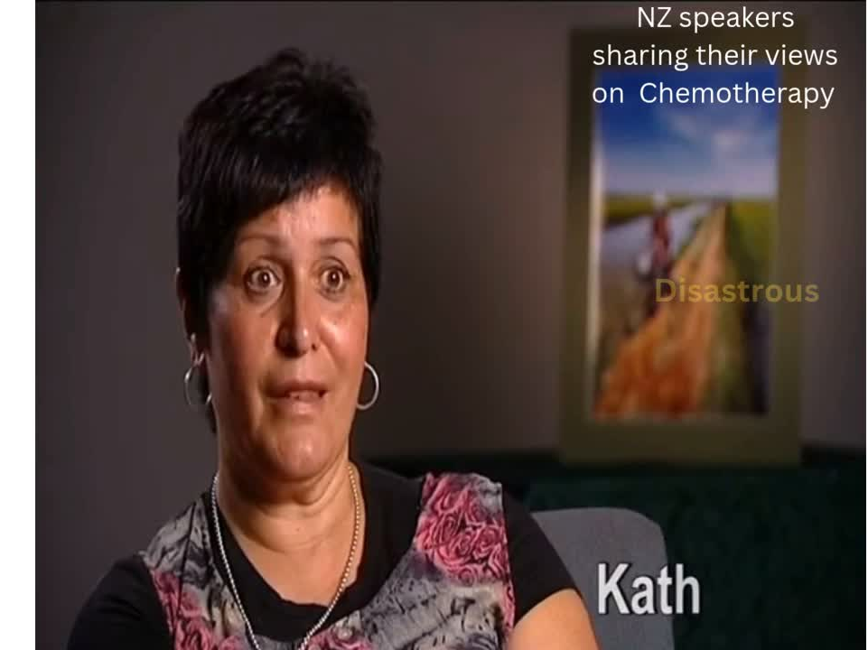
Notes:
https://www.canva.com/design/DAGoNz8Bg1A/9l6HYTcyJSZaos0nbAqm-w/edit

Slide 3
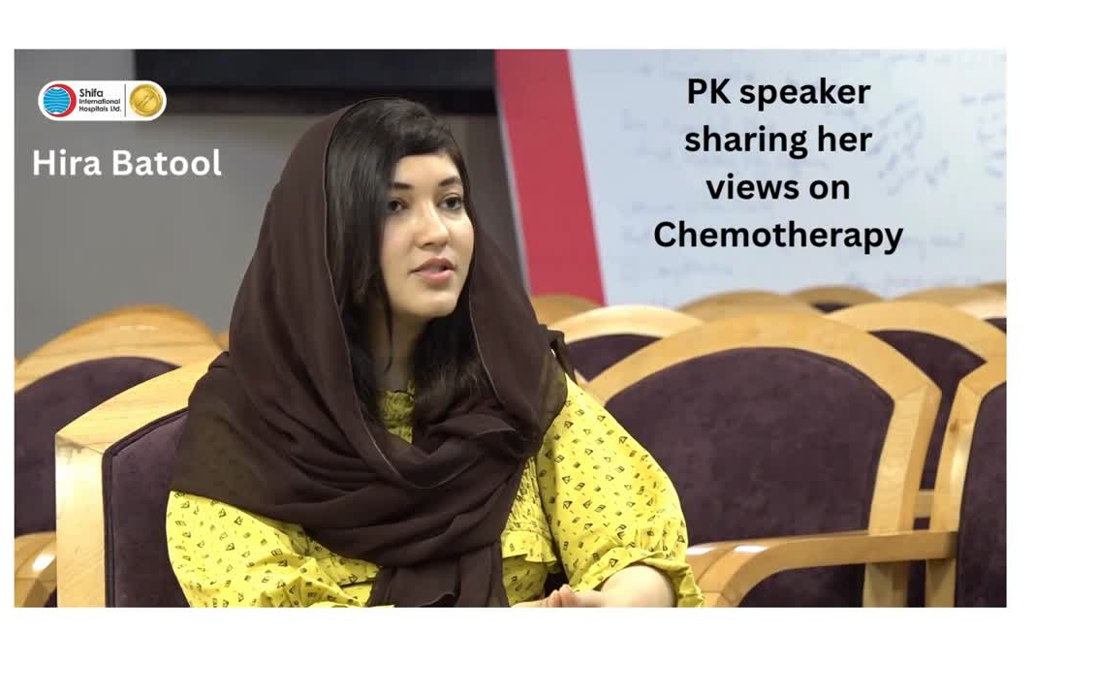
Notes:
https://www.canva.com/design/DAGoN0JjLT8/67qDIs6UlRTL2gXlK8Y_SQ/edit

Slide 4

Issue
Why it matters?
  Research largely takes a medical focus, overlooking thoughts and emotions.
  Studying thoughts and emotions reveal speakers’ experiences.
  Many of us know someone affected by this illness.
  Understanding their language helps us grasp their experiences more deeply.

Slide 5


Slide 6


Slide 7
Background of the Study
A metaphor helps us understand something unfamiliar by comparing it to something familiar.
  A part of the PhD research.
  Metaphors-the first linguistic feature studied in this study (others include pronouns, verbs and speech acts)​
Notes:
Metaphor is when we describe or understand something unfamiliar or abstract by relating it to something more familiar or concrete.

Slide 8


Focus of this presentation
  We use metaphors in everyday language.
  Breast cancer speakers use metaphors to express complex experiences.
  This study compares metaphor use across two countries, focusing on violence metaphors.

Slide 9






Metaphor and Illness
Semino et al (2018)
Gustafsson et al (2019)
Magaña & Matlock (2018)
They hit me with radiations for 10 days (p. 115 )
I will not give up! [...]. I will fight to the last drop of blood, and that’s it. (p. 270)
The battle began in 2005 (p. 632)
Notes:
Violence metaphor by semino
Gustafsson et al (2019) explored the same linguistic features in Swedish, studying the way in which Swedish bloggers use metaphors to present their experiences.
Magana and Matlock- Spanish breast cancer speakers

Slide 10


Data
Videos
Transcription
Various Speakers
  patients
  health professionals
  family members
  interviewers
  voiceovers
  other speakers
Whisper AI
  83 Total
  46 from NZ
  37 from PK
Transcription error correction

Slide 11
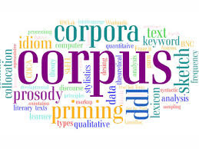

Data
Corpus Size
Narrrative topics
  36,241 words from NZ
  64,229 words from PK
  7 in NZ
  8 in PK

Slide 12

Narrative Topics
  Testing Phase
  Treatment Phase
  Remission Phase
  Family support
  Campaigns and awareness efforts
  Government support and funding
  General information
  Religious discourse

Slide 13
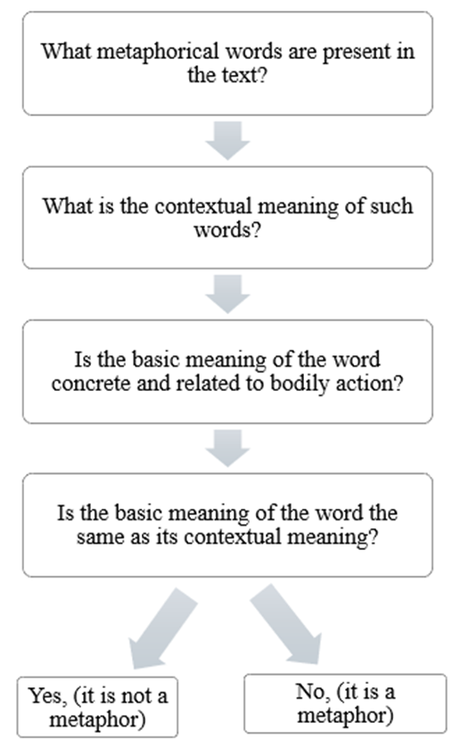
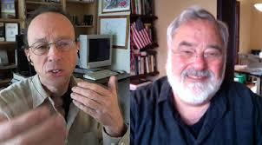
Methods
  Conceptual Metaphor Theory
  Qualitative Analysis
  Metaphor Identification Procedure (Pragglejaz Group, 2007)
  Use of Dictionaries
  Metaphor categories
MIP adapted from Pragglejaz Group (2007)
Notes:
Conceptual metaphors are based on the mappings between two conceptual domains, namely source and target domains. Source= concrete form of information (journey), target domain =abstract (life)
The New Zealand Oxford Dictionary
Feroz-ul- Lughat (Din, 2002)

Slide 14


Metaphors found in the study
Journey
  I was going through worst patches of [..]my treatment (NZ)
  Survivors ki bahut hard journeys hongi ‘survivors must have had very hard journeys’ (PK)
Violence
  Lymphedema can strike at any time (NZ)
  Ap ke saare ke saare cells maar deti hai ‘it (chemo) kills all of your cells’ (PK)
Container
  ..they take an area of fat and muscle out of your stomach and they literally bring it up the inside of your body.. (NZ)
  Nikalen, bahir phaink dain ‘take it out and throw it outside’ (PK)
Action
  ... that (reconstruction) would have been another thing to deal with (NZ)
  I had to deal with that (PK)

Slide 15

Violence Metaphors
  Terms representing any form of physical harm are categorized under ‘violence’ category. For example, hit, fight, aggressive, enemy, battle, strike, violent, kills, burns, devastating etc.
  Why violence but not battle metaphor?
  Extensions of violence metaphors.
Notes:
Because battle is an extension of violence metaphor. Violence is a broad category which also covers battle metaphor.

Slide 16

Research Questions
Are there any differences in the use of violence metaphors across various narrative topics?
What are the lexical variations in the choice of violence metaphors?

Slide 17
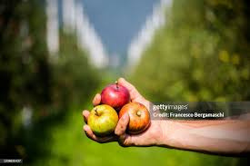
Findings
Violence metaphors were used differently across various stages of illness experience.​

Slide 18


NZ ...feeling like it was a death sentence, an immediate death sentence [...]​
​PK - Jese hi aap ko na breast cancer ka pata chalta hai [...] logon ko yeh hona shuru ho jata hai ke oh bas ab to moat ka parwana mil gaya hai.
‘Because as soon as you find out you have breast cancer [..] people start to feel that you have received a death warrant’ ​
Testing Phase: Diagnosis
As punishment

Slide 19


NZ- The first lot of chemo I had was disastrous. I ended up very sick. I remember coming home and I said to Gavin I don't know about this. I was violently vomiting and stuff but we got all that sorted (nzbreastcancer, 2011f).
​PK … chemotherapy [ke to], it's the worst of all. Theek hai, it’s like a healing poison. [To woh aap] chemotherapy baaki sab cheezon se difficult hai, radiation se bhi aur surgery se bhi..
‘…chemotherapy [about]; it's the worst of all. Okay, it’s like a healing poison. [And that you] chemotherapy is more difficult than everything else, even radiation and surgery’… (Shifa Foundation, 2019a)
Treatment Phase:
Negative impact and intensity of pain

Slide 20


NZ- So I've been doing chemo for five months, [..] and I just finished radiation two weeks ago. I love her to bits, I really do. And ok, as I say we've been through a lot of crap in the last five years or so. But we're still here, still together. She's had her battles and I've had mine. (nzherald.co.nz, 2022c)
​PK. Ghar walo ne meri boht himmat bandhi hai. Unhon ne mjhy kaha hai keh fight krni hai is se har haal mein. Jaise bachon ko maa ki zaroorat hoti hai [un ko dekh ke] phir mere andar himmat aati thi ke maine un ke liye theek hona hai
‘My family has given me a lot of support. They told me that I have to fight this no matter what. Just as children need their mother [looking at them] I felt determined that I had to get better for their sake’ (SKMCH, 2022b)
Family support:
Family member’s portrayal of cancer as an enemy

Slide 21


NZ- If you detect it early, if you're aware and if you're involved in your own well-being you can save your life, you can defeat the beast. (Breast Cancer Foundation NZ, 2011o)
​PK. I am not the same Amna main ye hi kahungi ke be a fighter. Zindagi maut Allah ke haath mein hai have faith in Allah. Aur koi aap ko agar support nahi karta to khuda ke ilawa us ki bas rassi ko pakre rakhain.
‘I am not the same Amna anymore; I would just say, be a fighter. Life and death are in Allah's hands, so have faith in Him. And if no one supports you, hold firmly onto the rope of Allah and trust Him’. (HUM News, 2021f)
Campaigns and awareness efforts:
The speaker urges patients to confront cancer as an enemy.

Slide 22

PK- Tum dekho, Imam Hussain ne bhi to jang jeeti thi na Karbala mein. To tum to unko maanne wali ho, to tumne Imam Hussain ki tarah jang jeetni hai.
‘Look, even Imam Hussain won the battle at Karbala, right? Since you follow him, you must win the battle just like Imam Hussain’ (Shifa Foundation, 2019a)
Religious discourse
- violence metaphors drawn from Islamic history

Slide 23

There are lexical variations in the choice of such metaphors.

Slide 24
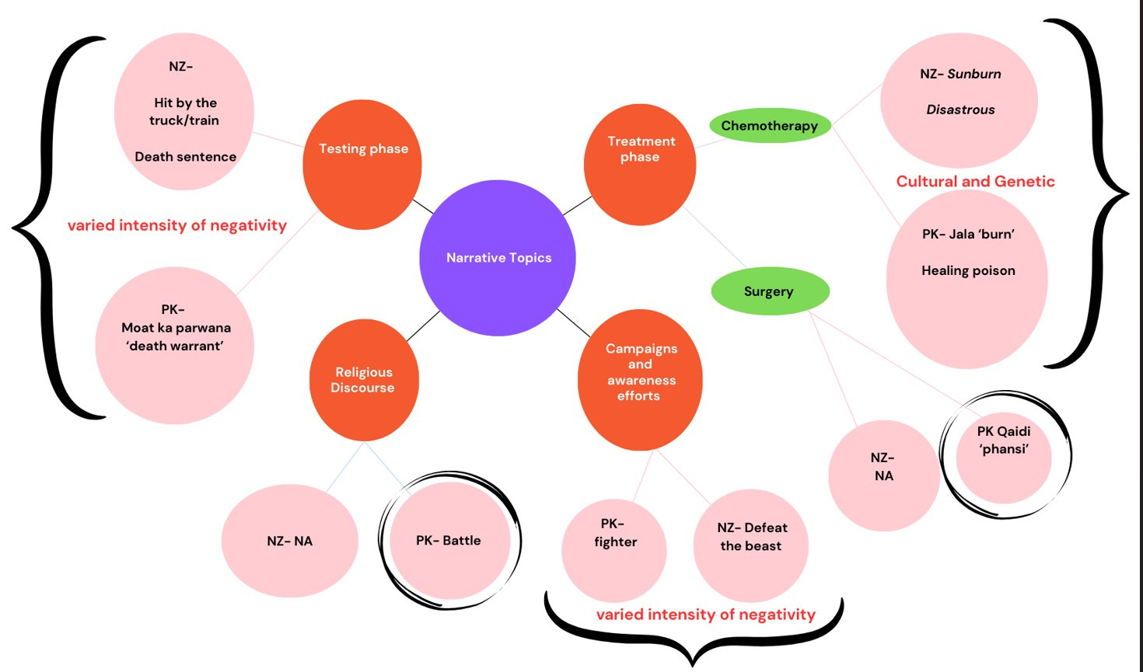

Slide 25

  An understanding of violence metaphors.
  They are used differently across various stages of illness.
  Differences in the choices of words by speakers from different countries.

Slide 26

  Understanding the language of breast cancer patients helps us grasp their experiences more deeply.
  Metaphor is one of the most common linguistic features in such language. ​

Slide 27


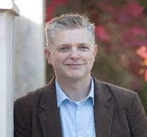
Acknowledgement
Andreea S. Calude
Joe Ulatowski

Slide 28
References
  Magaña, D., & Matlock, T. (2018). How Spanish speakers use metaphor to describe their experiences with cancer. Discourse & Communication, 12(6), 627-644.
  Semino, E., Demjén, Z., Hardie, A., Payne, S., & Rayson, P. (2018). Metaphor, cancer and the end of life: A corpus-based study. Routledge.
  Gustafsson, A. W., Hommerberg, C., & Sandgren, A. (2019). Coping by metaphors: the versatile function of metaphors in blogs about living with advanced cancer. Medical Humanities, 46(3), 267-277.
  Lakoﬀ, G., & Johnson, M. (1980). Metaphors we live by. University of Chicago, Chicago, IL
  Pragglejaz Group. (2007). A Method for Identifying Metaphorically Used Words in Discourse. Metaphor and Symbol, 22(1), 1–39.

Slide 29

Any Questions?

