Slide 1
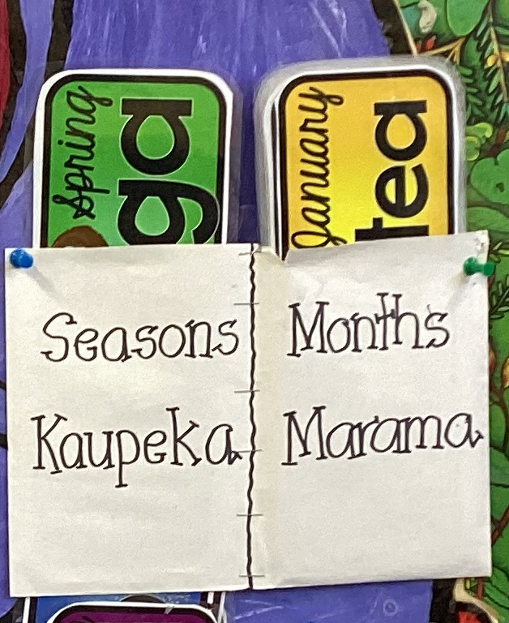
Words on walls: The linguistic landscape of Kirikiriroa primary school classrooms
Jessie Burnette¹, Andreea Calude1 & Hēmi Whaanga²
1 University of Waikato
² University of Massey

Slide 2
Loanwords in Aotearoa
The term ‘lexical borrowing’ is used to ‘describe the process of the transfer of lexical material from one language (the donor, source or model language) to another language (the receptor or replica language)’ (Zenner & Kristiansen 2014, p. 1)
New Zealand English is special, as we see a ‘flow of words from an endangered, minority-status language […] into a dominant, global lingua franca’ (Trye et al. 2020, p. 2).

Slide 3
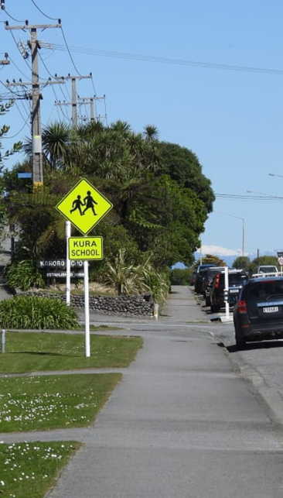
Linguistic Landscapes
‘The language of public road signs, advertising billboards, street names, place names, commercial shop signs, and public signs on government buildings combines to form the linguistic landscape of a given territory, region or urban agglomeration.’
(Landry and Bourhis, 1997, p. 25)
The ‘state-funded school, a central civic institution,’ ‘represents a deliberate and planned environment where pupils are subjected to powerful messages about language(s) from local and national authorities’ (Brown 2012, p. 282; see also Krompak et al. 2022 for an overview of LLs and education).
RNZ (2022). 'They'll have no bloody idea' - bilingual signs on the West Coast. https://www.rnz.co.nz/news/ldr/475482/they-ll-have-no-bloody-idea-bilingual-signs-on-the-west-coast

Slide 4
Research Questions
RQ1
RQ2
RQ3
Which te reo Māori (loan)words are children regularly exposed to through schoolscapes in Kirikiriroa English-medium primary schools?
What is their distribution across schools / classrooms / years?
What indirect language ideologies does the presentation of te reo Māori (loan)words within these classrooms suggest?

Slide 5
The Schools (Data & Method)
School One
School Two
Year 3/4 Class
Year 5/6 Class
Year 5/6 Class
Year 3/4 Class
Year 5/6 Class
Year 5/6 Class
School Three
Year 4 Class
Year 5/6 Class
Year 5/6 Class

Slide 6
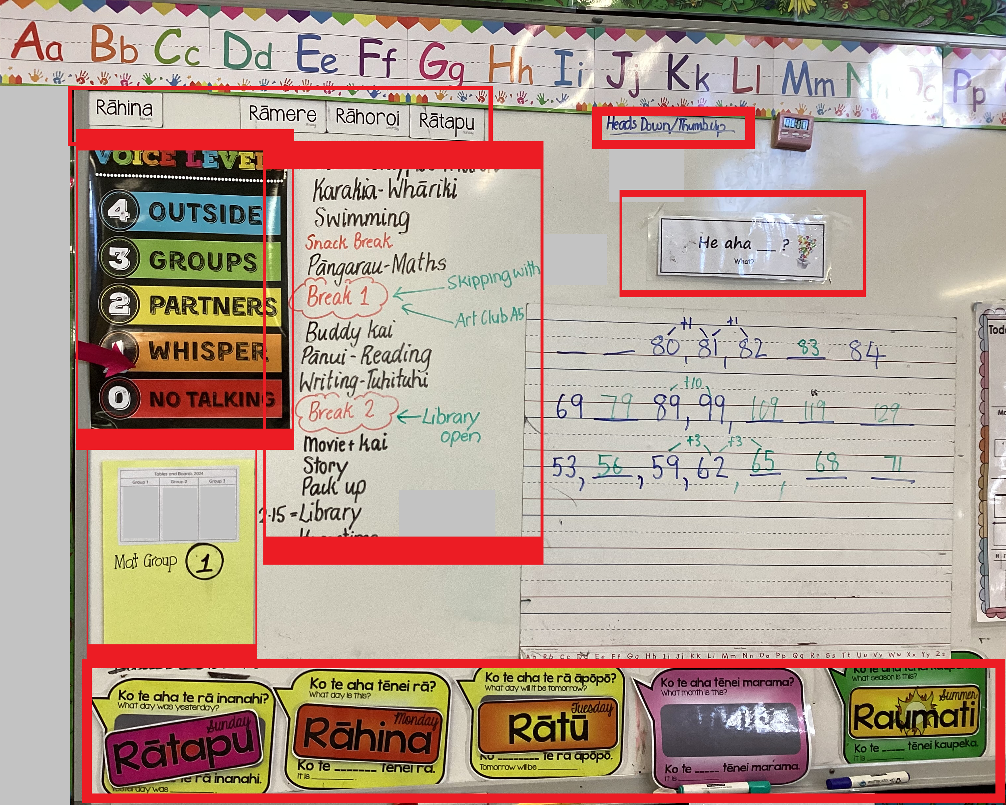
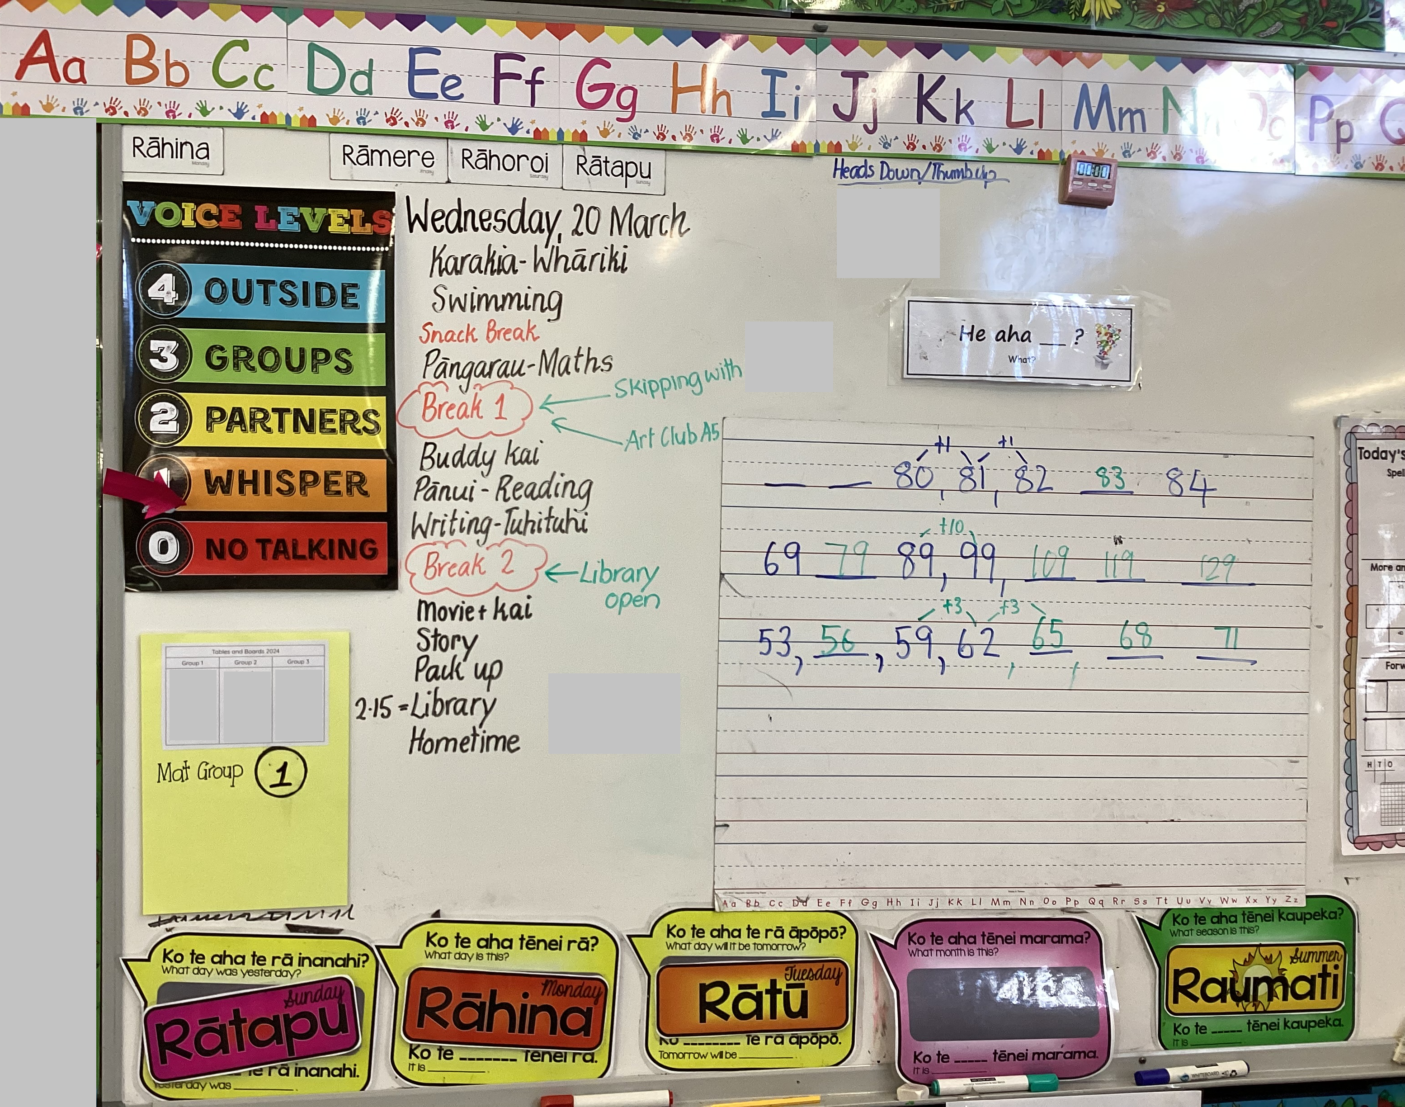
Artefacts & Clusters

Slide 7
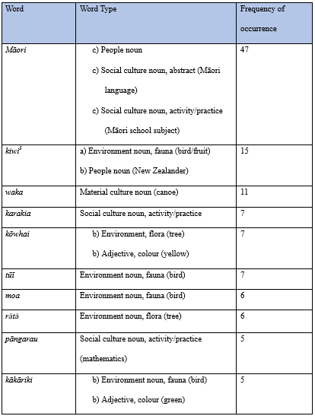
RQ1: Loanword Exposure
Figure 1. Ten most frequent te reo Māori loans

Slide 8
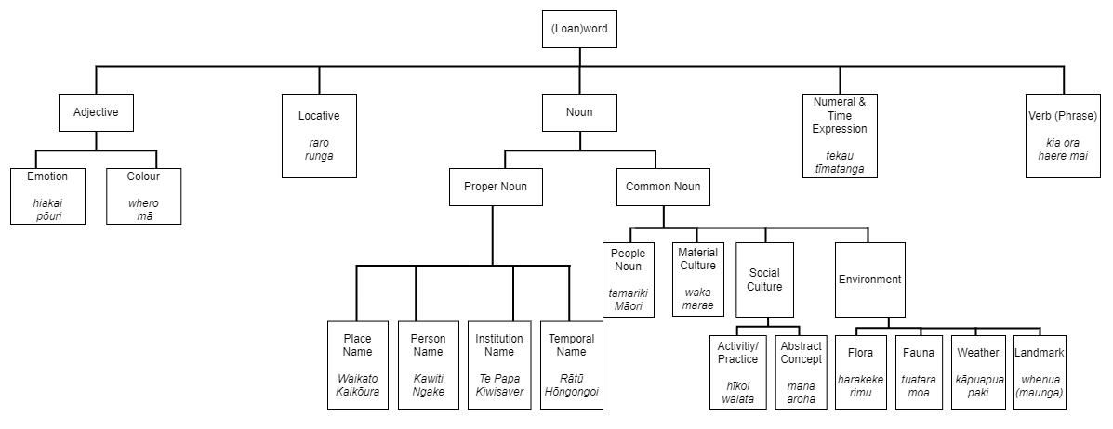
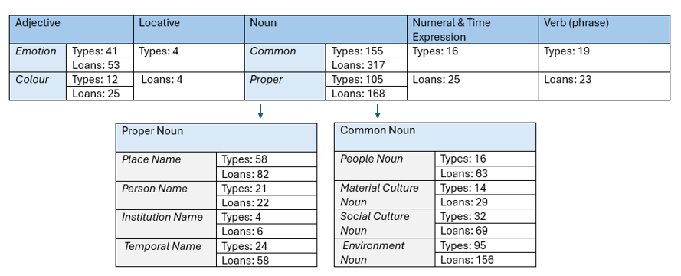
RQ1: Word type & semantic category
Figure 2. Taxonomy of te reo Māori loans
Figure 3. Distribution of te reo Māori loans

Slide 9
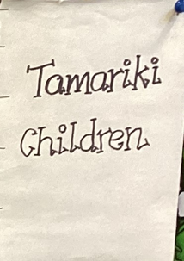
RQ2: (General) te reo Māori Exposure
Figure 4. Overview of images, clusters and text analysed from the nine classrooms

Slide 10
RQ2: (General) Māori Exposure
Figure 5. Comparison of Māori tokens normalised across individual classes (n=9)
Figure 6. Overview of Māori tokens normalised by school, year and theme (n=252, we excluded the four clusters relating to both daily planning and the environment)

Slide 11
But what does it mean?

Slide 12
If New Zealand is to achieve an educational landscape resonating with te reo, it is necessary for training institutions to support teachers’ development as access providers of the language, and for schools and policy makers to be supported wholly and realistically, understanding the needs of each school and the multifaceted identities of the teachers within them.
“
”
Barr and Seals (2018), p. 12.

Slide 13

Acknowledgements
Many thanks to my supervisors, Andreea Calude, Hēmi Whaanga, Eline Zenner & Laura Rosseel for all of their support & guidance!
Extra thanks to my PhD collaborator, Alex Pohl, for providing useful feedback and inter-rater reliability.
…and thanks to all of you!

Slide 14
References
Academic
Barbu, S., Nardy, A., Chevrot, J., & Juhel, J. (2013). Language evaluation and use during early childhood: Adhesion to social norms or integration of environmental regularities?. Linguistics, 51(2), 381-412. https://dx.doi.org/10.1515/ling-2013-0015
Barr, S., & Seals, C. A. (2018). He Reo for Our Future: Te Reo Māori and Teacher Identities, Attitudes, and Micro-Policies in Mainstream New Zealand Schools. Journal of Language, Identity & Education, 17(6), 434-447. https://doi.org/10.1080/15348458.2018.1505517
Brown, K. (2012). The linguistic landscape of educational spaces: Language revitalization and schools in southeastern Estonia. In D. Gorter, H. Marten & L. Van Mensel (Eds.), Minority Languages in the Linguistic Landscape (1st ed. pp. 281-298). Palgrave Macmillan.
Calude, A., Stevenson, L., Whaanga, H., & Keegan, T. T. (2020). The use of Māori words in National Science Challenge online discourse. Journal of the Royal Society of New Zealand, 50(4), 491-508. https://doi.org/10.1080/03036758.2019.1662818
Gorter, D., Marten, H. F., & Mensel, L. V. (2012). Minority Languages in the Linguistic Landscape. Palgrave Macmillan.
Greensill, H., Manuirirangi, H., & Whaanga, H. (2017). Māori language resources and Māori initiatives for teaching and learning te reo Māori. In H. Whaanga, T. T. A. G. Keegan, & M. Apperley (Eds.), He Whare Hangarau Māori - Language, culture & technology (pp. 1–9). Te Pua Wānanga ki te Ao / Faculty of Māori and Indigenous Studies, the University of Waikato. https://hdl.handle.net/10289/11734
Johnson, D. (2021). Linguistic Landscaping and the Pacific Region: Colonization, Indigenous Identities, and Critical Discourse Theory. Lexington Books.
Landry, R., & Bourhis, R. (1997). Linguistic landscape and ethnolinguistic vitality: An empirical study. Journal of Language and Social Psychology, 16(1), 23–49.
Macalister, J. (2006a). The Maori presence in the New Zealand English lexicon, 1850-2000: Evidence from a corpus-based study. English World-Wide, 27(1), 1-24. https://doi.org/10.1075/eww.27.1.02mac
Macalister, J. (2008). Tracking Changes in Familiarity with Borrowings from Te Reo Maori. Te Reo, 51, 75-97.
Macalister, J. (2021). Emerging voices or linguistic silence?: Examining a New Zealand linguistic landscape. Multilingua, 29, 55-75. https://doi.org/10.1515/mult.2010.003
Matika, C. M., Manuela, S., Houkamau, C. A., & Sibley, C. G. (2019). Support for teaching te reo Māori in Primary Schools. Mai Journal, 8(2), 172-187. https://doi.org/10.20507/MAIJournal.2019.8.2.6
Matras, Y. (2009). Language Contact. Cambridge University Press.
Ministry of Education. (12 January 2024). ‘Tau Mai Te Reo | The Māori Language in Education Strategy (English)’. https://www.education.govt.nz/our-work/overall-strategies-and-policies/tau-mai-te-reo/tau-mai-te-reo-the-maori-language-in-education-strategy-english/
Murphy, H., Reid, D., Patrick, A., Gray, A., & Bradnam, L. (2019). Whakanuia te reo kia ora: Evaluation of te reo Māori in English-medium compulsory education. Te Taura Whiri i te Reo Māori. https://thehub.swa.govt.nz/assets/Uploads/Whakanuia-te-Reo.pdf
New Zealand Government. (nd). Te Reo Māori in English-medium schools. https://tereomaori.tki.org.nz/Curriculum-guidelines/Teaching-and-learning-te-reo-Maori/Aspects-of-planning/The-concept-of-a-tuakana-teina-relationship
Pierre, T. S., Jaffan, J., Chambers, C. G., & Johnson, E. K. (2024). The Icing on the Cake. Or Is it Frosting? The Influence of Group Membership on Children’s Lexical Choices. Cognitive Science, 48, 1-17. https://doi.org/10.1111/cogs.13410
Shohamy, E., & Waksman, S. (2008). Linguistics Landscape as an Ecological Arena: Modalities, Meanings, Negotiations, Education. In E. Shohamy & D. Gorter (Eds.), Linguistic Landscape: Expanding the Scenery (pp. 313-331). Routledge.
Stewart, G. (2014). Te reo Māori in classrooms: Current policy, future practice. He Whakaaro Ano. https://www.nzcer.org.nz/system/files/journals/set/downloads/set2014_3_003.pdf [Accessed 23 March 2023]
Szabó, T. P. (2015). The management of diversity in schoolscapes: An analysis of Hungarian practices. Apples: Journal of Applied Language Studies, 9(1), pp. 23–51. https://doi.org/10.17011/apples/2015090102
Trye, D. Calude, A., Bravo-Marquez, F., & Keegan, T. T. (2020). Hybrid Hashtags: #YouKnowYoureAKiwiWhen Your Tweet Contains Māori and English. Frontiers in Artificial Intelligence, 3(15), 1-19. https://doi.org/10.3389/frai.2020.00015
Walker, R. (2004). Ka Whawhai Tonu Matou Struggle Without End. Penguin Books.
Zenner, E., Rosseel, L., & Speelman, D. (2021). Starman or Sterrenman: An acquisitional perspective on the social meaning of English in Flanders. International Journal of Bilingualism, 25(3), 568-591. https://doi.org/10.1177/1367006920960816
Media
RNZ (2020). Government wants all education providers to use te reo Māori every day. https://www.rnz.co.nz/news/national/430513/government-wants-all-education-providers-to-use-te-reo-maori-every-day
RNZ (2022). 'They'll have no bloody idea' - bilingual signs on the West Coast. https://www.rnz.co.nz/news/ldr/475482/they-ll-have-no-bloody-idea-bilingual-signs-on-the-west-coast

