Slide 1
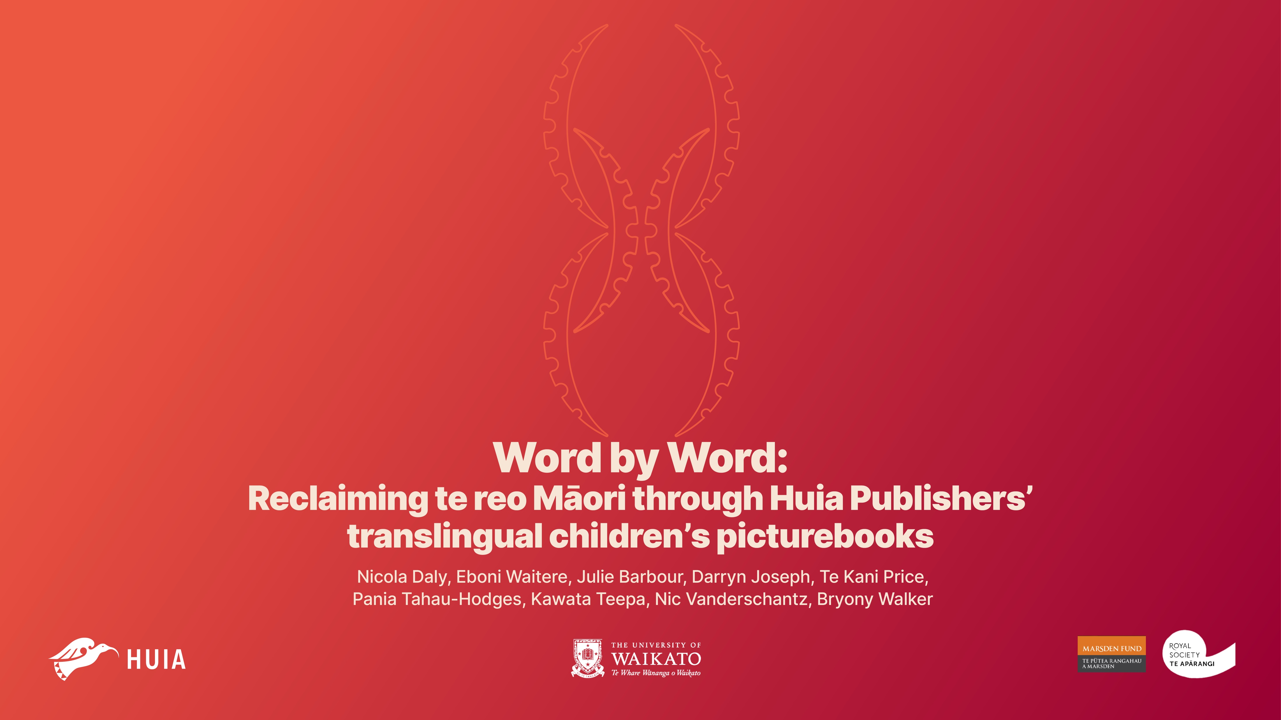

Slide 2
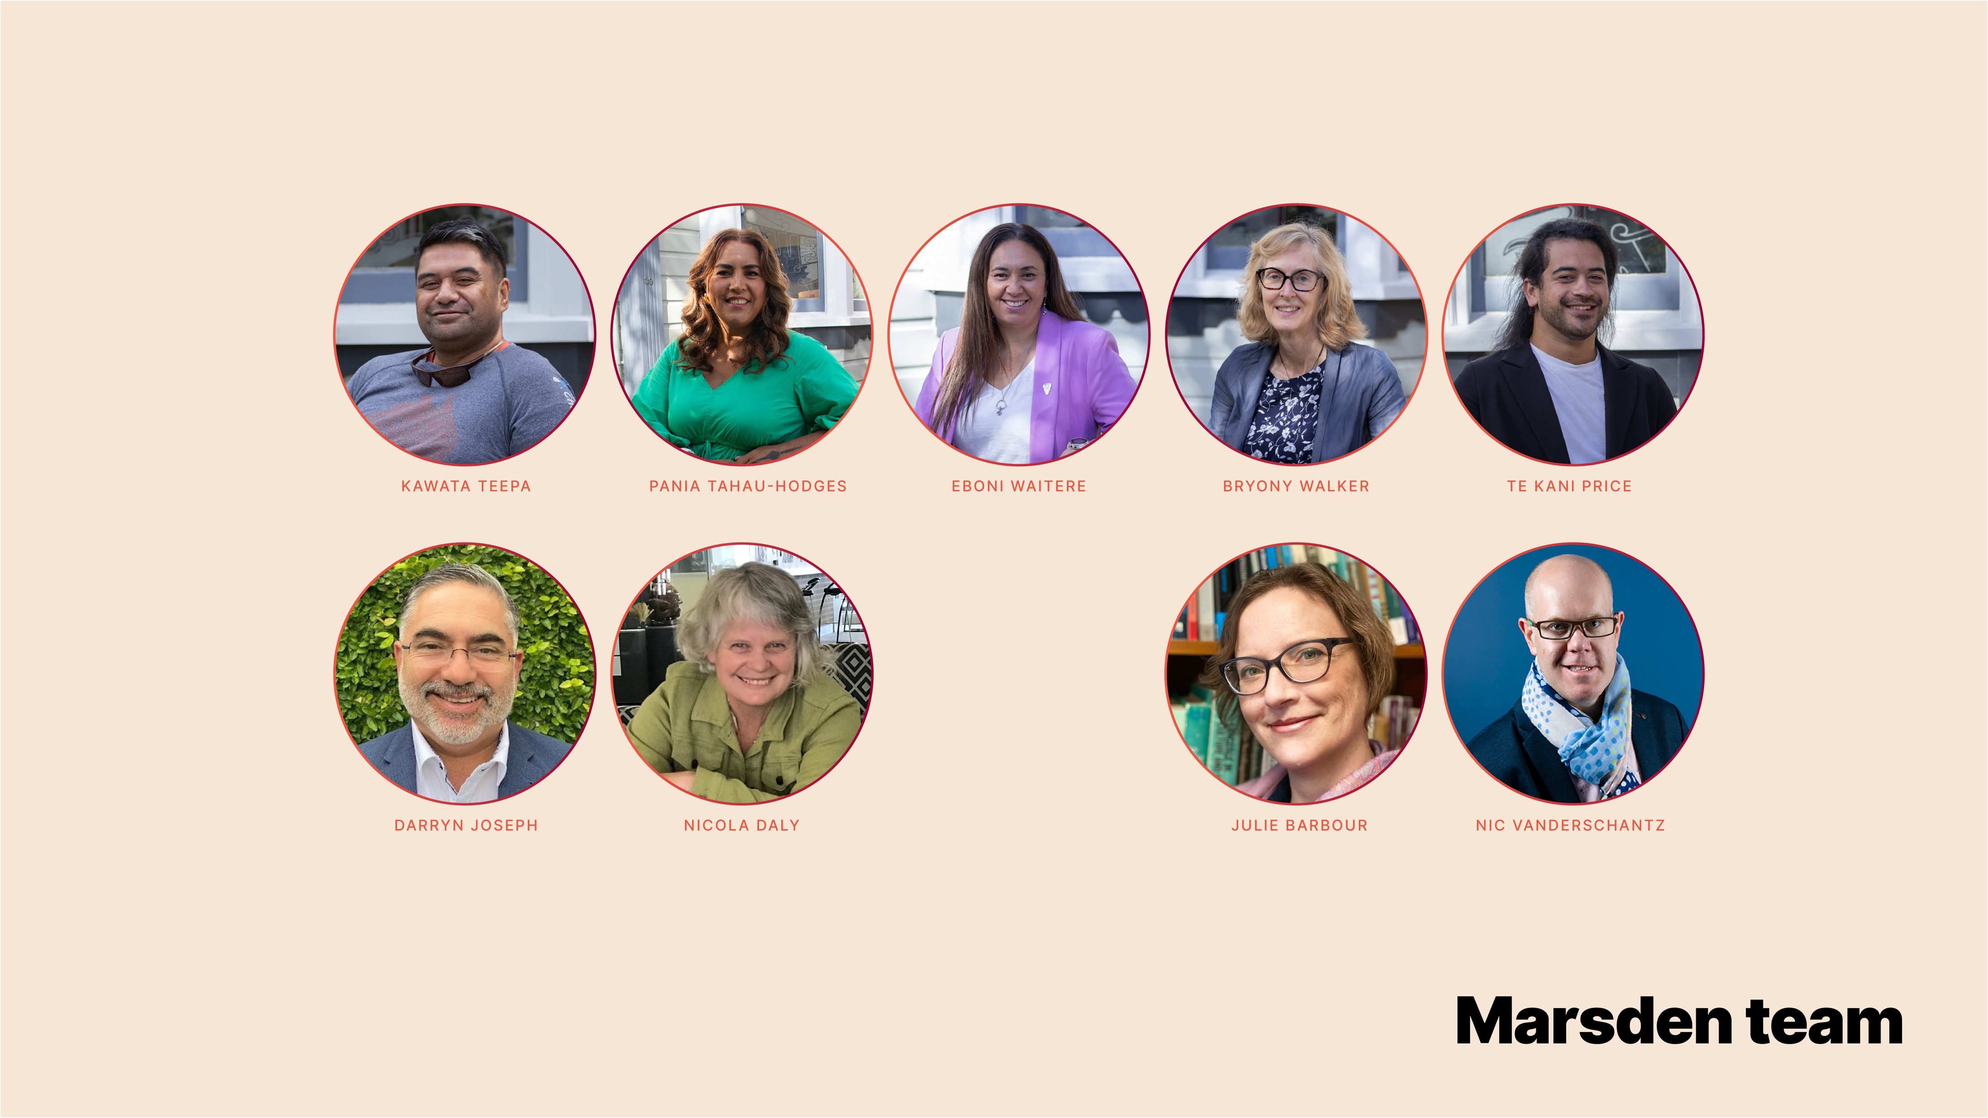

Slide 3
How do HUIA’s translingual TRADE picturebooks contribute to the reclamation of te reo Māori?
1995 - 2024
Data:
  kupu/kīanga Māori (Māori words & phrases)
Questions:
  What semantic domains are represented in the kupu and kīanga of translingual picturebooks?
  When did these semantic domains first occur? Are they enduring, transient or emergent?
Approach:
  treatment of kupu/kīanga as instances of te reo Māori
  semantic domain analysis guided by Māori (Polynesian/Oceanic) cultural categories

Slide 4
HUIA’s TRADE Picturebooks
1995 – 2024 (n=44)

Slide 5
Analysis Basics
Data for inclusion
  front page, running text, back cover, including glossary
Single concepts
  clipping: mokopuna & moko; Te Whiti o Rongomai & Te Whiti
  dialectal variation: tīrairaka & tīwaiwaka
  typographic variation: Māia & Maia, Tupu-ā-rangi & Tupuarangi
Separate concepts
  Marama (a character’s name) vs. marama (moon)
  Tama (a character’s name) vs. tama (younger male)
Kin terms ...

Slide 6
Kin Terms in Context
used as a common noun
  To get to her kuia’s house... [Roimata’s Cloak]
used to NAME an individual in a kin relationship
  ‘Tuakana, can you please come with me?’ [How my Koro became a Star]
used in a NAME phrase for an individual in a kin relationship [MĀO/ENG]
  They cried, talked, and sang to Koro Jack [Haere]
used in a vocative phrase [MĀO]
  ‘Oh, to the moon, e Koro,’ says Te Wai. [Te Wai, Tama and the Moon]
used as an honorific
  I am back with the other doctor – Whaea Tui. [I am a little voice]

Slide 7
KIN CONCEPTS
CONCEPT | to categorize kin | to name Kin | to name Kin Name | vocative e Kin/kin
KOROUA | 4 |  |  | *
KUIA | 17 |  |  | * [e kui]
KORO | 11 | 86 (5-HON) | 9 | 3 (e Koro)
MĀMĀ | 23 | 47 |  | *
PĀPĀ | 13 | 50 |  | *
WHAEA |  | 2 (2-HON) | 11 (11-HON) | *
MATUA |  |  | 9 (9-HON) | *
TUAKANA | 1 | 1 |  | *
TUAHINE |  | 1 |  | *
TAMA |  | 2 | * | 4 (e tama)
MOKOPUNA | 3 | 1 | * | 1 (e moko)

Slide 8
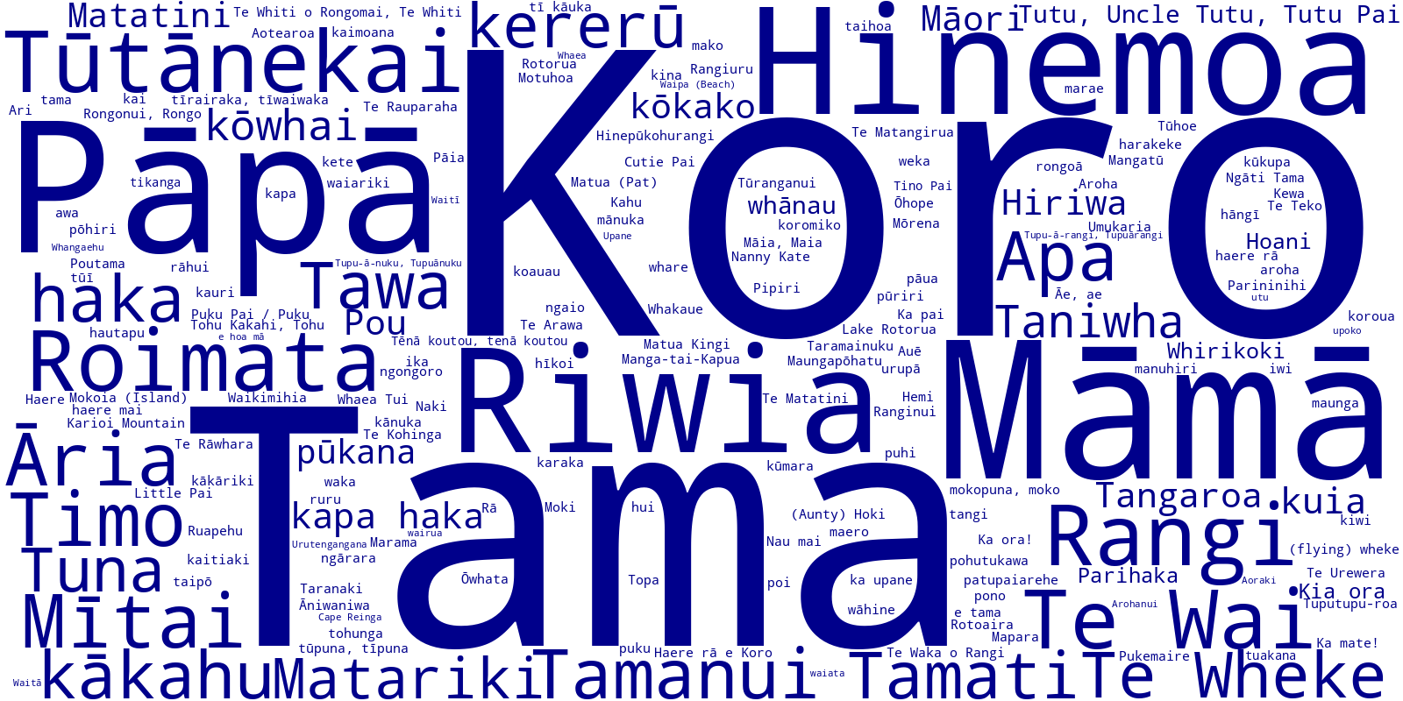

Slide 9
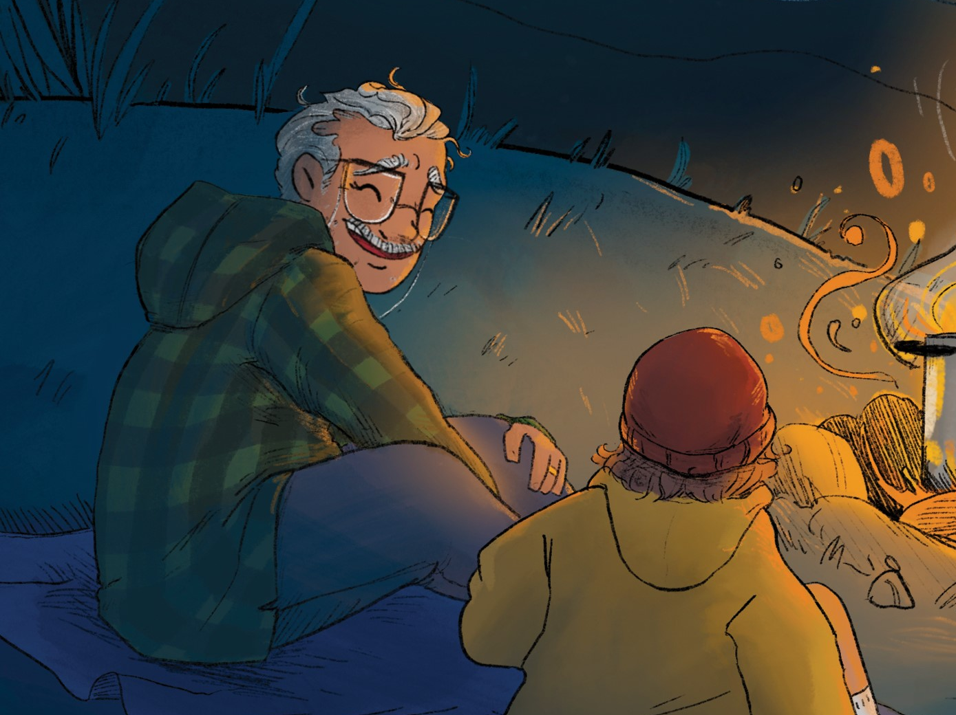
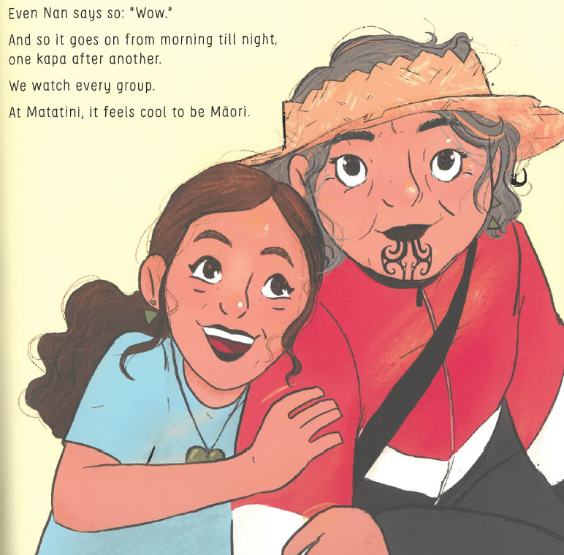
KORO, KOROUA & KUIA
KORO concept (1998–2024) n=109
KOROUA concept (2008 & 2023) n=4 common
KUIA concept (1995 & 1998) n=17 common

Slide 10
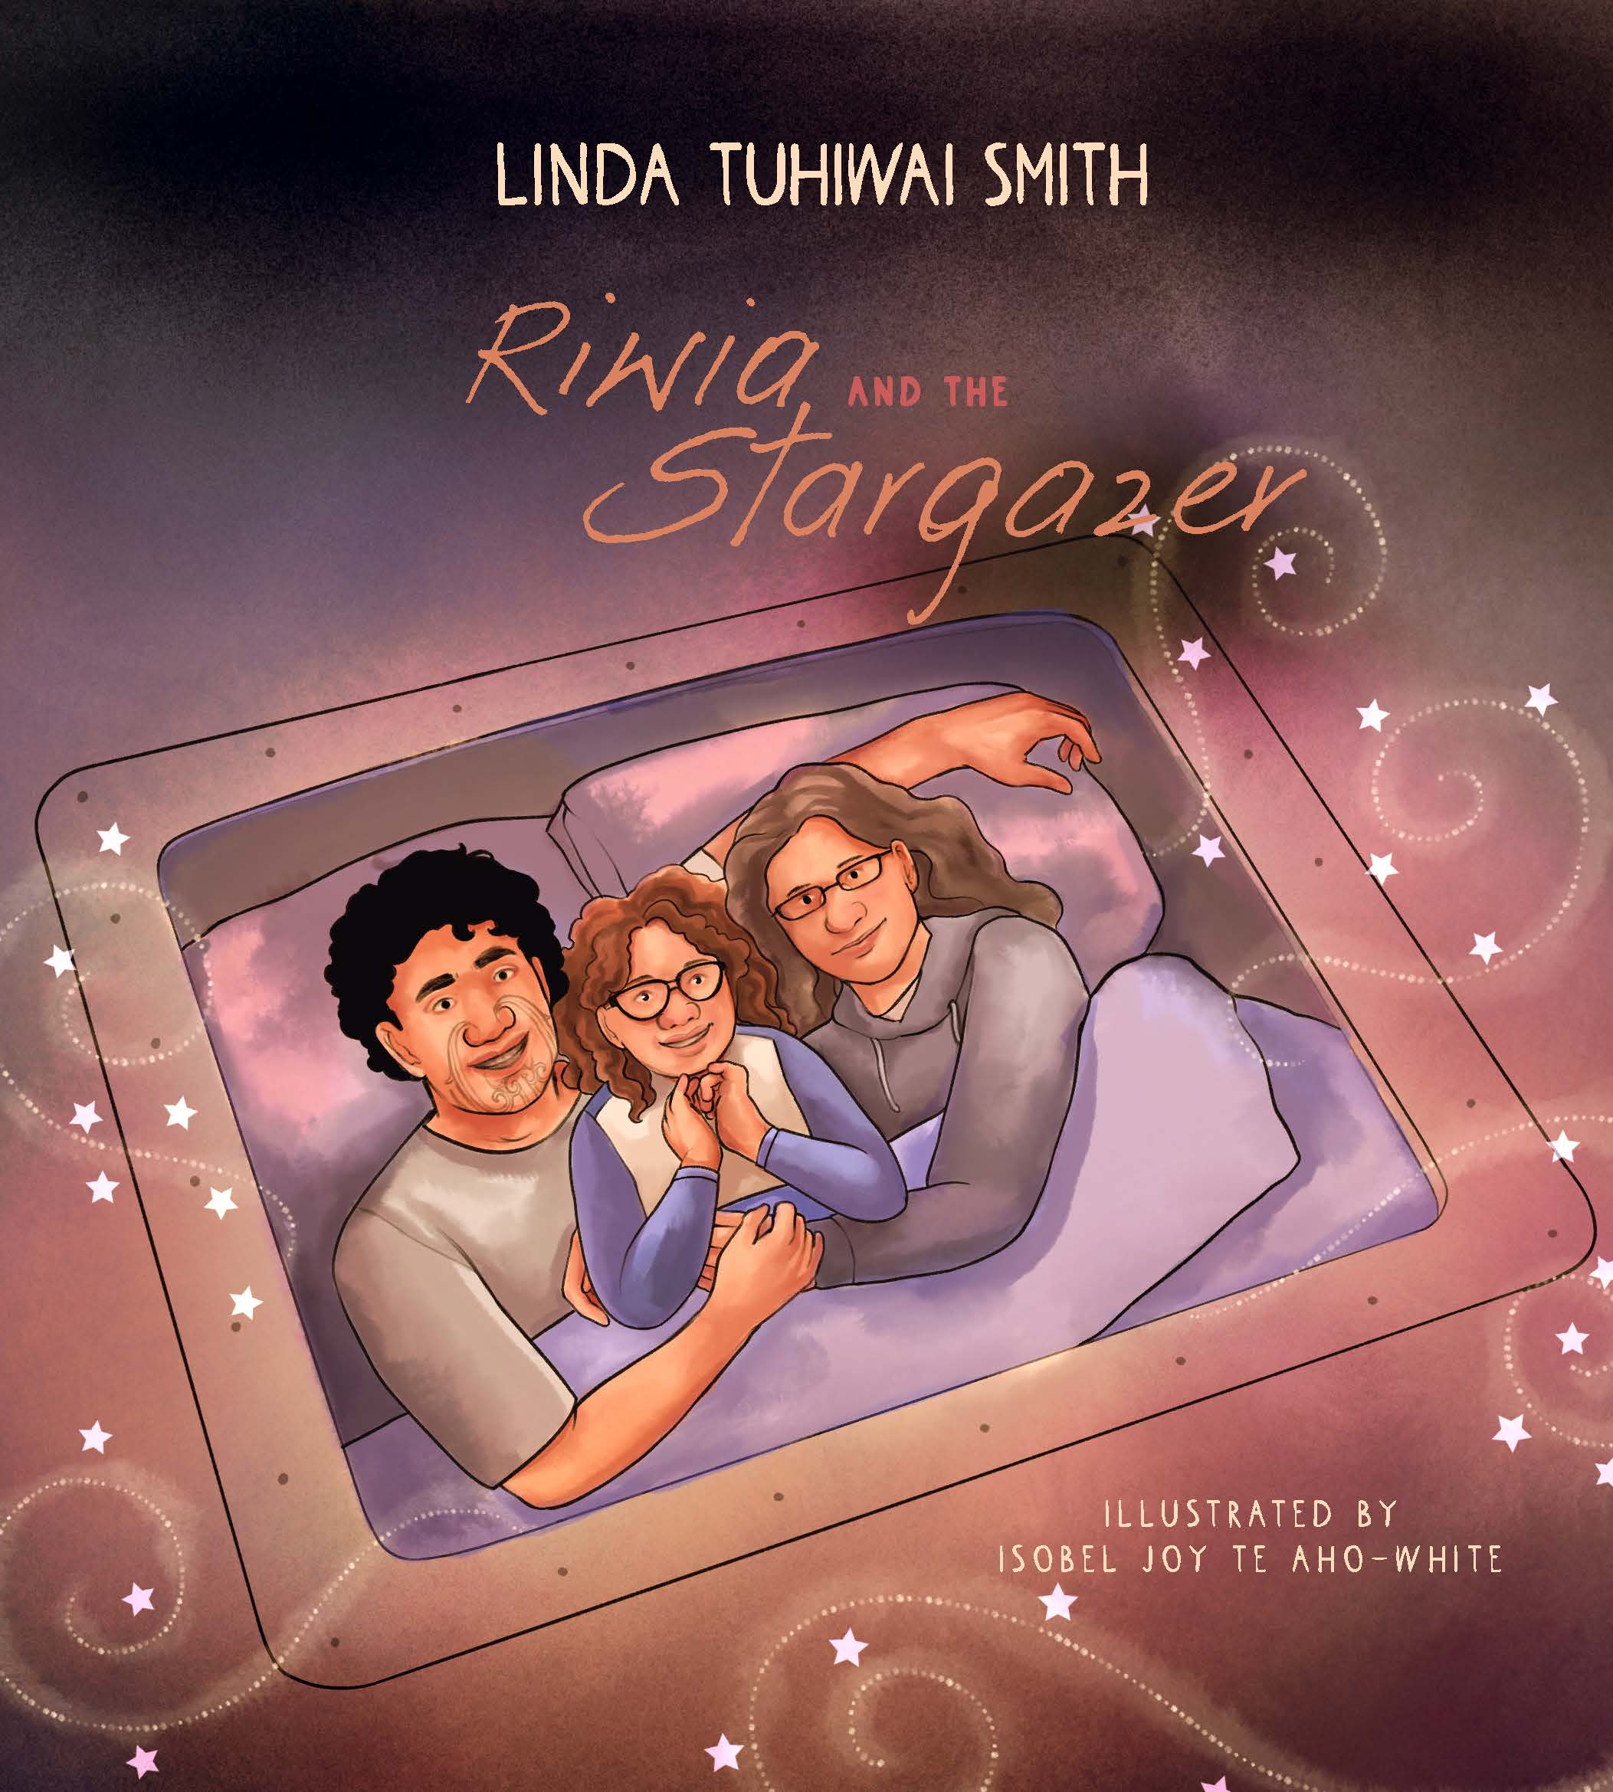
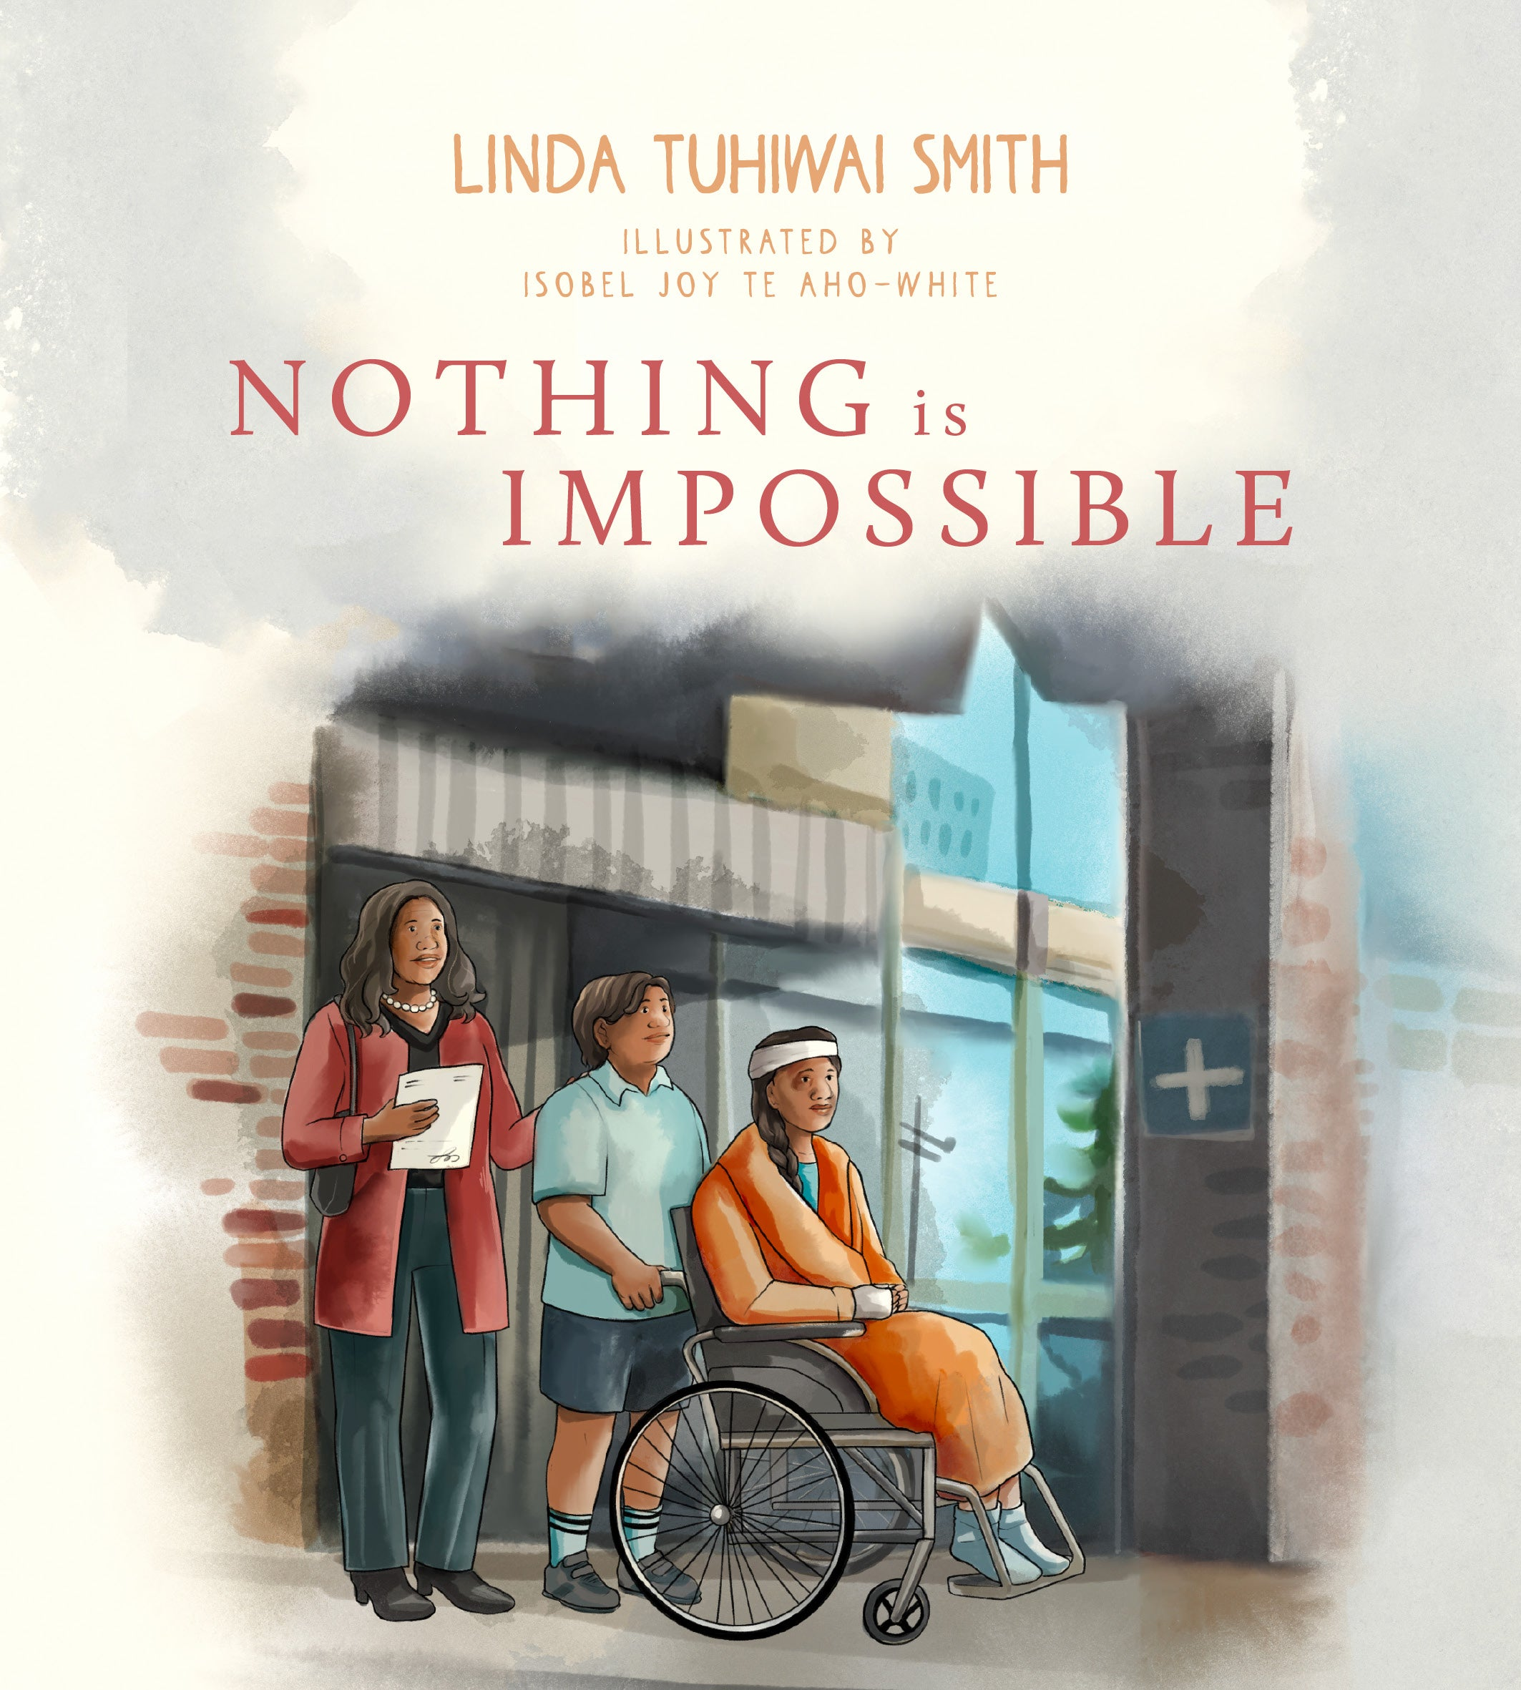
NANNY & KORO (KOROUA)
She is sad that Māmā and Pāpā and Nanny and Koro are sad, but she is happy to be home and to be playing with her cousins around the marae. [Riwia and the Stargazer ]
It was mostly good at Nanny and Koro’s place. [Nothing is Impossible]
her cousins and aunties and uncles and nannies and koroua... [Riwia and the Stargazer]

Slide 11
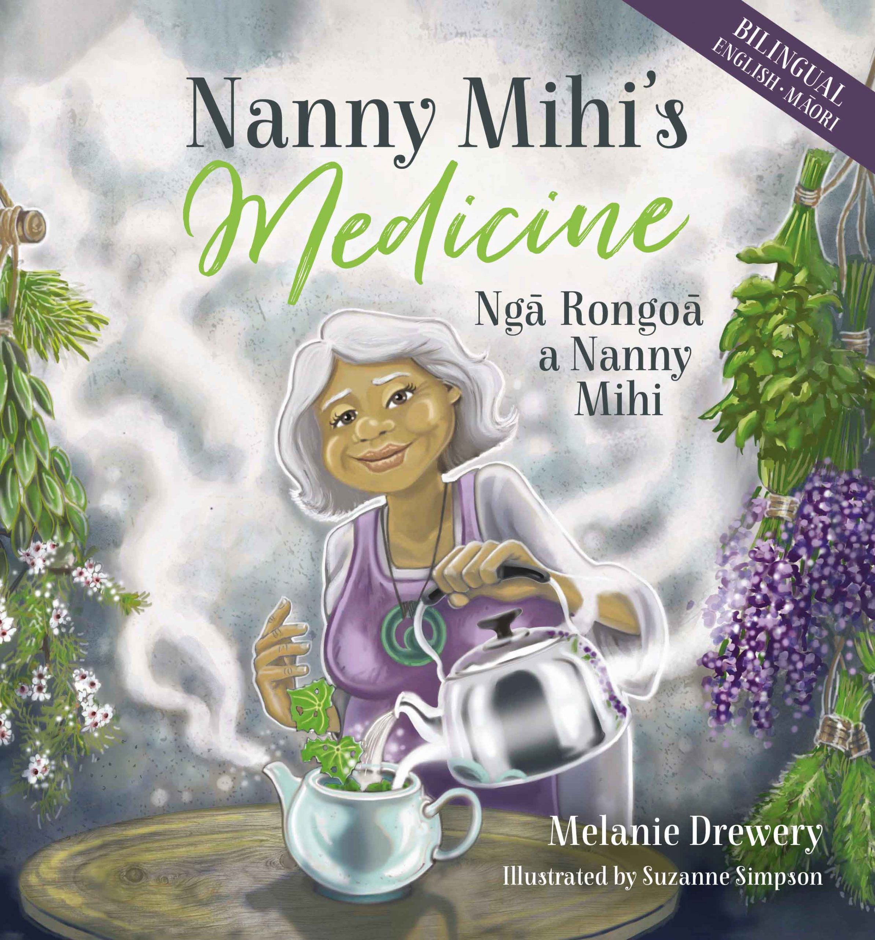
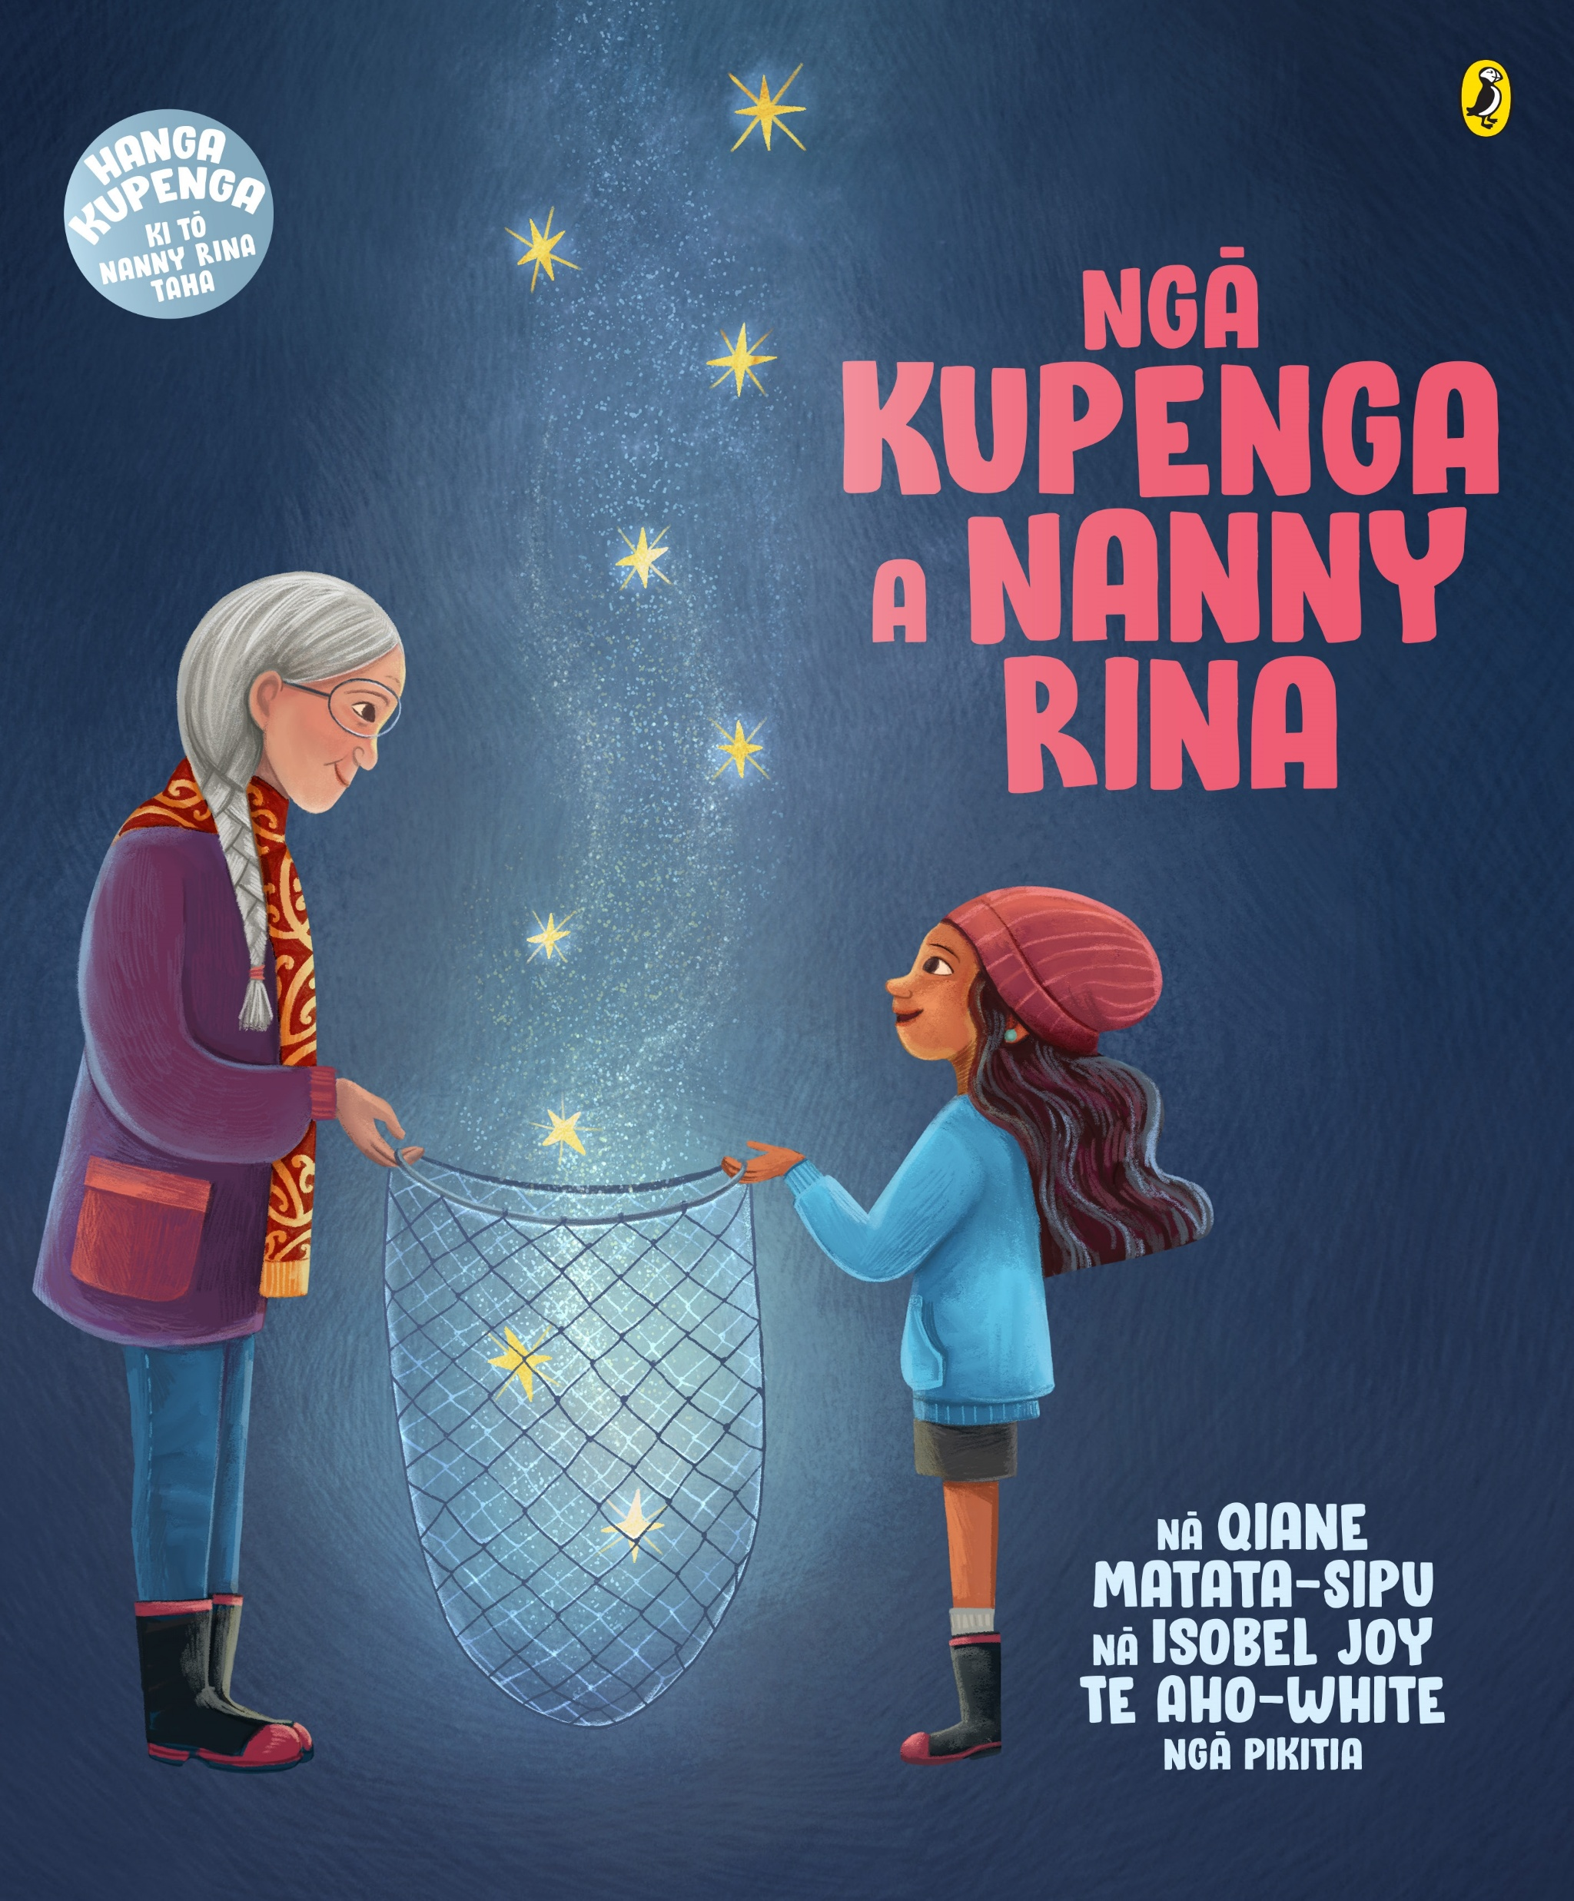
Nanny in the broader context of Aotearoa picturebooks
Oratia Media
Penguin

Slide 12
KIN CONCEPTS
CONCEPT | to categorize kin | to name Kin | to name Kin Name | vocative e Kin/kin
KOROUA | 4 | * | ? | *
KUIA | 17 | ? | ? | *
KORO (109) | 11 | 86 (5-HON) | 9 | 3 (e Koro)
NANNY (116) | 26 | 85 | 5 | n/a
nanny (67) | 17 | 45 | 5 (3-HON) | n/a
nan (44) | 9 | 35 | 0 | n/a
nana (5) | 0 | 5 | 0 | n/a

Slide 13
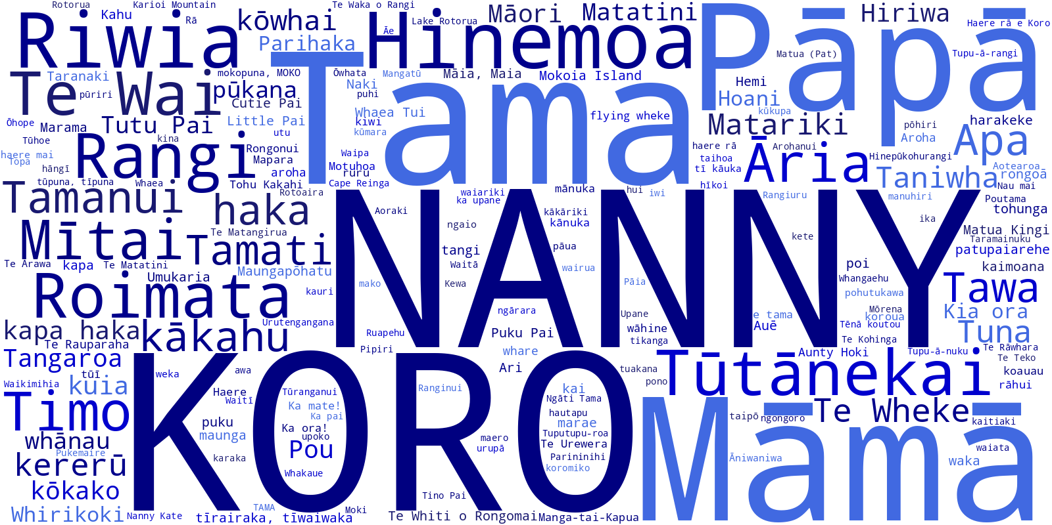

Slide 14
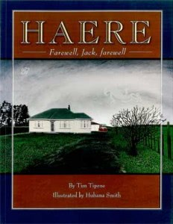
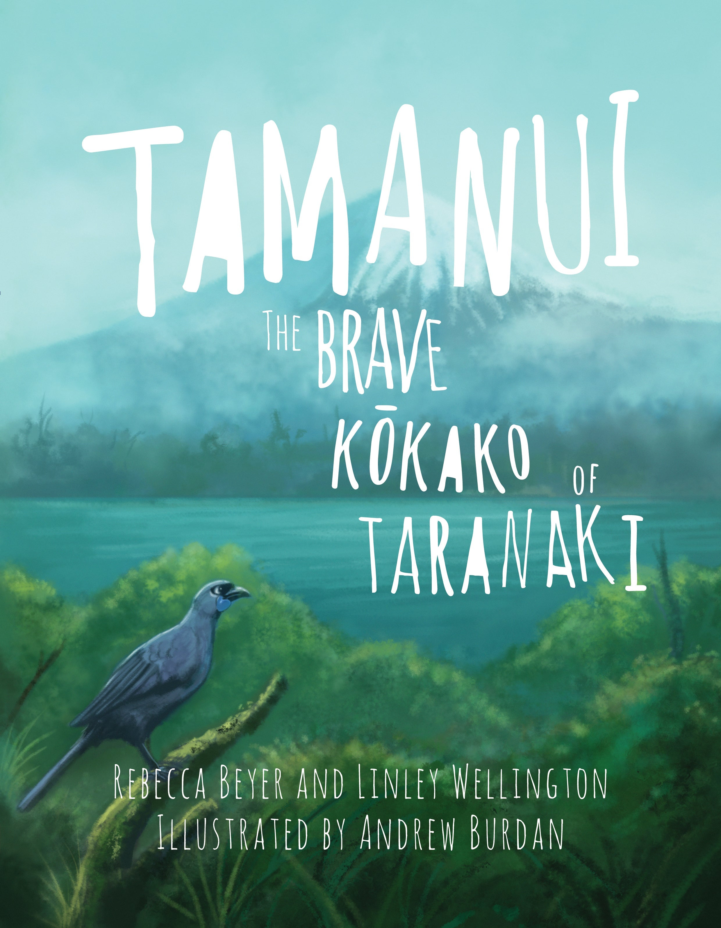
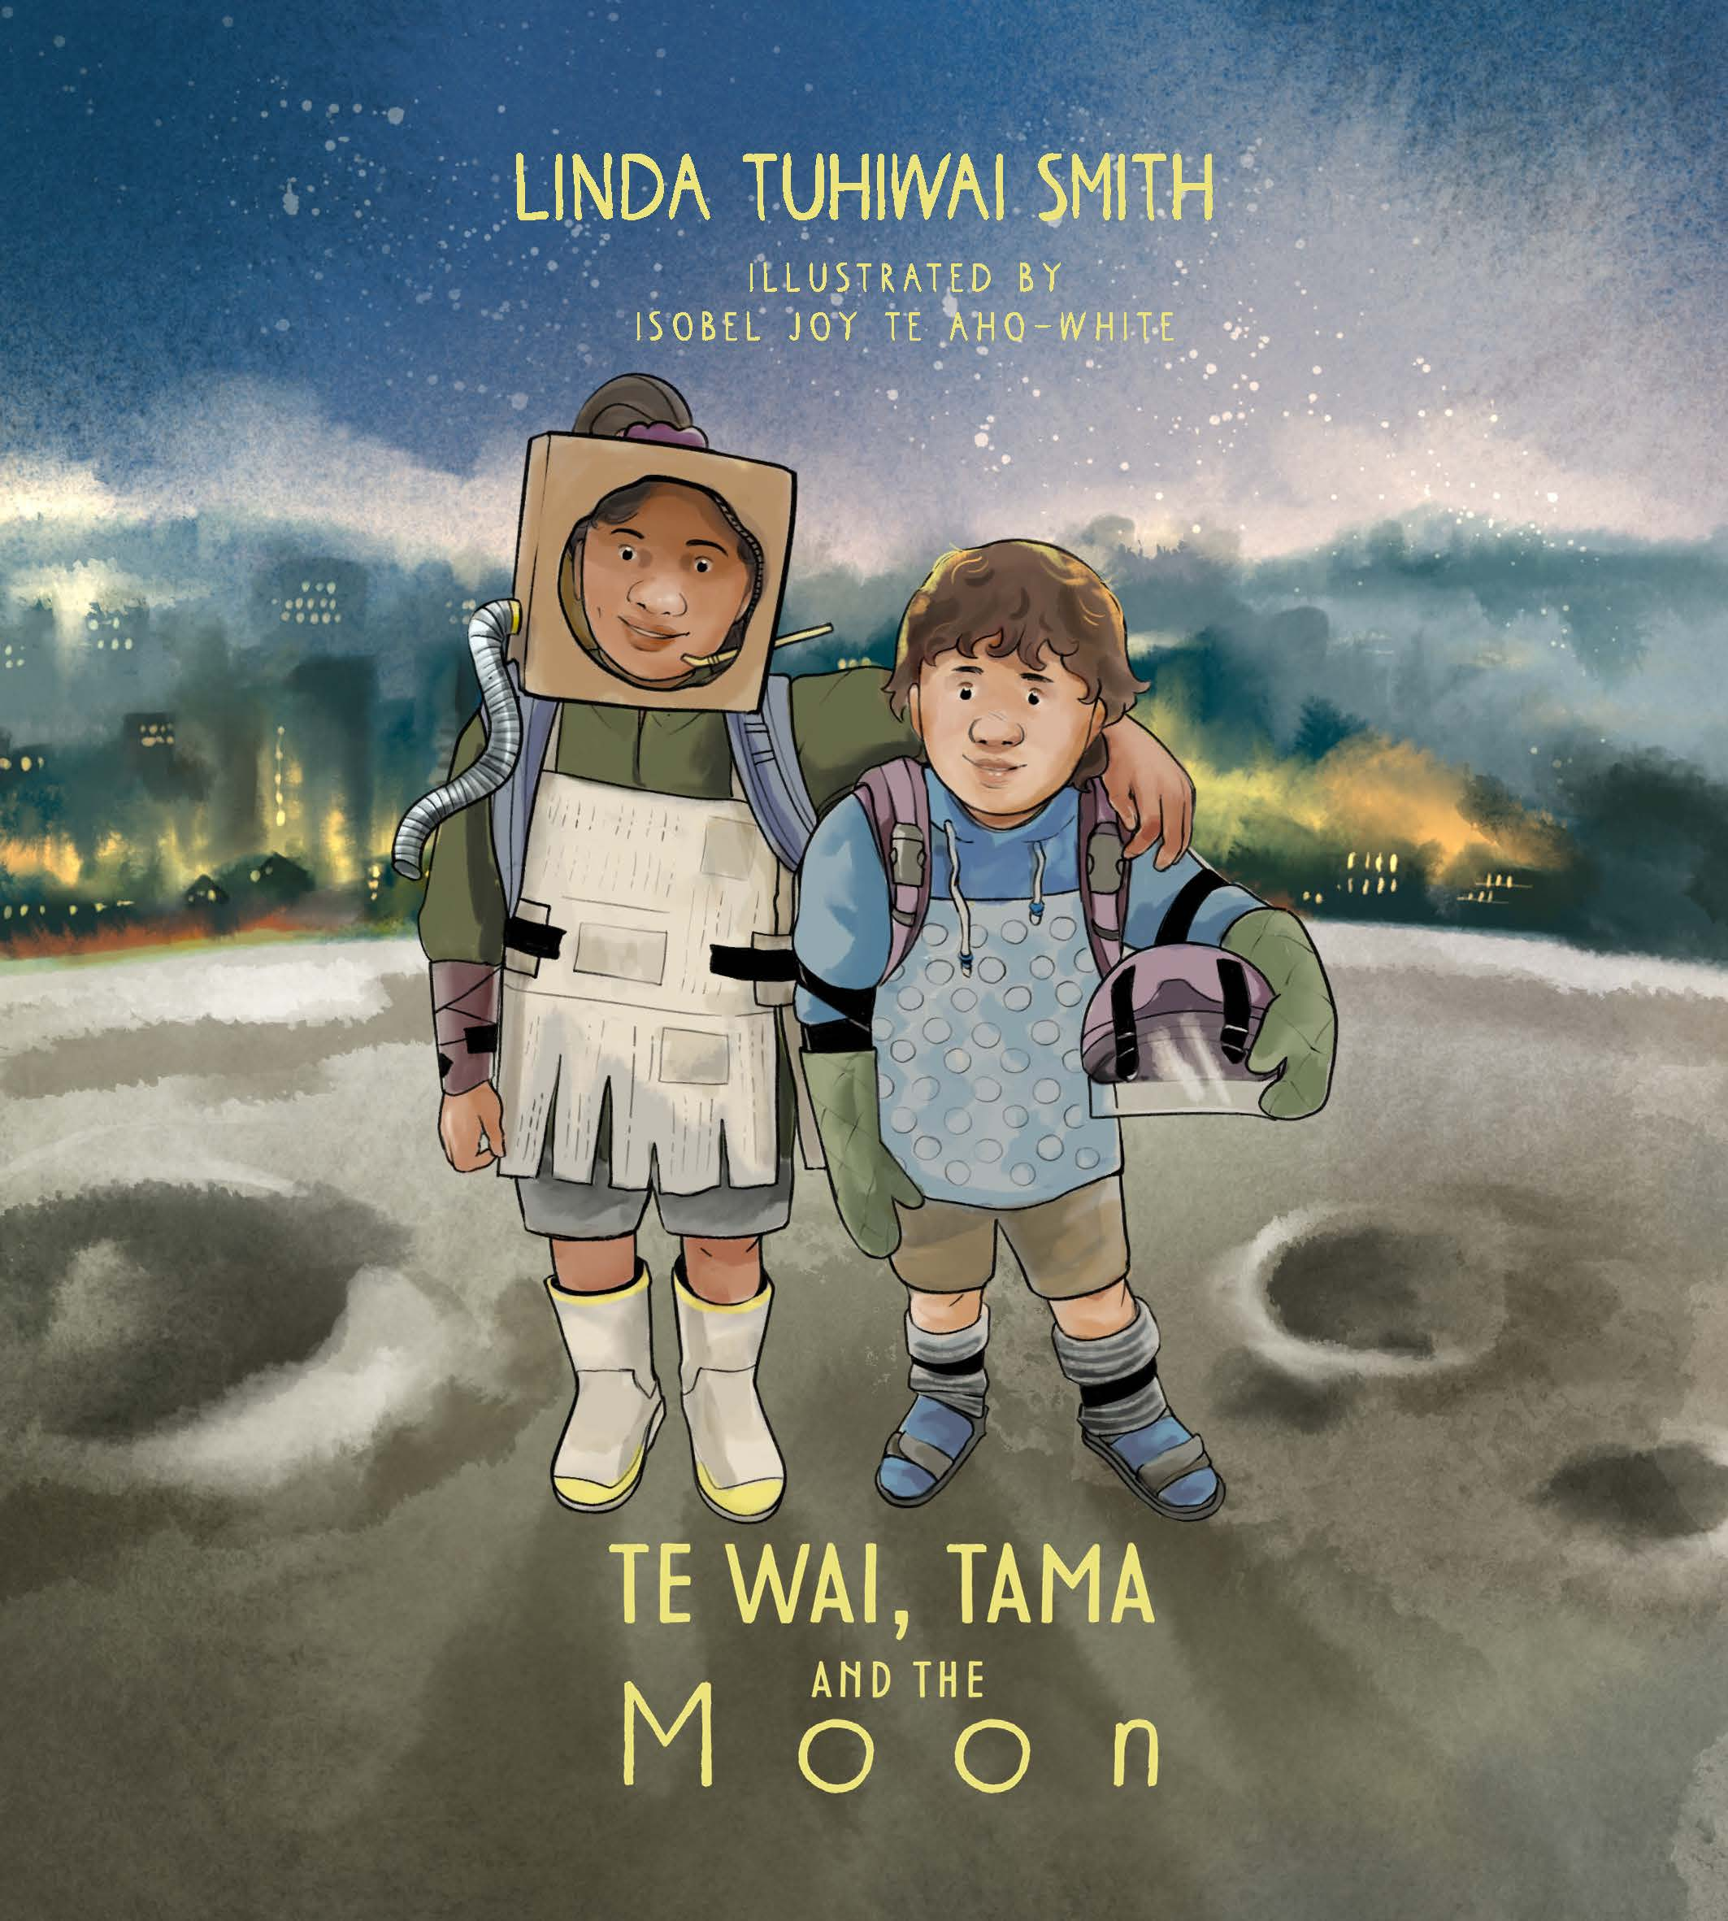
Vocative structures with e in pukapikitia
Haere rā e Koro, haere rā. [Haere, 2005]
After some time, the truck stopped and Tamanui heard voices. ‘Nau mai, haere mai, e te manu,’ they welcomed him. [Tamanui, 2015]
‘Kia ora, e Te Wai! Kia ora, e Tama!’ Koro Max says, smiling too. ‘Where are you two going?’ [Te Wai, Tama & the Moon, 2023]
‘Tēnā koutou, e hoa mā,’ I said to everyone. // ‘Tēnā koe, e Rangi,’ the whole class said back to me. [Nothing is Impossible, 2023]

Slide 15
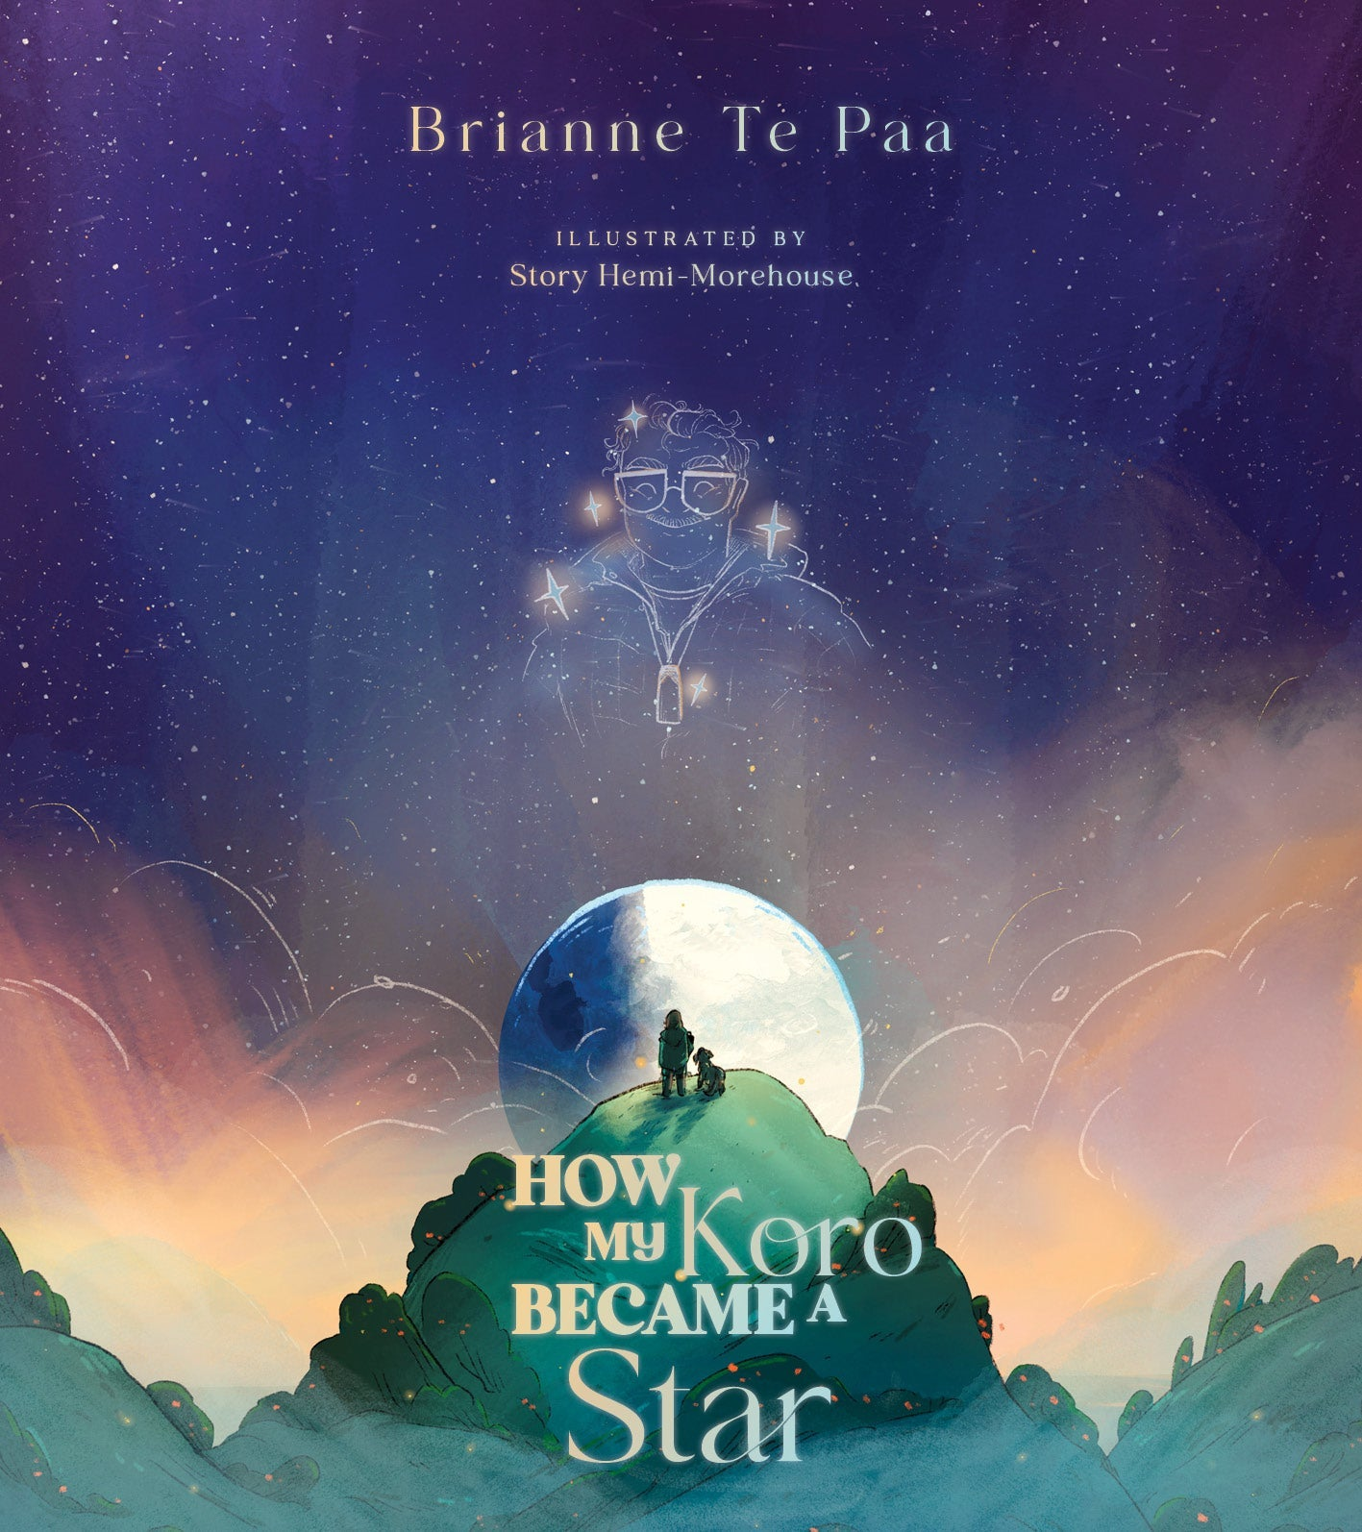
Vocative phrases with e in pukapikitia
‘Oh, to the moon, e Koro,’ says Te Wai. [Te Wai, 2023]
“Listen carefully, e moko,” he told me, “to the most important tikanga of all.” [My Koro, 2022]
“I’m a little bit busy, e tama,” Dad said. [My Koro, 2022)

Slide 16
Semantic Domain Analysis
SDs used in lexicography, linguistic anthropology, language contact
Some SDs are core to the experience of being human (e.g. kinship)
Some SDs are culture-specific (e.g. beliefs and practices)

Slide 17

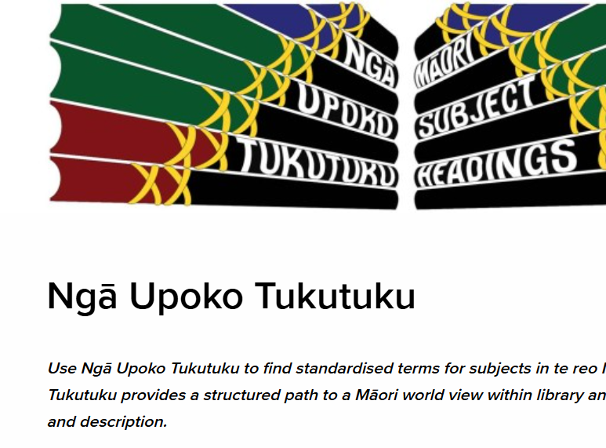
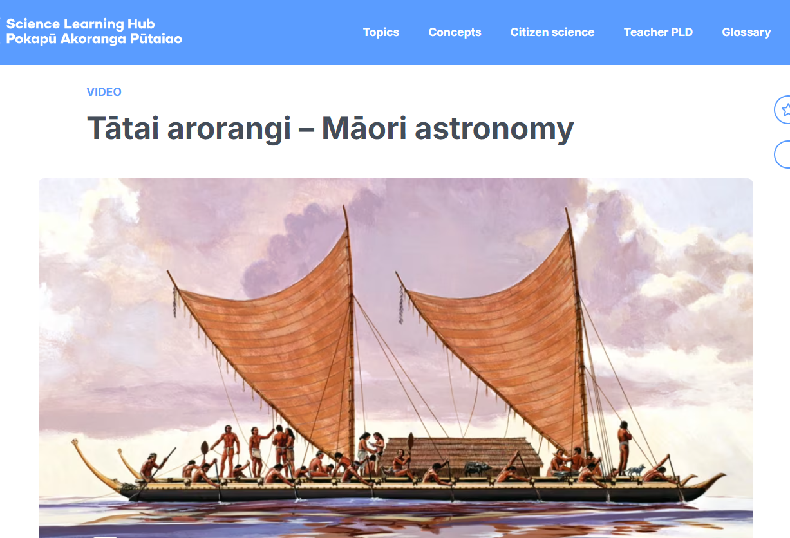
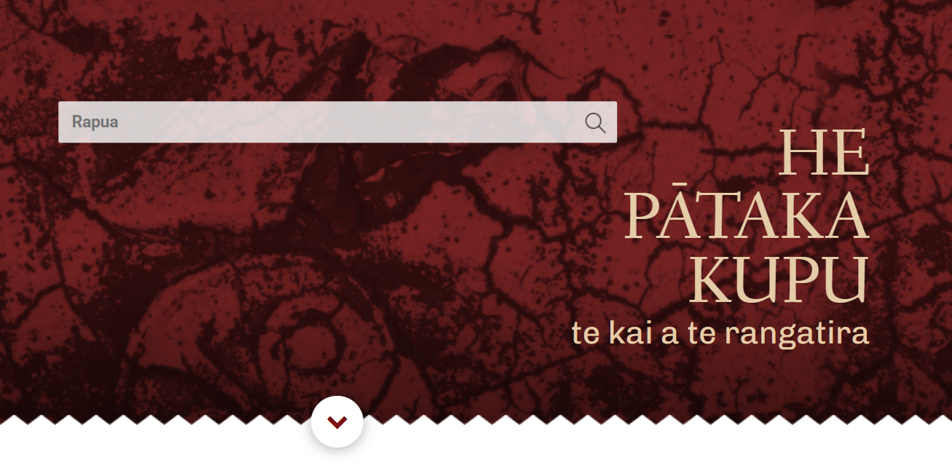
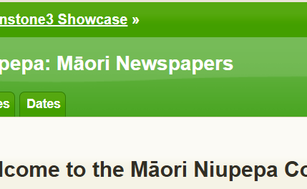
If te reo Māori, analyse within te ao Māori!
classify kupu/kīanga extracted from the running text of all 44 pukapikitia HUIA
Māori subject headings (National Library)
Māori language dictionary (He Pātaka Kupu)
Māori Niupepa Collection for historical perspective (Greenstone)
Māori cultural resources (e.g. Science Learning Hub – Tātai arorangi)

Slide 18
tūmoko enduring

Slide 19
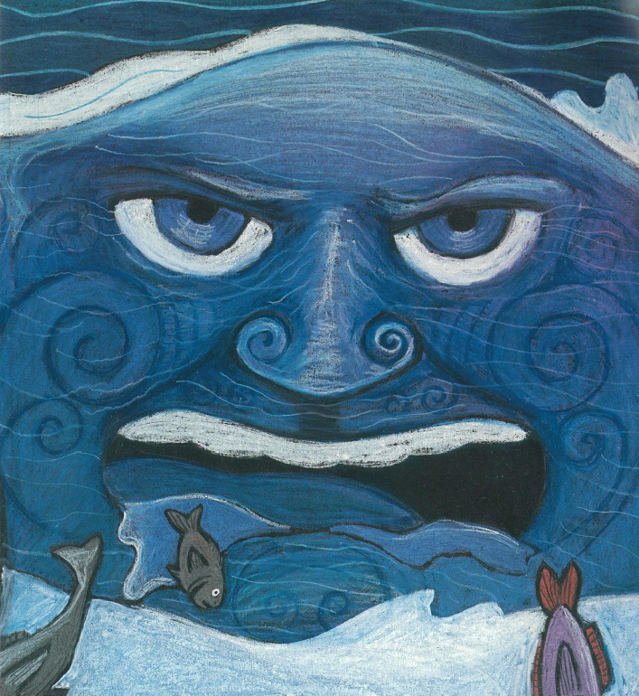
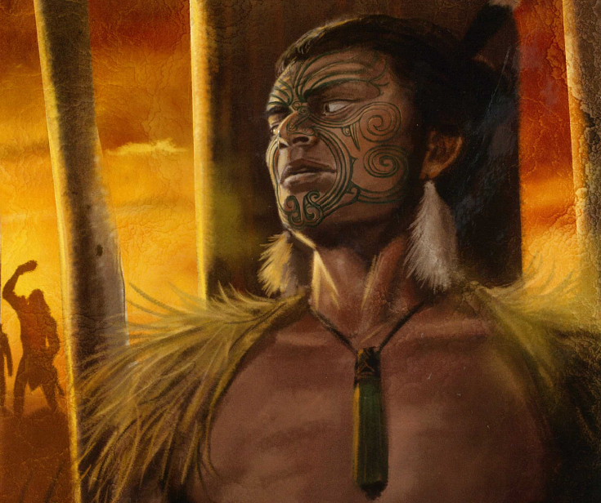
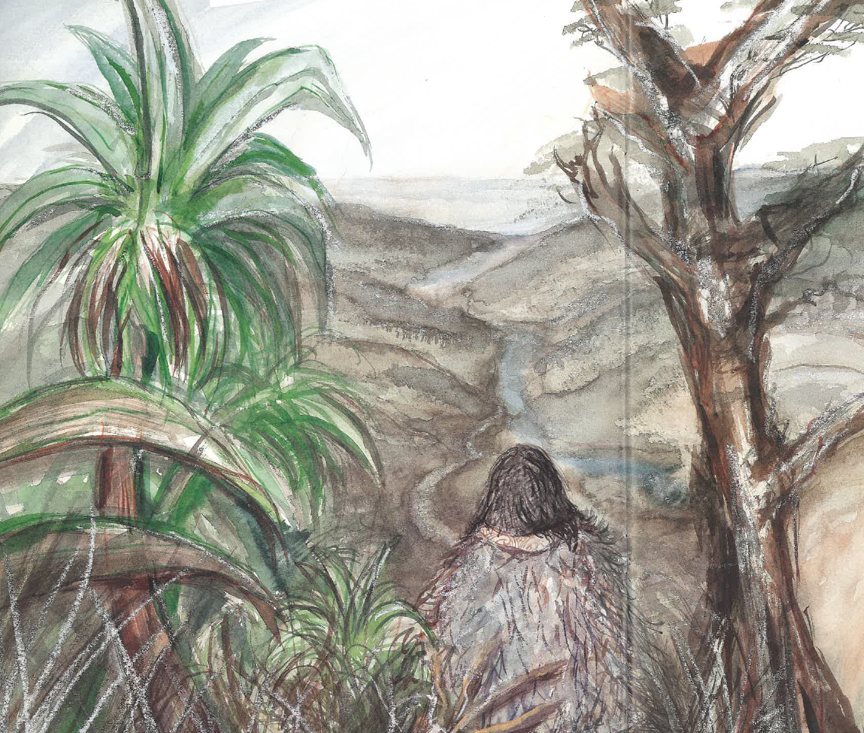
tūmoko
Atua
Tangata
Tapawāhi
Te Rauparaha
Tangaroa
Te Urewera

Slide 20
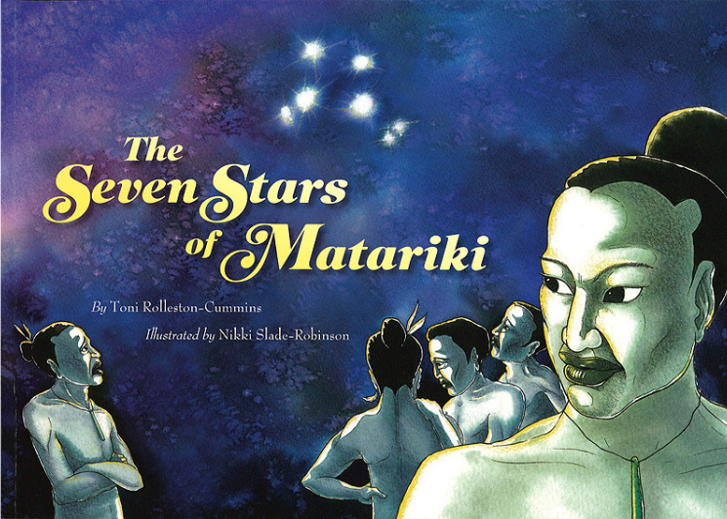
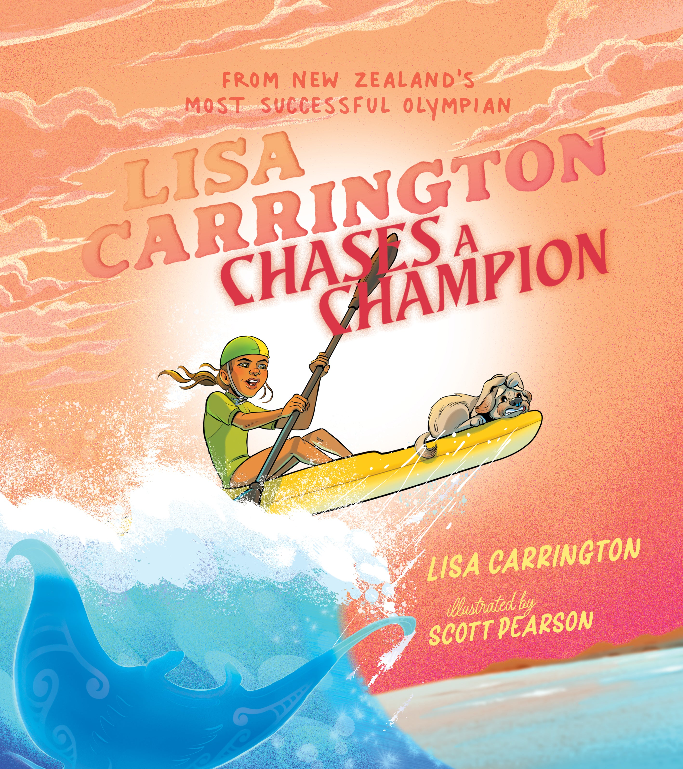
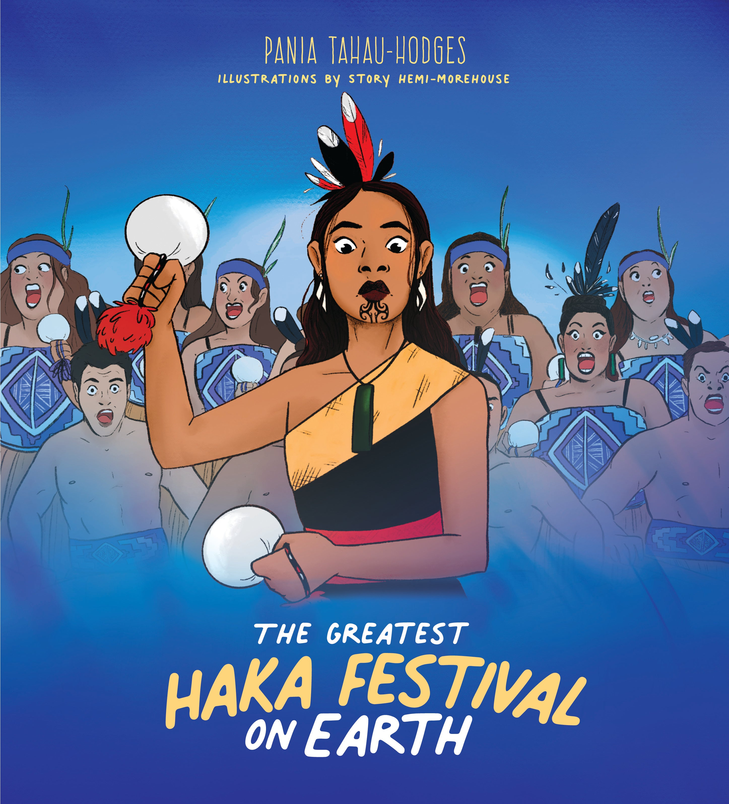
tūmoko
Atua
Tangata
Tapawāhi
Tātai Arorangi
Ahurea
2008 2022 2024 2021

Slide 21
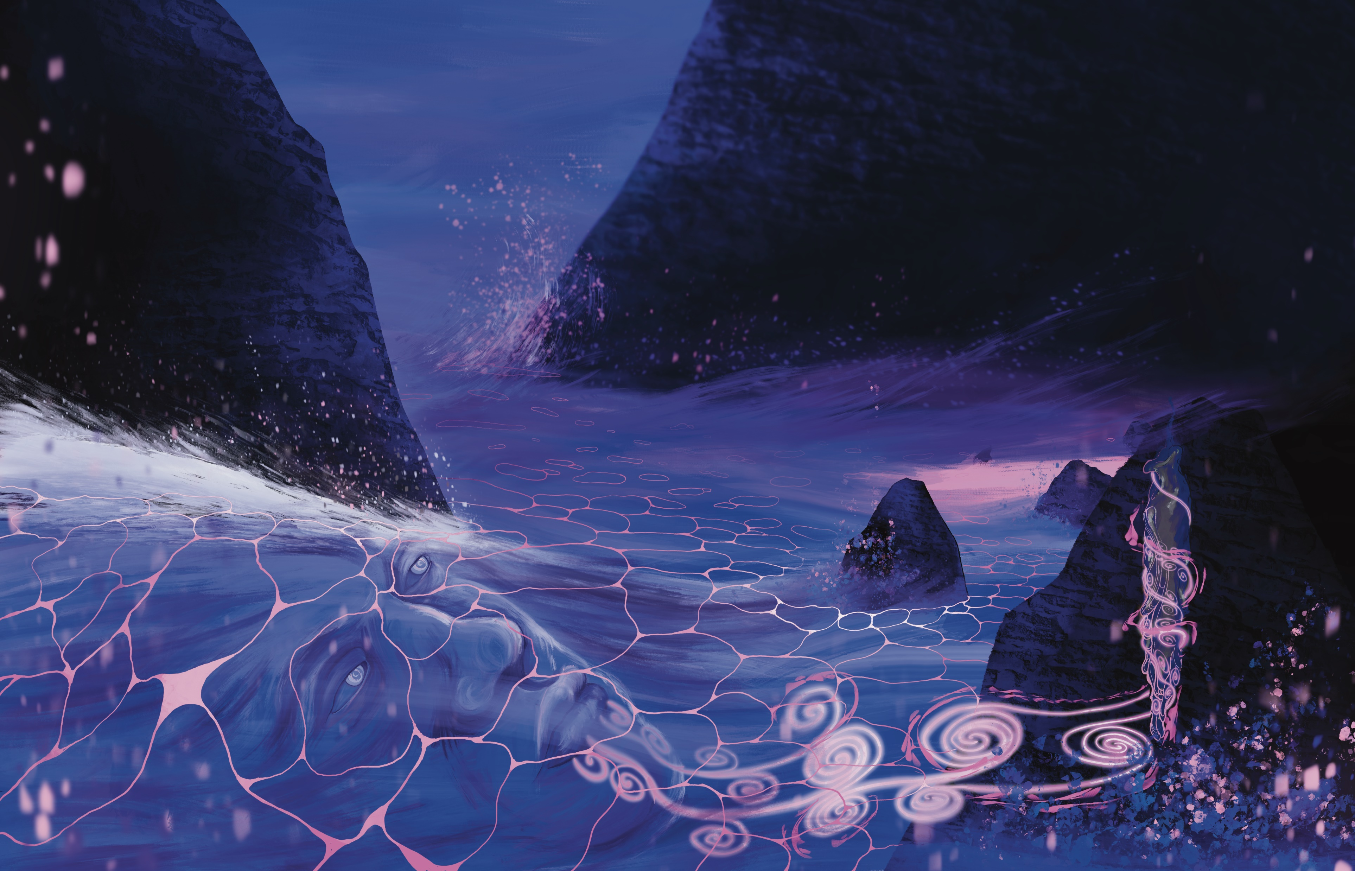
tūmoko
atua
atua-ā-iwi
Ranginui
Papatūānuku
Urutengangana
Rūaumoko
Tangaroa
Tāne
Hinepūkohurangi
Hinemoana

Slide 22
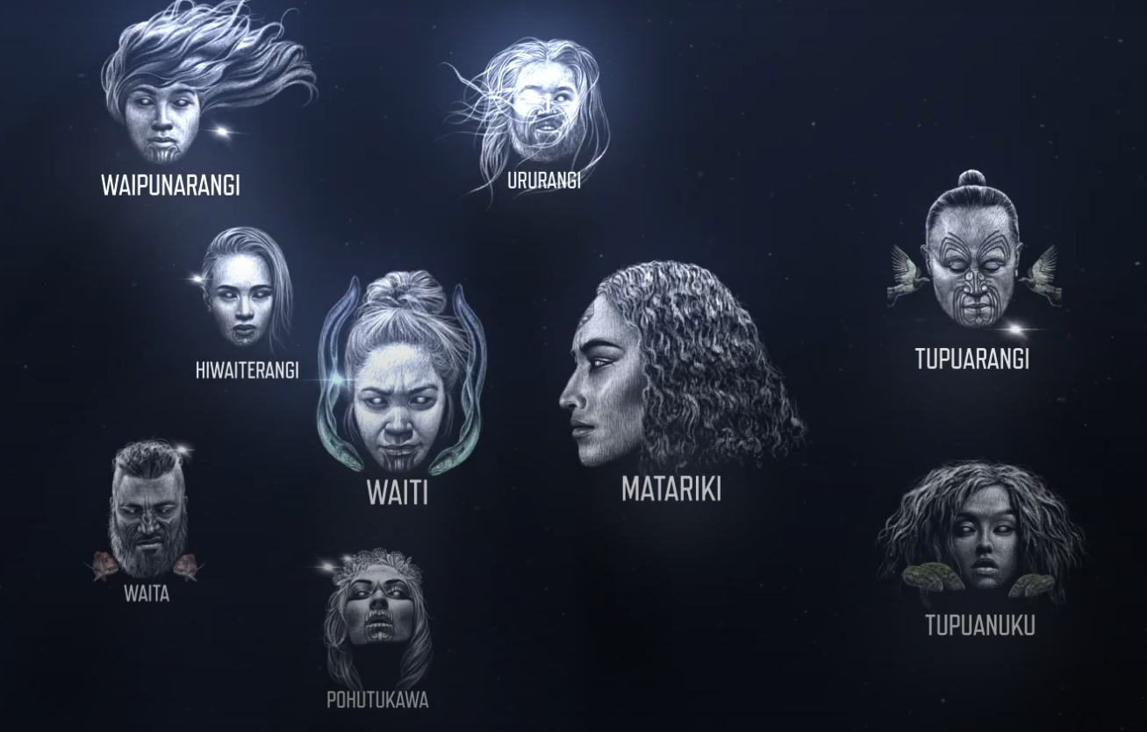
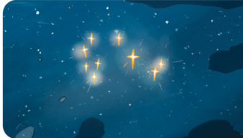

tūmoko whetū
kāhui whetū: Matariki
[Ngā mata o te ariki o Tāwhirimātea]
  Waitī
  Waitā
  Pōhutukawa
  Tupu-ā-rangi
  Tupu-ā-nuku
  Waipuna-ā-rangi

Slide 23
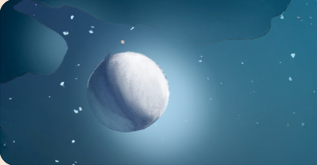
tūmoko in HUIA’s translingual pukapikitia
among tūmoko/atua, picturebooks most commonly feature Tangaroa, atua of the sea
revitalisation of Matariki traditions is reflected in books featuring whetū as celestial beings along with understandings of tūmoko/tātai arorangi, particularly the parts of the lunar cycle

Slide 24
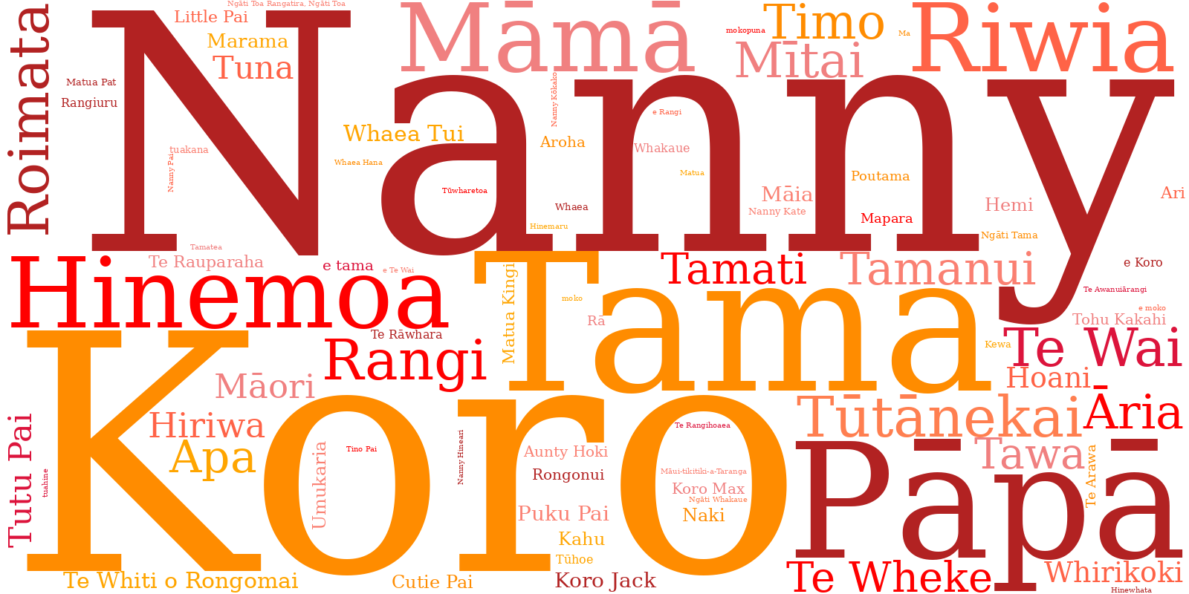
tūmoko tangata
ingoa mātāwaka – Māori
ingoa iwi – Tūwharetoa
ingoa tupuna – Tūtānekai
ingoa tangata – Marama
ingoa kiripuaki – Riwia
tūingoa whānau - Māmā

Slide 25
tūmoko in HUIA’s translingual pukapikitia
almost all picturebooks feature tūmoko/tangata, characters with Māori names or kin designations
tūmoko/tangata are employed to position characters as being Māori, but more than that, many characters belong to particular Māori communities, during particular periods of time

Slide 26
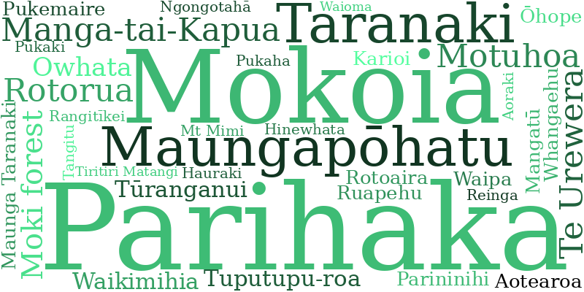
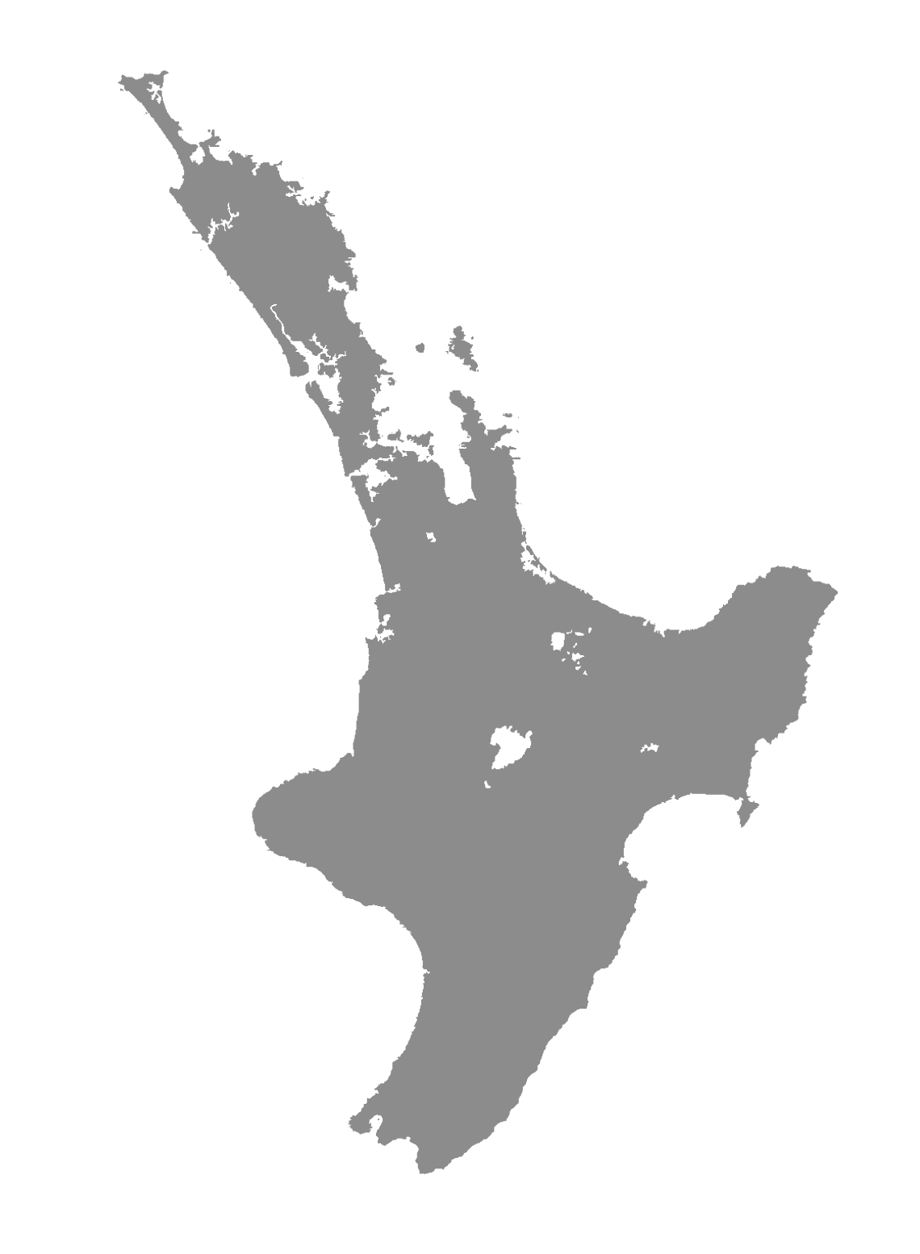
tūmoko tapawāhi
whenua – Aotearoa
motu – Mokoia
maunga-tupuna – Taranaki
puke – Maunga-tai-Kapua
moana – Hauraki
roto – Rotorua
awa – Rangitikei
ngahere – Te Urewera
papa kāinga – Parihaka
wāhi – Ōhope

Slide 27
tūmoko in HUIA’s translingual pukapikitia
composition of the tūmoko/tapawāhi domain reflects extended interactions of Māori communities with the natural environment, as well as establishment of named built environments since earliest settlement of Aotearoa
Indigenous place names have endured and continue to anchor Māori stories and mātauranga Māori to physical spaces

Slide 28
Kupu/kīanga in HUIA’s translingual pukapikitia
extensive collection of kupu/kīanga spread across 44 picturebooks through 30 years of publishing
preliminary analysis indicates semantic domains extend beyond those identified within New Zealand English loan word studies; analysis within te ao Māori reveals complex networks of cultural knowledge embedded in children’s stories
largest category represented is tūmoko

Slide 29
HUIA’s Translingual Pukapikitia
Young, Hepora. (1995). Hinemoa & Tūtānekai: A Te Arawa legend (Kerry Gemmill, Illus.). Huia Publishers.
Tamehana, Esther. (1995). Roimata’s cloak (James Molnar, Illus.). Huia Publishers.
Tamehana, Esther. (1997). The sandman (Kerry Gemmill, Illus.). Huia Publishers.
Clarke, Mere. (1997). Whirikoki and his seal (Manu Smith, Illus.). Huia Publishers.
Mataira, Katerina. (1998). Rangi and his dinosaurs (Ali Teo, Illus.). Huia Publishers.
Reedy, Mokena Potae. (2000). Timo and the kingfish (Elton Gregory, Illus.). Huia Publishers.
Tawhara, Merito. (2000). The pūriri tree (Nikki Slade-Robinson, Illus.). Huia Publishers
Tipene, Tim. (2001). Taming the Taniwha (Henry Campbell, Illus.). Huia Publishers.
Ihimaera, Witi. (2002). The little kowhai tree (Henry Campbell, Illus.). Huia Publishers.
Gabel, Ngāreta. (2003). Oh hogwash, Sweet Pea! (Ali Teo & Astrid Jensen, Illus., Hanna Rainforth, Trans.) Huia Publishers.
Drewery, Melanie. (2004). Koro’s medicine (Sabrina Malcolm, Illus.).
Tipene, Tim. (2005). Haere: farewell, Jack, farewell (Huhana Smith, Illus.). Huia Publishers.
Kapai, Tommy. (2006). Cuzzies find the rainbow’s end (Mike Henry, Illus.). Huia Publishers.
Kapai, Tommy. (2006). Cuzzies meet the Motuhoa shark (Mike Henry, Illus.). Huia Publishers.
Rainforth, Hannah. (2006). Barnaby Bennett (Ali Teo, Illus.). Huia Publishers.
Drewery, Melanie. (2007). The grumble rumble mumbler (Loudmouth Productions, Illus.). Huia Publishers.
Rolleston-Cummins, Toni. (2008). The seven stars of Matariki (Nikki Slade-Robinson, Illus.). Huia Publishers.

Slide 30
HUIA’s Translingual Pukapikitia
Waiariki, Kerehi. (2009). Where’s Koro’s hat? [Kei hea taku pōtae?] (Brian Gunson, Illus.). Huia Publishers. (Original work published 1998)
Szekely, Chris. (2011). Rāhui (Malcolm Ross, Illus.). Huia Publishers.
Beck, Jennifer. (2012). Remember that November (Lindy Fisher, Illus.). Huia Publishers.
Reedy, Mokena Potae. (2012). Timo and the kingfish (Jim Byrt, Illus.). Huia Publishers.
Szekely, Chris. (2013). Swim: The story of Hinemoa and Tūtānekai (Andrew Burdan, Illus.). Huia Publishers.
Cotter, Sacha. (2014). Keys (Josh Morgan, Illus.). Huia Publishers.
Beyer, Rebecca & Linley Wellington. (2015). Tamanui: the brave kōkako of Taranaki (Andrew Burdan, Illus.). Huia Publishers.
Grace, Patricia. (2015). Haka (Andrew Burdan, Illus.). Huia Publishers.
Cotter, Sacha. (2016). The marble maker (Josh Morgan, Illus.). Huia Publishers.
Goddard, Ripeka Takotowai. (2016). Tuna and Hiriwa (Kimberly Tethera Andrews, Illus.). Huia Publishers.
Hemi, Maxine. (2016). When the Bell Rings (Andrew Burdan, Illus.). Huia Publishers.
Cotter, Sacha. (2018). The bomb (Josh Morgan, Illus.). Huia Publishers.
Goddard, Ripeka Takotowai. (2016). Tuna and Hiriwa (Kimberly Tethera Andrews, Illus.). Huia Publishers.
Hemi, Maxine. (2016). When the Bell Rings (Andrew Burdan, Illus.). Huia Publishers.
Cotter, Sacha. (2018). The bomb (Josh Morgan, Illus.). Huia Publishers.
Kurahau. (2019). The smelly giant (Laya Mutton-Rogers, Illus.). Huia Publishers.

Slide 31
HUIA’s Translingual Pukapikitia
Huia Publishers. (2019). Santa’s worst Christmas (Te Aho-White, Isobel Joy, Illus.). Huia Publishers.
Matuku, Steph. (2021). The eight gifts of Te Wheke (Laya Mutton-Rogers, Illus.). Huia Publishers.
Tahau-Hodges, Pania. (2021). The greatest haka festival on Earth (Story Hemi Morehouse, Illus.). Huia Publishers.
Beck, Jennifer. (2022). My mum is queen of the road (Lisa Allen, Illus.). Huia Publishers.
Stirling, Amiria. (2022). The cats of Pāia Street (Sarah Klingworth, Illus.). Huia Publishers.
Te Paa, Brianne. (2022). How my Koro became a Star (Story Hemi-Morehouse, Illus.). Huia Publishers.
Cotter, Sacha. (2023). Dazzlehands (Josh Morgan, Illus.). Huia Publishers.
Smith, Linda Tuhiwai. (2023). I am a little voice (Isobel Joy Te Aho-White, Illus.). Huia Publishers.
Smith, Linda Tuhiwai. (2023). I don’t like Wednesdays (Isobel Joy Te Aho-White, Illus.). Huia Publishers.
Smith, Linda Tuhiwai. (2023). Nothing is impossible (Isobel Joy Te Aho-White, Illus.). Huia Publishers.
Smith, Linda Tuhiwai. (2023). Riwia and the star gazer (Isobel Joy Te Aho-White, Illus.). Huia Publishers.
Smith, Linda Tuhiwai. (2023). Te Wai, Tama and the moon (Isobel Joy Te Aho-White, Illus.). Huia Publishers.
Cleft New Zealand Te Manatōpū Riwha o Aotearoa & Huia Publishers. (2024). The Hunt for the Whistle: A Cleft Adventure (Scott Pearson, Illus.). Huia Publishers.
Lisa Carrington & Huia Publishers. (2024). Lisa Carrington chases a champion (Scott Pearson, Illus.). Huia Publishers.
Matuku, Steph. (2024). The Dream Factory (Zak Ātea, Illus.). Huia Publishers.

Slide 32
Deverson (1984) | Bellett (1995) | Macalister (2006) | de Bres (2006) | Hay et al. (2008) | Grant (2012)
Flora & Fauna | Flora & Fauna | Flora & Fauna | Flora & Fauna | Flora & Fauna | Flora & Fauna
Kinship | Relationships |  |  | Kinship | Genealogy
Māori Society | Concepts peculiar to Māori society | Social Culture | General Māori lexical items | Māori society and cultural practices | Māori Concepts
 |  | Material Culture
 | Mythology | Other
 | Religion
 | Phrases |  |  |  | Greetings
 |  |  | Proper nouns – place names | Place names | Toponyms
 |  |  | Proper nouns – personal names | Proper nouns – personal names

