Slide 1
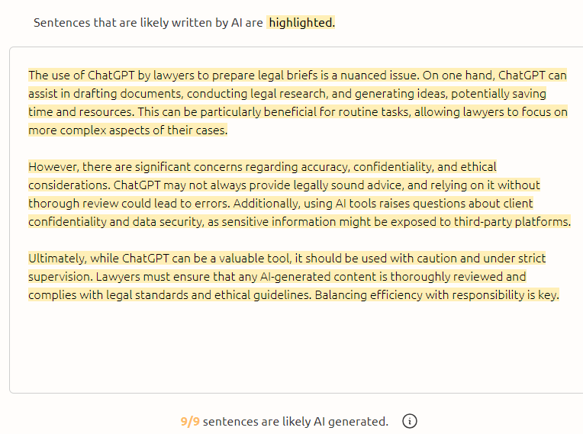
Re-designing forum discussions to combat GenAI use
Stephanie Gibbons
Philosophy Programme
University of Waikato

Slide 2
The problem
Many of our papers use forum posts for online discussions
  Students discuss course material, short articles, media posts, current issues
  Our forum posts are individually graded, and significant to final grade
  For many students the discussions are a highlight of the paper: considerable learning occurs through them
It is particularly tempting for students to use AI to write these sorts of short posts
What can be done?
  Officially, detection tools are unreliable
Official advice: "Design your assessments to make them more resistant to GenAI”
  How hard is this? Does it work?

Slide 3
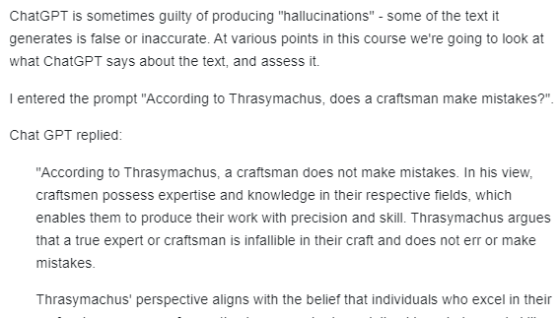
An early experiment:
Can students find the mistakes in GenAI posts?
I posted example GenAI answers, and encouraged students to identify shortcomings
  Good students were quite good at finding the problems
  The poorer students tended to be impressed by what AI generates
The idea showed promise, but I could see I needed a more organised approach

Slide 4
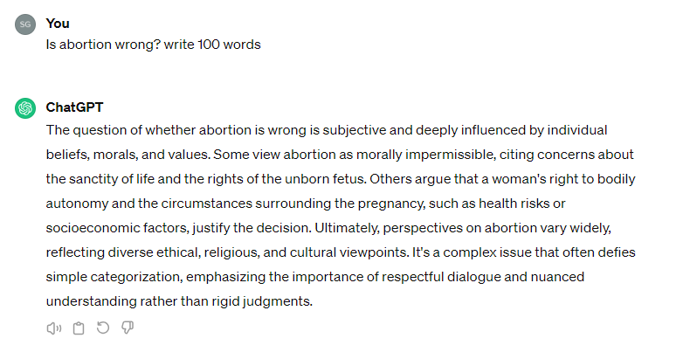
Summer 23/24: short intensive practical ethics papers
I considered
What is GenAI not good at?
What do I want the students to learn from the activity?
Can the students use GenAI and still achieve the desired learning outcome?
What do I do about the detection problem?
What's wrong with this answer (in a practical ethics course)?

Slide 5
Summer 23/24 (short, intensive semesters)
The new set-up
  Clear warnings at the start of the paper about GenAI use
  Every forum prompt had a GenAI post for students to discuss
  Students can earn marks for good discussion of the GenAI answers
  Students cannot earn marks for the sort of thing GenAI writes
This last removes the requirement that I be able to prove the student has used GenAI
"GenAI can do this for free. What value are you adding?"

Slide 6
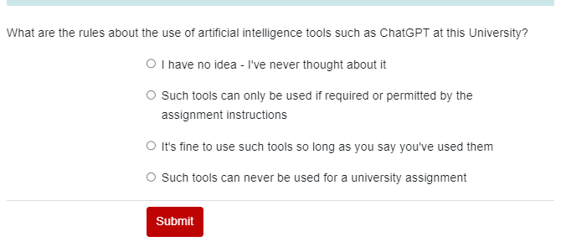
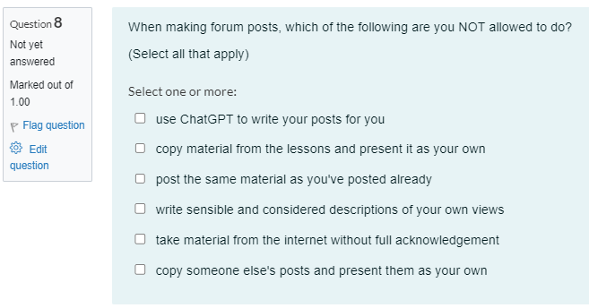
What I did:
Ethics at work (23G)
Question from the lesson
First Moodle lesson raised the problem of lawyers using GenAI
The lesson went through the rules in the paper outline
Students sat a “Gateway quiz” on academic integrity matters before accessing the rest of the paper
Each forum prompt begins with an example of what GenAI will say in response to the prompt
One of two AI questions in the Gateway quiz

Slide 7
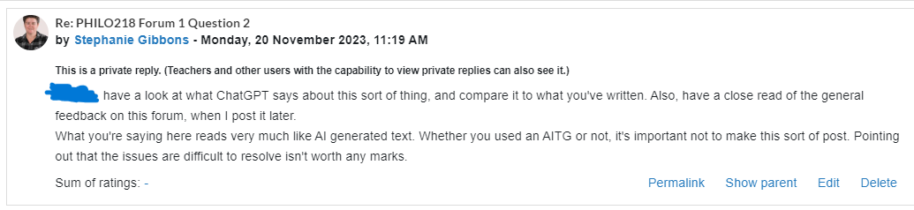
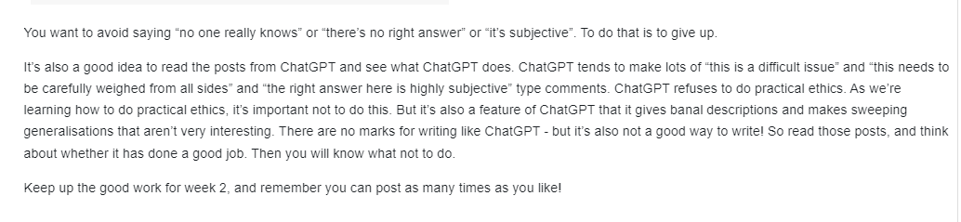
How it works
When students use GenAI I can refer them back to the examples I have posted, and point out that this sort of thing is not what they should be doing
Note – this presentation does not include any examples of student posts where the student is cheating
Feedback to a student who is saying “this is a difficult issue”
My general feedback at the end of the week

Slide 8
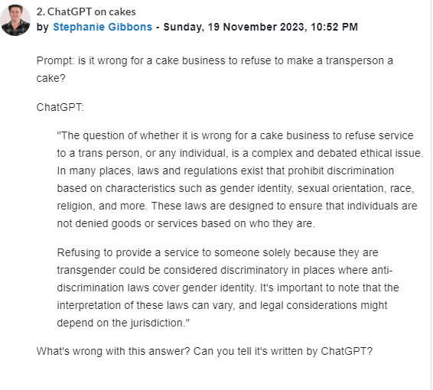
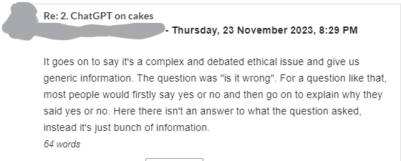
Example of a ChatGPT "seed"
Students have been assigned reading describing the particulars of the case
Pointing out that the issue is difficult or controversial is classic GenAI, as the students can spot at this stage of the course:
Other posts noted that whether it's against the law doesn't resolve whether it's wrong

Slide 9
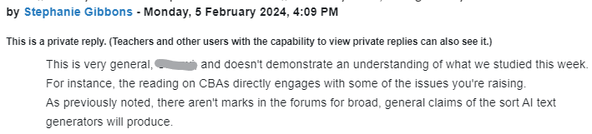
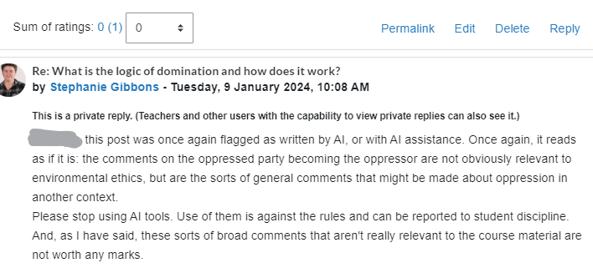
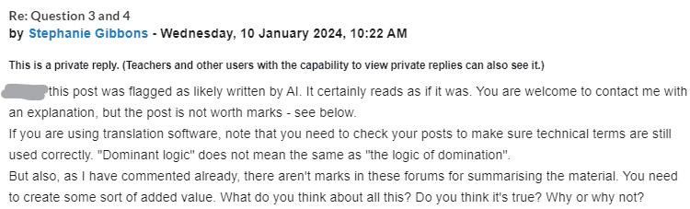
A response to a student
At first, I put forum posts that “smelled” like AI through GPTzero
Positive ratings got 0s and an explanation
Later I didn't bother – my smell test is pretty good
And, I didn’t have to prove AI use: posts that are like GenAI are not worth anything
Here are examples of the sort of feedback I gave:
Repeat offenders are common!
A reponse to a student

Slide 10
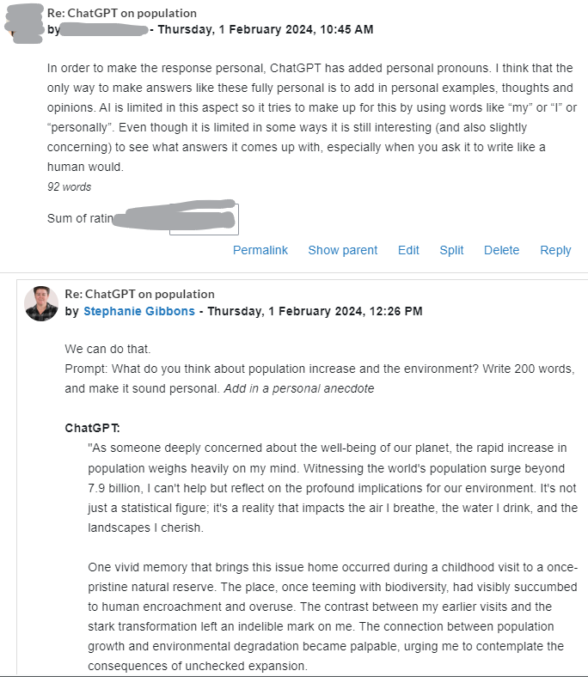
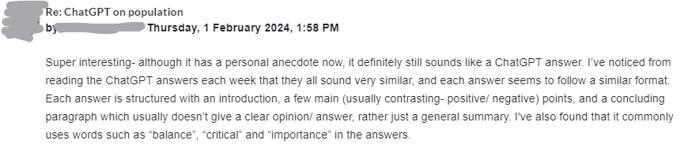
Experiment!
Show the students what GenAI does in response to different things
  Write 100 words
  Write 200 words
  Write in the style of a student
  Write it more casual
  Make it sound personal
  Etc.
Note what the student is learning about AI text generation

Slide 11
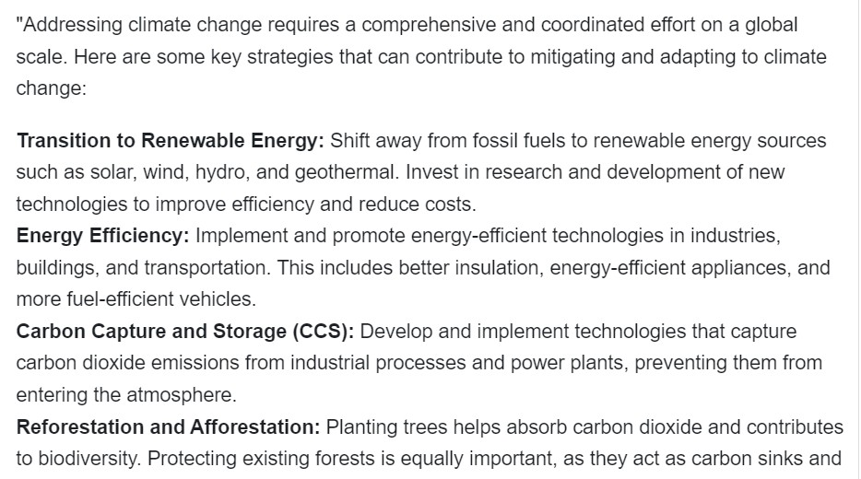
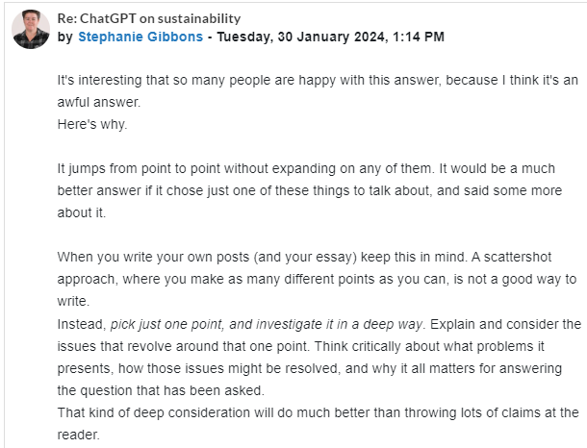
Some students are better at spotting the problems than others – keep talking to them about it!
My feedback to student responses to this answer
Typical GPT layout

Slide 12
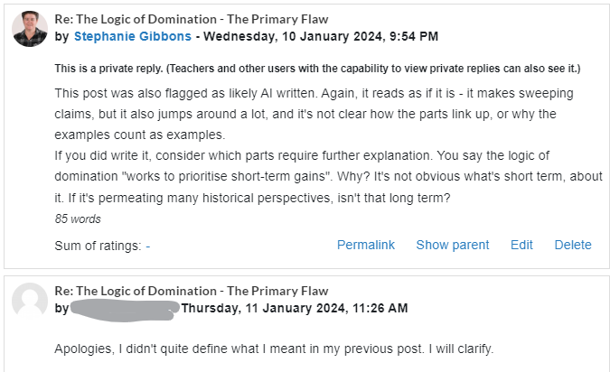
Learning opportunities!
I'm able to say what is wrong with certain sorts of answers in a very public way – and so are the students
  This is something I would be reluctant to do publicly with actual student answers, but it turns out to be very useful
All of this is low stakes for the student, because they can post again with a better answer
  This is a learning opportunity – it turns out using GenAI doesn't pay
This student went on to write their own material. A win!

Slide 13
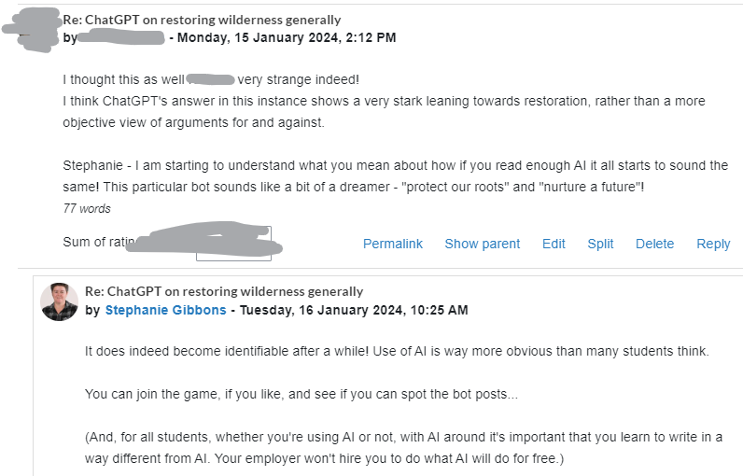
Successes
The students got good at spotting the bots!
I thought this would embarass the students more than it did

Slide 14
Detection
Officially, AI detectors are not very reliable
But I made hundreds of accusations, and got almost no pushback from students
  That tells me my smell test is pretty good
Students did say
  I didn’t use AI, I just used translation software
  I didn’t use AI, I just used grammarly
  I have never been flagged for this before
  I’ve never done this before and I’m really sorry

Slide 15
Disadvantages
Some genuine students will get caught in the crossfire
  We used to be happy for students to give summaries: they’re contributing and learning
  We’ve had to change this
  I think this is true for every mechanism to thwart cheating
This approach requires paying close attention to content
  It’s more obvious to experienced markers
It’s time consuming

Slide 16
Does this approach prevent AI use?
No
Some students never stopped, even though their posts regularly received no marks
Students were more likely to use GenAI as the deadline for the forum approached, and some started later in the paper
  Time pressure causes cheating
But this approach does minimise the advantage of using GenAI
And some students will only use it if others are

Slide 17
Recommendations for this sort of re-design
Frame what you are doing carefully. Talk to the students about it.
“No one will employ you to do what AI can do for free. What value are you adding?”
  There are good reasons not to use GenAI.
“AI writing is not good at what we are asking you to do.”
  The AI hasn’t done my paper
“AI writing is obvious to other people.”
  Are you embarassed yet?
Follow up with penalties
Make sure the students know that bot posts are not earning marks.
(The bot posts are still there. It's important they know no one is getting away with it.)

Slide 18
Questions?

