Slide 1
The cost-effectiveness of active surveillance compared to radical prostatectomy for low risk localised prostate cancer
Chunhuan Lao, Richard Edlin, Paul Rouse, Charis Brown, Michael Holmes, Peter Gilling, Ross Lawrenson

Slide 2
Introduction
localised prostate cancer
Low, Intermediate, High risk (D’Amico risk classification system)
Radical prostatectomy (RP)
The most common treatment
Active surveillance (AS)
To avoid harms caused by radical treatments

Slide 3
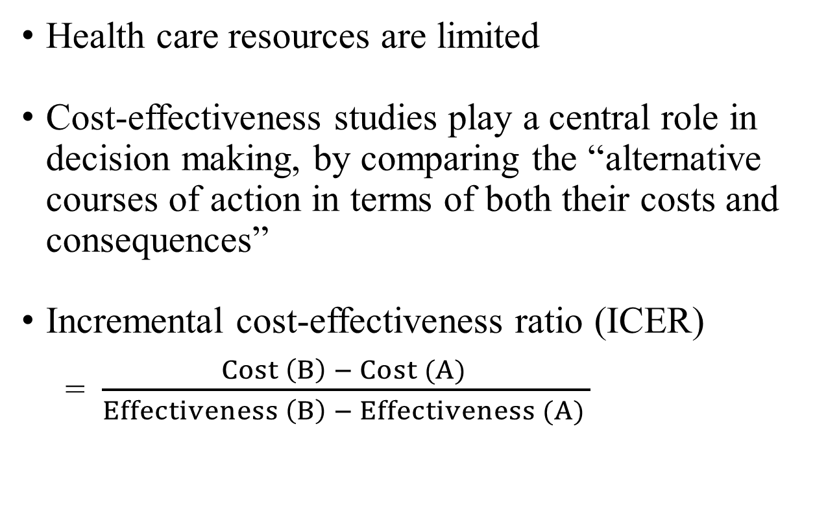
Introduction
Cost effectiveness analysis
Health care resources are limited
Cost-effectiveness studies play a central role in decision making, by comparing the “alternative courses of action in terms of both their costs and consequences”
Incremental cost-effectiveness ratio (ICER)
= $\frac{Cost \left(B\right) − Cost (A) }{Effectiveness \left(B\right) − Effectiveness (A) }$

Slide 4
Introduction
Aims
To compare the cost-effectiveness of active surveillance and radical prostatectomy for men diagnosed with low risk localised prostate cancer

Slide 5
Methods
TreeAge Pro 2015
Life-time Markov model
Age at diagnosis: 45, 50, 55, 60, 65, 70 years
Perspective of the Ministry of Health in New Zealand

Slide 6
Methods
Influence diagram for active surveillance:
Local progression
Post-surgery
Metastatic
Radical prostatectomy is performed when cancer progression is detected (1.6% per year)
Low risk Localised
Death from prostate cancer
Death from other causes

Slide 7
Analyses
Base-case
  Using costing data from the Midland prostate cancer study [1]
  Using 1.6% annual conversion rate from AS to RP [2-4]
  Using the quality of life of 0.89 for AS, 0.90 for RP [5]
Scenario analyses
  Using costing data based on NZ guidance [6]
  Using 5% annual conversion rate from AS to RP
  Using the quality of life of 0.83 for AS, 0.80 for RP [7]
[1] Lawrenson R, Brown C, Obertova Z, Lao C, Conaglen H. The Midlands Prostate Cancer Study: Understanding the pathways of care for men with localised prostate cancer. Auckland, New Zealand; 2014.
[2] Bill-Axelson A, Holmberg L, Filén F, Ruutu M, Garmo H, Busch C, Nordling S, Häggman M, Andersson SO, Bratell S et al: Radical prostatectomy versus watchful waiting in localized prostate cancer: The Scandinavian prostate cancer group-4 randomized trial. Journal of the National Cancer Institute 2008, 100(16):1144-1154.
[3] Bill-Axelson A, Holmberg L, Garmo H, Rider JR, Taari K, Busch C, Nordling S, Häggman M, Andersson S, Spångberg A et al: Radical prostatectomy versus watchful waiting in early prostate cancer. New England Journal of Medicine 2014, 370(10):932-942.
[4] Cooperberg MR, Ramakrishna NR, Duff SB, et al. Primary treatments for clinically localised prostate cancer: A comprehensive lifetime cost-utility analysis. BJU Int 2013; 111(3):437-450.
[5] Korfage IJ, Essink-Bot ML, Borsboom GJJM, et al. Five-year follow-up of health-related quality of life after primary treatment of localized prostate cancer. International Journal of Cancer. 2005; 116: 291-96.
[6] Prostate Cancer Working Group and Ministry of Health. Guidance on Using Active Surveillance to Manage Men with Low-risk Prostate Cancer. (Wellington: Ministry of Health, 2015).
[7] Hayes JH, Ollendorf DA, Pearson SD, Barry MJ, Kantoff PW, Stewart ST, Bhatnagar V, Sweeney CJ, Stahl JE, McMahon PM: Active surveillance compared with initial treatment for men with low-risk prostate cancer: A decision analysis. JAMA 2010; 304(21):2373-2380.

Slide 8
Results: Life-time costs
Base-case results: Life-time costs per man
Age (years) | Active surveillance | Radical prostatectomy
45 | $23,396 | $22,316
50 | $21,115 | $20,991
55 | $18,484 | $19,612
60 | $15,461 | $18,254
65 | $11,998 | $16,972
70 | $7,976 | $15,821
>
<
The gap in life-time costs for men aged 55-70 years
between AS and RP increases with age at diagnosis

Slide 9
Results: Life-time costs
Scenario analysis: using costing inputs based on guidance
Age (years) | Active surveillance | Radical prostatectomy
45 | $23,491 | $21,162
50 | $21,229 | $19,831
55 | $18,618 | $18,457
60 | $15,622 | $17,095
65 | $12,210 | $15,810
70 | $8,231 | $14,668
>

Slide 10
Results: Life-time costs
Scenario analysis: using a 5% annual conversion rate from AS to RP
Age (years) | Active surveillance | Radical prostatectomy
45 | $28,028 | $22,321
50 | $25,948 | $20,988
55 | $23,378 | $19,610
60 | $20,206 | $18,251
65 | $16,174 | $16,962
70 | $10,850 | $15,821
Base-case result: Active surveillance
$23,396
$21,115
$18,484
$15,461
$11,998
$7,976
>
The cost of active surveillance increased by 20% (aged 45 years) to 36% (aged 70 years)

Slide 11
Results: Life-time QALYs
Base-case results: Life-time quality-adjusted life-years (QALYs) per man, using 0.89 for AS, 0.90 for RP
Age (years) | Active surveillance | Radical prostatectomy
45 | 16.34 | 16.43
50 | 15.24 | 15.35
55 | 13.97 | 14.08
60 | 12.52 | 12.65
65 | 10.9 | 11.05
70 | 9.17 | 9.35
<

Slide 12
Results: Life-time QALYs
Scenario analysis: using 0.83 for AS, 0.80 for RP
Age (years) | Active surveillance | Radical prostatectomy
45 | 15.20 | 14.73
50 | 14.18 | 13.75
55 | 12.99 | 12.61
60 | 11.65 | 11.31
65 | 10.16 | 9.88
70 | 8.57 | 8.35
>

Slide 13
Results: ICER
Baseline: using the 1.6% annual conversion rate from AS to RP, the quality of life of 0.89 for AS and WW, 0.90 for RP
Age at diagnosis (Years) | ICER (Cost per QALY gained) |  | Dominance
 | AS vs RP | RP vs AS
45 | - | - | RP is less costly and more effective
50 | - | - | RP is less costly and more effective
55 | - | $10,255 | -
60 | - | $21,485 | -
65 | - | $33,160 | -
70 | - | $43,583 | -

Slide 14
Results: ICER
Scenario analysis: using the 5% conversion rate, 0.83 for AS, 0.80 for RP, and costing inputs based on guidelines
Age at diagnosis (Years) | ICER (Cost per QALY gained) |  | Dominance
 | AS vs RP | RP vs AS
45 | $21,015 | - | -
50 | $18,456 | - | -
55 | $14,969 | - | -
60 | $8,952 | - | -
65 | - | - | AS is less costly and more effective
70 | - | - | AS is less costly and more effective

Slide 15
Conclusions
Active surveillance is less likely to be cost-effective compared to radical prostatectomy for younger men diagnosed with low risk localised prostate cancer
The cost-effectiveness of active surveillance compared to radical prostatectomy is critically dependent on the ‘trigger’ for radical prostatectomy and the quality of life in men on active surveillance. Research on the latter would be beneficial

Slide 16
Thank you !

