Slide 1
The ever-changing landscape of New Zealand Vocational Education and Training:
The Reform of Vocational Education (RoVE) and the current and planned changes sought by the current Coalition Government.
Gemma Piercy, University of Waikato
Symposium: The National-led government’s first year: public policy changes and their employment relations issues, trends & implications, AIRAANZ conference, February 3-5 2025 Victoria University, Wellington, NZ

Slide 2
Introduction
A market model to industry training was introduced in 1992 since then vocational education and training has been in a state of constant change
My presentation will:
  Assess the capacity of the current VET system to deliver long-term improvement to vocational training,
  Explain RoVE reforms,
  Outline current changes,
  Offer views on likely impacts, on-going issues.

Slide 3
Drivers for reform under Labour
VET system evaluation: no longer fit for purpose
  Co-ordination failure between demand and supply in critical industries
  Inconsistency in quality of programmes,
  Confusion about the role of ITOs and poor collaboration across TEOs,
  Issues with split funding model: EFTS for off-job and STMs for on-job learning
  Several ITPs were financially insolvent
  Disconnection with TEOs from the labour market, industry and employers

Slide 4

RoVE: Aims
Redefine the roles of education providers and ITOs and extend industry and employers’ leadership role across vocational education.
Create system-level bodies to set standards and provide strategic direction.
Remove the distinction between workplace- and provider-based learning.
Create a New Zealand Institute of Skills and Technology (NZIST) to unify all ITPs into one organization and incorporate ITO operational functions.
Create a unified funding system.

Slide 5
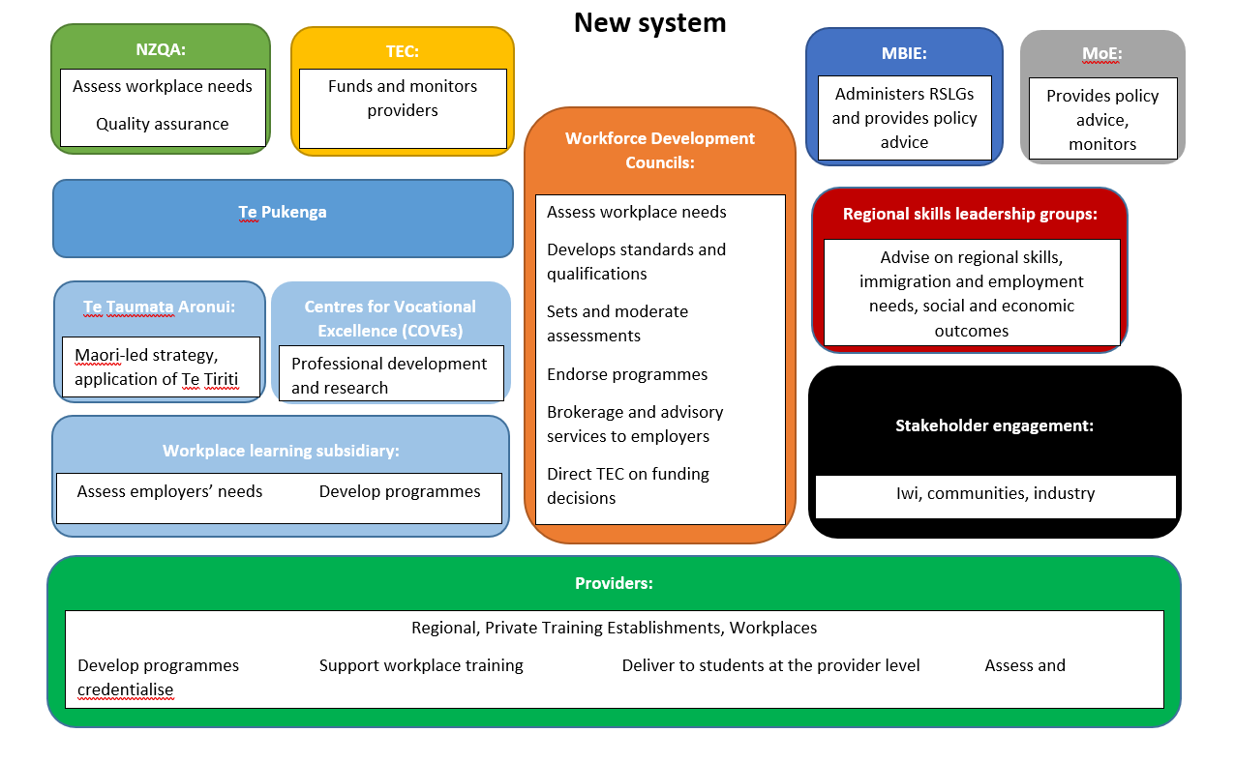

Slide 6
Implementation issues
The reforms offered much but remained focussed on student based demand for funding – funding model based on enrolments rather than operational costs
Resistance to the reforms remained amongst some ITPs, ITOs and employers
New systems were slow coming online and there were substantial cost blowouts
Operational connections between key bodies were not clear
The financial issues for sites unsustainable under a market approach remained.
In 2023 only two polytechnics and the work-based learning (ITO) were profitable
Notes:
there is also a role for industry in the Centres of Vocational Excellence (CoVEs) with their focus on teaching, learning, and research.51 The first two CoVEs to be established – ConCOVE in the construction industry and the Food and Fibre CoVE in primary industries, appear to have had input from industry and it will be interesting in the future to watch the extent to which employers are enabled to participate in and contribute to the work of the CoVEs. Alkema, p.157
The TEC talks about the CoVEs being “learner focused, industry led, government enabled”. This suggests people and organisations interacting with each other in ways that allow the complex problem of how to deliver vocational education to meet the needs of industry, employers, and learners/trainees/apprentices. (Alkema, p. 158 – but perhaps not – confusion exists compare to Chan Interview)

Slide 7

Election policy
National campaigned on reversing the centralization of Te Pukenga stating with no detail that autonomy would be returned to the regions via the creation of 8-10 organisations
They also signalled that regional skills leadership groups would be defunded
The dis-establishment of Te Pukenga was subsequently included in the 100 day plan once the coalition agreement had been signed

Slide 8
Current changes
Requiring legislative change progress has been slow and rumours have been many but Te Pukenga has halted IT projects working on the basis that it will be dis-established
A consultation took place in August 2023 that resulted in some clarity for the former polytechnics and signalled that WDCs would be replaced with Australian style industry skills boards but decisions on the co-ordination of apprenticeship work-based training has been deferred till 2025 when additional consultation will take place
The 8-10 organisations will be achieved by forcing smaller organisations into a federation while larger entities will merge on a regional basis, continuing a strategy pursued by ITPs under the previous National Government eg Toi Ohomai and Ara.

Slide 9
Markets and financial sustainability
The over-riding emphasis in the current policy is that polytechnics must be financially sustainable using funding models based on a market approach eg enrolments
Given the public and private economic and social benefits of training is the market the best means to distribute qualifications and skills development in the economy?
Relying on students as buyers results in an under supply of skills/qualification for some industries
Employers are also buyers of graduates/employees. Employers could invest in more training to address these gaps but based on experience this has not been the case
This demonstrates the public good problem inherent in VET – markets tend not to provide the right quantity of public goods creating co-ordination problems
Industry levies and subsidies could address these problems by incentivizing students/workers participation in VET

Slide 10
Looking ahead
Focussed on constituencies rather than developing a strong, integrated and responsive system, the reforms are likely to cement in pre-existing problems and inequalities
The ITP workforce is exhausted from constant change, the impacts of responding to COVID-19 lockdowns at the same time as dealing with RoVE
For sustained training culture, skill utilisation and demand-side issues need to be addressed – for example, policy development was and remains disconnected from labour market approaches taken by other parts of the government
Specialised training programmes, such as forestry in Rotorua are likely to continue to be cut, deepening pre-existing skills shortages
Questions remain over how and where work-based learning will be located as tensions remain between industry, employers and their trust in training providers such as private training providers, polytechnic and in some cases ITOs

