Slide 1
Ūkaipō: Wānanga, places of origin and photographic representation
Te Pūnaha Matatini 2024 Hui
Professor Tom Roa and Dr Rodrigo Hill

Slide 3
Photography and Wānanga
Linda Tuhiwai Smith posits Wānanga as ‘thought spaces’ (Smith et al., 2019).
We posit Wānanga as ‘the sharing of thought spaces’ where research participants are invited to reflect on, in, and for our research, and, in so doing, share in the ownership of it.
How does your image connect with your place of origin? - place comments on your own images
What this image is telling you? - place comments in all the images.
10-15 minutes than share back with group.

Slide 4
Ūkaipō – place of origin
Ūkaipō recognises the cultural, emotional, and spiritual along with the physical ties a Māori has with their place of origin, even if it is not their place of birth, emphasising grounded forms of connection between people and place and subsequent understandings of places and spaces. Hence the importance today of people asserting their pēpeha, tohu whenua landmarks with which they most strongly identify, consolidating their ‘birth of place’ or ‘place of birth’.

Slide 5
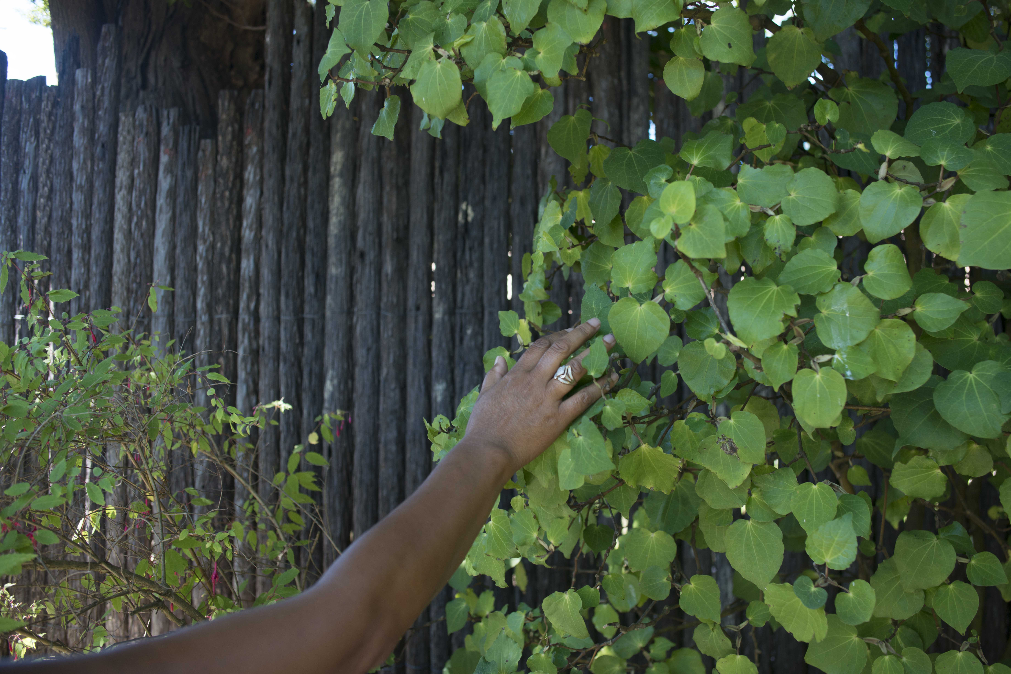
Oriori
Oriori (lullaby): Its prime purpose was to teach children about their whakapapa (genealogy), stimulating initial processes of place -bonding and -grounding and the inherent relationships within.

Slide 6
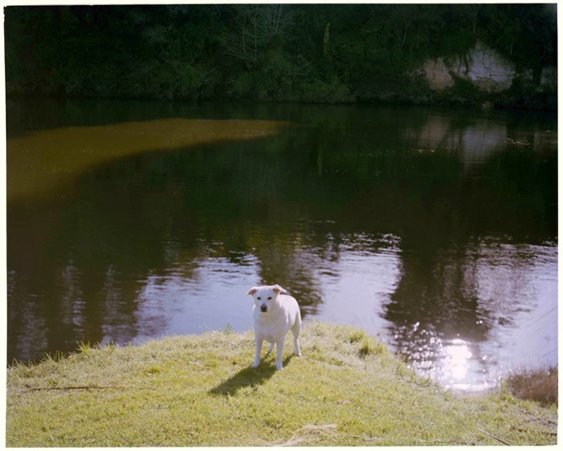

Slide 8
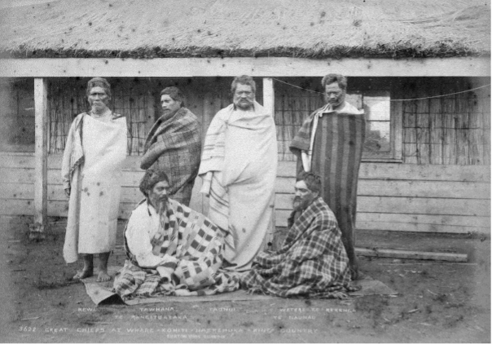
Mana Motuhake and Photography
How do we ensure mana motuhake is acknowledged? Belongs to whom?
How the images offer an expression of your place of origin and mana motuhake ?

Slide 9
Round two: Further post it comments on photographs.
How do we ensure mana motuhake is acknowledged? Belongs to whom?
How the images offer an expression of your place of origin and/or mana motuhake ?
How the images connect with the concept of Ūkaipō?
Share back / final discussions.

