Slide 1
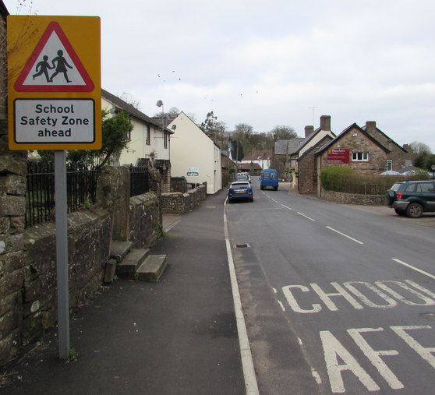
The Safety-fication of Curriculum as an Example of Bureaucratic Governance
Marta Estellés, University of Waikato, New Zealand
Hannah Spector, Penn State University at Harrisburg, USA
AAACS 2024 Conference Philadelphia, PA
This Photo by Unknown Author is licensed under CC BY-SA

Slide 2

Auckland, 2023
Notes:
Marta
Start of this work: Dec, 2023 in Auckland at PESA Conference
We randomly met having lunch and had a conversation about Arendt’s work – NOTE: and the UBC connection!!!
On that evening I checked Hannah’s work on bureaucracy, which put into words what I had just been observing in my ethnographic study on safetyfication
We had a few conversations about it,Hannah could see lots of resonances with trends in higher education
So we decided to start formalising this work by submitting a proposal for AAACS

Slide 3
The Safetyfication of education
Safe learning environments
Online safety
Safety checks
Safe spaces
Safe conversations about racism
Safety
Cultural safety
Safe schools
Safe care
Safe participation in the digital world
Safe and inclusive spaces for all learners
Health and safety
A safe curriculum?
Notes:
Marta
What is safetyfication? Safetyfication is the term I use to describe the process through which the notion of ‘safety’ has acquired an omnipresent status in education in the Anglophone world, including (although a bit more implicitly) the curriculum!

Slide 4
Genealogy of safety in education
Four phases:
  The development of mass education (1850-1970s) – when physical safety became of increasing importance
  The neoliberal turn (1970s-1980s) –when the issues of school violence and child abuse came to the forefront as part of the attack to public education
  The neoliberal consolidation period (1990s-2000s) –when wellbeing concerns proliferated
  The progressive neoliberal turn (2010s-present) –when safety has been associated with social justice claims as part of the ‘therapization of social justice’ (Ecclestone & Hayes, 2019) Estellés (under review)
Notes:
Marta
Part of my study in this space has been looking at where this trend comes from.
In my historical inquiry of this process, I could distinguish between four general phases: 1, 2, 3, 4
My main point here is that neoliberalism was only as a condition of possibility for the widespread use of safety in education, but also its main driver

Slide 5
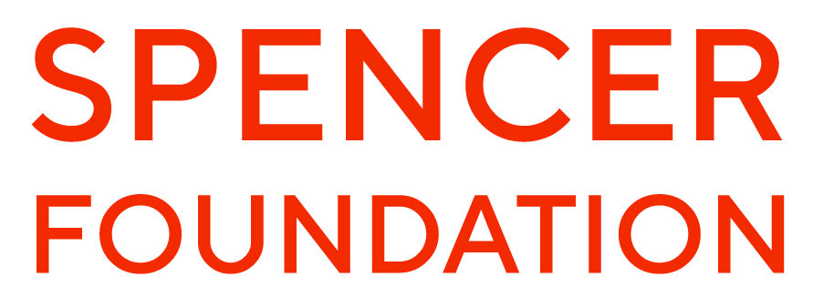
Ethnographic study
–
4 NZ schools on how they understand and promote safety
School policy text related to safety in physical, emotional and cultural terms
Interviews with 4 principals and 17 teachers
Focus groups with 52 (16+) students
Notes:
Marta
By the time I met Hannah I was just finishing the data collection of an ethnographic study on how 4 schools in NZ were doing to promote safe learning environments. I wanted to see how current ideas of safety play out in schools. I was trying to make sense of the themes that I was seeing and one of the themes that I was really struggling to theorise, particularly with the data from the teachers, was the culture of overregulation that safety led. This is the point where I was at when I read Hannah’s analysis of bureaucracy…

Slide 6
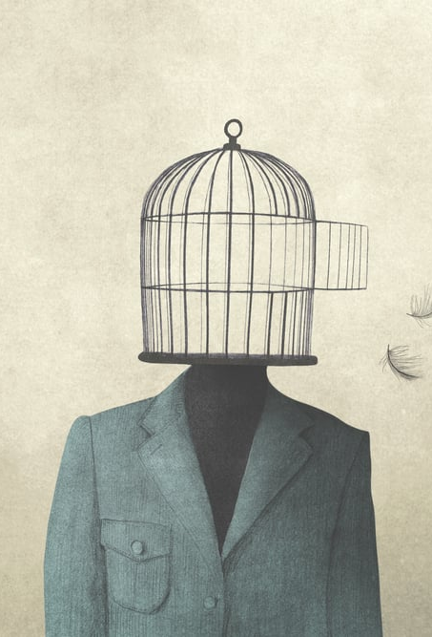
Bureaucracy in education
Analyses of this subject underscore bureaucracy in education from an economic perspective associated with efficiency and productivity.
When studied from a political perspective, an understanding of the ways in which bureaucracy influences ethical consciousness can be gleaned. This influence brings attention to questions concerning the ‘nature’ of responsibility under the bureaucratic apparatus that governs US public schooling.
Spector (2018; 2023) counterintuitive case study: US neoliberal school reform. Education-based critical analyses on reform underscore it a privatizing agenda. This agenda nevertheless uses bureaucratic techniques and strategies (e.g., standard operating procedures; fragmentation of knowledge; performance metrics).
Notes:
Hannah / Theoretical framework:
Weber: “assert[ed] that the chances were very great indeed that mankind would in the future be imprisoned in an iron cage of his own making” (Coser as cited in Spector, 2018). For Weber, bureaucratic secrets have more to do with command and control than they do with functionality
Arendt (1969) aptly calls bureaucracy as a form of government ‘rule by Nobody’ (p.38). Because this type of rule does not need to justify its actions and exercises its power by way of a top-down central administrative authority, it is tyrannical. Arendt, too, looked at the relationship between bureaucracy and secrecy.
Hibou (2015) The bureaucratization of the world in the neoliberal era.

Slide 7
Bureaucracy and safety in neoliberal times
“Bureaucratization of safety has brought benefits, including a reduction of harm, standardization, transparency and control. It has been driven by regulation, liability and insurance arrangements, outsourcing and contracting, and technologies for surveillance and data storage. However, bureaucratization generates secondary effects that run counter to its original goals. These include a reduced marginal yield of safety initiatives, bureaucratic entrepreneurism and pettiness, an inability to predict unexpected events, structural secrecy, 'numbers games,’ the creation of new safety problems, and constraints on organization members’ personal freedom, diversity and creativity, as well as a hampering of innovation” (Dekker, 2014, p. 348).
“The bureaucracy of safetyism” in higher education (Lukianoff & Haidt, 2018, pp. 195-212).
  The corporatization of college; the customer is always right; overreaction and overregulation cases; moral dependency in which “new ideas about microaggressions, trigger warnings, and safe spaces” (p. 210) overprotect students making them “more vulnerable instead of less.”
Notes:
Hannah

Slide 8
How is bureaucracy as a form of governance operating through the safetyfication of education?
Ethnographic study
–
NZ secondary schools
Policy/document analysis
–
US tertiary education
Notes:
Hannah

Slide 9
Ethnographic study – nz schools
a) Calls for regulation
Teacher 1: We know all the kids are vaping. They're not necessarily doing it right in front of our faces, but they're doing as soon as they're out in the playground. And after school. We know that when they are at Te Aroha [another school], if you are caught vaping at school, you are stood down for a day and then…they have to have a meeting with the drug and alcohol counselor.… that's a compulsory reentry, part of the reentry back into school. We don't seem to have that.…
Teacher 2: Because we have no policies, we just haven't have good policies. What is the process? What is the flowchart for? So if a student is caught… what is the process?
Notes:
Marta

Slide 10
Ethnographic study – nz schools
b) Conflict avoidance /seeking support from superiors/ the client is always right?
Marta: Have you ever been concerned with, you know, the safety,, either in physical, emotional or cultural terms, of your students?
SS teacher 1: Interesting. Yeah. The last two years, I've talked a unit about the legalized love campaign in New Zealand, which was for same sex marriage equality. And students, particularly Māori, but especially Pacific students from, and Filipino actually, Filipino from Catholic backgrounds and Pacific students from different, largely from different Christian denominations have felt unsafe in that space because their religious beliefs are very much in opposition to same sex marriage in particular… So that's been an interesting space to navigate. Because as a social science educator, I see it as really important for young people to have these conversations and to look at Rainbow rights from a human rights perspective. And, actually, in the first year that we taught it, I consulted with one of our assistant principals who is the cultural advisor and we decided that perhaps I should offer a different topic for the students who felt unsafe. And so we did that. And I felt uncomfortable about it, because then I had, not many, but I had somewhere between three to five students who were studying a completely different topic, but they were still present in the class
Notes:
Marta

Slide 11
Marta: Coming back to the cultural safety thing, have you ever had any issues where you had to, like, needed to get support from from someone outside your classroom?
SS Teacher 2: Yeah, so last year… I sent a welcome letter via Kamar [app for communication with parents], which is something I have always done just to say, these are the topics we're doing and this is my contact information. And if there's anything I should know about your student before they come in, like, let me know…. And anyway, last year, one of our unit titles because we were trying to be more culturally responsive and respectful had a name in te reo [Indigenous language]… and I got a really nasty email back from a parent accusing us of whitewashing … the assumption straightaway was that ‘oh, this is a white teacher who's doing the wrong thing’. So it was really quite ugly. I won't lie about it. And so I went through our Dean here I went to my Head of Learning as well because I was just like: ‘Oh, she's gonna expect a response. But what do I respond?’. And I also went to our Head of te reo and I also went to our Deputy Principal because I was just like, I just felt it was above my paygrade to be sort of accused of whitewashing when I was just trying to tell them what the kids were going to learn.
Marta: what happened there ?
SS Teacher 2: We had to change all the names back to English because of that, which was really frustrating. We felt like we were making a step forward in terms of truly being culturally responsive in terms of recognizing that there's an English name, and a te reo name…. But yeah, we basically got told that we should not use te reo… it just sort of feels like yeah, we've taken a step backwards.
Notes:
Marta

Slide 12
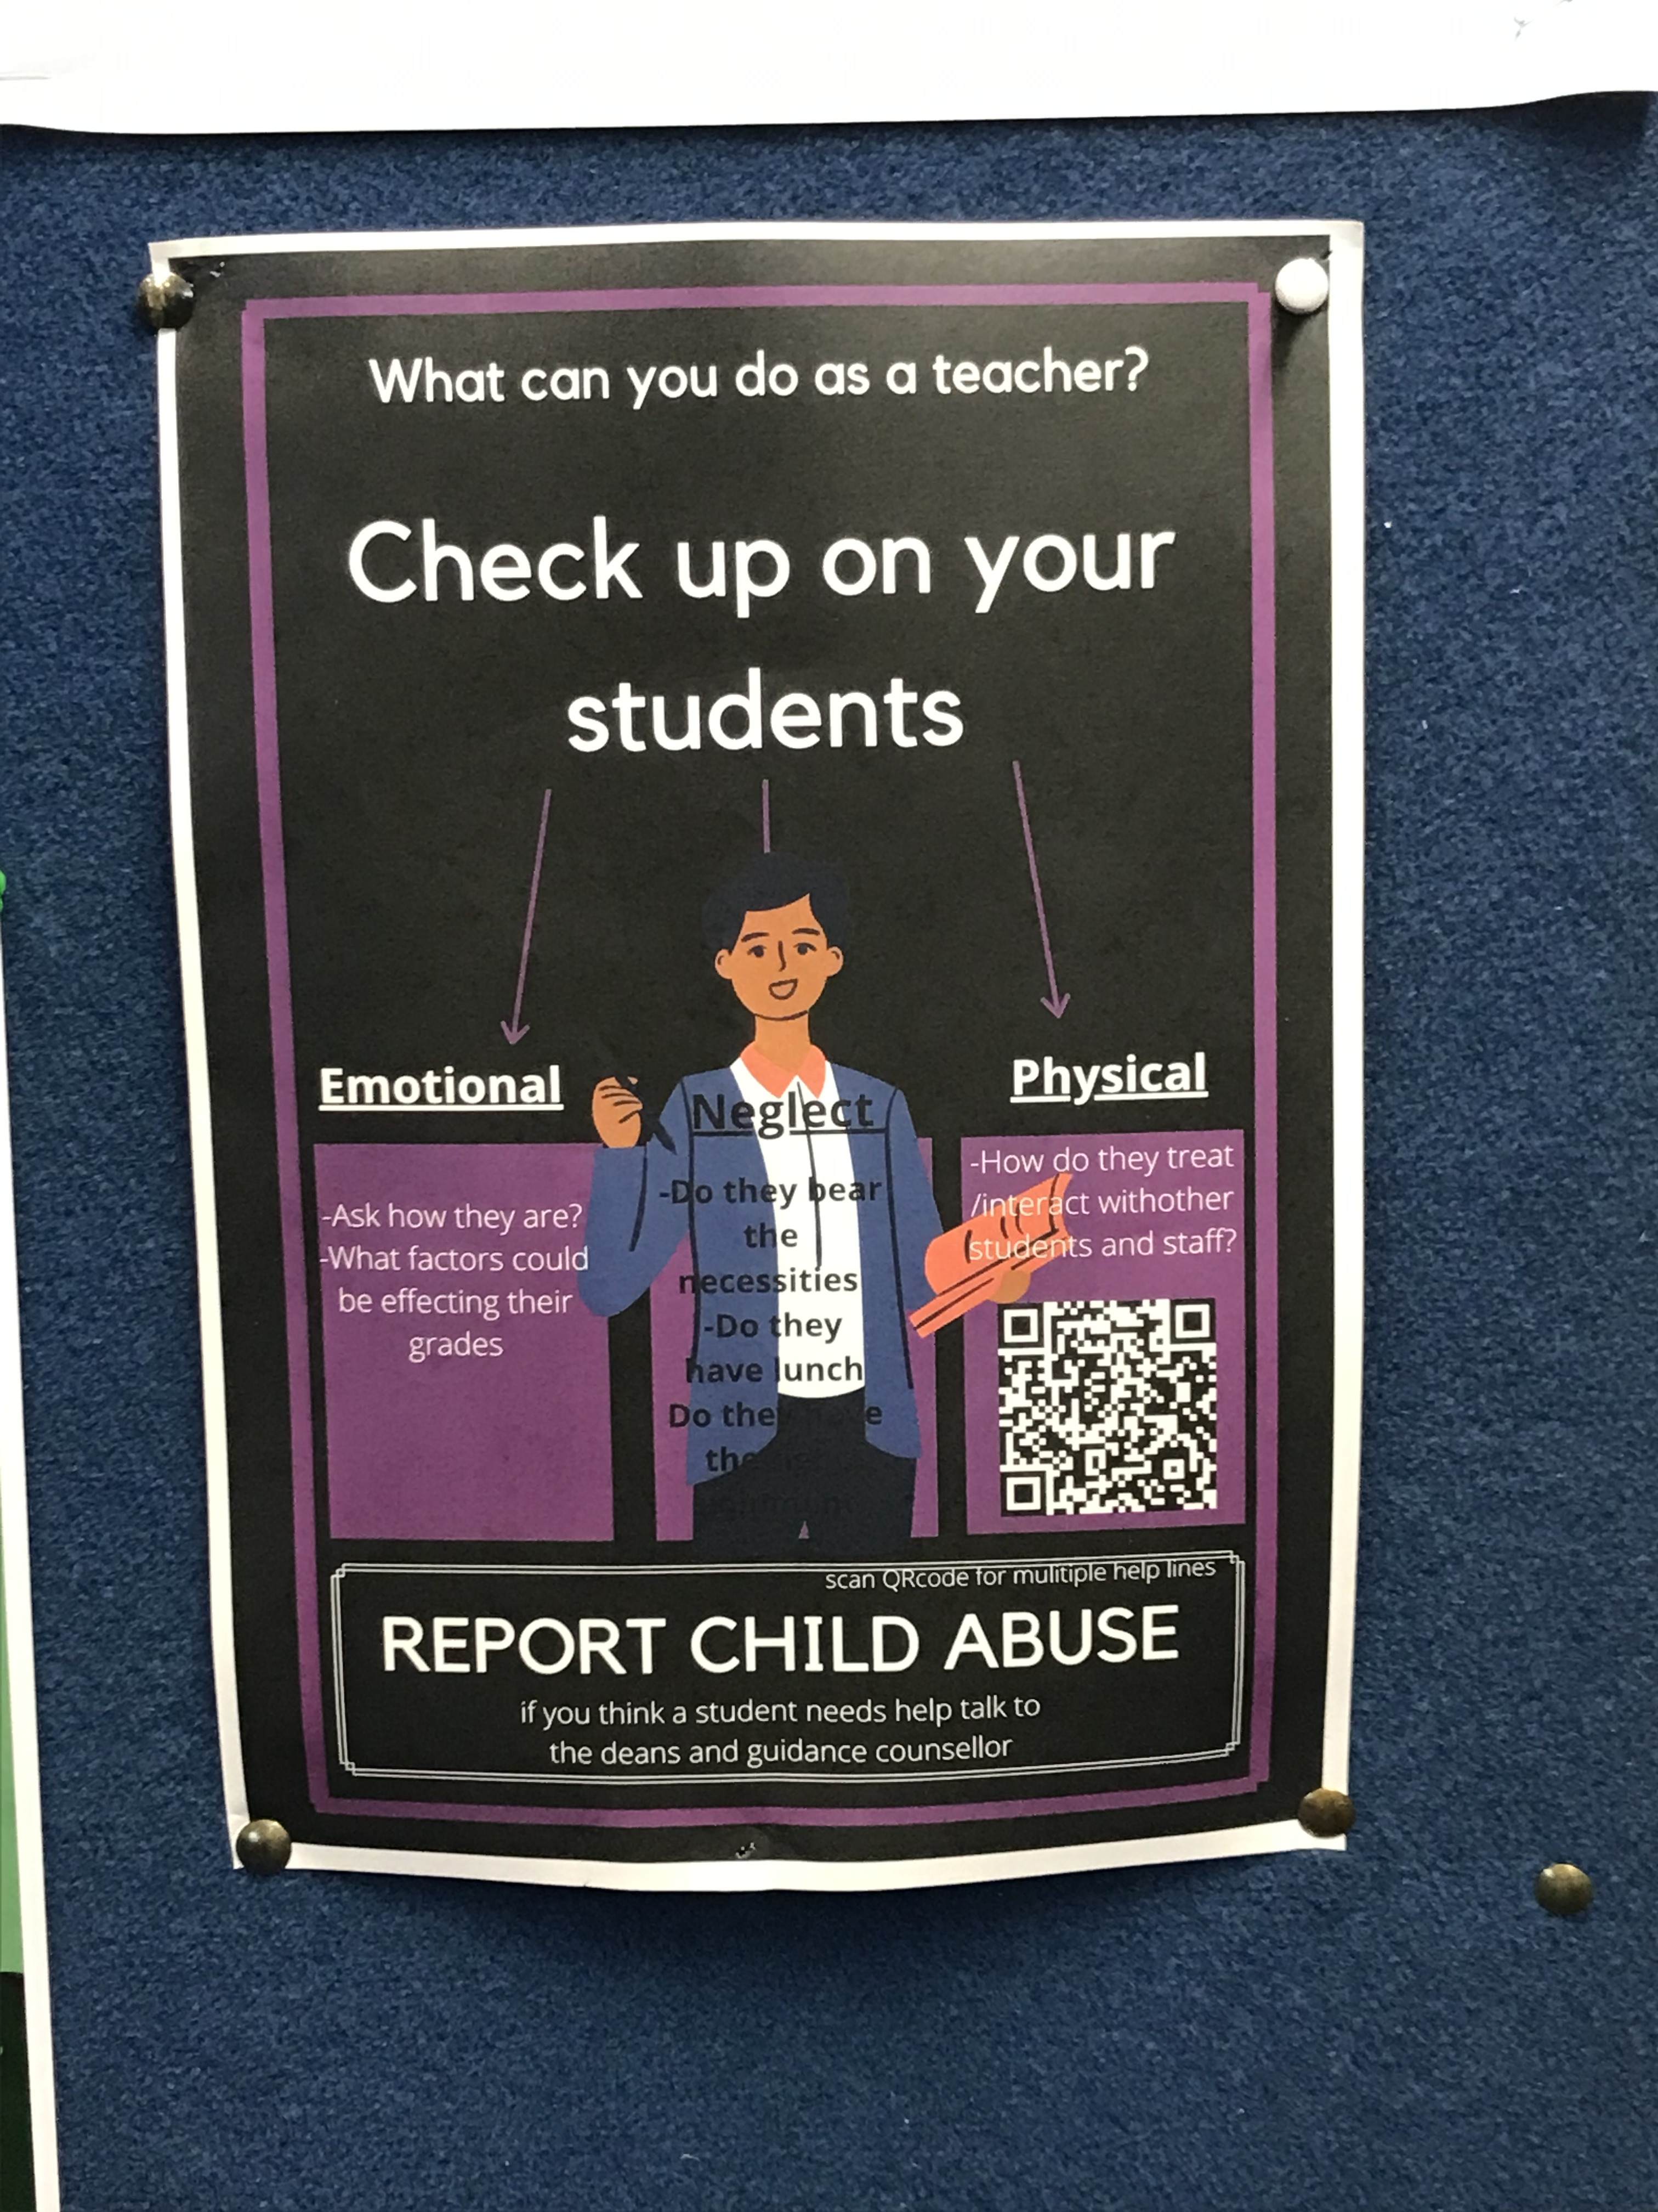
Ethnographic study – nz schools
C) Hypervigilance –and culture of suspicion
Drama teacher: I think, these days, students are very aware of their rights and their, I guess, you just have to be a lot more careful about things like me ensuring that everyone feels safe. And sometimes it can be really, really tricky when students perceive that that hasn't happened within that space. So it's, it is a tough one being transparent, but also being aware of each student's privacy. So it's a real tricky situation. So when we have plays where there's, I don't know, maybe a kiss or a hug, that becomes quite a big issue. And you have to really talk your way around that and talk about consent to touch shoulder. And so all those things become really, really key. And so you're trying to do it in a way that is sensitive, but also transparent. And that's, that's a real hard balance
Notes:
Marta

Slide 13
Document analysis in us higher ed
With increasing emphasis on students as clients, universities seek to serve all their student/clients’ needs, whether they knew they had these needs or not. Often, it is the faculty who are placed in the role of servant.
Starting FA24 at all Penn State campuses, teaching will also be assessed by students mid-semester. MSEEQ
In SP24, Penn State Harrisburg developed a survey for undergrad students to share their experience being advised by professional & faculty advisors. Sample email to faculty to see what students received in their inbox:
  Dear student: We have developed a survey to learn about your academic advising experience at Penn State Harrisburg. This survey is confidential – we will not ask for your name, ID number, or email address. Your feedback will help us determine our effectiveness at supporting you and provide direction to advising efforts at Penn State Harrisburg moving forward. We ask that you complete this survey using the link below between now and the last day of classes. Once you’ve completed it, you will be provided a link to enter a drawing to win a pair of Apple AirPods. Please note that you may receive more than one email about this survey if you have multiple assigned advisers. Please complete this survey using the survey link on each email. Thanks for taking the time to share your advising experience!
  Student “comfort” and “safety” has become the #1 concern: e.g., Penn State The Safer People Safer Places Network
Notes:
Hannah
All requested feedback from students about their experiences is anonymous. Yet, faculty provide individualized feedback on student work throughout the semester that, obviously, has our name on it. We are responsible for what we say. That students provide all kinds of feedback anonymously has become similar to the psychology of trolling in social media. This raises concerns regarding demonstrating responsibility for what one says and can feed into dark impulses. I am reminded of Peter Fleming’s recent sardonic book Dark Academia: How Universities Die in which he talks about “students as customers and evaluators.”

Slide 14
discussion
The safetyfication of curriculum as a dangerous trend in education because it:
fosters a culture of conflict/discomfort avoidance and conformance with the market
undermines political freedom
It de-professionalizes teaching (teachers as curriculum/policy implementors)
Notes:
Hannah/Marta –
We argue that safetyfication encourages a culture of conflict/discomfort avoidance which disperses individual responsibility unto systems, undermines political freedom, and disavows ethical consciousness, ultimately dehumanizing the teaching profession and the educational experience.

Slide 15
REFERENCES
Arendt, H. (1969). On violence. Harvest Books.
Arendt, H. (2003). Responsibility and judgment. Schocken Books.
Estellés, M. (in progress). The safetyfication of education, and the end of democratic education.
Estellés, M. (under review). A dangerous turn: the confluence of safety and citizenship discourses in educational scholarship. Article submitted to the journal Review of Educational Research.
Estellés, M. (2024). Safetyfication: a Dangerous Trend in Citizenship Education [Conference paper]. American Educational Research Association Conference 2024 Annual Meeting. Paper awarded as Best Conference Paper by the Democratic Citizenship in Education SIG.
Lukianoff, G. and Haidt, J. (2018). The coddling of the American mind: How good intentions and bad ideas are setting up a generation for failure. Penguin Press.
Spector, H. (2018). Bureaucratization, education and the meanings of responsibility. Curriculum Inquiry, 48(5), 503-520.
Spector, H. (2023). In Search of Responsibility as Education: Traversing Banal and Radical Terrains. Routledge.

