Slide 1
Using picturebooks in a second year Cultural Perspectives course to draw on and highlight the knowledge of cultural insiders
Nicola Daly and Julie Barbour
University of Waikato
New Zealand
Notes:
Kia ora koutou,
I’m presenting today on behalf of myself and my colleague, Associate Professor Dr. Nicola Daly, Nicola is our resident picturebook expert from Te Kura Toi Tangata (Education), she’s also a sociolinguist, and I am a general linguist from Te Kura Toi (Arts) at Waikato.

Slide 2
The research in context
LINGS203 Language, Society & Culture – Cultural Perspectives paper
Approximately 100 students – Flexi mode
Developing...
Competence in culturally diverse contexts
Effective communication and collaboration
How can picturebooks be used to support tertiary students’ engagement with and understanding of the Ethnography of SPEAKING (Hymes, 1962, 1964) in a second year New Zealand university course?
Notes:
Nicola and I have been working on a couple of different picturebook projects.
The particular project that we will be sharing with you today relates to a second year paper that I teach – LINGS203 Language Society & Culture, which is a Cultural Perspectives paper for Arts and Social Science students. This year I had nearly 100 students enrolled. The paper is taught in flexi mode with online learning resources and face-to-face or online workshops.
The general purpose of a cultural perspectives paper is two-fold
to develop student competence in culturally diverse contexts
to develop effective communication and collaboration among our students
The question that Nicola and I wanted to explore in our research was whether and how we could use picturebooks to support the engagement with and understanding of linguistic frame of analysis – this being Dell Hymes’ Ethnography of Speaking.
We could see the potential to use picturebooks as a resource for students to learn how to analyse cultural practices using the SPEAKING frame.

Slide 3
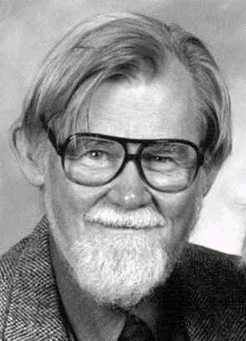
Ethnography of SPEAKING Frame developed by Dell Hymes (1962, 1964)
An ethnography “is directed at the description and understanding of communicative behavior in specific cultural settings” (Muriel Saville-Troike, 1989, p. 2)
Rules for communication and interaction
Awareness of participant roles
Cultural knowledge and beliefs underpinning interaction
Setting – Participants – Ends – Act sequence – Key – Instrumentalities – Norms of interaction – Genre
Notes:
Just briefly, the Ethnography of SPEAKING is a frame developed by Dell Hymes over 60 years ago for describing and analysing communicative behaviour in specific cultural settings.
SPEAKING is an acronym for the different components of the FRAME listed at the bottom of the slide.
Working through the SPEAKING model, students consider how the event unfolds, the ‘rules’ or conventions that guide the interaction, the various roles that participants fill, and in the big picture, the cultural knowledge and beliefs that underpin and shape or transform the interaction.

Slide 4
Expanding Cultural Perspectives with Picturebooks
Picturebook research into cultural communicative competence with:
Spanish preservice teachers (Ruiz, 2012)
Primary school children in the Netherlands (de Bruijn, 2017)
Secondary ELT students in Norway (Heggerness, 2019)
Picturebooks used to prompt intercultural discussion & develop intercultural awareness
Notes:
Picturebook research on cultural competence is relatively rare, but Nicola did manage to find a few studies in educational settings.
These have involved Spanish preservice teachers,
primary school children in the Netherlands,
and ELT secondary students in Norway.
In these studies picturebooks have been used successfully to prompt intercultural discussion and develop intercultural awareness.

Slide 5
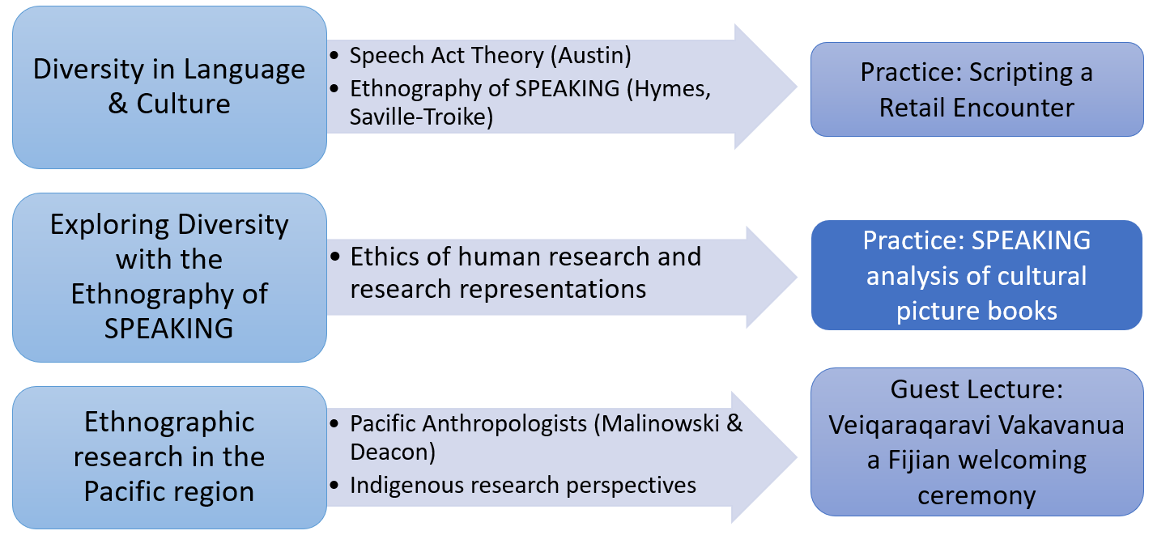

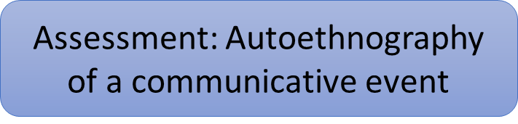
Developing the pedagogy
Notes:
In our research, the picturebook pedagogy was embedded in a unit on language and cultural practices.
Week 1 Students are introduced to a frame for analysing cultural events - Ethnography of SPEAKING
Week 2 Students apply the Ethnography of SPEAKING to analyse cultural picturebooks.
Week 3 Student hear a Fijian colleague, Dr. Apo Aporosa, using the Ethnograpy of SPEAKING frame to analyse a Fijian welcoming ceremony
Then, students prepare their own autoethnography of SPEAKING, describing and analysing a communicative event that they have participated in.

Slide 6
Selecting the Picturebooks
Text Factors:
  written and/or illustrated by cultural insiders
  focussing on cultural events
  including languages other than English
Student factors:
  Remote students from China
  Domestic students with diverse cultural identities and heritages
Tutor factors:
    Aotearoa (Māori)
India (Telugu, Hindi)
Japan (Japanese, Urdu)
Notes:
For the practice analysis, Nicola and I decided to select a small number of picturebooks.
Our selection was guided by several different factors:
Text factors: we wanted books that had been written and/or illustrated by cultural insiders, with a focus on a cultural event, and ideally, weaving in language other than English. So the books would be written in English, but contain vocabulary from the culture depicted in the story.
Student factors: we had a cohort of students based in China, as well as students living in Aotearoa, but with diverse cultural identities and heritages, and we wanted books that would reflect at least some of the experiences of the student cohort.
Tutor factors: I have aimed to employ a tutor from a different cultural background to myself. In the past few years, I’ve had a tutor whose first language is te reo Māori, one who speaks Telugu and Hindi, and one who speaks Japanese and Urdu. We wanted books that the tutor could discuss with confidence.

Slide 7
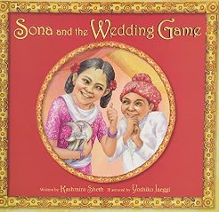
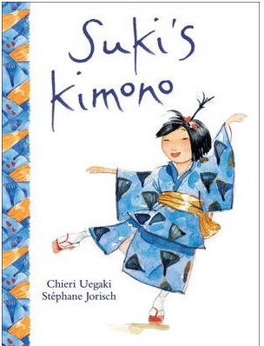
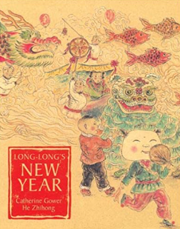
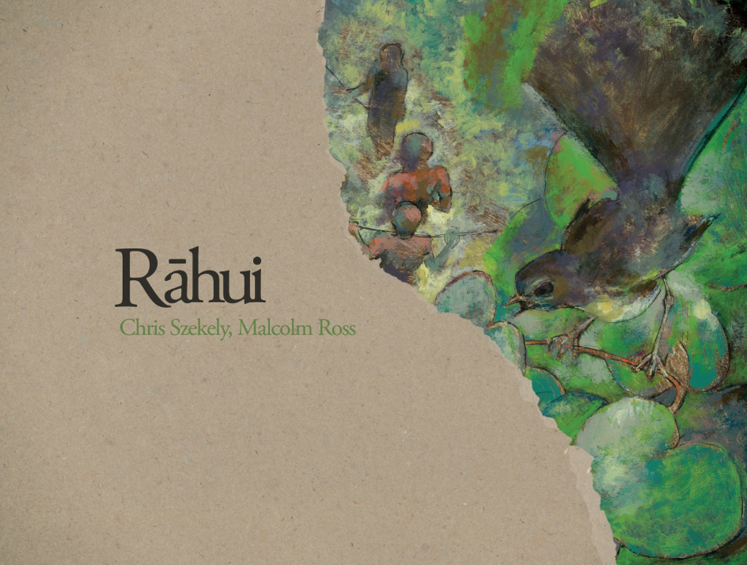
The Picturebooks
Notes:
So we selected a small number of books that seemed to fit with the course context:
Suki’s kimono (Kids Can Press) written by Chieri Uegaki and illustrated by Stephanie Jorisch 2003 – a story about a young girl who recounts her memory of attending a Japanese street festival with her obachan, her grandmother.
Long Long’s New Year (Frances Lincoln) written by Catherine Gower, and illustrated by He Zhihong, 2005 - a story about a young boy in China who goes to the market with his grandfather to sell produce and buy goods for the family’s New Year celebrations.
Sona and the Wedding game (Peachtree) by Kashmira Sheth (Author), Yoshiko Jaeggi, 2015 – a multi award winning story about a young girl who is given the job of stealing the groom’s shoes at her sister’s wedding. The wedding involves a traditional Hindi ceremony.
And Rāhui (Huia) written by Chris Szekely (Ngā Puhi, Ngāti Ruanui) and illustrated by Malcolm Ross, 2011 – another multi award winning story about cousins spending their summer holiday in a rural Māori community, during which one of the boys drowned.

Slide 8
SPEAKING Analysis of Picturebooks - preparatory task for students
Suki’s Kimono by Chieri Uegaka, illustrated by Stèphanie Jorisch
Genre | Children’s cultural story//Significant life event
Ends/Communicative purpose
Instrumentalities (physical channel, message form)
Setting (time and place of interaction)
Participants | …
Notes:
Students were asked to select two of the books and prepare a draft analysis using the SPEAKING frame.
Then, in their workshop, they discussed the books in groups, and developed their analysis further.
In the remainder of the talk, I will share some of observations of how our picturebook pedagogy worked in practice.

Slide 9
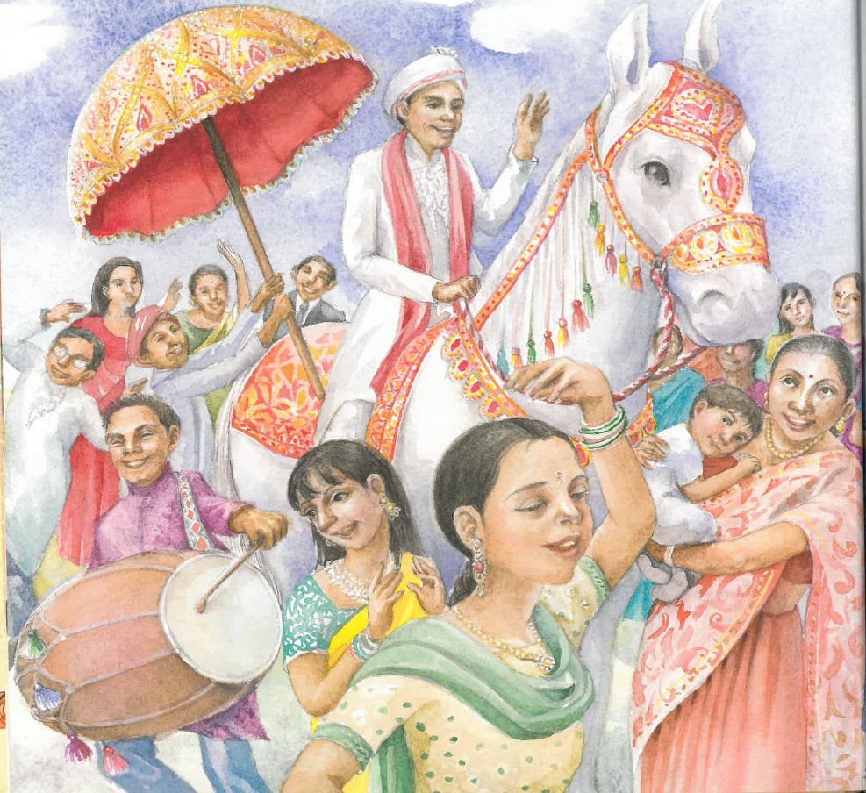
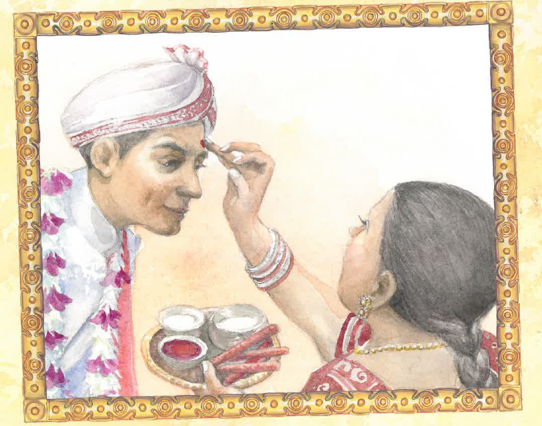
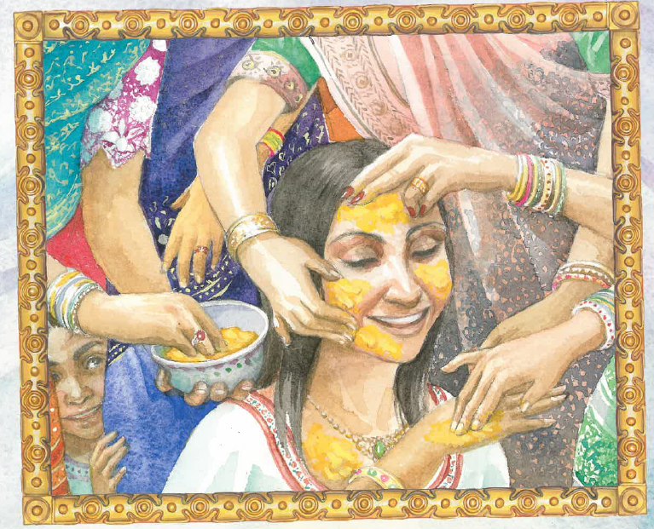
Finding (1) Picturebooks provided a glimpse into familiar and unfamiliar aspects of culture
Familiar: traditional Indian clothing and the red mark on forehead
Unfamiliar: the application of turmeric paste to soften skin
The groom parading through the streets on a white horse
Sona and the Wedding Game
Notes:
One of the important outcomes of introducing the books into a tertiary setting was that students given a glimpse into aspects of culture that they were already familiar with, but they were also shown unfamiliar aspects of culture.
In Sona and the wedding game, students recognised traditional Indian clothing and the red mark on foreheads; through the story, they learned that tumeric paste is applied to the bride as a beauty treatment AND that the groom arrives at the wedding on a white horse. Students who have grown up in India confirm that white horses are a common feature of Hindu weddings!

Slide 10
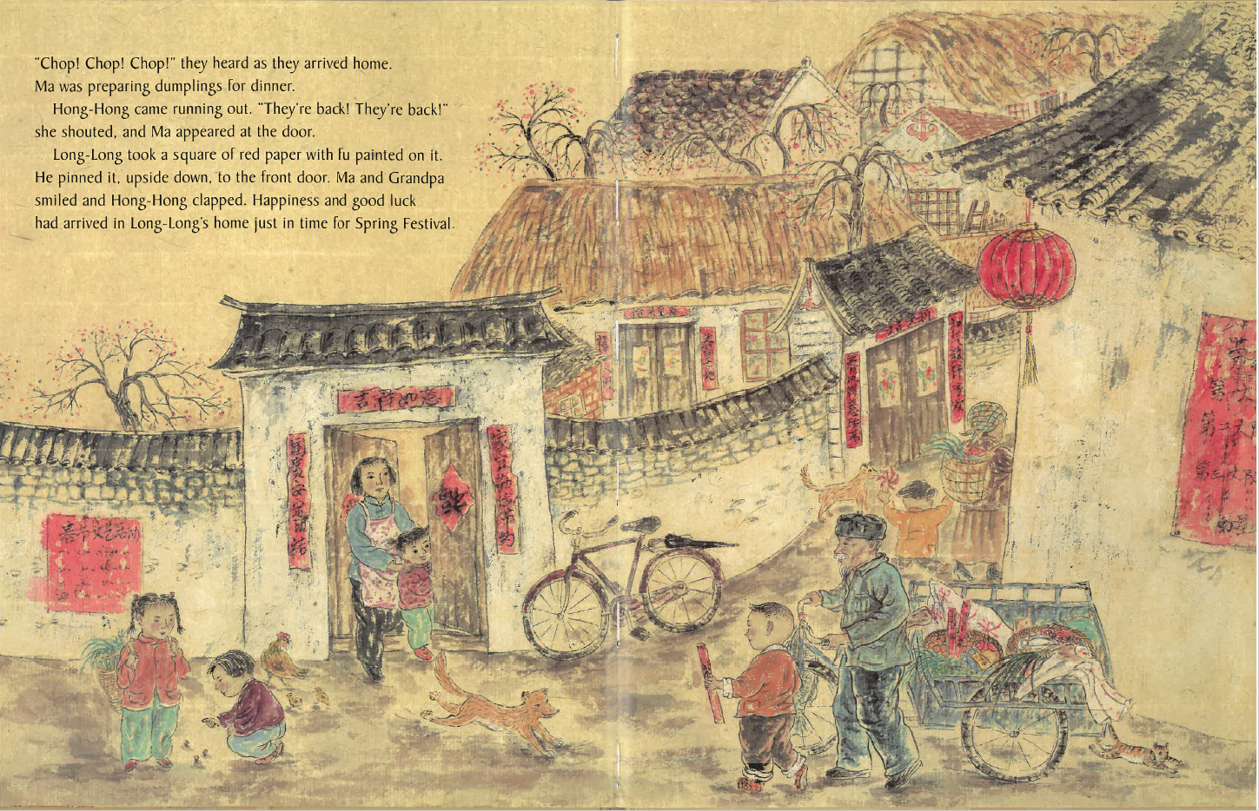
Finding (1) Picturebooks provided a glimpse into familiar and unfamiliar aspects of culture
Familiar: red papers with Chinese characters hung over windows and doorways
Unfamiliar: “Long-Long” is a common name for people born in the Year of the Dragon (Glossary).
Long-Long’s New Year
Notes:
Another example of this was in Long-Long’s New Year. The pictures show familiar red decorations with Chinese characters on them; and from the story we learned that Long-Long’s name is a common nickname for children born in the Year of the Dragon, which was being celebrated in the book.

Slide 11
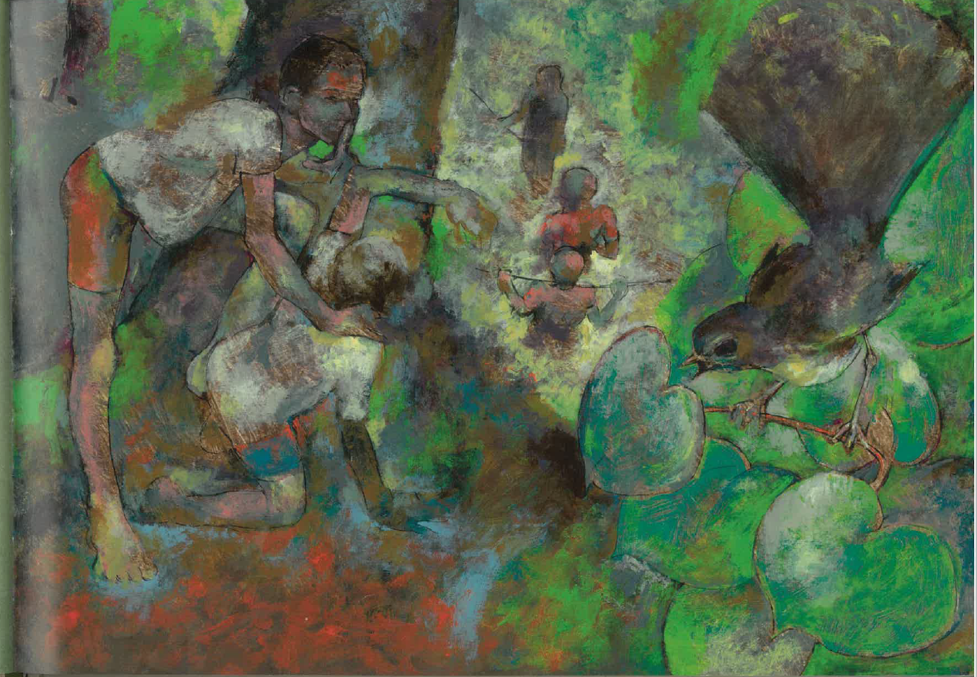
Finding (2) Picturebooks created experts of students who were cultural insiders
A really useful teaching point was the way that the students who were from the cultural backgrounds of the stories were able to interpret the images and activities for us, revealing more than was evident to an outsider reading the text.
Fantail as omen of death
Kawakawa leaf associated with mourning
Rāhui
Notes:
A really important outcome of picturebook pedagogy was that we created instant experts in the classroom from our cultural insiders.
Rāhui is a book of rather few words, but the illustrations are layered with cultural meaning. This particular illustration, from the cover of the book and on the second double page of the story, is accompanied by text that says only: “We play in the bush”.
But the illustration depicts an agitated fantail perched on what seems to be a kawakawa twig.
- cultural insiders can identify the fantail as an omen of death, foreshadowing the drowning that occurs later in the book. Some may associate the kawakawa leaf with mourning rituals.

Slide 12
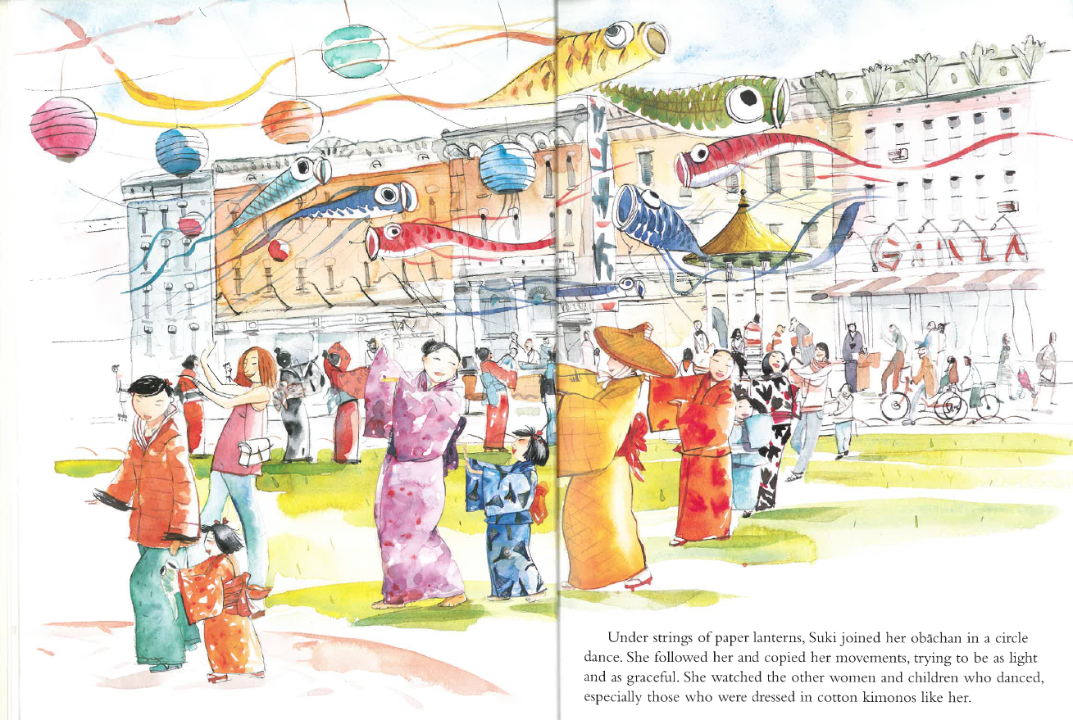
Finding (2) Picturebooks create experts of students who are cultural insiders
A Japanese student found the artwork problematic and inconsistent with their experiences
Festival was most likely to be Summer Festival, giving the timing of new school year in North America
BUT… fish streamers typically hang outside homes for Children’s Day in Spring
Suki’s Kimono
Notes:
Another opportunity for students to be ‘experts’ came with Suki’s Kimono. This turned out to be a problematic picturebook.
Japanese students had difficultly identifying the particular festival being shown – it took place during summer in the book’s timeline, but the fish streamers are a symbol of the Spring Festival. This book was not illustrated by a Japanese artist, and there is a useful message there about cultural understandings of insiders as compared to outsiders (Nicola and I both have some personal familiarity with Japanese culture, but we didn’t notice anything problematic about the book until we were told! But it is a bit like hanging a Christmas wreath at Easter.)

Slide 13
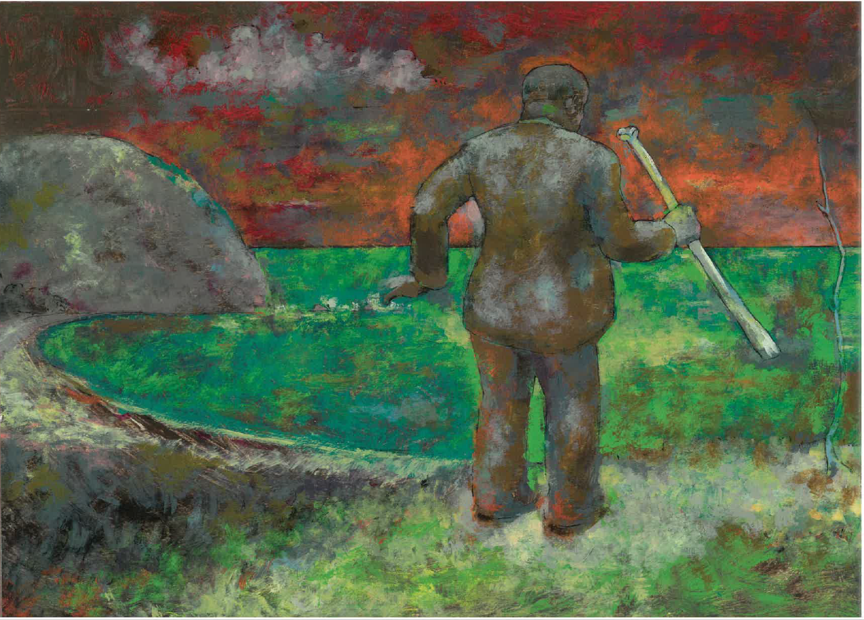
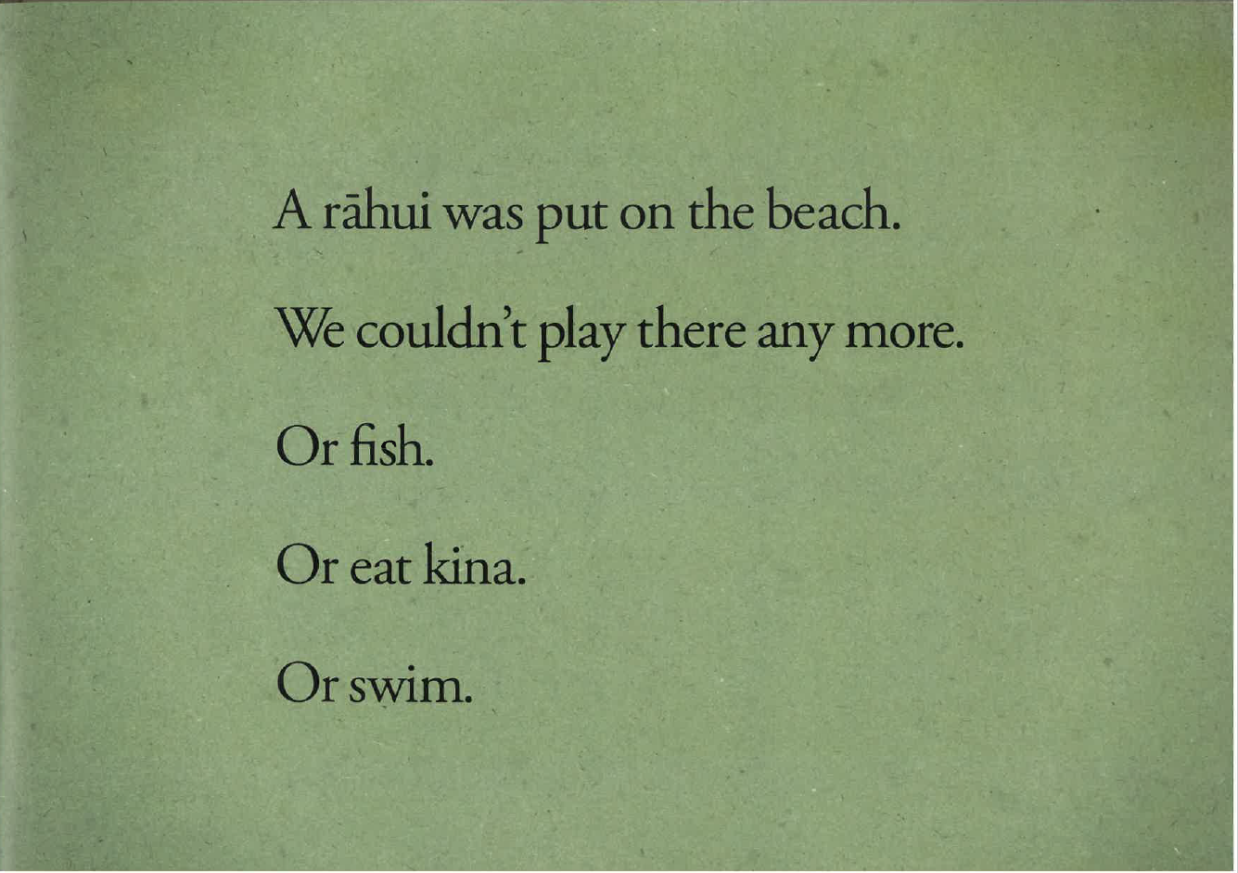
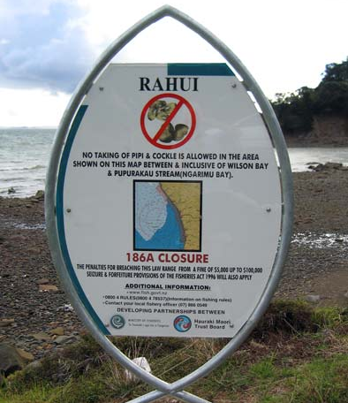
Finding (3) Picturebooks provided a finite experience of a complex situation, suitable for classroom discussion and analysis
Notes:
In terms of using picturebooks at the tertiary level, Nicola and I were hoping that the picturebooks would be both complex enough to engage the students, but short enough that they wouldn’t lose interest. And this did turn out to be the case. The books provided a manageable amount of cultural content to prompt analysis and discussion.
The illustration shows the placing of the Rāhui over the beach where the boy drowned. Ritual prohibitions are complex, but in Rāhui, the circumstances leading to the prohibition, the details of the prohibition (We couldn’t play there any more, or fish, or eat kina, or swim), and how it is placed, are all laid out simply through the lens of the child’s experience.
The image resonated with a Māori student who picked out this illustration and said that it ‘felt’ like a rāhui being placed.

Slide 14
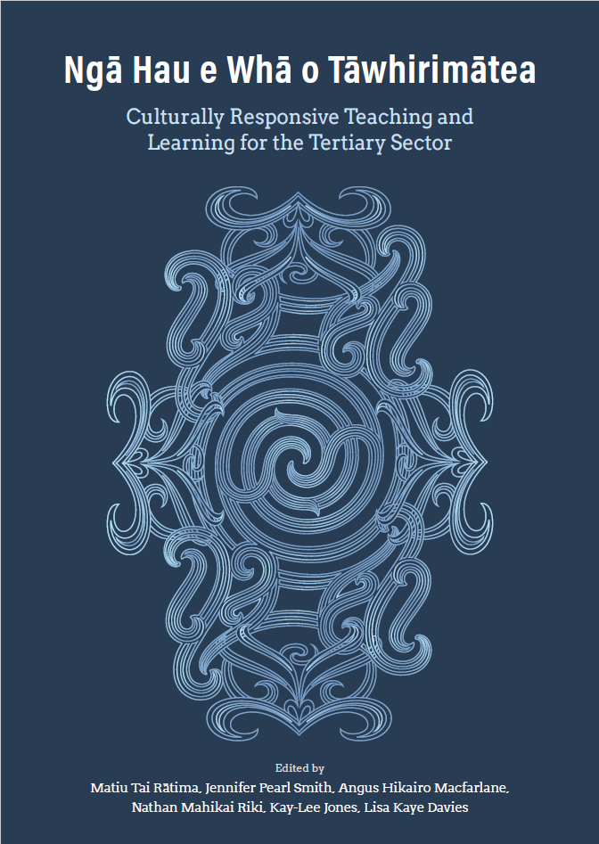
Culturally Responsive Tertiary Pedagogy
Ngā Hau e whā o Tāwhirimātea. Culturally Responsive Teaching and Learning for the Tertiary Sector (Rātima et al., 2022)
Assessing and refining our pedagogy
Notes:
Having tried out this picturebook pedagogy (we ran the materials in 2021 and 2022), we are now at the stage of assessing whether we are providing culturally responsive learning experiences that make it possible for students to develop intercultural communicative competencies. Earlier this year, our subject librarian (thank you Anne) circulated a new publication from the University of Canterbury, called Ngā Hau e whā o Tāwhirimātea (the four winds of Tāwhirimātea). We’ve been using this publication to assess our pedagogy and to look for opportunities to develop it further.

Slide 15

Picturebook pedagogy as Culturally Responsive?
Relevance: offering mirrors and windows
Balance of power: creating experts and engaged learners
Scaffolding: preparing students for autoethnographic writing
Oranga
Health & Wellbeing
Relevance
Balance of power
Scaffolding
Notes:
At the centre of a culturally responsive tertiary pedagogy is Oranga – which addresses student health, wellbeing, and life in a broad sense.
Oranga has three overarching tenets for the tertiary classroom – Relevance, Balance of power, and Scaffolding. We’ve considered whether the picturebook pedagogy is fulfilling these tenets.
In terms of Relevance of content: we see picturebooks as offering mirrors that reflect the personal experiences of some students and windows into the experiences of other students. While we don’t have picturebooks that cover the entirety of the cultural diversity in the cohort, we are attempting to represent key parts of that diversity.
In terms of the balance of power: the analysis of picturebooks from cultures which are not our own, created opportunities for some of the students to become instant experts as cultural insiders, able to interpret cultural symbols and describe cultural significances that are not readily available to outsiders. A knock-on effect is to create space for the outsider students to engage more closely with their peers, and to see their peers (particularly peers who are among the minority in the classroom) as having valuable knowledge.
Finally, the three week learning programme worked effectively to scaffold students: the application of the SPEAKING model to picturebooks provided a successful stepping stone towards writing an autoethnographic account of a cultural event.

Slide 16
Developing an autoethnographic voice via Picturebook Pedagogy
Research that strengthens us as a people is invaluable. The gathering of histories, research on our language, identities, and traditions is often research that feeds the thirst many Māori have for knowing ourselves. (Cherryl Smith, 2013, p. 94 – Te Atawhai o Te Ao)
Indigenous biography, oral history, and life stories, for me, are interesting phenomena. They are, in my tribe, treasured gifts left for the days destined to each generation. (Nēpia Mahuika, 2016, p. 331, Te Whare Wānanga o Waikato)
Notes:
Now... why is it important for students to engage with the Ethnography of SPEAKING? And what does this have to do with the theme of this year’s LearnFest – Revitalisation?
The outcome of this unit is an assessment where students record and interpret their own behaviours within their cultural content. They create a record of an event that is specific and detailed, and often deeply personal. Records like these, personal histories, teach us about ourselves, and help us to stay connected to our past.
Two indigenous authors that I ask my students to read during this unit, comment on the importance of personal histories in research: ...
Inspired by children’s stories, the LINGS203 students are creating autoethnographic accounts of cultural events, connecting them to their lived cultural experiences and their personal histories. Hopefully, this process is helping to breath life into those histories, to keep them alive for future generations. And as they do so, we also hope to develop their appreciation for the cultural practices of others.

Slide 17
Selected References
Deardoff, D. K. (2011). Assessing intercultural competence. New Directions for Institutional Research, 149(1), 65-79.
de Bruijn. (2019). From representation to participation: Rethinking the intercultural educational approach to folktales. Children’s Literature in Education, 50(3), 315–332. https://doi.org/10.1007/s10583-017-9330-x
Heggernes, S. L. (2019). Opening a dialogic space: Intercultural learning through picturebooks. Children’s Literature in English Language Education, 7(2), 37-60.
Hymes, D. (1962). The ethnography of speaking. In Gladwin, Thomas; Sturtevant, William C. (eds.). Anthropology and Human Behavior. Anthropology Society of Washington.
Hymes, Dell (1964). Introduction: Toward Ethnographies of Communication. American Anthropologist. 66 (6): 1–34. doi:10.1525/aa.1964.66.suppl_3.02a00010
Rātima, T. M., Smith, J. P., Macfarlane, A. H., Riki, N. M., Jones, K. L., & Davies, L. K. (2022). Ngā Hau e Whā o Tāwhirimātea: Culturally Responsive Teaching and Learning for the Tertiary Sector.
Ruiz-Cecilia, R. (2012). Narrowing cultural boundaries in the EFL classroom: fairy tales from India. Revista Española de Lingüística Aplicada, 25, 225+.

Slide 18
Picturebook References
Gower, Catherine & Zhihong He. (2005). Long Long’s New Year. Frances Lincoln.
Sheth, Kashmira & Yoshiko Jaeggi. 2015. Sona and the Wedding Game. Peachtree.
Szekely, Chris & Malcolm Ross. (2011). Rāhui. Huia.
Uegaki, Chieri & Stephanie Jorisch. (2003). Suki’s kimono. Kids Can Press.

Slide 19
Intercultural Communicative Competence
“effective and appropriate behaviour and communication in intercultural situations” (Deardoff, 2011, p.66)
“Knowledge of others; knowledge of self; skills to interpret and relate; skills to discover and/or to interact; valuing others’ values, beliefs, and behaviors [sic]; and relativizing one’s self. Linguistic competence also plays a key role” (Deardoff & Jones, 2009, p.13).
Notes:
Intercultural communicative competence: “effective and appropriate behaviour and communication in intercultural situations” (Deardoff, 2011, p.66). Intercultural communicative competence is a complex notion, involving at least the following set of knowledge and skills: “Knowledge of others; knowledge of self; skills to interpret and relate; skills to discover and/or to interact; valuing others’ values, beliefs, and behaviors [sic]; and relativizing one’s self. Linguistic competence also plays a key role” (Deardoff & Jones, 2009, p. 13).

Slide 20
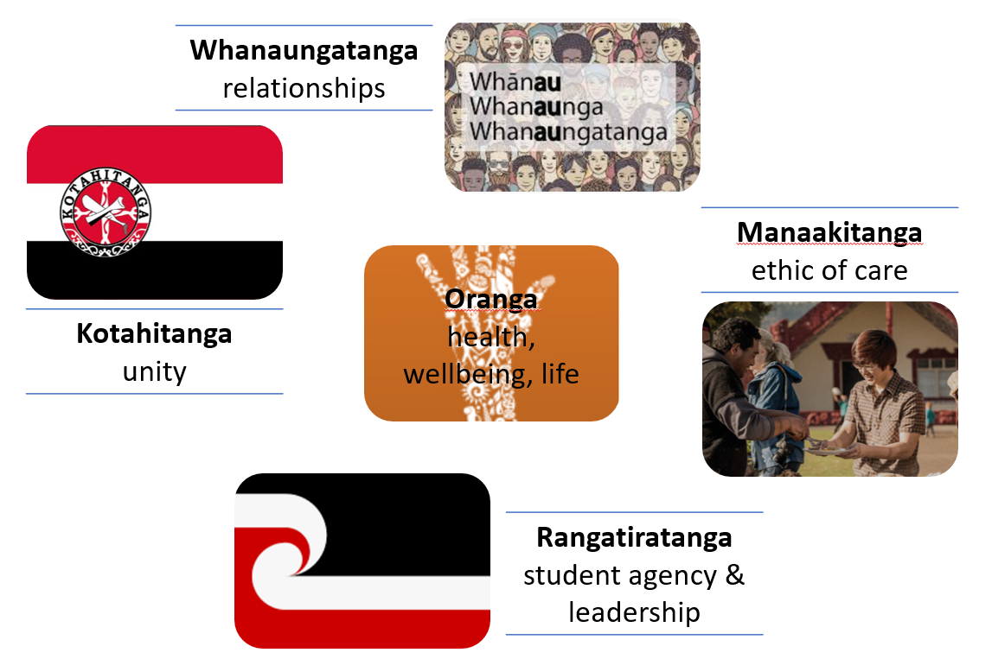

Slide 21
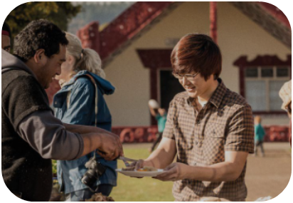
Classroom learning draws on cultural and linguistic differences and similarities
Potential to increase representation
> student recommendations?
> student critique?
Manaakitanga
ethic of care
modelling respect for diversity;
creating a sense of belonging through representation
Notes:
Classroom learning draws on cultural and linguistic differences and similarities
diverse cultural practices are presented as opportunities for learning
students may see representations of their own cultures and language
students may see representations of their peers
Potential to increase representation
inviting students to recommend additional cultural texts
inviting critique of our choices
Julie identified the need to include Pacific cultural texts

Slide 22

A common ground for analysis
the Ethnography of SPEAKING frame
Potential > minimise the lecturer’s voice
Potential > student-led discussion and self critique/correction
Kotahitanga
Unity
building group understanding through shared observations
Notes:
A common ground for analysis is developed, by introducing the students to the Ethnography of SPEAKING frame
Students apply the SPEAKING frame together to better understand its components
Potential to minimise the lecturer’s voice as student understandings grow
Potential for student-led discussion and self critique/correction during application of SPEAKING frame

Slide 23

Picturebooks analysis as an informed collaborative exercise
Important: allow ample discussion time
Whanaungatanga relationships
supporting learning through collaboration
Notes:
Picturebooks analysis is designed as an informed collaborative exercise
individual students prepare in advance of the workshop
In small groups, they share ideas and clarify their understandings
Important: time is an issue for this activity; students need enough time for differences in understanding to emerge, and to then work towards reading a common ground

Slide 24

Students as experts
Students as active learners
Potential to model learner role
Rangatiratanga
student agency & leadership
positioning some students as experts;
positioning others as active learners
Notes:
Students can be positioned as cultural experts
Revealing their personal cultural understandings
Sharing their personal experiences of cultural events
Students are encouraged to be as active learners
Developing personal understandings
Asking for explanations, clarifications
Listening and responding to experts
Potential for lecturer to explicitly model the learner role through asking questions, responding to ‘expert’ information that is shared, and then step back to make room for students to lead as learners

Slide 25
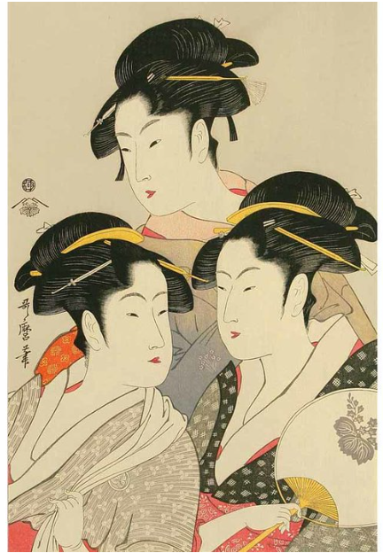
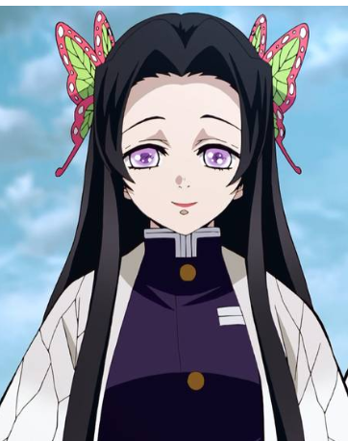
Traditional depiction of Japanese women
Three Famous Beauties, Woodblock Print by Kitagawa Utamaro
Modern depiction of a female character in a Japanese anime
Demon Slayer’s Kanae Kocho, originally drawn by manga author and illustrator Koyoharu Gotouge

