Slide 1
Why standardised assessment doesn’t measure up?
Marta Estellés
The University of Waikato
May 2025

Slide 2
Overview
What is this policy about?
Why this policy?
What are the effects of standardised assessment?

Slide 3

What is this policy about?
Part of the broader ‘Teaching the Basics Brilliantly’ policy
“We have set an ambitious target to reach 80 per cent of Year 8 students at or above the expected curriculum level for their age in reading, writing and maths by December 2030” –Erica Stanford
In March, the Ministry issued a tender to ‘purchase’ an assessment tool

Slide 4
What is this policy about?
“We require a new ‘Standardised Tool for Assessment and Aromatawai’ that will deliver a long-term solution to support all schools and kura to effectively enact twice-yearly assessment of learners and is aligned to Years 3 to 10 of the new National Curriculum….
To achieve this, we are introducing a whole-of-pathway approach to assessment, aromatawai, reporting and monitoring across our schooling system so that good quality data about students’ learning progress is available to inform teaching and learning, provide timely information to parents, whānau and caregivers, and underpin decisions at every level of the education system”
–Ministry of Education (2025, emphasis is ours)

Slide 5

=
?

Slide 6

There was considerable variability in the accuracy of teachers’ ratings against the National Standards for individual work or assessment samples
–Thomas and Ward (2012, p. 2)

Slide 7
Why this policy?
Ideological
Political
Economic
Sociological

Slide 8
Why this policy?
Ideological
  Neoliberal ideals (parental choice, competition, accountability…)
  Meritocracy
“Education is the great liberator, the great equaliser and the most enduring gift we can bestow on our children”
–Finance Minister Nicola Willis

Slide 9
Table. Wealth distribution by group in New Zealand
Group | Wealth ($bn) | Cumulative wealth ($bn) | Share | Cumulative share
Wealthiest 1% | 274 | 274 | 20% | 20%
Next 4% | 331 | 605 | 24% | 44%
Next 5% | 203 | 808 | 15% | 59%
Next 40% | 536 | 1,344 | 39% | 98%
Poorest 50% | 24 | 1,368 | 2% | 100%
Education?
Source: Rashbrooke et al. (2021, p. 6)

Slide 10
Why this policy?
Political
  Pressure on the education system to correct social inequalities (Berliner, 2013; Lingard, Sellar & Savage, 2014; Thrupp, 2018)
  Control – ‘steering at the distance’ (Sellar & Lingard, 2013)

Slide 11
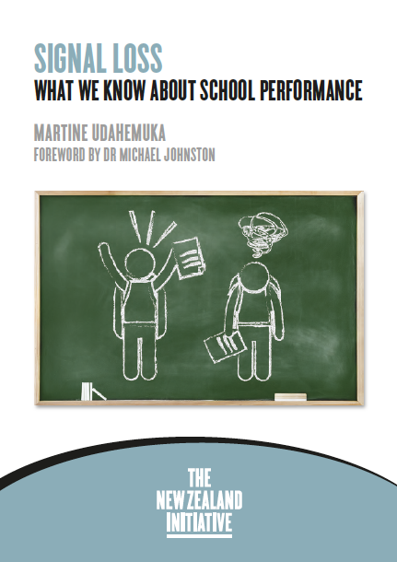
Why this policy?
Economic
  Social investment approach – data-driven approach to target (reduce) social expenditure

Slide 12

“It [social investment approach] is very much about trying an intervention, measuring it, and discarding it quickly if it doesn’t work in order to try something else. […] The social investment approach also puts great weight on the significance of specific indicators and less on the overall context of deprivation or poverty”
–Thrupp (2018, p. 206)

Slide 13
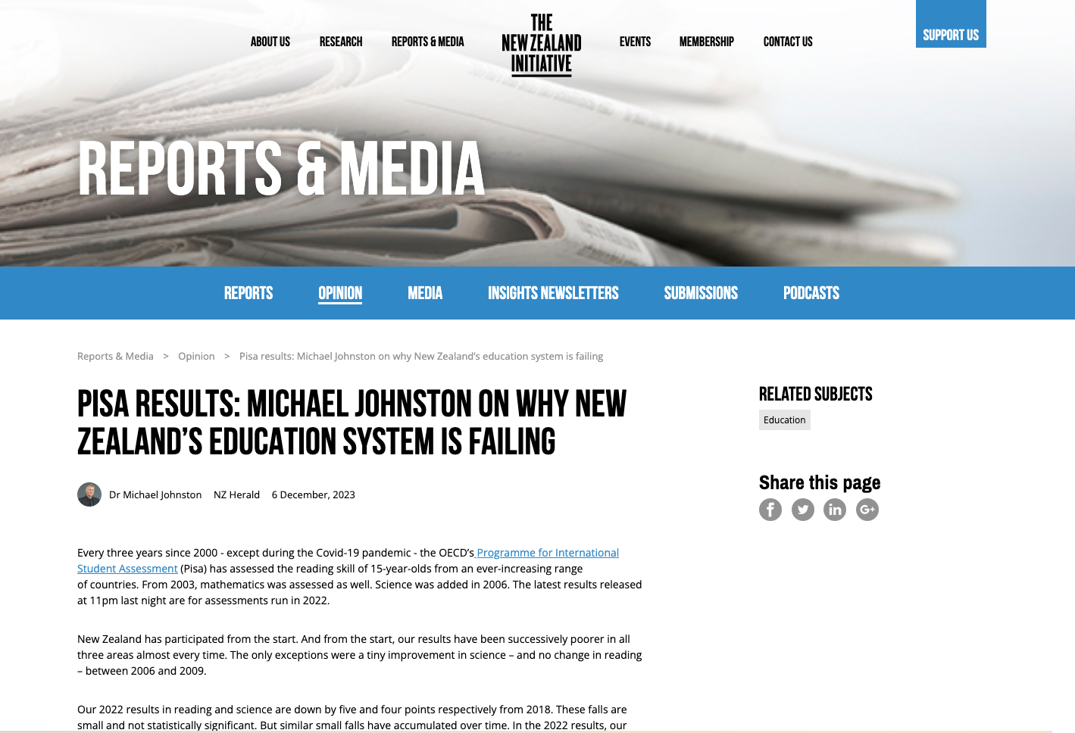
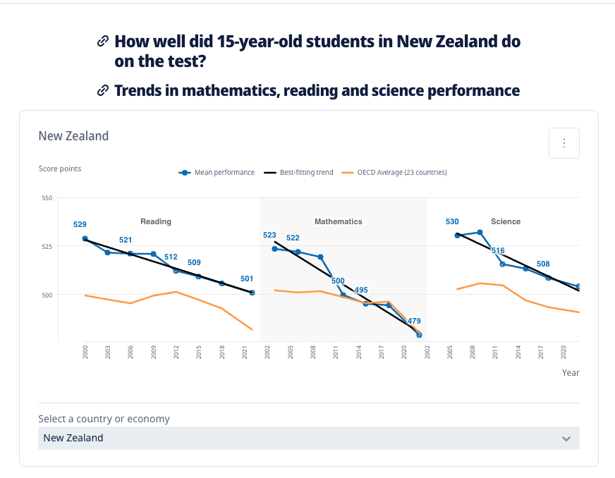
Why this policy?
Sociological
  Ministry’s concerns with the ‘PISA slide’

Slide 14
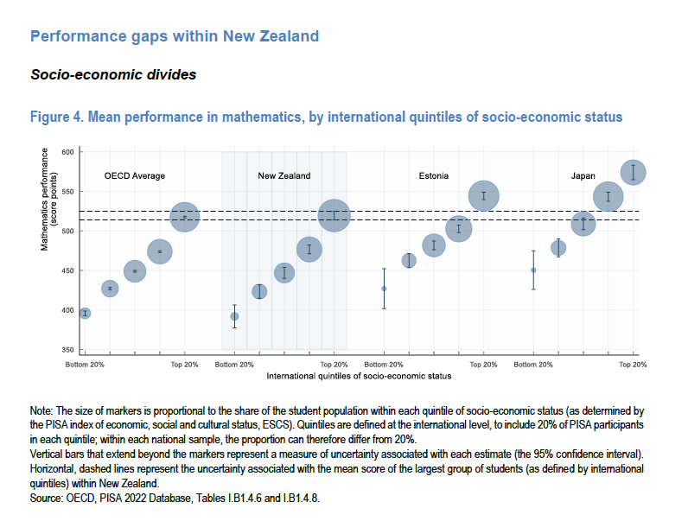

Slide 15



Why this policy?
Sociological
  Ministry’s concerns with the ‘PISA slide’ influenced by the NZ Initiative
  Global Education Reform Movement (GERM, Sahlberg, 2011)
    SATs tests (1991)
    No Child Left Behind (2002), Race To The Top (2009), Every Student Succeeds Act (2015)
    NAPLAN (2008)

Slide 16

What are the effects of national testing?
  Effects of SATs tests introduced in 1991
    Early gains in test results, yet unsustainable –> Key Stage 2 results rose from 1995 to 2000, but then plateaued (example of ‘teaching to the test’, see Wiliam, 2001)
    The number of students achieving Level 4 in numeracy and literacy has still not reached the 75% and 80% respectively expected by 2002. In 2023, the percentage was 65.1% (Department for Education, 2024)
    Results have highlighted a gap between the poor and middle classes. Only 25% of disadvantaged students get a good pass in English and Maths in Key Stage 4 (Social Mobility and Child Poverty Commission, 2020)
    Positive effect: teachers and students have a clearer idea of the performance standard expected at each stage (Hargreaves, 2002).
    Unintended consequences: league tables, narrowing curriculum, teaching to the test, decrease in student motivation, labelling of children and impact on their identity as learners, fabrication of results, increase in stress and anxiety for teachers and students, intensification of teachers’ workload, pressure on schools to recruit ‘bright’ middle-class children (Cambridge Primary Review, 2009; Carver, 2000; Earl et al., 2003; Hargreaves, 2002; Moss, 2017; Reay & Williams, 1999)

Slide 17
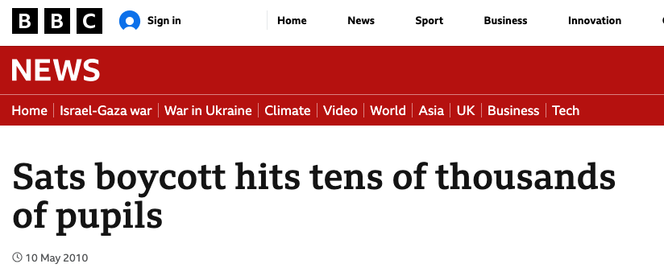
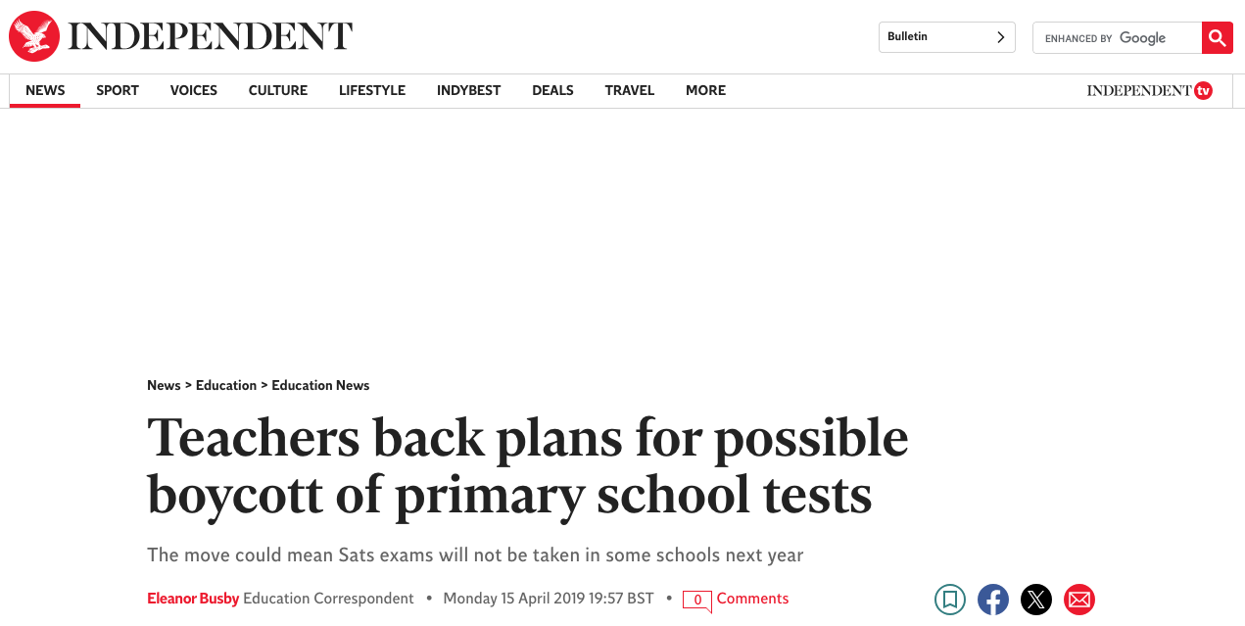
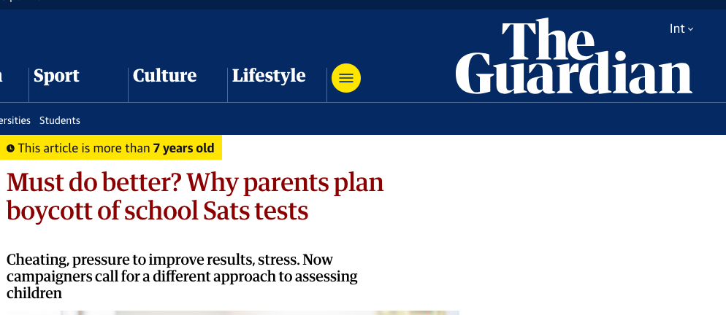

Slide 18
What are the effects of standardised assessment?
  No Child Left Behind (2002), Race To The Top (2009), Every Student Succeeds Act (2015)
    Relationship with student achievement: little or no relationship to reading achievement, and a weak to moderate relationship to math (Braun et al., 2006; Braun et al., 2010; Figlio & Ladd, 2008; Nichols et al., 2006, 2012)
    Unintended consequences: teaching to the test, narrowing of the curriculum, cheating culture, increase stress and anxiety for teachers and students, culture of fear, decreased motivation, especially for low performing students (Amrein & Berliner, 2002; Amrein et al., 2010; Au, 2022; Jones et al., 2003; Nichols, 2016; Nichols & Berliner, 2007; Vasquez Heilig & Darling-Hammond, 2008)
    Other findings: privatisation of public education (Au, 2022) and state manipulation of test scores (Hursh, 2015)

Slide 19
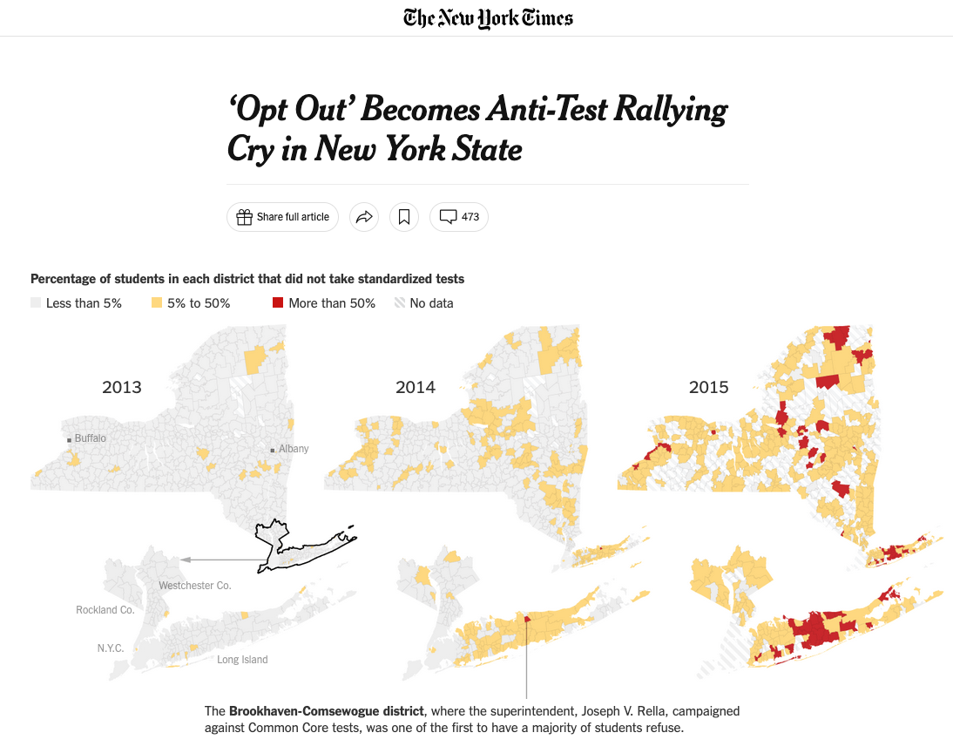


Slide 20
What are the effects of standardised assessment?
  Effects of NAPLAN (2008)
    No significant student achievement improvements –stable results over time (2008-2023) with slight increase in the first years and decrease in 2023 (ACARA, 2023)
    Unintended consequences: creation of league tables, narrowing curriculum, teaching to the test, gaming of the data, decreased levels of motivation in students, increased levels of stress for teachers and students, less time for students who need extra support, extra support for students who would quickly achieve better results, labelling of children, little impact on timely identification of and intervention with students at risk, intensification of teacher workload (Comber, 2012; Cormack & Comber, 2013; Cumming et al., 2016; Lingard et al., 2016; Klenowski, 2011; Thompson, 2013; Wu, 2010)
    Large studies on teachers’ views:
      Only 23% of teachers believed that NAPLAN had improved learning in literacy. Only 14% believed so in relation to numeracy (Thompson, 2016)
      90% of teachers reported at least 1–10 students feeling stressed by the test, 90% reported similar numbers of students who were concerned that they were ‘too dumb’ for the test (Rice et al., 2016)
      85% of teachers do not believe NAPLAN improves student outcomes (AEU, 2020)
    Other findings: low-performing students more likely to not participate in NAPLAN tests, continuous decline of participation (Lu et al., 2023) and the growth of test industry and other edu-businesses (Hogan, 2016)

Slide 21

What are the effects of standardised assessment?
Most visible: teaching to the test, narrowing curriculum, league tables, labelling of children, de-contextualised learning, cheating culture, intensification of teachers’ workload
Less visible: outsourcing of the curriculum, two-tier curriculum, politics of blame, further exclusion of disadvantaged students
Hidden: social segregation, privatisation, de-skilling and de-professionalisation of teaching profession

Slide 22
“We have set an ambitious target to reach 80 per cent of Year 8 students at or above the expected curriculum level for their age in reading, writing and maths by December 2030” –Erica Stanford
👎

Slide 23
References (I)
Australian context:
Comber, B. (2012). Mandated literacy assessment and the reorganisation of teachers’ work: Federal policy, local effects. Critical Studies in Education, 53 (2), 119–136. DOI: 10.1080/17508487.2012.672331
Cormack, P., & Comber, B. (2013). High-stakes literacy tests and local effects in a rural school. Australian Journal of Language and Literacy, 36 (2), 78–89.
Klenowski, V. (2011). Assessment for learning in the accountability era: Queensland, Australia. Studies in Educational Evaluation, 37 (1), 78–83. DOI: 10.1016/j.stueduc.2011.03.003.
Lingard, B., Thompson, G. & Sellar, S. (2016). National testing from an Australian perspective. In Lingard, B., Thompson, G. & Sellar, S. (eds.). National testing in schools: An Australian Assessment (pp. 1-17). Routledge.
Thompson, G. (2013). NAPLAN, MySchool and accountability: Teacher perceptions of the effects of testing. The International Education Journal: Comparative Perspectives, 12 (2), 62–84.
Thompson, G. (2016). Local experiences, global similarities: Teacher perceptions of the impacts of national testing. In Lingard, B., Thompson, G. & Sellar, S. (eds.). National testing in schools: An Australian Assessment (pp. 57-71). Routledge.
Thompson, G., & Mockler, N. (2015). Principals of audit: Testing, data and ‘implicated advocacy’. Journal of Educational Administration and History, 1–18. DOI: 10.1080/00220620.2015.1040376.
Wu, M. (2010). The use of NAPLAN data for English language teaching. Idiom, 47 (1), 38–41.
New Zealand context:
Estellés, M. & O’Neill, J. (2024). Social justice imaginaries and education policy in Aotearoa New Zealand (2017-2024). New Zealand Journal of Educational Studies. https://doi.org/10.1007/s40841-024-00348-0
Johnson, M. (2023). PISA results: Michael Johnston on why New Zealand’s education system is failing. The NZ Herald, 6 December. https://www.nzherald.co.nz/nz/pisa-results-michael-johnston-on-why-new-zealands-education-system-is-failing/BMMKL5VYIZDZTLX4BORRCIWPLU/
National Party. (n.d.). Teaching the basics brilliantly. https://assets.nationbuilder.com/nationalparty/pages/17861/attachments/original/1684306137/Teaching_the_Basics_Brilliantly_Final.pdf?1684306137
Thrupp, M. (2018). The Search for Better Educational Standards: A Cautionary Tale. Springer
Udahemuka, M. (2016). Signal Loss: What we know about school performance. Wellington: New Zealand Initiative. pp. 43–44.
Ward, J., & G. Thomas, G. (2012). National Standards: School sample monitoring & evaluation project 2011. Report to the Ministry of Education. Dunedin, New Zealand: Maths Technology Ltd. Retrieved from https://www.educationcounts.govt.nz/publications/series/NationalStandards/111080 p. 2.

Slide 24
References (II)
UK context:
Carver, G. (2000). Tested to destruction? A survey of examination stress in teenagers. London: Education Committee of the Professional Association of Teachers and the Secondary Heads Association.
Cambridge Primary Review. (2009, February). Towards a new primary curriculum: A report from the Cambridge primary review. Cambridge: University of Cambridge
Earl, L., Watson, N. & Katz, S. (2003). Large-scale Education Reform: Life Cycles And Implications For Sustainability. London.
Hargreaves, A. (2002) Sustainability of educational change: the role of social geographies. Journal of Educational Change, 3.3, pp. 189–214
Heubert, J.P. (2000). High-stakes testing opportunities and risks for students of color, English-language learners, and students with disabilities. New York: National Center on Accessing the General Curriculum.
Moss, G. (2017). Assessment, accountability and the literacy curriculum: reimagining the future in the light of the past. Literacy, 51(2), 56-64.
Reay, D., & Wiliam, D. (1999). ’I’ll be a nothing’: structure, agency and the construction of identity through assessment. British educational research journal, 25(3), 343-354.
Wiliam, D. (2001). Level best? Levels of attainment in national curriculum assessment. London: Association of Teachers and Lecturers.
US context (I)
Amrein, A. L., & Berliner, D. C. (2002). High-Stakes testing, uncertainty, and student learning. Education Policy Analysis Archives, 10(18).
Amrein, A., Berliner, D.C. & Rideau, S. (2010) “Cheating in the first, second, and third degree: Educators' responses to high-stakes testing” Educational Policy Analysis Archives, 18 (14).
Au, W. (2022). Unequal By Design: High-Stakes Testing and the Standardization of Inequality. Routledge
Braun, H. I., Wang, A., Jenkins, F., & Weinbaum, E. (2006) The Black-White achievement gap: Do state policies matter? Education Policy Analysis Archives, 14(8).
Braun, H., Chapman, L., & Vezzu, S. (2010). The Black-White achievement gap revisited. Education Policy Analysis Archives,18(21).
Figlio, D., N. & Ladd, H. F. (2008). School accountability and student achievement. In H. F. Ladd & E. B. Fiske (Eds.), Handbook of research in education finance and policy (pp. 166-182). NY: Routledge.

Slide 25
References (III)
US context (II):
Hursh, D. W. (2015). The end of public schools: The corporate reform agenda to privatize education. Routledge.
Jones, M. G., Jones, B., & Hargrove, T. (2003). The unintended consequences of high-stakes testing. Lanham, MD: Rowman & Littlefield.
Nichols, S. L. (2016). High-stakes testing and students' developing motivation: The role of context, class, and race. In Handbook of Social Influences in School Contexts (pp. 312-328). Routledge.
Nichols, S., & Berliner. D. C. (2007). Collateral damage: How high-stakes testing corrupts America’s schools. Cambridge, MA: Harvard Education Press.
Nichols, S. L., Glass, G. V., & Berliner, D. C. (2006). High-stakes testing and student achievement: Does accountability pressure increase student learning? Education Policy Analysis Archives, 14(1).
Nichols, S. L., Glass, G. V, Berliner, D.C. (2012) High-stakes testing and student achievement: Updated analyses with NAEP data. Education Policy Analysis Archives, 20 (20)
Vasquez Heilig, J., & Darling-Hammond, L (2008). Accountability Texas-style: The progress and learning of urban minority students in a high-stakes testing context. Educational Evaluation and Policy Analysis, 30(2), 75–110.
Other references:
Berliner, D. C. (2013). Effects of inequality and poverty vs. teachers and schooling on America's youth. Teachers College Record, 115(12), 1-26.
Lingard, B., Sellar, S., & Savage, G. C. (2017). Re-articulating social justice as equity in schooling policy: The effects of testing and data infrastructures. In Neoliberalism and education (pp. 78-98). Routledge.
Rashbrooke, M. (2021). Too much money. How wealth disparities are unbalancing Aotearoa New Zealand. Bridget Williams Books.
Sahlberg, P. (2011). Finnish Lessons . New York: Teachers College
Sellar, S., & Lingard, B. (2017). The OECD and global governance in education. Journal of Education Policy, 28(5),710-725.

