Slide 1
Te Puna Aurei LearnFest 2023
Māori and Pacific language data in linguistics classes
Julie Barbour
Te Whare Wānanga o Waikato
University of Waikato
Kanauhea Wessels
Te Herenga Waka
Victoria University of Wellington
Notes:
Tēnā koutou,
I’m presenting today on behalf of myself and my collaborator Kanauhea Wessels. Kan and I are both Pacific linguists, and Kan is also a speaker and tertiary lecturer of te reo Māori at Te Herenga Waka, Victoria University of Wellington.
In our talk today we are considering the inclusion of Māori and Pacific language data in linguistics classes, as a strategy for being more inclusive of Māori and Pacific students.

Slide 2
Indigenous languages of the Pacific
Austronesian languages | 1200+
Oceanic languages | 450+
Polynesian languages | 36
Te reo Māori in Aotearoa | 1
Austronesian languages are distributed from Taiwan, Hawai‘i (north) to Madagascar (west) to Rapa Nui/Easter Island (east) and Aotearoa (south)
Notes:
The Pacific is home to an incredibly large number of languages.
Almost all of the Pacific languages belong to the parent family Austronesian – which is second largest language family in the world
Of most relevance to us in Aotearoa is the Oceanic subgroup of Austronesian. This subgroup contains over 450 Pacific Island languages. Among these are the 36 or so Polynesian languages that are te reo Māori’s closest relatives.

Slide 3
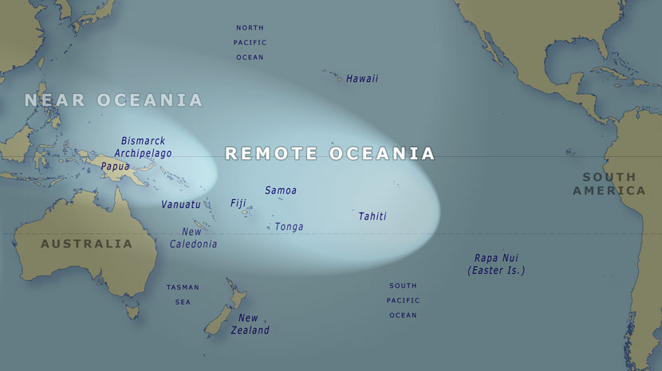
Notes:
By way of background, the origin point of the Austronesian family is Taiwan, circled on the map, where the indigenous Formosan languages are spoken
The Austronesians travelled from Taiwan through the Philippines and Malaysia/Indonesia. By the time they reached the Bismarck Archipelago off the coast of Papua New Guinea, we see the emergence of the Lapita culture and the Oceanic language family. The Lapita people migrated east from the Bismarck Archipelago around 4000 years ago, and from there into Remote Oceania, arriving in the Tonga/Samoa region around 3500 years ago.
Given the wealth of languages in the Pacific region, it seems obvious that Pacific languages would feature in our linguistic teaching, particuarly te reo Māori should be a priority. We do not attract a lot of Māori and Pacific student, and this is something we’d like to change.

Slide 4
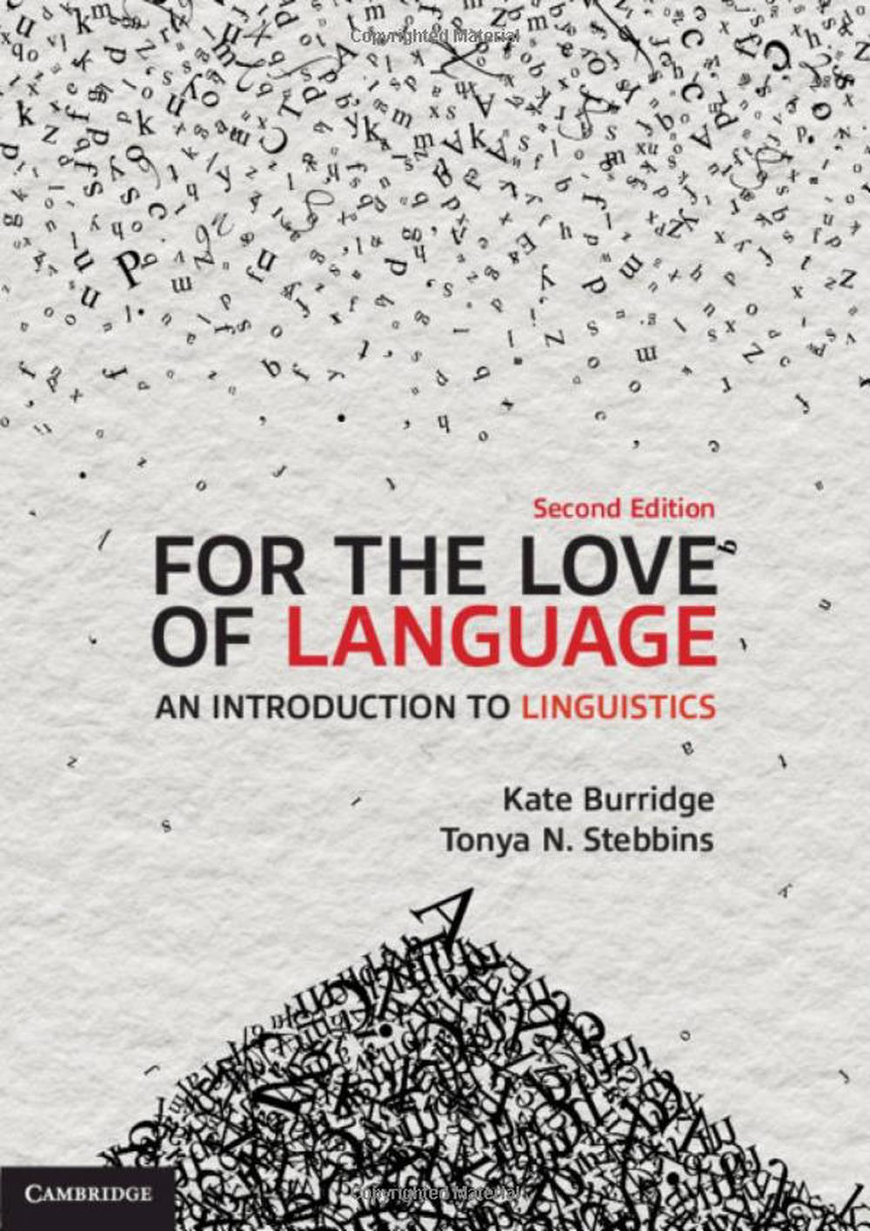
For the love of language
(Burridge & Stebbins 2020)
Notes:
So... for some time now, we have been looking for introductory linguisitics textbooks that contain material that we might be able to use in teaching. We are particularly interested in textbooks that are still in print, and that have new editions being released fairly regularly.
To date, most textbooks we have looked at have only a handful of vocabulary items, or small amounts of data from a tiny number of the languages belonging to the larger Austronesian family. Where there is Pacific language data, it is positioned amongst data from multiple other languages, and it is used to illustrate different aspects of the phenomenon of language in general, rather than Pacific languages in particular.
One textbook that we thought looked promising is Burridge & Stebbins, For the love of language. The authors, Kate Burridge and Tonya Stebbins are Australian linguists.
Te reo Māori is one of 9 case study languages included in the textbook
The language is introduced with some sociolinguistic content in a one-page introduction. And in the index, there are references to topics about the social context of Māori, its vocabulary, sound system, word structure and grammar. On the surface, it looks like a good source of teaching material.

Slide 5
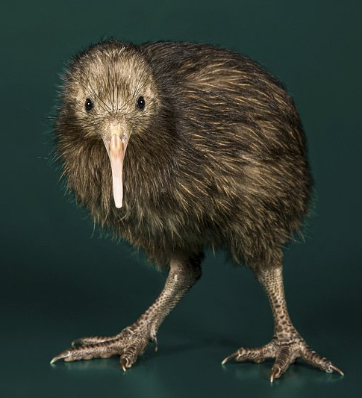
What do we learn about te reo Māori from Burridge & Stebbins?
New Zealand English uses words from Māori for names of places, people, organisations, words relating to sociocultural concepts and objects, names of flora and fauna [Yes]
BUT... kiwi is not a loan word from Māori used in New Zealand English [???] (p. 29)
kai- is a prefix that expresses a person who performs an action [Yes]
  ako ‘teach’ and kaiako ‘teacher’ [Yes]
  mahi ‘work’ and kaimahi ‘worker’ [Yes]
  kārero ‘speak’ and kaikārero ‘speaker’ [???] (p. 121)
Notes:
Now, what do we learn about te reo Māori from Burridge & Stebbins work ?
In their introduction to te reo Māori, the authors use a paragraph to explain how NZE uses quite a lot of Māori vocabulary, mentioning names of places, people, organisations, words relating to sociocultural concepts and objects, names of flora and fauna
But then they say that kiwi is not one of these words. Except it is! We don’t use a word of English origin for the bird...
Later in the book, they talk about word formation processes, and they explain that in te reo Māori, there is a prefix kai- which expresses the person who performs an action: they give examples of ako, Kaiako; mahi, kaimahi, and then this word kārero, and its kai- form, kaikārero.
Rather than going through the material problem by problem, we just want to indicate that there are problems, and that we are not able to use this material with Māori students.

Slide 6

New materials for teaching:
A work in progress
Notes:
So, there is a need for us to create our own materials to illustrate linguistic concepts with Māori and Pacific language data.
We are going to talk you through a couple of examples of materials that we have created. We’ve used analysis and examples from grammars of Māori written by Winifred Bauer and Ray Harlow, grammatical studies by Māori scholars like Peter Keegan, and I have relied heavily on Kan’s own knowledge of te reo Māori as a native speaker and tertiary teacher of the language. Kan and I have both carried out research in Vanuatu with indigenous communities. Kan is still in the ananlysis phase of her latest Project, so I’ll illustrate a bit of my field data and analysis.

Slide 7
Teaching the category of number singular & plural (after Harlow 2015)
t- for possession of singular entities
10 | tōku pōtae | ‘my hat’
11 | ōku pōtae | ‘my hats’
12 | tōku hū | ‘my shoe’
13 | ōku hū | ‘my shoes’
Prefixes & Suffixes
t-ēnei, ēnei | hat, hat-s
‘nothing’ as meaningful
 | Māori | English
Singular | t- | -Ø
Plural | Ø- | -s
t- for singular demonstrative determiners
7 | tēnei tūru | ‘this chair’
8 | ēnei tūru | ‘these chairs’
18 | tēnei waea pūkoro | ‘this phone’
19 | ēnei waea pūkoro | ‘these phones’
Notes:
On this slide, we are illustrating the grammatical category of number. Most languages have a grammatical system to distinguish between singular and plural for a whole variety of objects and entities that can be counted.
In Māori: we can see t- affixed to possessives (10, 12) and demonstratives (7 and 18) for singular, compared with the absence of t- for plural
In English: singular has no extra marking on nouns – a noun by itself is singular, but plural nouns have an –s suffix.
We can see how the presence and absence of t- or -s creates the same meaningful contrast. But the contrast is made in different places. Māori codes explicitly for singular, while English codes explicitly for plural.
The understanding that languages can express the same contrast, or the same types of information about the world, using different strategies is a fundamental understanding in linguistics. Beyond that, understanding the ‘nothing’ can be a meaningful part of a system is important.

Slide 8
Teaching Reduplication
(Data from Keegan 1996)
Simplex | Gloss | Reduplicated | Gloss
hopu | ‘catch’ | hopu~hopu | ‘catch one after another’
pātai | ‘question’ | pātai~tai | ‘question frequently’
pātuki | ‘strike, knock’ | pātuki~tuki | ‘strike or knock repeatedly’
takahuri | ‘roll, turn’ | takahuri~huri | ‘keep on turning round, roll over and over’
epa | ‘pelt’ | epa~epa | ‘pelt continuously’
patō | ‘knock’ | patō~tō | ‘knock repeatedly’
Function
  repetition of an action
Forms
complete: hopu → hopu~hopu
partial: pātai → pātai~tai
Notes:
Another teaching example we use relates to reduplication.
Reduplication is not a process that is found in English, but it is widespread in languages of the Pacific region, as well as in Australia.
Here is a small set items from Peter Keegan’s thesis on Reduplication in Māori. These items show the use of reduplication for repetition. This is an iconic use of reduplication, where in the words of Lakoff and Johnson, ‘MORE OF FORM stands for MORE OF CONTENT’ (1980:128)
These data illustrate both complete or full reduplication of a word, and partial reduplication of a word – these are the two major forms of reduplication that we find in the world’s languages.

Slide 9
Reduplication (Keegan 1996)
Simplex | Gloss | Reduplicated | Gloss
hopu | ‘catch’ | hopuhopu | ‘catch one after another’
pātai | ‘question’ | pātaitai | ‘question frequently’
pātuki | ‘strike, knock’ | pātukituki | ‘strike or knock repeatedly’
takahuri | ‘roll, turn’ | takahurihuri | ‘keep on turning round, roll over and over’
epa | ‘pelt’ | epaepa | ‘pelt continuously’
Forms
  CVCV (~hopu)
  CVV (~tai)
  VCV (~epa)
Abstracting to a single CV template
  ~(C)V(C)V
Notes:
From those simple observations, we can create CV templates, templates that represent the sequence of consonants and vowels that are ‘copied’ or reduplicated in each word
Students find it easy to create CV templates for individual words.
But they then need to figure how how to represent the different looking CV templates as a single CV structure to express in this case, repetition of an action. This involves more abstract thinking - the ability find a pattern from seemingly different forms of reduplication.
The template says, reduplicate the final two vowels of a word, and their preceding consonants, if there are any.

Slide 10
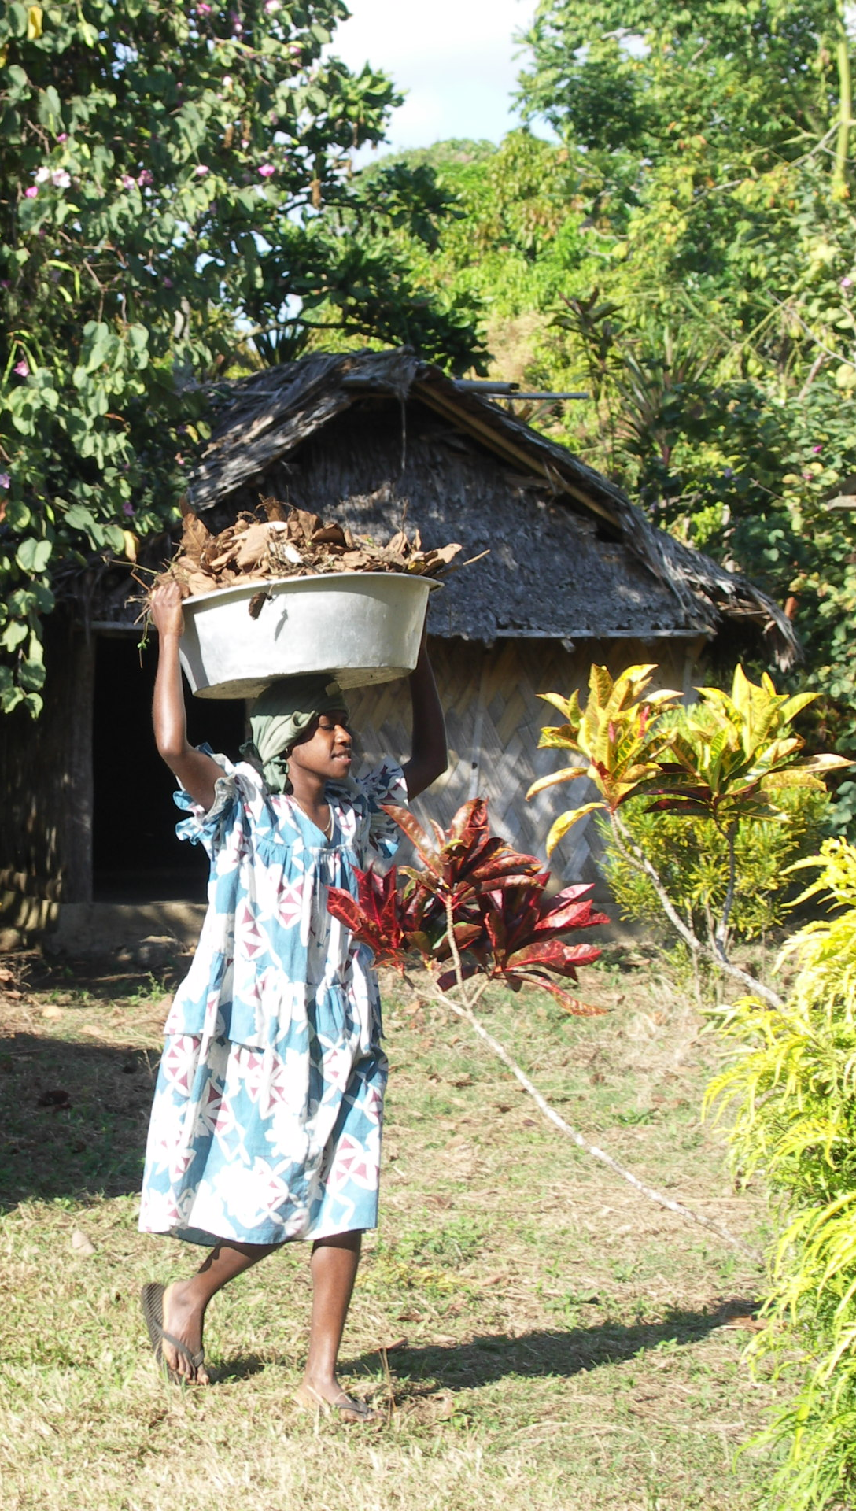
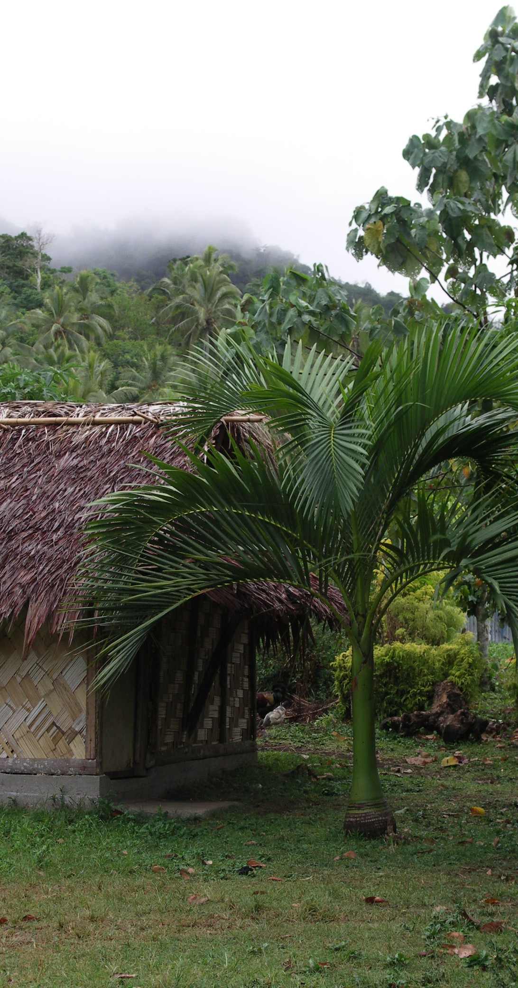
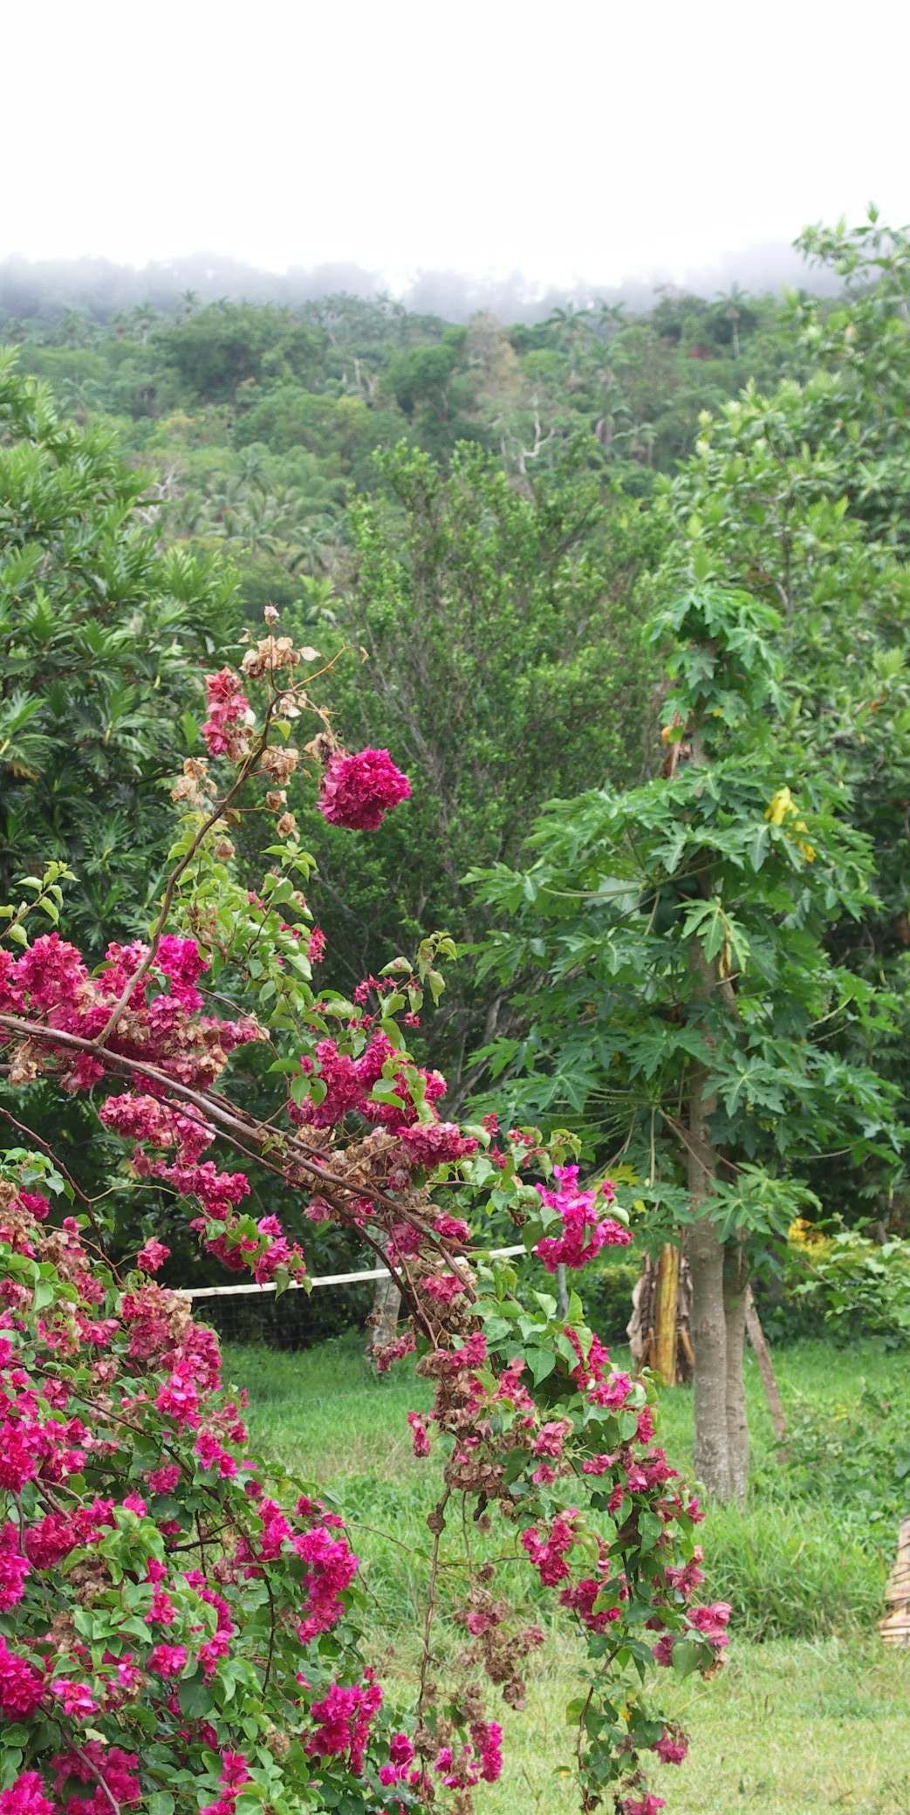
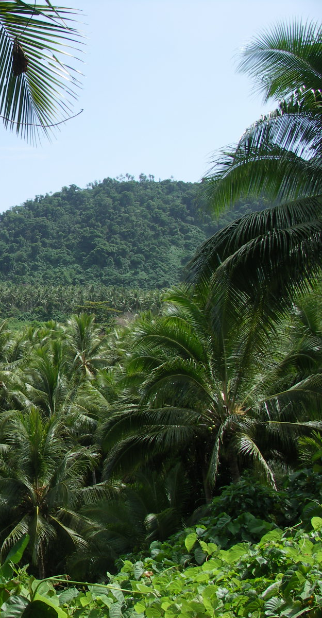
Neverver (Malekula Island, Vanuatu)
Emlina Simo
Limap village
Notes:
I want to share a little data from Neverver, which is an Oceanic language spoken on Malekula Island in Vanuatu. Malekula is a high island. It was recently in the news when Cyclone Lola passed over in late October this year. Neverver was the topic of my doctoral research, and although I have studied many other languages of Malekula, it is probably the language that I know the most about.

Slide 11
Reduplication in Neverver
(after Barbour 2012)
xit | ‘see something’ | xit-xit | ‘look’
gav | ‘rake something’ | gav-gav | ‘do raking’
vul | ‘buy something’ | vul-vul | ‘go shopping’
Reduplication changes a transitive verb into an intransitive verb
Reduplication changes an active verb involving movement, into a stative verb, with no movement
Reduplication changes a verb into a noun, along with a prefix ni- and suffix -ian
tur | ‘stand up’ | tur-tur | ‘stand’
vor | ‘sit down’ | vor-vor | ‘sit’
jing | ‘lie down’ | jing-jing | ‘be lying down’
bit | ‘err’ | ni-bit-bit-ian | ‘wrong-doing, evil’
jal | ‘be ill’ | ni-jal-jal-ian | ‘epidemic’
sien | ‘think, consider’ | ni-si-sien-ian | ‘thought, decision’
Notes:
Neverver, like many other Pacific languages, uses reduplication extensively.
These example show how reduplication is used to change the way that words work, particularly verbs, in different ways.
The first set shows a change from transitive verb (where we perform an action on something) to intransitive verb (where we just focus on the action.)
The second set shows a change from an action (where we can visualise a person moving) to a state (where there is no movement)
And the third set shows the change from a verb, to a noun, in combination with a prefix and a suffix.
Together, these examples illustrate to students that a single process (in this case reduplication) has a number of different effects, and that to undestand the effects, we need to pay careful attention to word meaning.

Slide 12
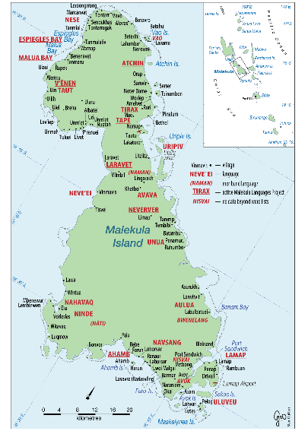
Asymmetrical Standard Negation in Māori
Symmetrical Standard Negation in Neverver (Vanuatu Field Research)
Mang i-vu. ‘The man went.’
Mang i-vu si. ‘The man didn’t go’
I haere a Hōne. ‘Hōne went.’
Kāore a Hōne i haere. ‘Hōne didn’t go’
(Not this: Kāore i haere a Hōne.)
Notes:
Finally, on this slide, we are illustrating different ways of making negative sentences. In every human language, there is a way of expressing negation – this corresponds with the capacity that humans have for lying!
Data from Neverver nicely illustrates symmetrical negation. The negative marker is positioned after the verb: Mang i-vu means ‘The man went’; Mang i-vu si means ‘The man didn’t go.’ The negative marker is the only element that is different between the affirmative and negative sentences.
In te reo Māori, Negation is asymmetric. We have our positive sentence: I haere a Hōne, meaning ‘Hōne went’. If we want to say ‘Hōne didn’t go’, we add a negative marker, and we also change the order of elements. So the negative comes first: kāore. This is followed by a Hōne, and then the action i haere. So the order of the action and the subject changes between the affirmative and negative clauses.
These data show how a single function – the expression of negation – can be achieved in different ways.
[Another really useful point that we can teach with this data is the idea of constituency. That is to say, the elements in a language form structures. i haere is one such structure; a Hōne is another. When a sentence is negated, it is the constituents that change order, not just individual words.]

Slide 13

Some interim reflections
There is a lack of accurate published teaching materials presenting language data from te reo Māori and other Pacific languages
Māori and Pacific language data can demonstrate important concepts and categories in linguistics
Māori and Pacific language data *might* be more interesting and relevant to Māori and Pacific students of language
Any newly developed materials need to be carefully checked, ideally by speakers and language specialists who can identify and eliminate errors
Notes:
Where does this leave us?
firstly: there is certainly a lack of current teaching materials that presenting language data from te reo Māori and other Pacific languages. Where data is included, it is not always accurate.
secondly: language data, Māori and Pacific language data can be used effectively to demonstrate important catgories and processes and concepts in linguistics
thirdly: Māori and Pacific language data *might* be more interesting and relevant to Māori and Pacific students of language, than say, examples from European languages.
and finally: any newly developed teaching materials need to be carefully checked, ideally by speakers and language specialists who can identify and eliminate errors. Inaccurate data is really problematic, particularly if the objective is inclusion.

Slide 14
References
Barbour, Julie. 2012. A grammar of Neverver. Berlin: De Gruyter.
Bauer, Winifred A. & Parker, William & Evans, Te Kareongawai & Teepa, Te Aroha Noti. 2003 [1997]. The Reed reference grammar of Māori. Auckland: Reed.
Burridge, Kate & Stebbins, Tonya. 2020. For the love of language, 2nd edn. Cambridge: Cambridge University Press.
Harlow, Ray. 2007. Māori: A linguistic introduction. Cambridge: Cambridge University Press.
Harlow, Ray. 2015 [2001]. A Māori Reference Grammar. Wellington: Huia Publishers.
Irwin, Geoff. 2005 (updated 2017, Feb 8). 'Pacific migrations - The world’s first seafarers', Te Ara - the Encyclopedia of New Zealand, http://www.TeAra.govt.nz/en/map/1762/the-pacific-ocean-showing-remote-oceania (accessed 26 November 2023) https://teara.govt.nz/en/map/1762/the-pacific-ocean-showing-remote-oceania
Ross, Malcolm, Andrew Pawley & Meredith Osmond (eds). 2016. The lexicon of Proto Oceanic. Vol. 5 People: body and mind. Asia-Pacific Linguistics, A-PL 28.
Wessels, Kanauhea, Beau Stowers & Julie Barbour (2023 in press). Katoa: a descriptive, comparative and historical analysis. Te Reo: Journal of the Linguistic Society of New Zealand.
Image of Kiwi from: https://www.rawpixel.com/search/kiwi%20bird?page=1&path=_topics&sort=curated

Slide 15
A problematic task (2nd edn.)
Complete the following pronoun paradigm and explain the inclusive exclusive distinction. Note that the shaded areas in the table cannot be filled. Can you explain why? (p.141-42)
Ka haere au. ‘I will go.’
Ka haere koe. ‘You will go.’
Ka haere tāua. ‘You and I will go.’
Ka haere māua. ‘We two will go.’
Ka haere tātou. ‘We all, including you, will go.’
Ka haere mātou. ‘We all are going, but not you.’
 | Singular | Dual | Plural
First Person
Inclusive
Exclusive
Second Person
Third person
 | Singular | Dual | Plural
First Person | au
Inclusive |  | tāua | tātou
Exclusive |  | māua | mātou
Second Person | koe
Third person
Notes:
Another example of problematic material in the Burridge & Stebbins text is a task they set for students to complete. They ask students to find pronouns in a set of sentences, and complete a pronoun table, which looks like this:
Only six sentences are provided, which means students can only complete the table provided like this:
They also ask students to explain why the shaded areas cannot be filled in. This is a question that can only be answered superficially by saying that there is insufficient data (for example for the second person cells), but the same explanation also applies to the third persons cells which are not shaded. So...

Slide 16
A problematic task (1st edn.)
Complete the following pronoun paradigm and explain the inclusive exclusive distinction. Note that the shaded areas in the table cannot be filled. Can you explain why? (p.141-42)
Ka haere au. ‘I will go.’
Ka haere koe. ‘You will go.’
Ka haere tāua. ‘You and I will go.’
Ka haere māua. ‘We two will go.’
Ka haere tātou. ‘We all, including you, will go.’
Ka haere mātou. ‘We all are going, but not you.’
Ka haere kōrua. ‘You two will go.’
Ka haere koutou. ‘You all will go.’
Ka haere rāua. ‘Those two will go.’
Ka haere rātou. ‘They will all go.’
 | Singular | Dual | Plural
First Person | au
Inclusive |  | tāua | tātou
Exclusive |  | māua | mātou
Second Person | koe | kōrua | koutou
Third person | ? | rāua | rātou
Notes:
It turns out that the original task in first edition of the textbook had 10 sentences.
It is still missing an example of ia, the third person singular pronoun, but otherwise we have evidence of 10 different pronouns.
The shaded cells were originally also different, although most linguists would avoid these cells by drawing the table differently.

Slide 17

A problematic task (1st edn.)
Complete the following pronoun paradigm and explain the inclusive exclusive distinction. Note that the shaded areas in the table cannot be filled. Can you explain why? (p.141-42)
Ka haere au. ‘I will go.’
Ka haere koe. ‘You will go.’
Ka haere tāua. ‘You and I will go.’
Ka haere māua. ‘We two will go.’
Ka haere tātou. ‘We all, including you, will go.’
Ka haere mātou. ‘We all are going, but not you.’
Ka haere kōrua. ‘You two will go.’
Ka haere koutou. ‘You all will go.’
Ka haere rāua. ‘Those two will go.’
Ka haere rātou. ‘They will all go.’
 | Singular |  | Dual | Plural
1st | au | Inclusive | tāua | tātou
 |  | Exclusive | māua | mātou
2nd | koe |  | kōrua | koutou
3rd | ? |  | rāua | rātou
Notes:
We would draw it like this: where the only empty cell is the third person singular
Between the first edition and the second, it appears some sentences have been deleted, most likely because they didn’t fit on the page, and then the table has been reformatted to make it look nice, without reference to the task. The resulting task ends up as nonsense.
And there are other issues in the data and analysis of te reo Māori presented by Burridge and Stebbins. I imagine that errors and problems in the materials are likely to have the opposite effect to ‘inclusion’.

