Slide 1
Words on Walls: te reo Māori (loan)words in Aotearoa New Zealand primary school classrooms
Jessie Burnette¹, Andreea Calude¹ & Hēmi Whaanga²
1 University of Waikato
² University of Massey

Slide 2


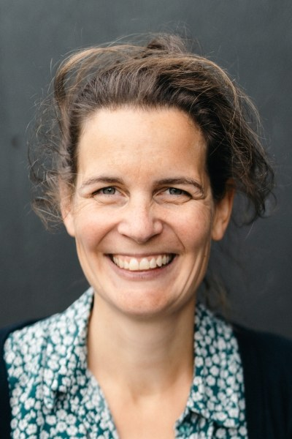
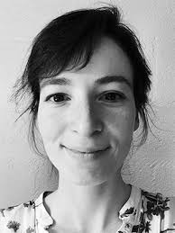
Research Team
Dr Andreea Calude Dr Hēmi Whaanga
University of Waikato Massey University
Dr Eline Zenner Dr Laura Rosseel
KU Leuven Vrije Universiteit Belgium

Slide 3

Language Contact in Aotearoa New Zealand
New Zealand English is special, as we see a ‘flow of words from an endangered, minority-status language […] into a dominant, global lingua franca’ (Trye et al. 2020, p. 2).
Publicly available book identified within classrooms.
Matamua, R., Kamo, M., Joy, I., & Aho-White, T. (2022). Matariki Around the World: A Cluster of Stars A Cluster of Stories. https://www.paperplus.co.nz/shop/books/a-cluster-of-stars-a-cluster-of-stories-matariki-around-the-world

Slide 4
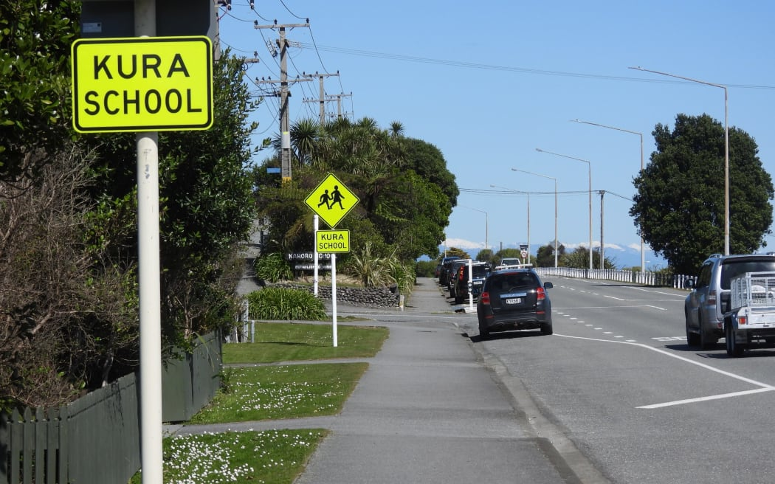
Study One: Words On Walls
‘The language of public road signs, advertising billboards, street names, place names, commercial shop signs, and public signs on government buildings combines to form the linguistic landscape of a given territory, region or urban agglomeration.’
(Landry and Bourhis, 1997, p. 25)
RNZ (2022). 'They'll have no bloody idea' - bilingual signs on the West Coast. https://www.rnz.co.nz/news/ldr/475482/they-ll-have-no-bloody-idea-bilingual-signs-on-the-west-coast

Slide 5
Research Questions
RQ1)
What type of produce te reo Māori (loan)words are children regularly exposed to through schoolscapes in Aotearoa New Zealand English-medium primary schools? What is their distribution across schools/classrooms/years/thematic categories?
Is there a correlation between frequency and type of (loan)word occurrence and presence in past corpora from different genres?
What indirect language ideologies does the presentation of te reo Māori (loan)words suggest? For example, are items scaffolded for teaching? Are there differences in the presentation of different lexical items and, if so, is there any correlation between scaffolding and dictionary listedness or frequency of use in past corpora?
RQ2)
RQ3)

Slide 6
The Schools
School One
School Two
Year 3/4 Class
Year 5/6 Class
Year 5/6 Class
Year 3/4 Class
Year 5/6 Class
Year 5/6 Class
School Three
Year 4 Class
Year 5/6 Class
Year 5/6 Class

Slide 7
Artefacts & Clusters

Slide 8
Results: (General) Māori Exposure

Slide 9
Results: (General) Māori Exposure
Figure 5. Comparison of Māori tokens normalised across individual classes (n=9)
Figure 6. Overview of Māori tokens normalised by school, year and theme (n=252, we excluded the four clusters relating to both daily planning and the environment)

Slide 10
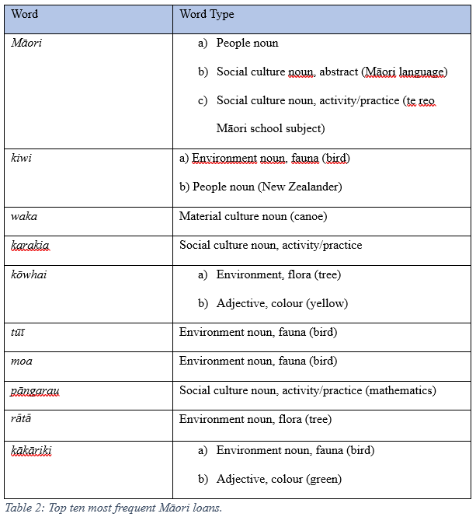
Results: Loanword Exposure

Slide 11
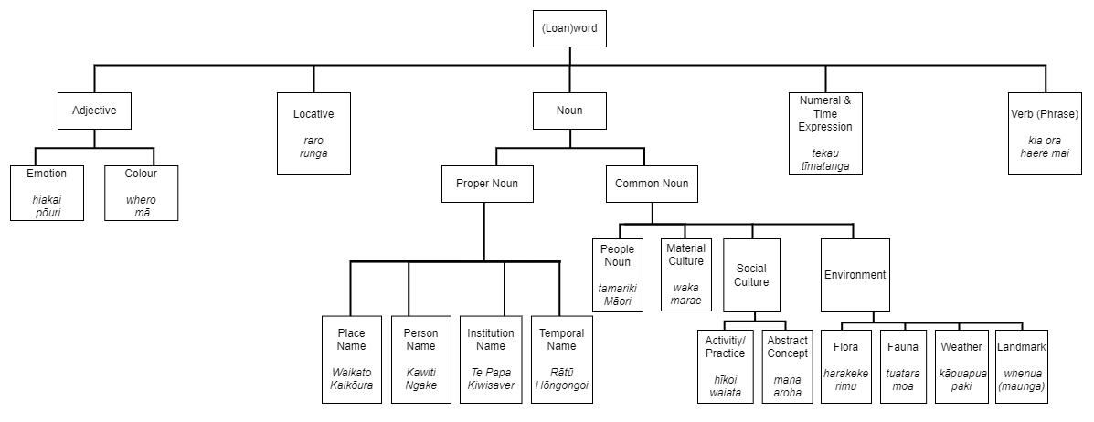
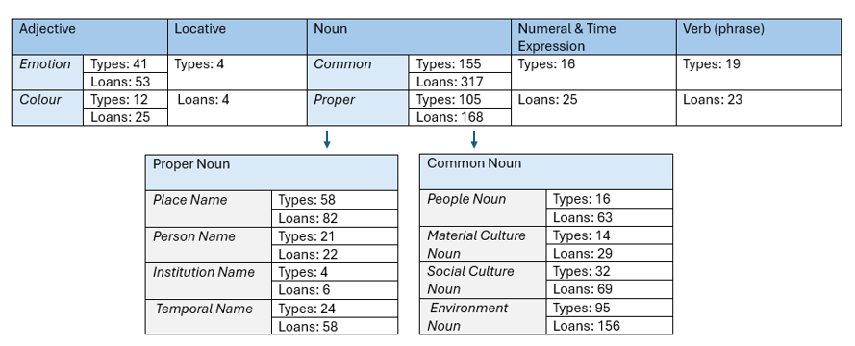
Results: Loanword Exposure
Figure 8: Distribution of Māori Loans

Slide 12
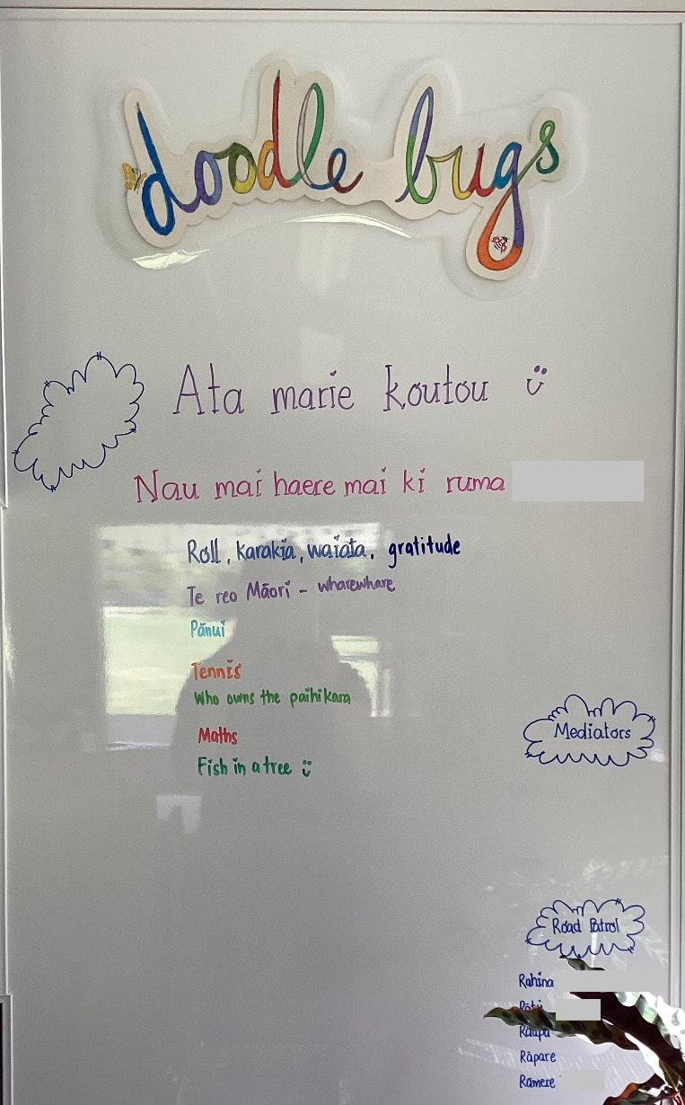
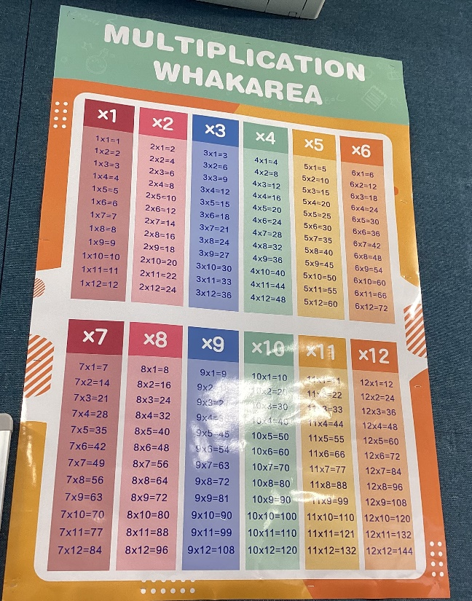
Results: Loanword Exposure

Slide 13

Acknowledgements
Many thanks to my supervisors, Andreea Calude, Laura Rosseel, Hēmi Whaanga, & Eline Zenner for all of their support & guidance!
Extra thanks to my fellow PhD collaborator, Alex Pohl, for providing useful feedback and inter-rater reliability.
…and thanks to all of you!

