Slide 1




Breast Cancer Talk: A Cross-Linguistic Study of Lexical Verbs occurring with generic pronoun ‘You’
Sara Malik
PhD in Linguistics
Andreea Calude and Joe Ulatowski
School of Psychological and Behavioural Sciences
and School of Law, Politics, and Philosophy
The University of Waikato

Slide 2






Introduction
  A part of the PhD research
  Analysing and comparing linguistic features in NZ Eng and PK Urdu of the YouTube Breast cancer narratives.
  Various linguistic aspects analysed.

Slide 3

Why it matters?
• Research largely takes a medical focus, overlooking thoughts and emotions.
• Studying thoughts and emotions reveal speakers’ experiences.
• Many of us know someone affected by this illness.
• Understanding their language helps us grasp their experiences more deeply.

Slide 4

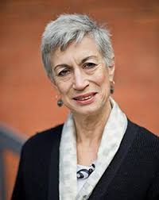
Stirling and Manderson’s (2011)
• This study examines how generalized you is used in interviews to express personal experiences.
• Using you instead of I helps speakers maintain authority, engage empathy, and present experiences objectively.
• For example, “I asked him to close the door, and you know, to lock it, and I took- took off my shirt, and my- the bra that I had on and, and the tsk- the prosthesis [that they give you]”
Lesley stirling
Lenore Manderson

Slide 5
Functions of generic pronoun ‘you’
Universalising the experience
Shared emotional validation
Giving implicit advice or guidance
Collective identity and empathy

Slide 6




Focus of this presentation
To investigate the use of lexical verbs following generic second-person pronouns.
To analyse their semantic patterns which offer insight into how speakers construe illness.

Slide 7


Lexical verbs?
“you feel that you've lost your own self”
A verb that carries the main semantic content of a sentence, expressing an action, process, or state, and is essential for conveying meaning.

Slide 8
Functions of lexical verbs
Lexical verbs show what breast-cancer speakers:
    do
    feel
    experience
Revealing insights into
    Agency
    emotion
    shared illness narratives.

Slide 9



Data
Videos
Transcription
Various speakers
• breast cancer speakers
• health professionals
• family members
• interviewers
• voiceovers
• other speakers
• 83 Total
• 46 from NZ
• 37 from PK
  Whisper AI
  Transcription error correction

Slide 10


Data in Two languages
Included
NZE
PKU
Excluded
PKE

Slide 11




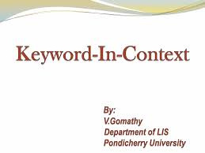
Method
Mixed-method approach
Qualitative analysis
Quantitative analysis
Generic uses of ‘you’
Types of lexical verbs that follow it

Slide 12
Verb Analysis
Examples included
Examples Excluded
All instances of lexical verbs, even the ones after Aux verbs:
You feel
You are aware
You help
Non generic instances of ‘you’, where you represent:
Second person
Indirect speech
Audience
All instances of non lexical verbs
Semi modals (you need..)
Modal verbs (can, could etc)
General extenders (you know)

Slide 13
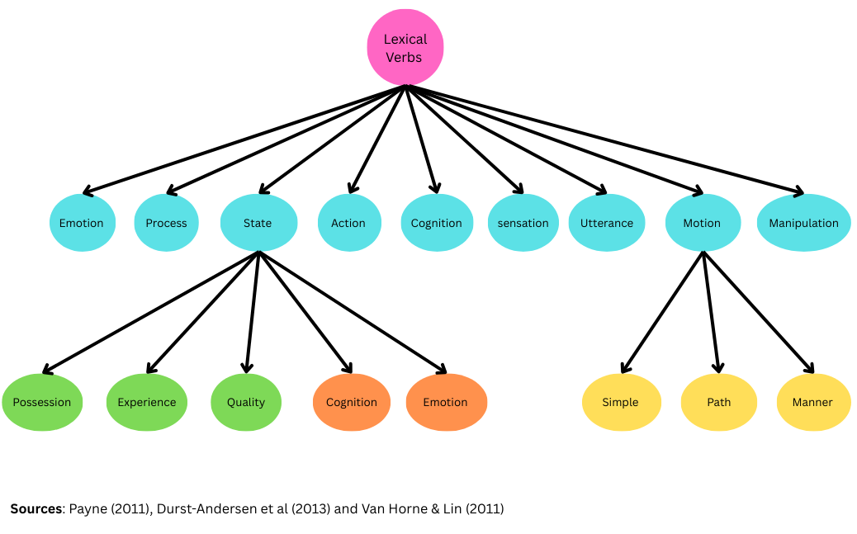
Lexical verb categories

Slide 14

Research Questions
  What are the shared and distinct lexical verbs across the datasets?
  What insights can be drawn from the most frequently used verbs in each dataset?

Slide 15

Findings
  Most verb types are similar across both datasets, with action and state verbs being the most frequently used.

Slide 16
Findings
Types of verb | Frequency in NZE data | Frequency in PKU data
Action | 99 | 100
Cognition | 36 | 25
Emotion | 18 | 1
Manipulation | 1 | -
Motion | 17 | 26
Process | 1 | 2
Quality | 1 | -
Sensation | 15 | 7
State | 69 | 53
Utterance | 11 | 13
Total instances of Pronoun “you”
NZE: 437
PKU : 426

Slide 17
Examples of State verbs (experience)
NZ
It is really tough and you have your good days and you have your bad days and I am very lucky to be surrounded by so many wonderful awesome people in my life (Angela Stuart Beauty, 2022a)
[emotional depth, acceptance and gratitude]
PK
Text: Aap ko diagnosis ho gayi, pata chal gaya. I think 12-14 days hai ke nahi hai, ke nahi. Toh woh aap pe bohot mushkil se guzarta hai. Once you got to know ke ab theek hai yeh diagnosis hai, ab toh kuch nahi ho skta (Shifa Foundation, 2019a)
Translation: You’ve been diagnosed, you’ve found out. I think it’s those 12–14 days of uncertainty, whether it is or isn’t, you have to go through those hardest days. Once you know, okay, this is the diagnosis, then there’s nothing more you can do. [ acceptance and shared empathy]

Slide 18
Functions of state verbs
Emotional Depth
Fostering Empathy
Reflection and Acceptance

Slide 19
Examples of Action verbs
NZ
Don't be frightened or embarrassed when you're in the shower to feel your tits, you know, feel your boobs. And if you do find something or something's not right or it doesn't feel right, go to your doctor and get it checked out as soon as possible (nzherald.co.nz, 2022c) [agency and persuasion]
PK
Text: jitna aap apna manual check up aap screening aur in cheezon ko aap seriously lain ge itna hi aap ke liye apne liye beneficial hai kyunki aap ki apni quality of life itni achi hogi (Shifa Foundation, 2019a)
Translation: The more seriously you take your manual-check up, screenings, and these things, the more beneficial it is for you, because your quality of life will be improved. [first hand knowledge, experience and advice]

Slide 20
Functions of action verbs
Agency and Control
Credibility
Persuasion and Empowerment

Slide 21
Implications of the study
Highlights mental, emotional and social dimensions of the illness experience.
Contribution to theoretical research.

Slide 22


Acknowledgement
Andreea S. Calude
Joe Ulatowski
Notes:
UNIV OF WAIKATO for funding your trip

Slide 23
References
  Durst-Andersen, P. (2011). Linguistic supertypes: A cognitive-semiotic theory of human communication (Vol. 6). Walter de Gruyter.
  Payne, T. E. (2011). Understanding English grammar: A linguistic introduction. Cambridge University Press.
  Stirling, L., & Manderson, L. (2011). About you: Empathy, objectivity and authority. Journal of Pragmatics, 43(6), 1581-1602.
  Owen Van Horne, A. J., & Lin, S. (2011). Cognitive state verbs and complement clauses in children with SLI and their typically developing peers. Clinical linguistics & phonetics, 25(10), 881-898.

