Slide 1
University of Liverpool
Centre for the Study of International Slavery
Dibia’s World:
Life on an early sugar plantation
William Jennings
University of Waikato, New Zealand

Slide 2
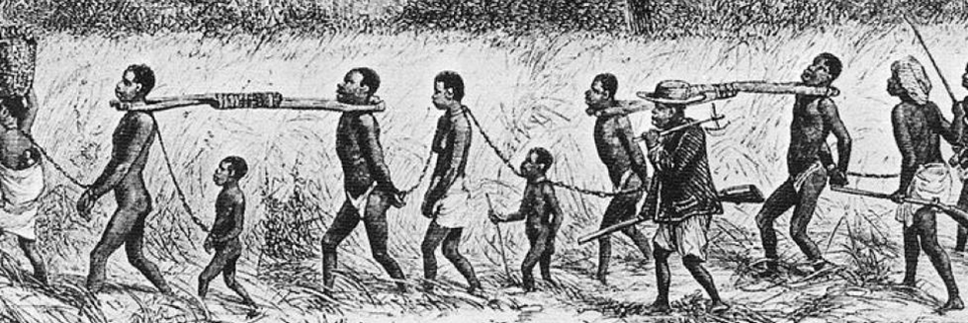
International Day of Remembrance of the Victims of Slavery and the Transatlantic Slave Trade
12.5 million people loaded in Africa
How many do we know by name?
How did they live, work, eat, rest?
How did they cope?

Slide 3
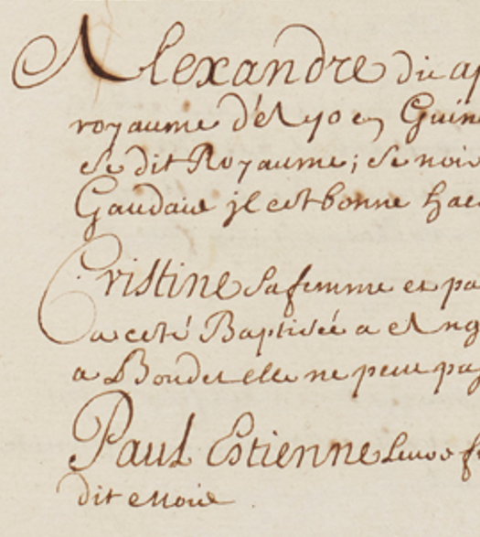
An enslaved family in May 1690
Alexandre, known as Apacy and called Doon by the Blacks, aged 37, is from the kingdom of Ayo in Guinea, which is further inland and behind the Foin kingdom. This Black came in the Perle, was sold by Bienvenu to Mr Gaudais. He is a good axeman.
Cristine, his wife, called Anne by the Blacks, aged 42, is from Congô and was baptised in Angolle by the Portuguese. She came with Vanpantegen, who sold her to Boudet. She can only be considered weak.
Paul Estienne, their son, known as Paul, was born on 27 May 1688 and was baptised on the 30th of that month.

Slide 4
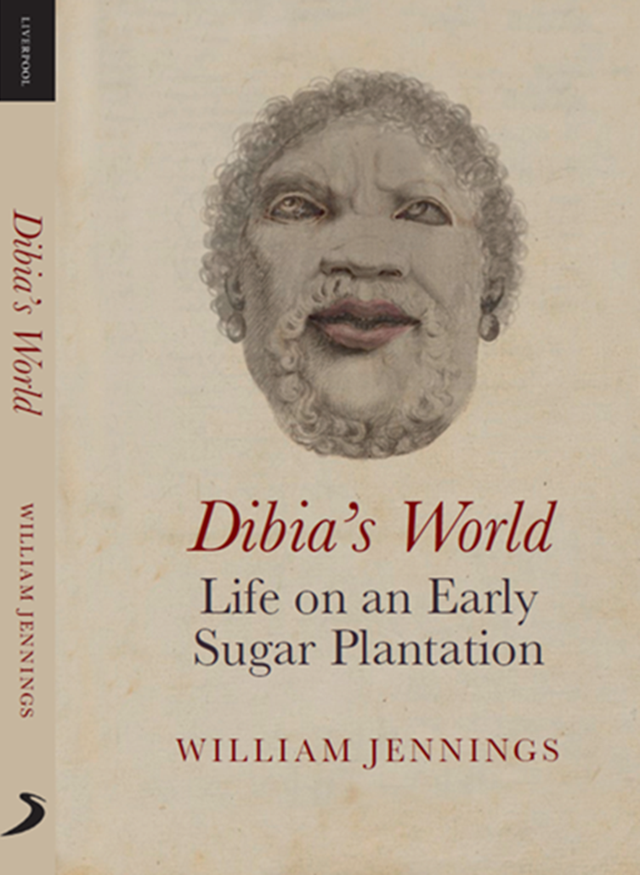
Tonight’s talk
The manuscript
The earliness
Reconstructing moments
An enslaved community
Ethnicities and voyages
Names
Families
Health
Daily life
Agency

Slide 5
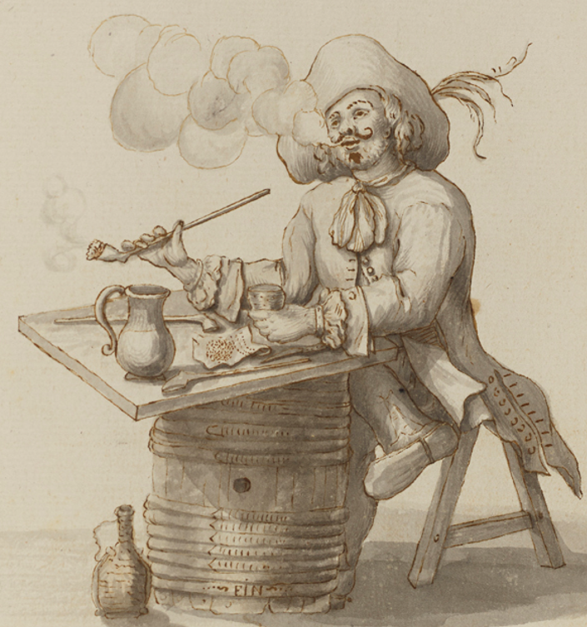
The Manuscript
Rouen Library
Jean Goupy
  Parisian doctor’s son
  15 years in the Atlantic world

Slide 6
The Manuscript
Rouen Library
Jean Goupy
  Parisian doctor’s son
  15 years in the Atlantic world
Confirmed by multiple checks
  Shipping, parish, legal, NASA

Slide 7
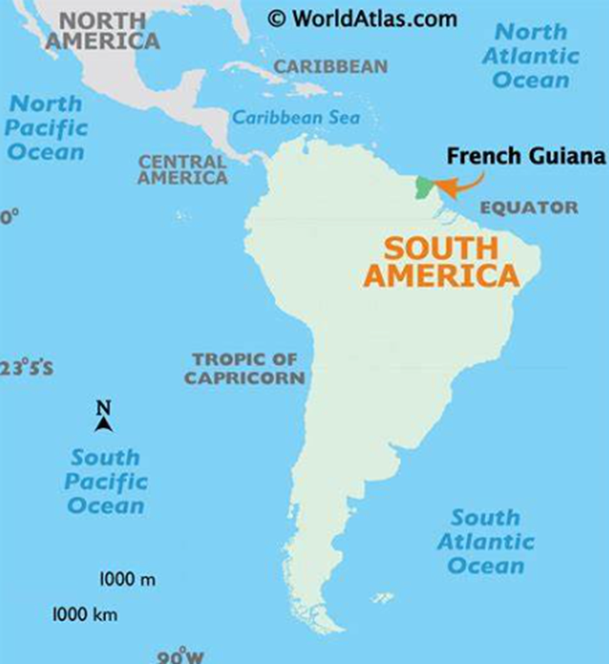
The Manuscript
395 pages
French Guiana: 1675-76, 1688-90
Travel writing
Inventory
How to run a plantation
How to manage slaves
How to prepare canefields
How to produce and sell sugar

Slide 8
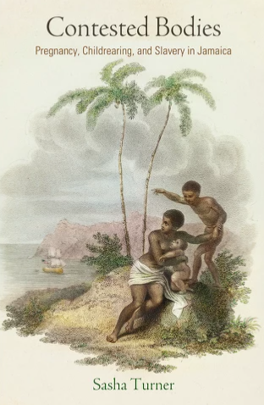
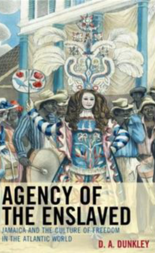
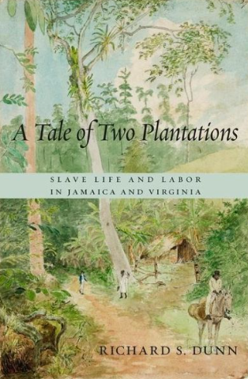
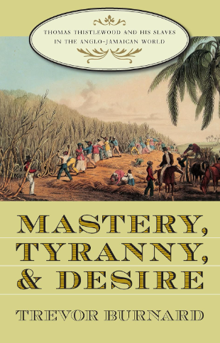
The Earliness
Recency bias
  More information
  More sources
Plantation life
  Before peak slavery
  Before the end of the trade
  During early industrial slavery

Slide 9
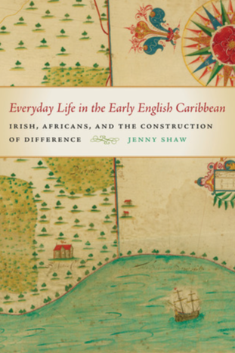
Reconstructing moments
Four enslaved people report Dibia has been beaten
A traumatic voyage followed by a forced marriage
Oulé’s baptism

Slide 10
An enslaved family in 1690
Alexandre, known as Apacy and called Doon by the Blacks, aged 37, is from the kingdom of Ayo in Guinea, which is further inland and behind the Foin kingdom. This Black came in the Perle, was sold by Bienvenu to Mr Gaudais. He is a good axeman.
Cristine, his wife, called Anne by the Blacks, aged 42, is from Congô and was baptised in Angolle by the Portuguese. She came with Vanpantegen, who sold her to Boudet. She can only be considered weak.
Paul Estienne, their son, known as Paul, was born on 27 May 1688 and was baptised on the 30th of that month.
Yoruba, arrived in 1682 aged 29
Bantu, arrived in July 1687 aged 39
Born 10 months later

Slide 11
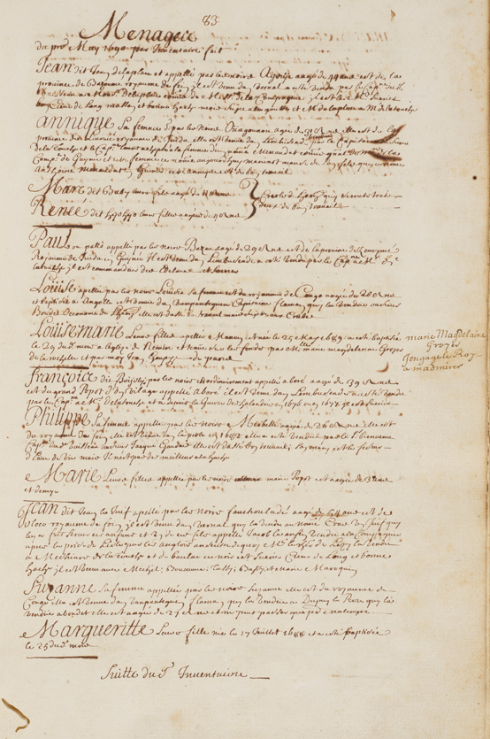
An enslaved community
93 people
71 adults (16 and over)
  40 men
  31 women
22 children, all Creoles
  11 boys
  11 girls
11 deaths in previous two years
2 stillbirths

Slide 12
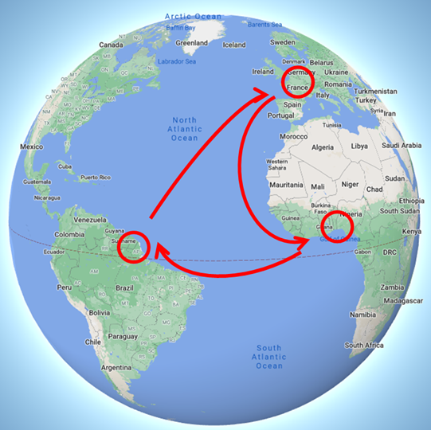
Ethnicities and voyages
Mostly from Ouidah, but also Senegal, Calabar and Angola
First slave ship in 1660
Dutch slavers until 1672, then mostly French
300 settlers, 1100 slaves in 1690
French colonies nationalised in 1664
Reconstructing an enslaved community’s first decades

Slide 13
Names
Loüis, known as Boucanne, called Boneau by the Blacks, which means ‘surgeon’ in the language of the Blacks of Juida
Suzanne, his wife, called Tassy by the Whites and the Blacks
Izabelle, called Izabelle Dibia by the Whites and the Blacks
Usually three
  Official name
  ‘called by the Whites’
  ‘called by the Blacks’
Children usually have two
Some names linked to professions

Slide 14
Families
Multilingual and multicultural
Forced marriages
Women as rewards
Age gaps among siblings
Pregnancies, new mothers and children not considered
Marc, called Baby, their son aged 11.
Renée, called Hyohyo, their daughter, aged 4.
Catherine, known as Cathou, and called Simbé by the Blacks, aged 6, their daughter. Will be a good worker.

Slide 15
Fecundity
31 women, 22 children
  Overwork, malnutrition, neglect
Four women arrived in 1682
  Merbellé, 18
  Coüya, 18
  Guenoupla, 25
  Houlacy, 28
In 1690, they had two living children
14 April 1689. Marie, the wife of Doré, gave birth before term to a dead boy after returning from the Royal Works

Slide 16
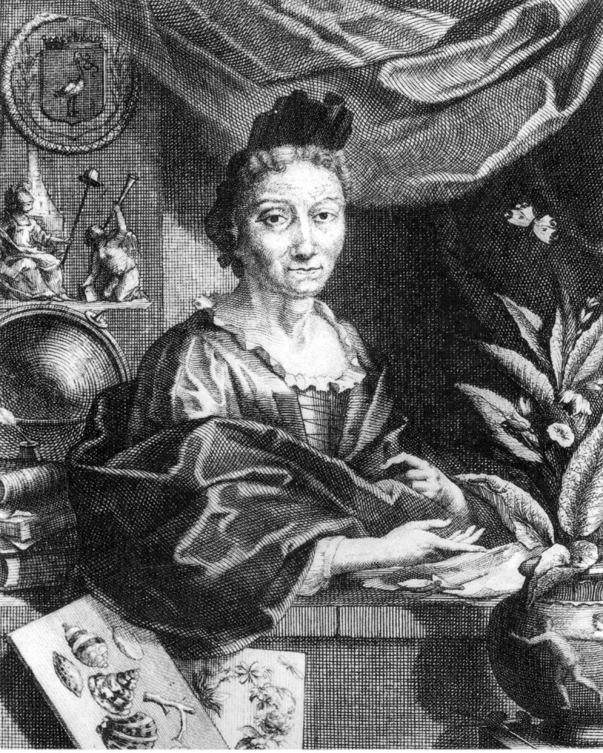
Maria Sybilla Merian (1647-1717)
Metamorphosis insectorum surinamensium
(Amsterdam, Valck, 1705)

Slide 17
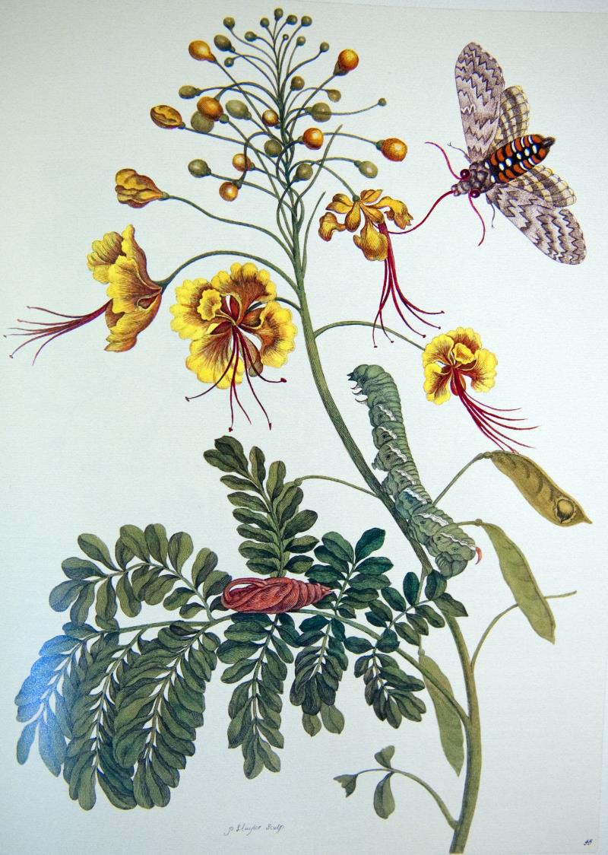
The peacock flower
Its seed is used by women in labour as it helps them give birth. The Indian slaves of the Dutch are treated with great strictness in this country and use the seeds to procure an abortion so they will not bring into the world children who would be as miserable as they are. As for the Negresses transported to Suriname from the Guinea or Angola coasts, they do not seek to have children and in effect have them rarely.

Slide 18
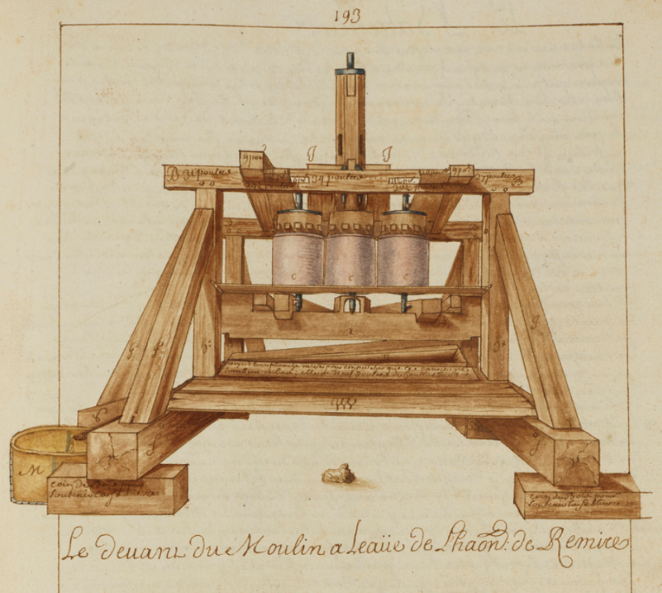
Health
Physical
  Injuries (especially to feet and legs)
  Hunger and malnutrition
  Fatigue
  Disease
  Punishment
Psychological
  ‘Useless’; ‘weak’
  ‘We get him to make fishing nets; he has never been worth much’

Slide 19
Medical practice
1. European
André Renoux, indentured surgeon, 22
2. African
Dibia, Boneau, Tassy?
Tropical knowledge
3. Native American
Local experts
Ritualistic
If the surgeon has a slave with an ailment he cannot find a remedy for, he must notify the master in case the latter can try to find an Indian or Black who claims to be a healer who can treat and cure him and this is to be done in the presence of the surgeon and the master.

Slide 20
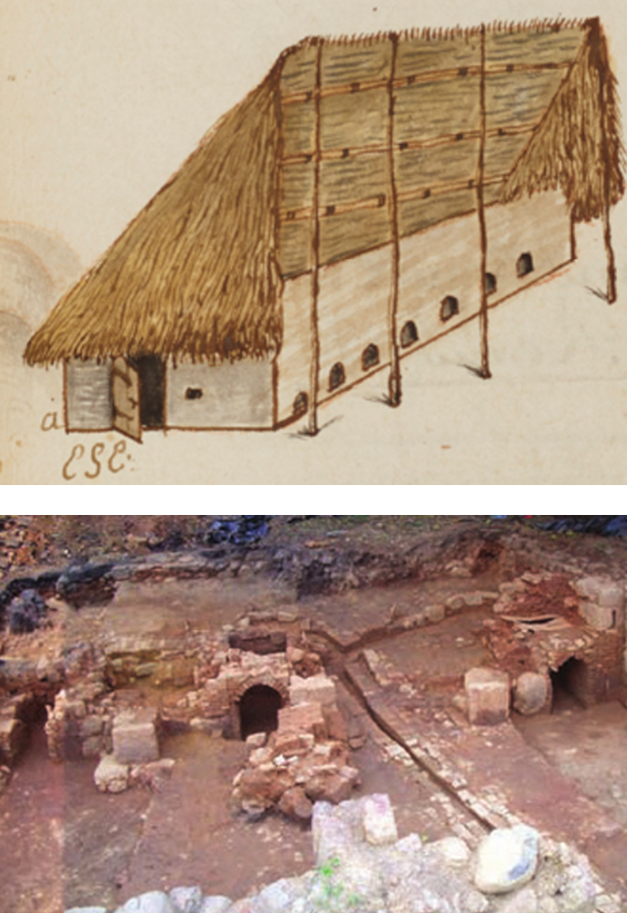
Daily life
Early industrial plantation slavery
  Clearing forest
  Farm work (crops and animals)
  Hunting, fishing
  Building and maintenance
  Royal works (colonial infrastructure)
Sugar production: 130 days per year

Slide 21
Daily life: professions
Sugar-maker Toolmaker
Potter Sawyer
Gardener Distiller
Cart-driver Hunter
Harness-maker Blacksmith
Axeman Net-maker
Mason Roofer
Carpenter Cowherd
Slave-driver Woodcutter
Fisherman Furniture-maker
Multiple skills
Women’s roles not mentioned except for:
  Cook
  Laundress
  Planter’s mistress
  Gathering herbs
  Feeding chickens
Gang system not yet in place?

Slide 22
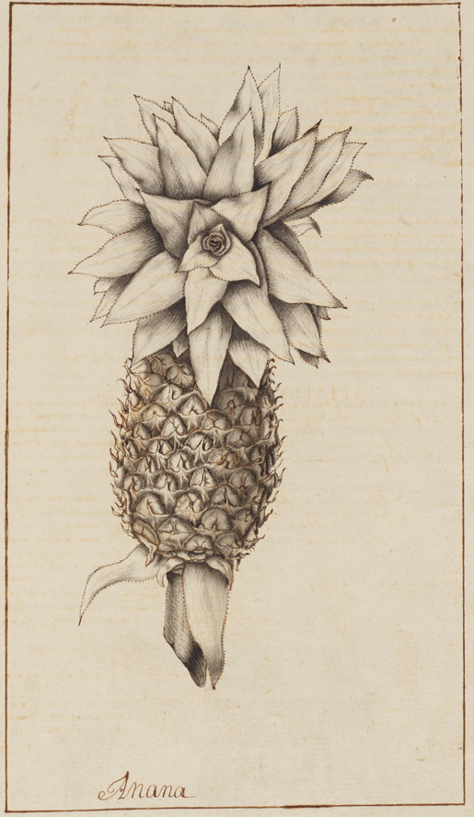
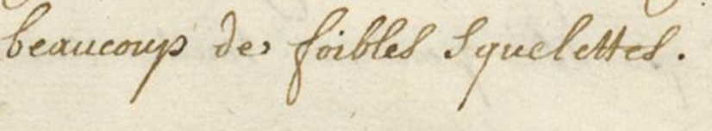
Daily life: food
West African influence
  Okra and pea soup (‘canolou’)
  Yams
Rum and local alcohols
Slave gardens
Insufficient food
‘A lot of feeble skeletons’
(Description of sugar plantation slaves, 1709). ANOM, Guyane, C14/6, 85.

Slide 23
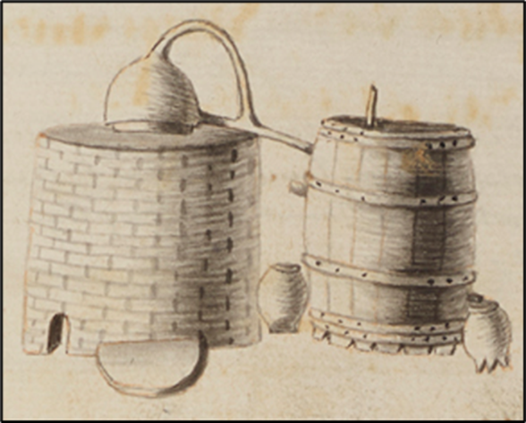
Daily life: rest
Very little free time
Mostly in darkness
Sundays
Mass
Gardens
Dances

Slide 24
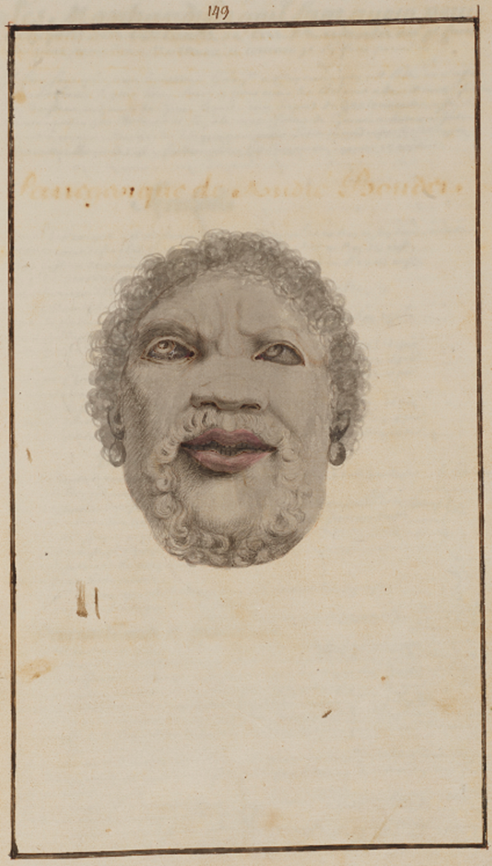
Agency
Birth control
Working slowly
Resting when unsupervised
  Hunting, woodcutting, cowherding
Theft of food
Illicit trade
Short absences
Long absences

Slide 25
Tonight’s talk
The manuscript
The earliness
Reconstructing moments
An enslaved community
Ethnicities and voyages
Names
Families
Health
Daily life
Agency

Slide 26
University of Liverpool
Centre for the Study of International Slavery
Dibia’s World:
Life on an early sugar plantation
William Jennings
University of Waikato, New Zealand

Slide 27
Further reading
Clifton, Jonathan and Dorien van de Mieroop, Master Narratives, Identities, and the Stories of Former Slaves (Amsterdam, John Benjamins, 2016).
Dunkley, D. A., The Agency of the Enslaved: Jamaica and the culture of freedom in the Atlantic world (Lanham, MA, Lexington Books, 2013).
Dunn, Richard S., A tale of two plantations: Slave Life and Labor in Jamaica and Virginia (Cambridge, MA, Harvard University Press, 2014).
Hall, Douglas, In Miserable Slavery: Thomas Thistlewood in Jamaica, 1750-86 (London, Macmillan, 1989).
Handler, Jerome S. and Frederick W. Lange. Plantation Slavery in Barbados: An Archaeological and Historical Investigation (Harvard University Press, 1978). See also http://jeromehandler.org/Categories/archaeology/ for more recent studies.
Palmer, Jennifer L., Intimate Bonds: Family and Slavery in the French Atlantic (Philadelphia, University of Pennsylvania Press, 2016).
Shaw, Jenny, Everyday Life in the Early English Caribbean: Irish, Africans, and the Construction of Difference (Athens, University of Georgia Press, 2013).
Slave Voyages Database, www.slavevoyages.org.
Thomas, Hugh, The Slave Trade (New York, Simon & Schuster, 1997).
Turner, Sasha, Contested Bodies: Pregnancy, Childrearing and Slavery in Jamaica, 1770–1834 (Philadelphia, University of Pennsylvania Press, 2017).

Slide 28
Sources
Goupy, Jean, ‘Voyages de M. Goupy aux îles de l’Amérique et aux côtes de l’Afrique en 1681’ (Bibliothèque de Rouen, Mss. Montbret 125, 1690).
Le Roux, Yannick, Réginald Auger and Nathalie Cazelles, Loyola, les jésuites et l’esclavage. (Québec, Presses de l’Université du Québec, 2009).

Slide 29
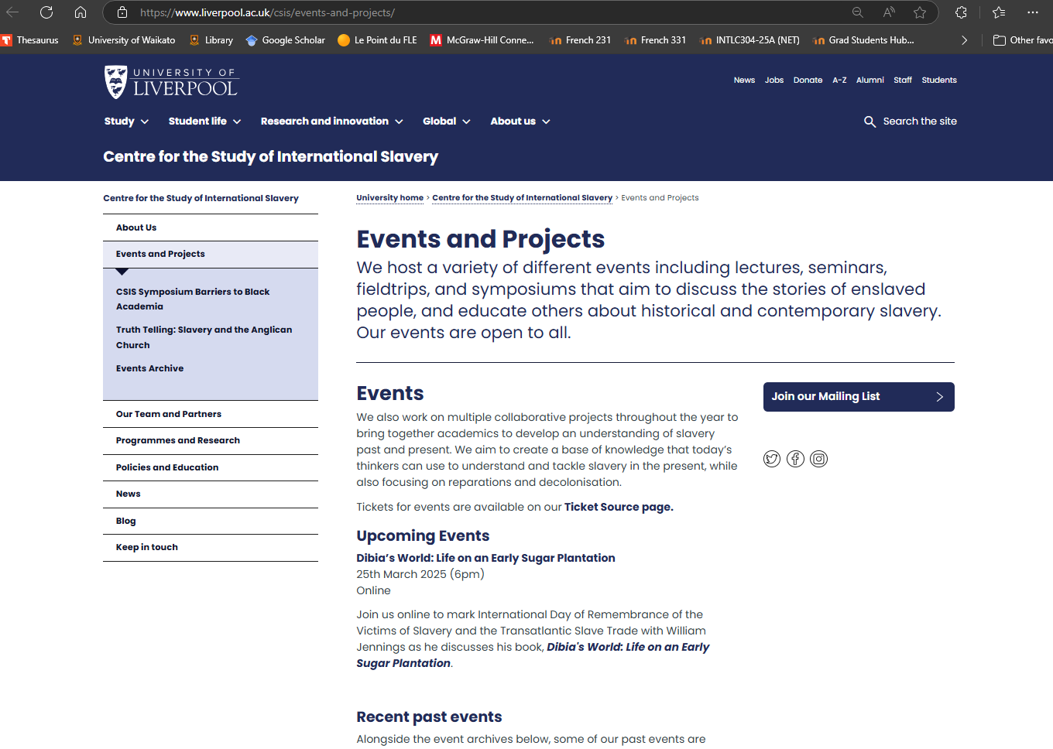

Slide 30
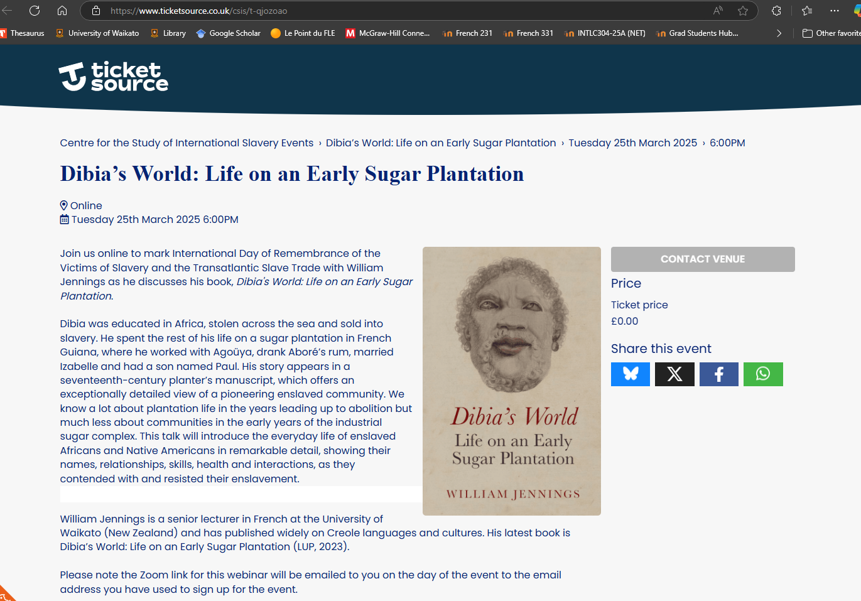

Slide 31


