Slide 1
Russell’s So-Called Truth Primitivism
Joseph Ulatowski

Slide 2
Outline of presentation
Early Russell on Truth
  Russell against correspondence
Others on Early Russell on Truth
  Truth as an unanalysable property / Truth primitivism
    Gettier (1961), Landini, Candlish and others
    Asay (2013, 2025), Wyatt (2025)
  Identity theory of Truth
    Dodd (2007)
Russell’s Correspondence Theory of Truth
  Correspondence of beliefs with facts (1910-12)
Early Russell against primitivism
Does Early Russell have a view on truth?
  Russell did not offer or argue for a theory of truth before 1910.

Slide 3
Early Russell on Truth
Who is Early Russell?
  The Principle of Mathematics (1903)
  “Meinong’s Theory of Complexes” (1904a, b, c)
  “On Denoting” (1905)
  Unpublished manuscript on truth (1905)
  Harold Joachim, The Nature of Truth (1906), Ch 2
    Review of Joachim, The Nature of Truth [The Independent Review (1906)]
    Review of Joachim, The Nature of Truth [Mind (1906)]
  “The Nature of Truth” (1907)

Slide 4
Early Russell on Truth
1899-1907:
  Orthodox story: Following Moore, Russell was a primitivist about truth
1907-1909:
  An epiphany: Russell’s multiple relation theory of judgment → correspondence theory of truth
1910-1970:
  Russell was a correspondence theorist about truth for the remainder of his life; however, he was a correspondence theorist of different stripes
    1910-2: truth as correspondence of beliefs with facts
    1914-8: truth as correspondence of propositions with facts
    1919-21: truth as correspondence of propositions with facts
    1927: truth as correspondence of statements with facts
    1940-8: truth as correspondence of beliefs with facts

Slide 5
Others on Early Russell on Truth
Asay (2013, 2025)
Candlish (2007)
Cartwright (2003, 2027?)
Gettier (1961)
Griffin (2003)
Landini (2005)
Sainsbury (1979)
Wyatt (2025)

Slide 6
Others on Early Russell on Truth
Jamin Asay (2013, 2025)
  Dilemma: Either facts exist for true judgements or false judgments have no object at all. Takes second horn and, voila, a theory of truth. (2025)
Jeremy Wyatt (2025)
  1905 unpublished Jowett Society paper: (i) “propositions are the bearers of truth and falsity”, (ii) facts are true propositions and fictions/objective falsehoods false propositions, and (iii) “truth and falsehood… are ultimate, and no account can be given of what makes a proposition true or false” (Russell, 1906/7: 48).

Slide 7
Others on Early Russell on Truth
Historical infelicities:
  Jamin Asay (2013, 2025) claims “What is Truth?” is an unfinished paper by Russell rather than a review of Joachim’s that had been published in The Independent Review.
  What is The Independent Review? A Liberal journal of 19C Britain that promoted liberalism, progress, and peace.

Slide 8
Russell’s primitivism
Preliminaries:
  Assumptions
    every belief must have an object other than itself
    truth and falsehood apply not to beliefs, but to objects
    even an object of thought that does not exist has a being which is in no way dependent on its being an object of thought
  Judgment
    “Complex idea” is the content of judgment
    Othello believes Desdemona loves Cassio
      The content of his belief is a mental counterpart of the proposition “Desdemona loves Cassio”
      So, the belief that Desdemona loves Cassio is a single complex idea referring to the proposition (single complex object) Desdemona loves Cassio

Slide 9
Russell’s primitivism
Preliminaries:
  Propositions are objects/entities and “anything that is true or false” (PoM, p. 12) but “not in general mental” (Ibid, p. xix).
    Subsistent complexes independent of judgments (Meinong’s Complexes p. 206fn)
    False propositions are as “transcendent” as true ones
    “Unities” of a “special and apparently indefinable kind” and not just “aggregates” of terms and relations (Meinong’s Complexes, p. 210).
    Truth and falsehood are qualities of propositions as wholes (Ibid)

Slide 10
Russell’s primitivism
It may be said—and this is, I believe, the correct view—that there is no problem at all in truth and falsehood; that some propositions are true and some false, just as some roses are red and some white; that belief is a certain attitude towards propositions, which is called knowledge when they are true, error when they are false. (Meinong’s Complexes, p. 523)
What is truth, and what falsehood, we must merely apprehend, for both seem incapable of analysis. (p. 524)

Slide 11
Russell’s primitivism
Dyadic relation:
BELIEF PROPOSITION
TRUE FALSE
Desdemona loves Cassio
Desdemona loves Cassio

Slide 12
Russell’s primitivism
Objective Falsehoods
FICTION
The Sun orbits Earth
The Sun orbits Earth
FACT
Earth orbits the Sun
Earth orbits the Sun

Slide 13
Early Russell against correspondence
And here it may be worthwhile to criticize the notion that truth consists in the correspondence of ideas with reality. This can only mean, as Meinong points out (Annahmen, p. 125), the correspondence of the immanent objects of ideas with reality, i.e., with the transcendent objects. (Meinong’s Complexes, p. 514)
Thus a belief, if this view is adopted, will not consist of one idea with a complex object, but will consist of several related ideas. That is, if we believe (say) that A is B, we shall have the ideas of A and of B, and these ideas will be related in a certain manner; but we shall not have a single complex which can be described as the idea of “A is B”. (“The Nature of Truth,” 46)

Slide 14
Early Russell against correspondence
There is a great difficulty in explaining what this correspondence consists of, since, for example, the belief that A and B have the relation R must be a three-term relation of the ideas of A and B and R. Whether a satisfactory definition of the required correspondence is possible, I do not know. (“The NoT, p. 46-7fn).
  A judgment consisting of a triadic relation is more complex than the dyadic relation of the objects of those ideas, so correspondence is more difficult to explain.

Slide 15
Early Russell against correspondence
Correspondence truth is not acceptable because:
  The content of judgment consists of single complex ideas
  The object of judgment consists of single complex objects which are intrinsically true or false
  According to correspondence truth, an incorrect judgment has no object, and he wished to avoid this conclusion in favour of the view that “beliefs always have objects” (NoT, p. 45-6)
  According to primitivist Russell, the objects of incorrect judgments were objective falsehoods.

Slide 16
Early Russell against correspondence
Falsehoods
X
Desdemona loves Cassio

Slide 17
Russell against correspondence
Objective Falsehoods
The Sun orbits Earth
The Sun orbits Earth

Slide 18
Russell against primitivism
[I]t would seem that the argument that false beliefs must be beliefs in something is not conclusive in favour of objective falsehood. (“The Nature of Truth”, pp. 46-7)

Slide 19
Does Russell have a view on truth, 1903-7?
Russell does not have a settled view of truth.
  Historically, his papers where he mentioned primitivism about truth were not addressing truth at all but the views of others, e.g., Meinong & Joachim
  In PoM, he has a primitivist account of mathematical variables, so why not try on truth as a primitive?
    Trying on a piece of clothing isn’t buying it; the same applies to primitivism about truth in PoM.
Truth as an independent entity, trial and error
Akin to his approach to Principia Mathematica following the Principle of Mathematics

Slide 20
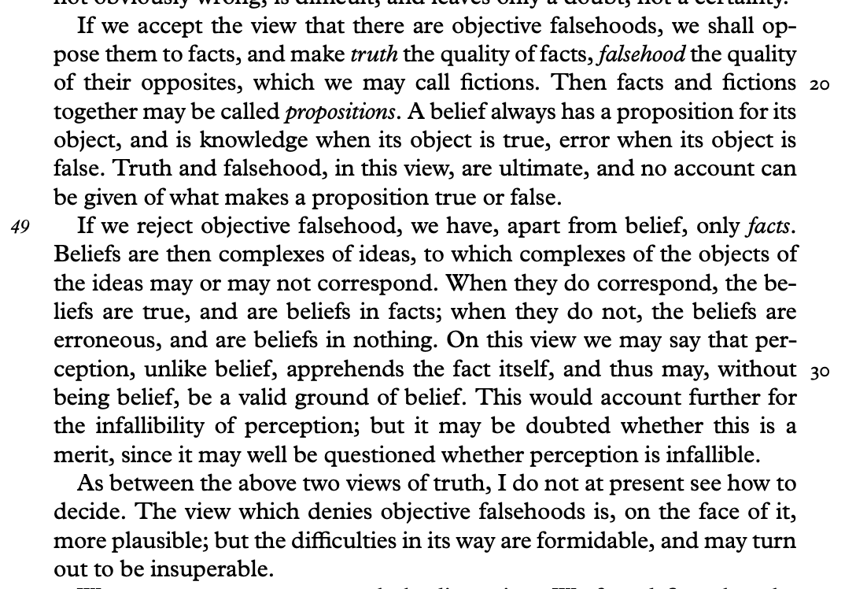
Does Russell have a view on truth, 1903-7?

Slide 21
Does Russell have a view on truth, 1903-7?
Asay’s dilemma:
  In early Russell, there was no dilemma.
  Russell offered two possible means of understanding truth, both of which presented a problem.
Wyatt’s reconstruction:
  That no account can be given of truth might mean just that. Russell’s admitting that he had no account to offer for truth (as yet!).
  Either we take him at his word or we apply our own view that Russell’s a primitivist.

Slide 22
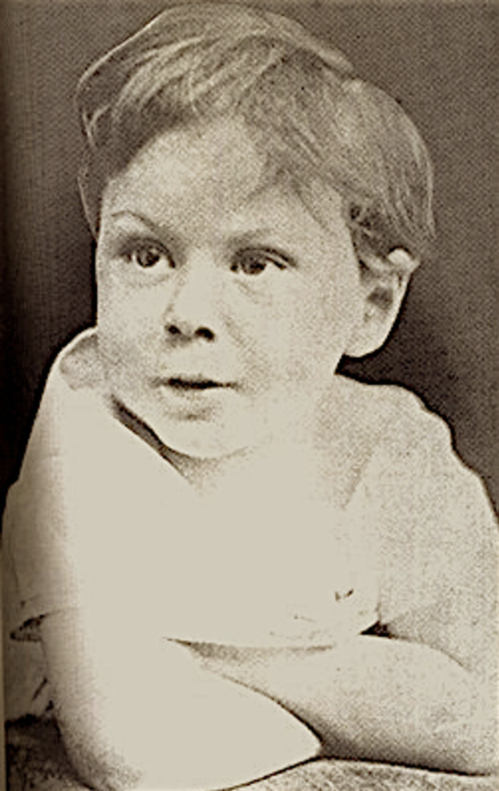
Does Russell have a view on truth, 1903-7?

Slide 23
Kia ora • Thank You
I am grateful for conversation with Nick Griffin, Andy Bone, Ken Blackwell, and Jeremy Wyatt, and for the space and resources provided to me while I was Bertrand Russell Visiting Professor at the Russell Arcives, McMaster University (Northern Autumn, 2025).

Slide 24
Russell’s correspondence theory 1910-2
Truth is correspondence of beliefs with facts
  Russell takes judgment to be a multiple relation whose terms are the mind and more than one object
    Rejects psychical content as a single complex idea
    Rejects the unitary non-psychical proposition
    Rejects propositions as a single complex object

Slide 25
Russell’s correspondence theory 1910-2
Rejects psychical content
  No longer necessary to say that there is a mental counterpart of complex objects (cf. “Knowledge by Acquaintance and Knowledge by Description”)
  Traces the origin of “complex ideas” to overemphasise on psychical element in judgment:
    The view seems to be that there is some mental existent which may be called the “idea” of something outside the mind of the person who has the idea, and that, since judgment is a mental event, its constituent must be constituents of the mind of the person judging. (Mysticism and Logic, p. 221-2)
  In Othello’s belief that Desdemona loves Cassio, there are no “ideas” of Desdemona, loving, and Cassio which are interposed in addition to Othello’s mind and the objects of his belief: Desdemona, loving, and Cassio.

Slide 26
Russell’s correspondence theory 1910-2
New view of psychical element
  The judgments or beliefs are themselves constituent of judgments: “Judgments… consist of relations of the mind to objects” (PE, p. 174).
  There is an emphasis, rather than independence, of the relation of objects to the mind: “judging or believing is a certain complex unity” of a mind and its objects (PP, p. 128-9).

Slide 27
Russell’s correspondence theory before 1912
Rejects the unitary non-psychical proposition
  The mind in judgment is related to more than one object:
    Othello believes falsely that Desdemona loves Cassio. We cannot say that this belief consists in a relation to a single object, ‘Desdemona’s love for Cassio’, for if there were such an object, the belief would be true. There is in fact no such object, and therefore Othello cannot have any relation to such an object. Hence his belief cannot possibly consist in a relation to this object. (PP, p. 124)
  Breaks up objective falsehoods into its constituent parts:
    Thus it is easier to account for falsehood if we take judgments to be a relation in which the mind and the various objects concerned all occur severally; that is to say, Desdemona and loving and Cassio must all be terms in the relation which subsists when Othello believes that Desdemona loves Cassio. This relation, therefore, is a relation of four terms, since Othello also is one of the terms of the relation. (PP, p. 125)

Slide 28
Russell and Stout on Truth
The mind is related to Charles I, dying, and the scaffold by judging, and together with its objects forms a complex unity
This unity is the unity of a relation and not of a subsistent entity
  Nothing that concerns Charles I and dying and the scaffold separately and severally will give the judgment “Charles I died on the scaffold”. In order to obtain this judgment, we must have one single unity of the mind and Charles I and dying and the scaffold, i.e., we must have, not several instances of a relation between two terms, but one instance of a relation between more than two terms. (Ulatowski, Stout & Russell,2026/1911 forthcoming, p. xxx)

Slide 29
The Problems of Philosophy
Familiar example from PP:
  Thus the actual occurrence, at the moment when Othello is entertaining his belief, is that the relation called ‘believing’ is knitting together into one complex whole the four terms Othello, Desdemona, loving, and Cassio. (PP, p. 126)
The relation between the mind and its objects is not a haphazard aggregate but a complex unity
Judging gives a certain “sense” or “direction” to the objects

Slide 30
Russell on Truth, pre-1912
“When the belief is true, there is another complex unity, in which the relation which was one of the objects of the belief relates the other objects” (PP, p. 128)
  First period: the object of a correct belief is a fact
  Second period: A fact is composed of the objects of belief
    In this case, one of the objects of belief, namely the relation, actually relates the other objects of belief (a relating relation).
    Beliefs, then, are what is true or false rather than propositions.

Slide 31
Russell on Truth, pre-1912
The reason why he abandoned truth and falsehood as unanalysable qualities of propositions is that the view provides no explanation for the difference between true and false propositions (or “objectives”)
Beliefs are extrinsically true or false because they depend on the objects of the belief, on their being related as the belief relates them.

