Slide 1
Why your battery meter tells lies and it’s hard to fix:
Effect of pauses in cycling on submillihertz battery impedance
Marcus Wilson, Logan Cowie, Michael Cree
NZIP2025 Auckland, 1-3 July 2025
https://waikatobattery.co.nz/
Notes:
Kia Ora,
I’m Marcus Wilson from the University of Waikato and I’ll be talking about the effect of the history of battery usage on its impedance, after which I hope you’ll appreciate why the ‘charge indicator’ in your electric car or mobile phone doesn’t always tell you the truth.

Slide 2

Batteries are not capacitors
Notes:
I’ll start with a story.
My youngest child enjoys playing with these: battery powered trains. 2 AAA batteries. A couple of years ago, he switched one on and watched it scuttle across the carpet, under the sofa, and then got distracted by something else and forgot about it for a few hours. When he got me to fish it out from under the sofa, the batteries were dead. Thomas was going nowhere. That’s not surprising – it had hit the wall, stalled, and had been drawing a lot of current. Flat battery. I switched it off, put it on the table, and a day later switched it on again. And off he went.
Somehow the battery had recovered enough to be useful still. So a dead battery is not actually dead.
Now if you think about wet batteries, like the lead acid battery in a petrol car, this makes some sense. If you use up the reactants around the electrodes, the voltage will plummet. But give it time, more reactants will diffuse to the electrodes, and the voltage can recover.
Capacitors don’t do this – Q = CV so a lack of voltage is a lack of charge. Batteries are more complicated.

Slide 3
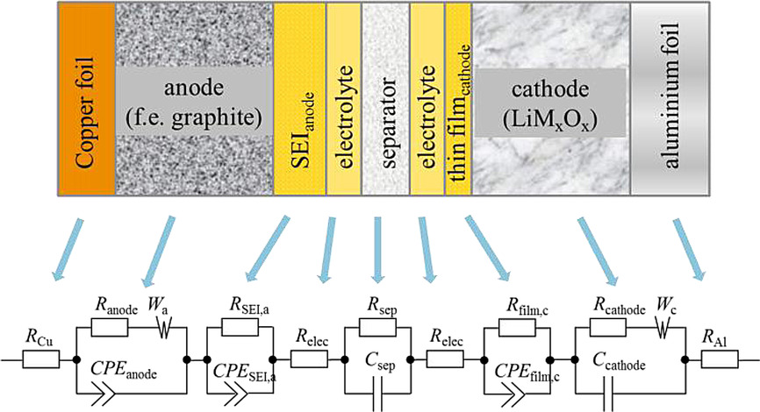
Current and voltage relationship
current
time
voltage
time
U. Westerhoff, K. Kurbach, F. Lienesch, M. Kurrat, Energy Technol. 2016, 4, 1620. Figure 1.
Notes:
So here’s what’s happened in schematic form, a bit simplified.
Imagine we are drawing a constant current from the battery (in battery language drawing current from the battery is a negative current.)
The voltage slowly drops (not necessarily linearly).
Then we stop drawing current. The voltage recovers!
This behaviour can be described with fractional elements. The diagram shows a model of Westerhoff, in which each part of a Li-ion cell has been modelled with a circuit element. The capacitors and resistors are familiar, but there are also these pointy-capacitors and ‘W’ symbols, which are fractional capacitors.

Slide 4

Fractional element
$$I=C_{F}\frac{d^{α}V}{dt^{α}}$$
0 < α < 1
Fractional derivative can be defined (in several ways!) by some less-than-straightforward maths
Fractional derivative is non-local
What happens now depends on what happened in the past
Notes:
Now, if I have a CAPACITOR, my charge is just proportional to the voltage, Q = CV. Differentiate both sides, and we get dQ/dt, which is current I, equal to dV/dt times the capacitance.
But with a fractional element, this order of differential is not one. It’s fractional.
Can we actually do that? Yes we can. Fractional differentials can be defined with mathematics (in fact there are multiple definitions), but the maths is moderately hideous. A key property of fractional differentiation is that it’s a non-local operator. That means the differential doesn’t just depend on what the function is doing now, but on it’s entire history.
We give a fractional capacitor this arrow-like capacitor symbol. If alpha is exactly 1 we have our normal capacitor, if alpha is exactly 0 we have a resistor (current proportional to voltage), and if alpha is ½ we have the special case which is called a ‘Warburg’ element – that was the ‘W’ on the previous slide.

Slide 5
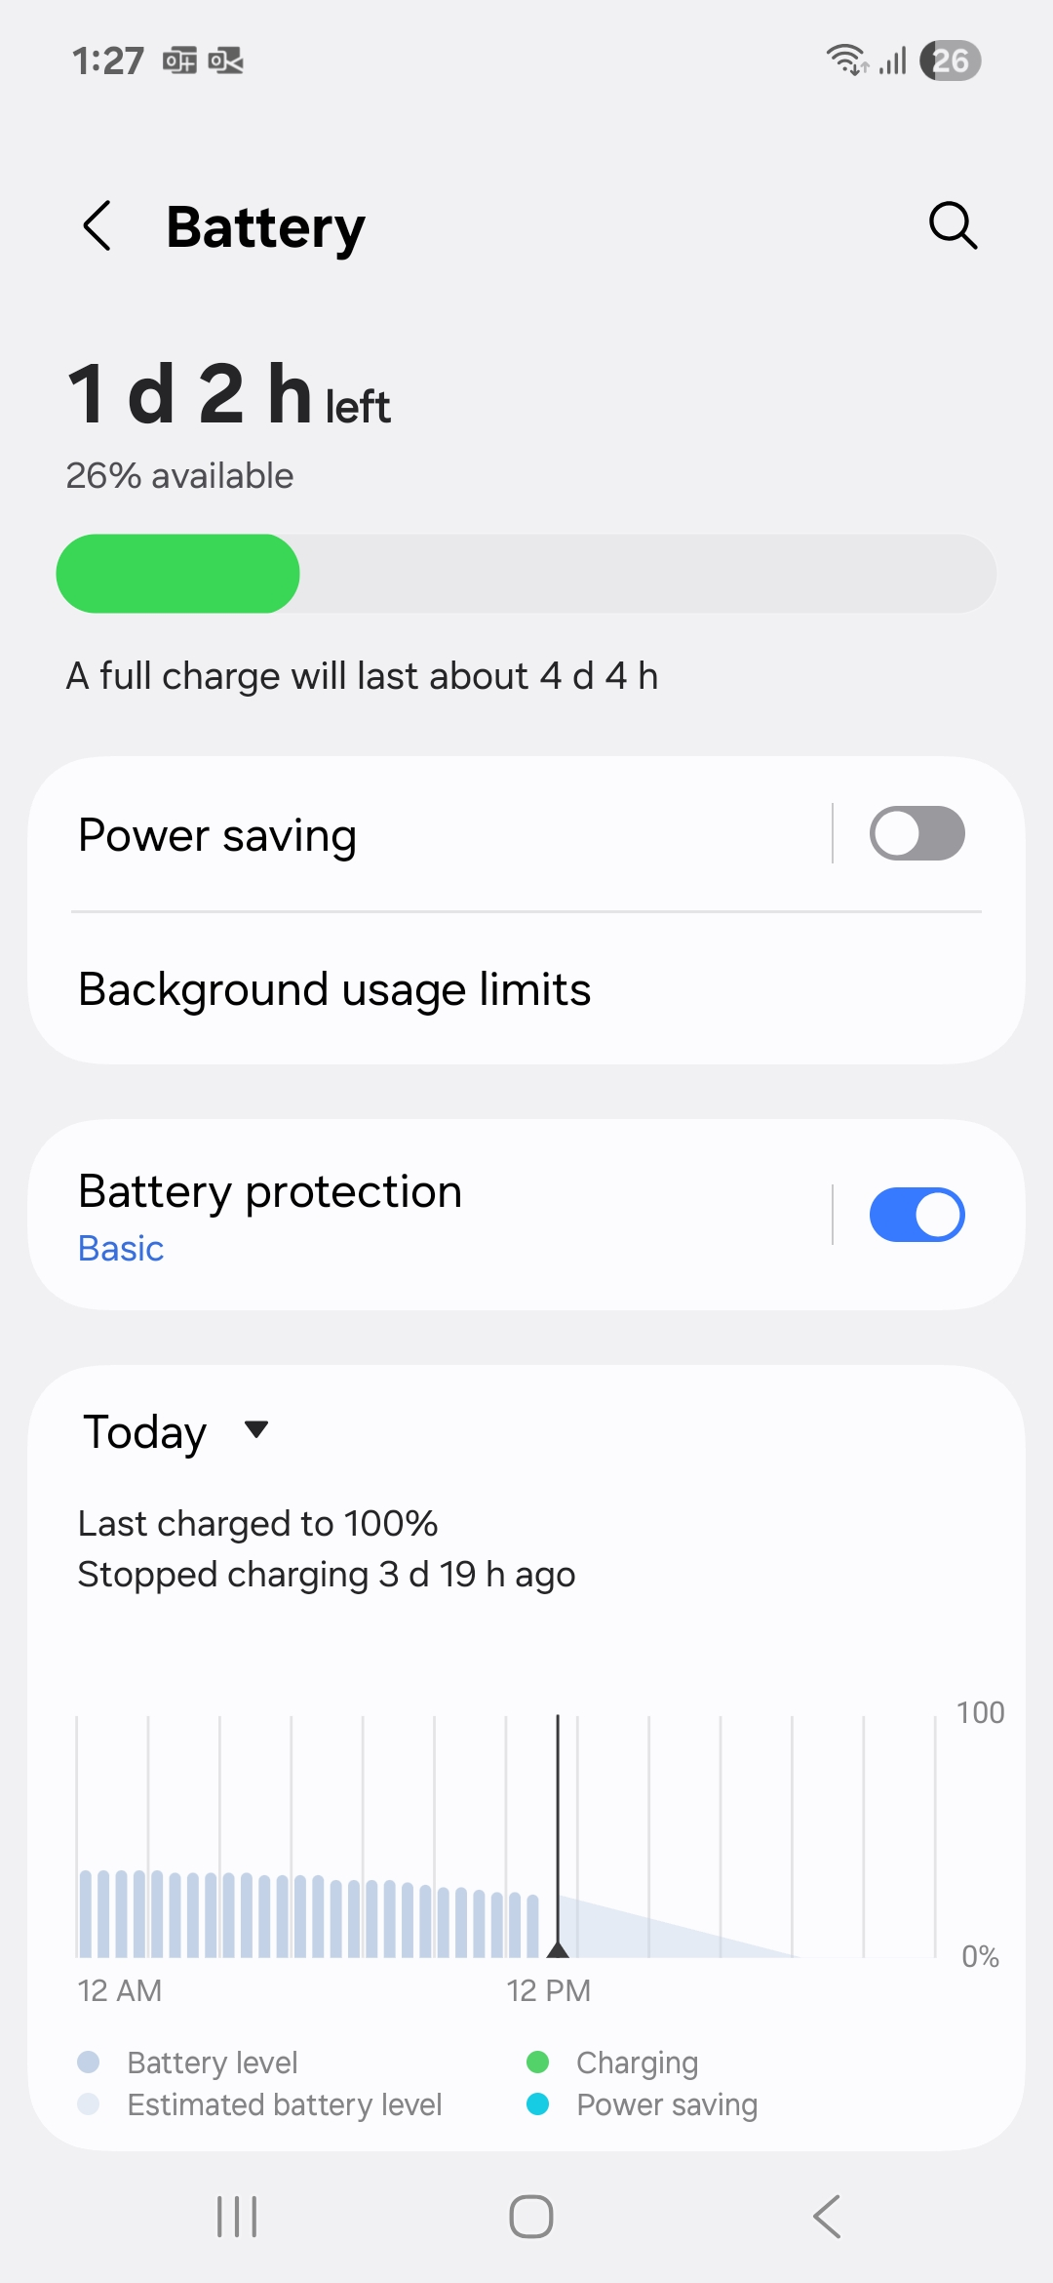
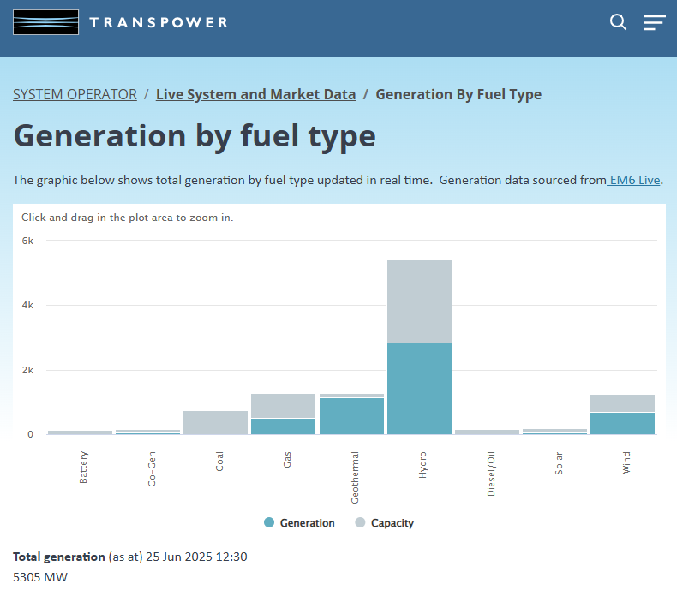
What does this mean?
Maybe, maybe not
How much is REALLY available?
Notes:
So what does this mean? On the trivial scale, my phone battery meter might not be telling the whole truth.
But if we consider really big capacity batteries like the Battery Electric Grid Storage Systems (BESS), it’s really important to know just how much energy is available. This grey bar might look small, but as we lose the coal and gas and grow wind and solar, it will grow significantly. If we don’t really know how big it is, there is a risk that on a cold winter’s morning the grid might not actually be able to provide the energy Transpower thinks it can.

Slide 6

Short memory principle
Fortunately we don’t have to account for ALL the history (Podlubny, 1998)
$$T={\left(\frac{M}{ε|Γ\left(1−α\right)|}\right)}^{1/α}$$
Error: $ε∝T^{−α}$
The longer the history we consider, the lower the error
But a power-law decay with 0 < α < 1 is SLOW
y(t)
M
T
d^{α}y/dt^{α}
ε
Notes:
QUICKER version
Now, we are never going to know the full history. But the ‘short memory principle’ says that the error in only having a length ‘T” of history decays as T to the power of minus alpha. But such a decay is SLOW.
LONG version
So how do we deal with circuits with these things in?
Well, usefully, we don’t need to account for ALL the history. If we can accept an error in our derivative of size epsilon, then Podlubny’s Short Memory Principle tells us we only need to consider what has happened over a certain time T in the past, where T is given by this equation here, with M being the maximum extent of the function we differentiate.
Putting it perhaps a more useful way, if we are able to consider a history of length T, then we can expect the error in our calculated differential to decay as T to the power of negative alpha. So more history T, less error, which makes sense.
It’s important to note that a power law decay is NOT an exponential decay. With an exponential, there is a time constant. Then practically we might say once we’ve had three time constants nothing much changes. But we can’t do that with a power law. There is no time-scale. And if alpha isn’t much bigger than one, this T to the minus alpha decay can be really slow. That means we might have to consider the history over a really long time before we can get our error dropping to something acceptable.

Slide 7
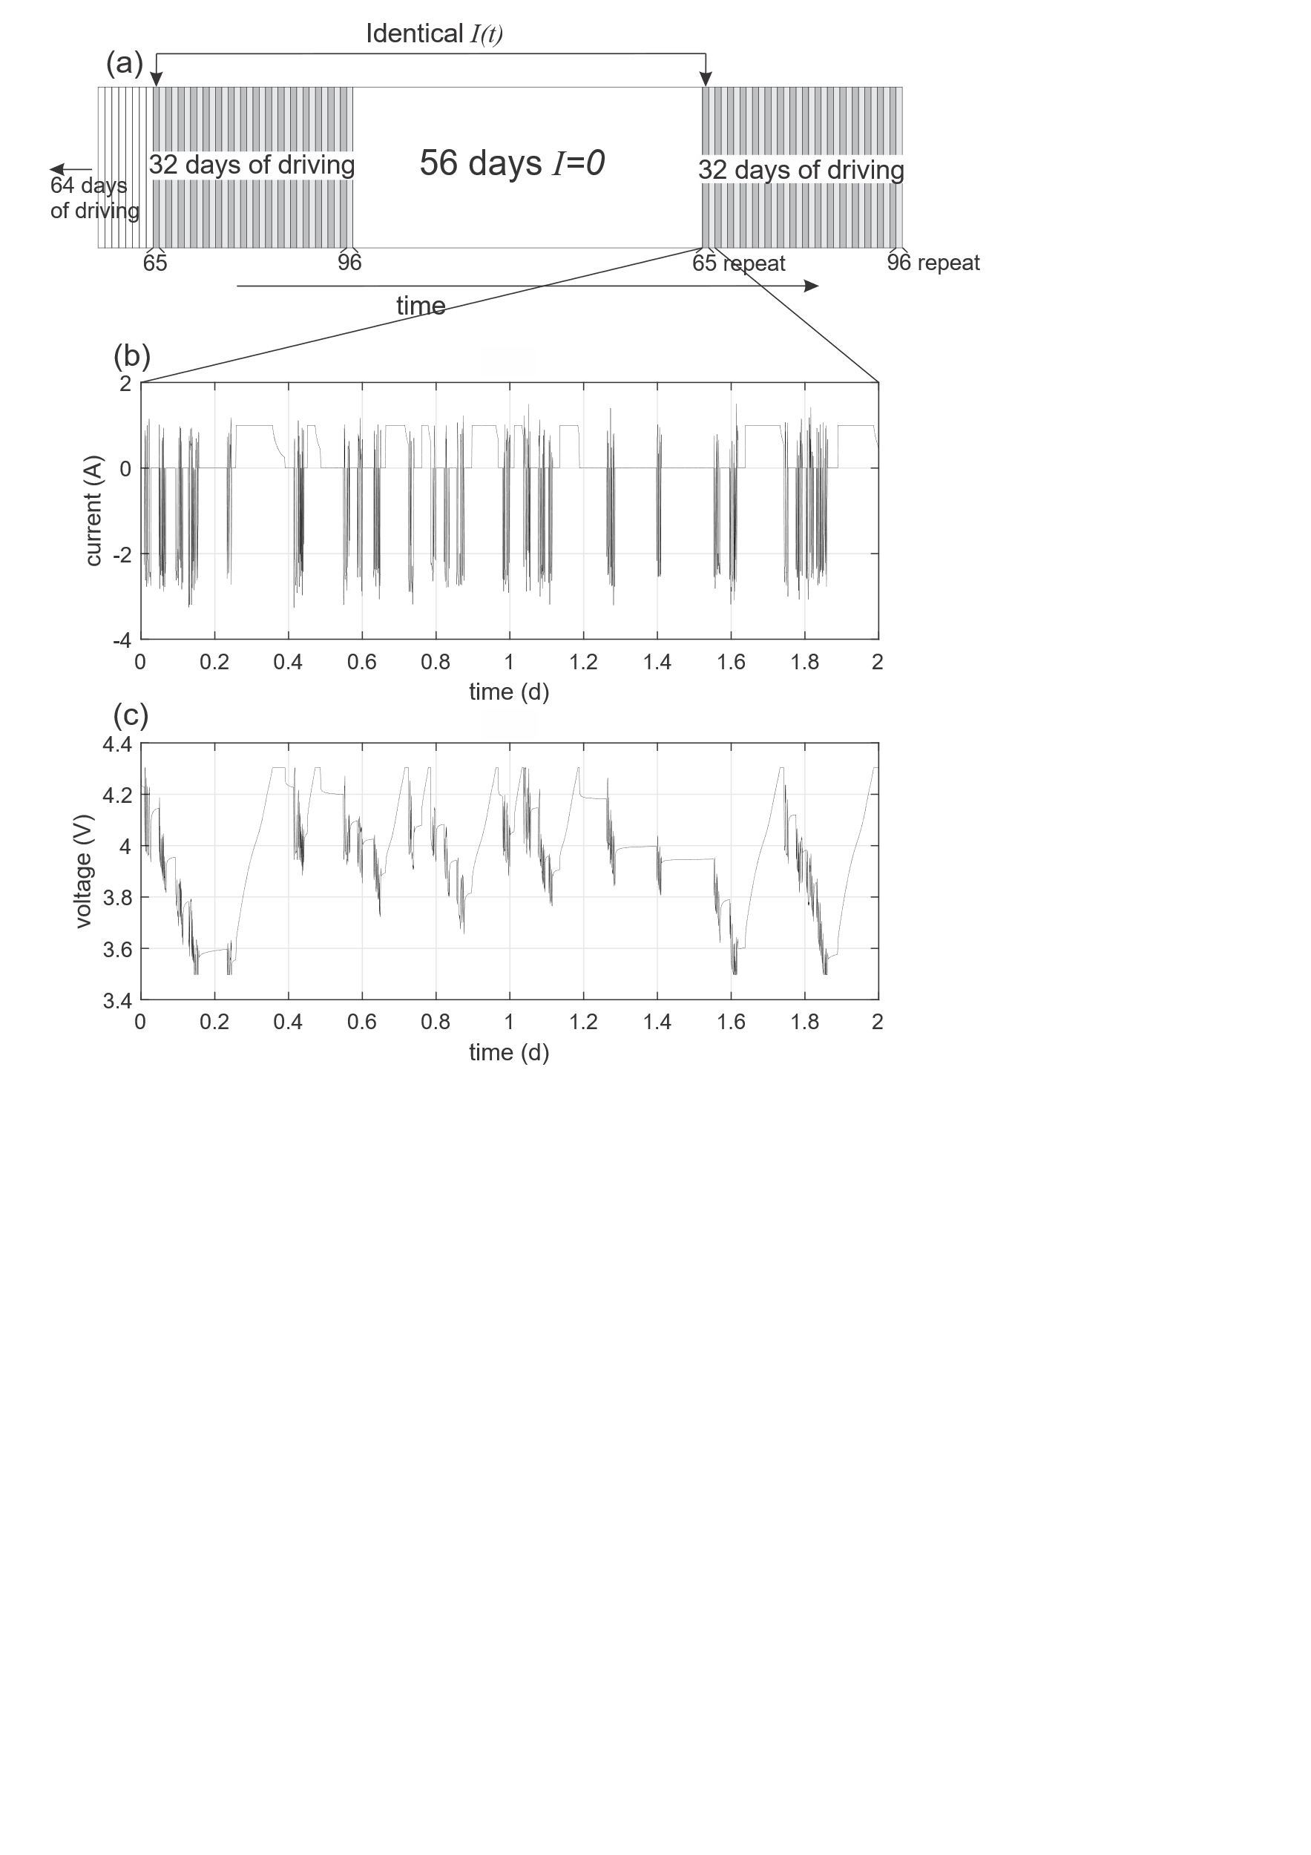
How long do these history effects last?
Drive NCA Li-ion cell with current simulating electric vehicle
Measure voltage
After 96 days, there was an unforeseen 56 day pause
Drive again with repeating current
Compare the equivalent days
Notes:
Okay, so let’s talk about an experiment our battery group did last year. It’s not one we planned to do.
We had been undertaking an experiment on battery aging. Basically, we had a Li-ion cell, and had been charging and discharging it in a pattern that is roughly representative of an electric vehicle. So we’ve got long periods of rest, periods of ‘charging’, then some intense periods of discharge to represent car use, and recharge to represent regenerative braking. This experiment was designed to go six months.
We got to day 96 when one of our mechanical engineering friends managed to set fire to another Li-ion battery by overzealous charging. This resulted in the VC decreeing that all Li-ion battery experiments needed to stop while a safety review was done. So we had to stop our experiment, and it was 56 days before we were able to start again.
But this break was an opportunity to do something really interesting. When we recommenced driving the battery, we did so by repeating the exact same current sequence as over the 32 days previous to the shutdown. We could then see how the history affected the measured impedance of the cell.
So if we look at the blue days here, we can see they have completely different histories. It wouldn’t be surprising for those days to have different properties – i.e. produce different voltage traces for the same current input.
But the green days share the previous 16 days of history, so we might expect some similarity in the voltage, and the brown days share the previous 32 days of history, so we’d expect more similarity still.

Slide 8
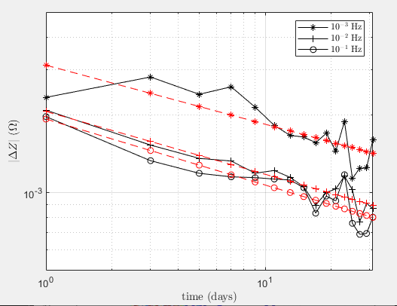
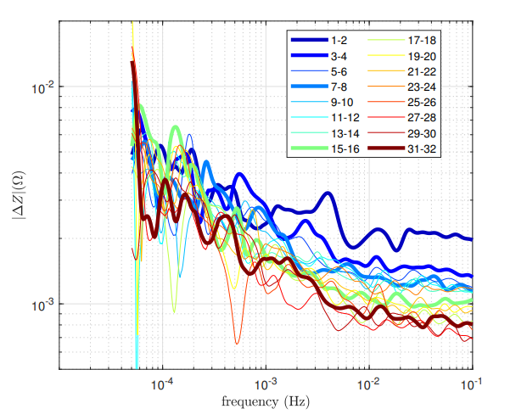

MODA results
Wavelet analysis to find impedance spectrum Z( f )
Multiscale Oscillatory Dynamical Application (MODA) toolbox, Lancaster University
Compare spectrum for equivalent days before and after break
|ΔZ( f )| decays as a power law $\sim T^{−0.24}$ over 10⁻³ Hz to 10⁻¹ Hz
Notes:
So what did we get.
This slide takes a bit of talking through so bear with me.
A primary way of analyzing battery data is with impedance spectra. There are various ways of calculating these from current against time and voltage against time signals. We have used wavelet analysis with the multiscale oscillatory dynamical application toolbox from Lancaster University in the UK.
What we are particularly interested in is not the impedance spectrum as such, but the difference in impedance spectrum for the equivalent days before and after the break. So on the y-axis we have the change in impedance, and on the x-axis frequency – note both are on logarithmic scales - and the different coloured lines show the different time periods after the break (we’ve put the data in 2-day long chunks) Thus the most difference is immediately after the break, because the history is very different. But as time goes on, the history gets more similar, and we can see that the change in impedance between the equivalent periods before and after the break reduces.
You’ll see some of the lines in bold – note these are geometrically distributed in time after the break: each is a doubling. On the plot you’ll see, especially at the higher frequencies, that we have a smooth progression downwards in log Delta Z, indicative of a power-law decay with time.
We can also plot Delta Z against the time period, for different frequencies, as in this plot. Roughly speaking, the linear lines on a log-log scale show a power law decay, with average gradient of 0.26.
Note that’s really slow – to halve the impedance difference, or error, we need sixteen times the length of time!

Slide 9
Conclusion
Can still see effect of the pause 32 days later
Effect of history decays as power law (slow!)
Consistent with fractional capacitor
Frustrating unexpected events can sometimes be useful
Finding the state-of-charge of Thomas’s battery involves some very intensive maths
https://waikatobattery.co.nz/
Notes:
So to conclude then.
The unexpected shutdown gave us an opportunity to do an experiment that we hadn’t anticipated. We can see the effect of history on battery impedance spectrum, and that effect decays as a power law consistent with fractional behaviour. It’s a really slow decay – we can still see the effect 32 days later.
Hence Thomas here is always going to struggle to know how much charge he has left.

